Slide 1
How to make my paper open
Elena Giglia
Ufficio Accesso aperto – editoria elettronica
Università di Torino
This work is licensed under a Creative Commons Attribution-ShareAlike 4.0 International License.
Notes:
1

Slide 2
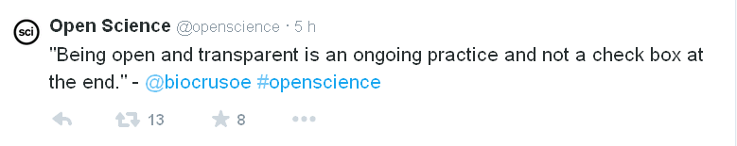
Openness

Slide 3
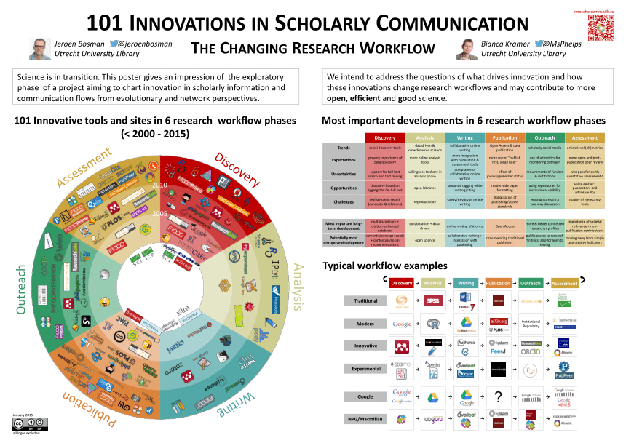
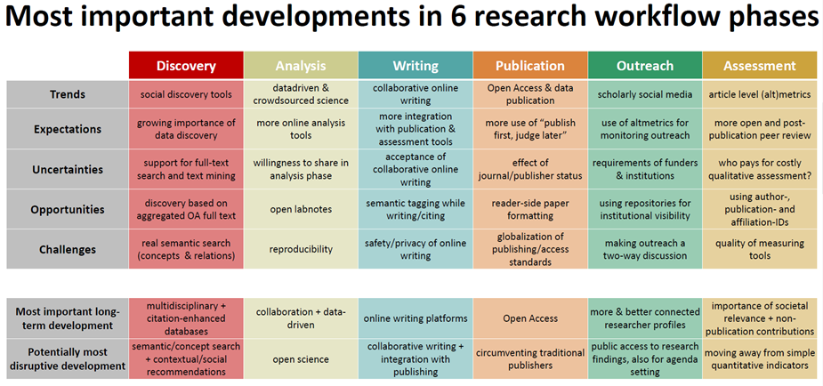
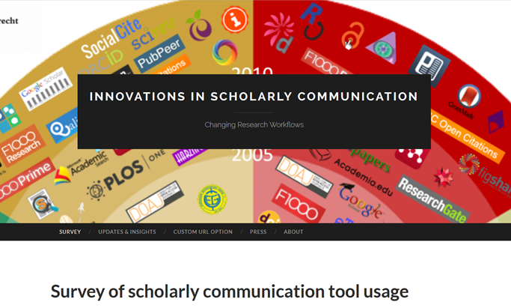
A blurred picture…
https://101innovations.wordpress.com/
http://figshare.com/articles/101_Innovations_in_Scholarly_Communication_the_Changing_Research_Workflow/1286826

Slide 4
Offrire ai ricercatori i servizi che chiedono
sull'esempio di Academia.edu: profilo autore con le sue competenze
“UniTo connections”: luogo di vetrina e di scambio per dare accesso non tanto alla produzione scientifica che si trova anche via altri canali, ma piuttosto a 1) profili di competenze 2) linee di ricerca
Alerting, following, gruppi come in Research Gate
Academia.edu o Research Gate : il vantaggio è che oltre a ricerca permettono di seguire autori e creano collegamenti fra ricercatori affini
Cite alert: mi avvisa quando qualcuno mi cita (Google: anche quando compaio in pagina web)
necessario che i sistemi si parlino fra loro, non replicare l’esistente né chiedere di reinserire dati presenti altrove: deve essere a costo zero per il docente già oberato di richieste: interoperabilità e integrazione fra sistemi esitenti
network di relazioni su Research Gate (utile vedere con chi lavori o sei in relazione); utili i contatti: ti chiamano anche da fuori UniTO e da fuori ambiente universitario (professionisti) se sono interessati al tuo ambito di ricerca
indice di visibilità come quello di Academia.edu (e bisognerebbe riflettere sul fatto che mio lavoro più scaricato è articolo in italiano del 1985)
Focus groups di 4 aree – Progetto ARC Regione Piemonte – dicembre 2014

Slide 5
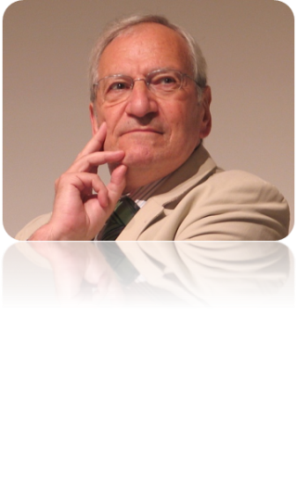
Zen scholarly communication?
Scholarly communication is
distributed process of knowledge creation that requires a great conversation.
Much of scientific work is made up of collaboration rather than competition. Science exhibits the nature of networks, not that of Olympic games. Concern of quality has been replaced by an obsession for competition
Imagine writing the history of print from the perspective of the scriptoria…
1) What will it be like? The question can be framed in two ways:
The first is the scriptorium way: how to adapt the present to the (yet unknown) future.
Open Access debate has followed this path.
The second way, more fundamentally, strongly foregrounds the notion of “scientific communication”: WHAT DOES IT NEED TO WORK BEST?
- a set of useful, credible, peers;
“crystals” of knowledge
2) Who will control it?
SKILLS AND SERVICES NEEDED FOR THE GREAT CONVERSATION SHOULD SERVE ITS OBJECTIVES, NOT THE REVERSE.

Slide 6
Green and Gold

Slide 7
Green road - selfarchiving
The author self-archives
in an Open Access repository
his/her final version of the paper,
wherever it was published,
according to copyright agreements
It’s not the final printed version (publisher’s layout) but the «postprint», or Author’s accepted manuscript
Why selfarchiving in an Open Access repository (istitutional or subject-based)?
- It provides a persistent ID (handle), VS a personal page – subject to URL changes
- It’s no-profit VS Research Gate and Academia.edu

Slide 8
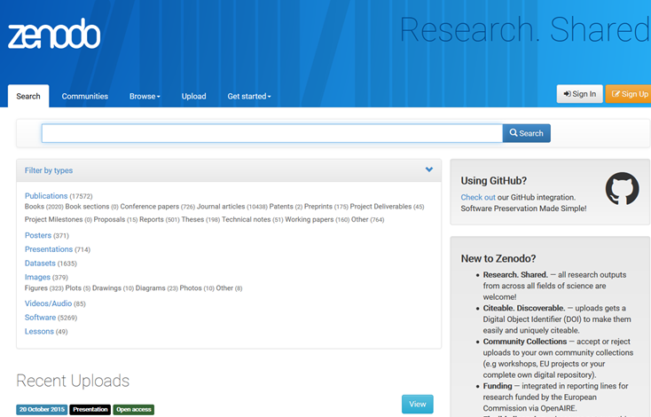
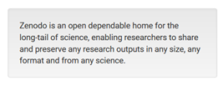
Looking for a green repository?
http://zenodo.org/

Slide 9
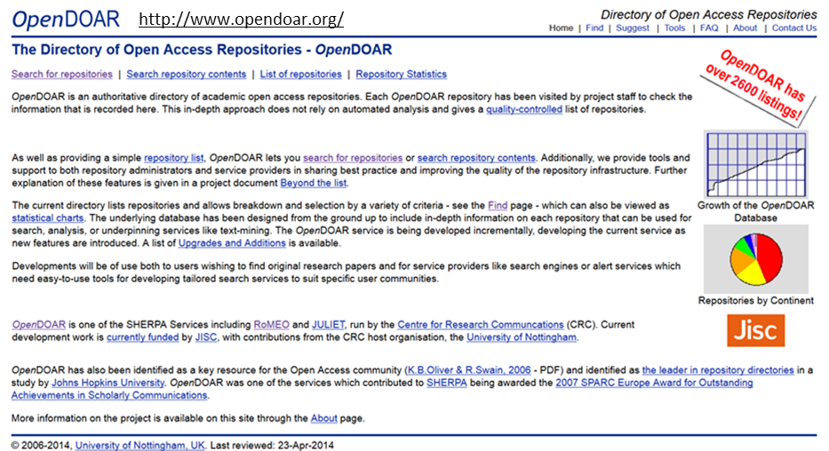
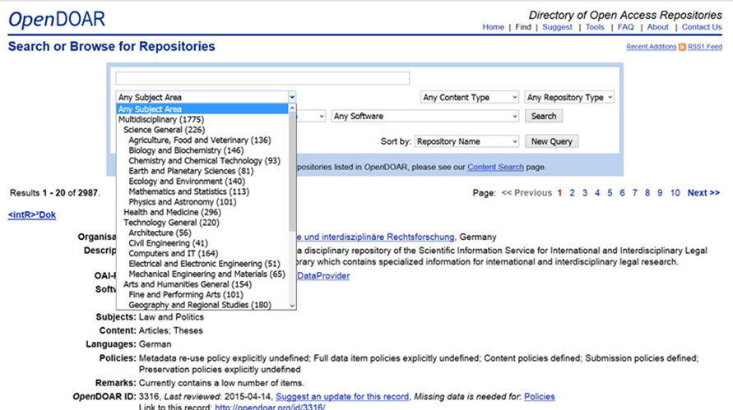
Looking for a green repository?

Slide 10

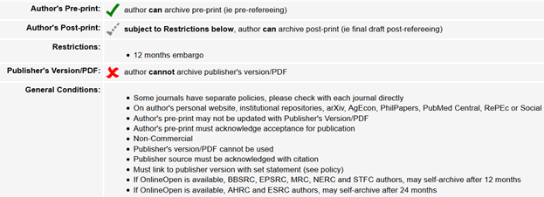
Green road – self-archiving
70% of international publishers
allows some kind of selfarchiving
(Elsevier, Wiley, Springer…); list:
http://www.sherpa.ac.uk/romeo/
…possible limitations:
- no pdf with the publisher’s layout
- embargo period requested
ONLY IF
you have signed a copyright transfer agreement…
if not, the author is the rights holder

Slide 11
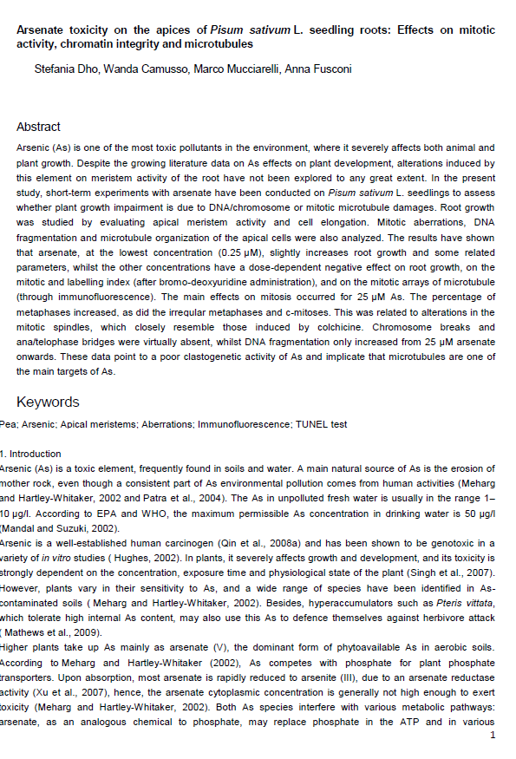
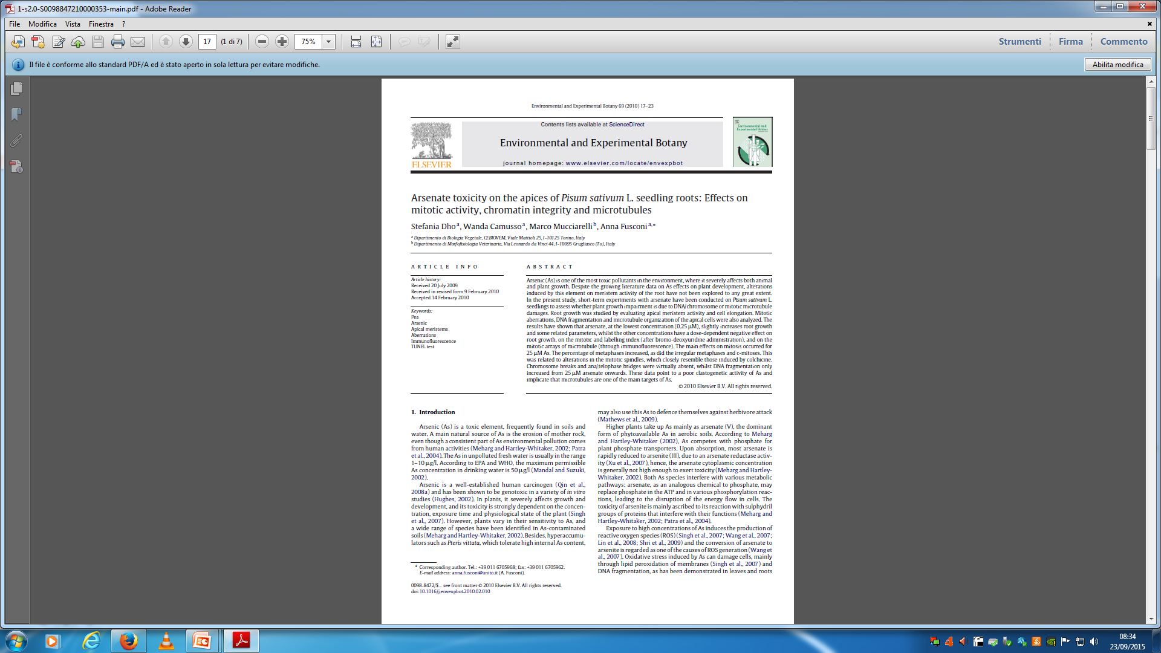
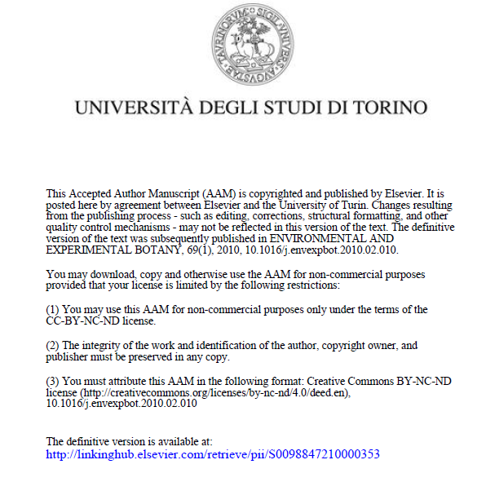

Slide 12
Green OA advantage:
AUTHORS DON’T HAVE TO CHANGE THEIR HABITS
YOU CAN GO ON PUBLISHING IN THE MOST REPUTATED
JOURNALS/SERIES, as requested by research assessment exercises,
funders, prestige in your discipline
then you make the content free by self-archiving
your final version of the work

Slide 13
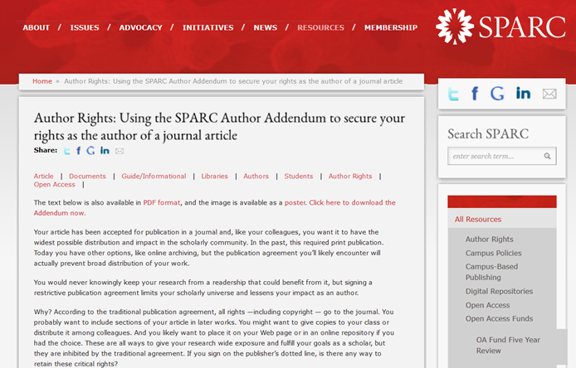
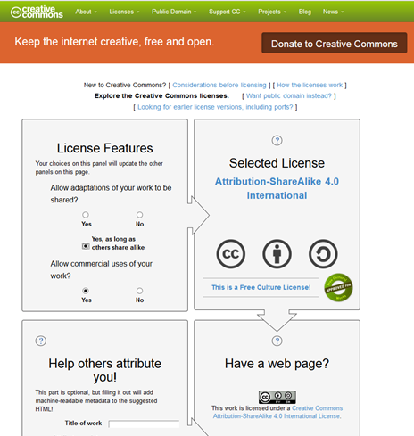
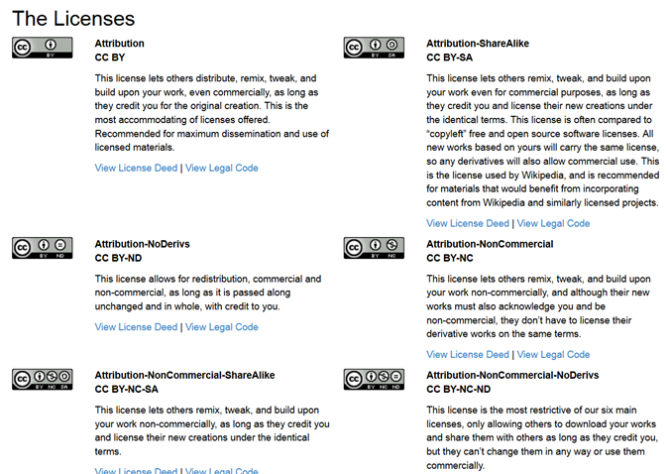
Licensing / rights: let’s change your habits!
http://www.sparc.arl.org/resources/authors/addendum
http://creativecommons.org/choose/?lang=en

Slide 14
Rights are two-sided:
Rights IN (do I have the rights to use anyone else’s work?)
Rigths OUT (what can a reader do with my work?)

Slide 15

Gold road – Open Access journals
you change your publishing venue
you choose one of the over 10.000 Open Access journals (listed in DOAJ, Directory of Open Access Journals) or an Open Access publisher
23% of the journals requests an Article Processing Fee, going from 500 to 2900 $ per article (like a stamp…)
https://doaj.org/

Slide 16
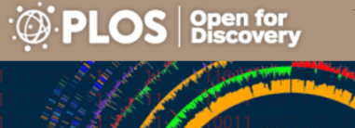
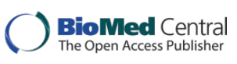

Gold road
Open Access journals:
are peer reviewed,
some have high Impact Factor,
they have no subscription,
they grant re-use

Slide 17
The «red road»
Gold road is not the «Open Choice» offered by traditional commercial publishers (Elsevier, Springer, Wiley…)
paying a 3000 $ fee, your single article becomes Open Access, but the journal still remains available by subscription
so, you pay twice…
you have to use it only if the funder asks for a shorter embargo period
please avoid, because it’s «double dipping»

Slide 18
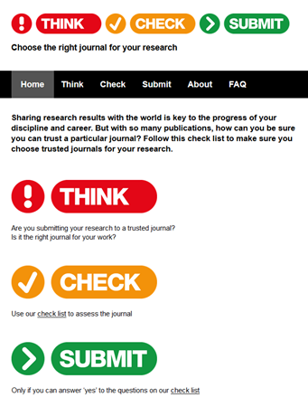
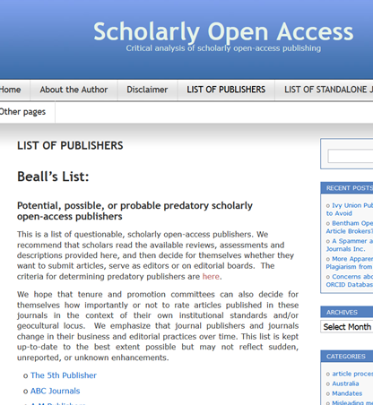
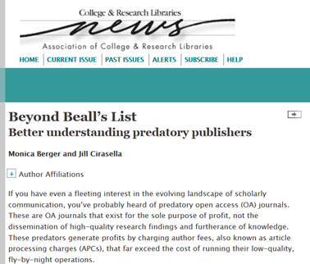
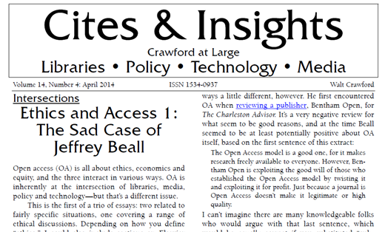
Beware of picpockets
http://scholarlyoa.com/publishers/
March, 2015
http://thinkchecksubmit.org/
citesandinsights.info/civ14i4.pdf

Slide 19
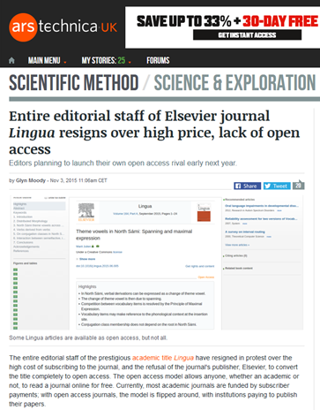
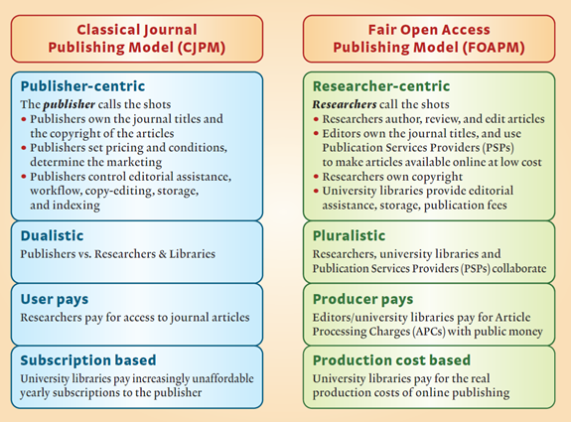

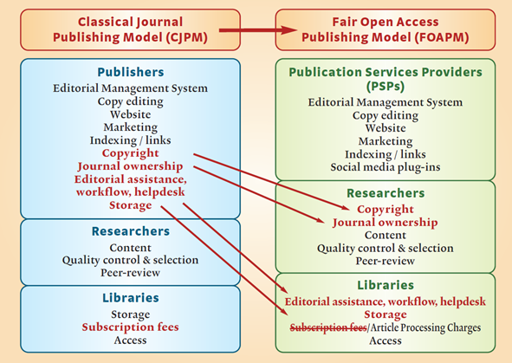
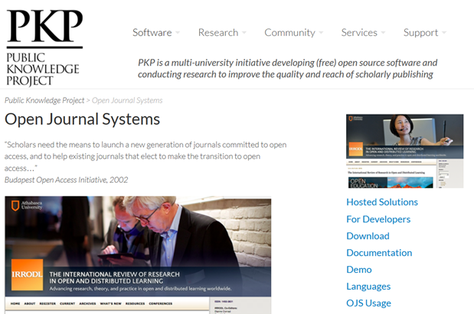
A more radical change of perspective
http://goo.gl/HxFYgg
https://pkp.sfu.ca/ojs/
http://goo.gl/BR0pON

Slide 20
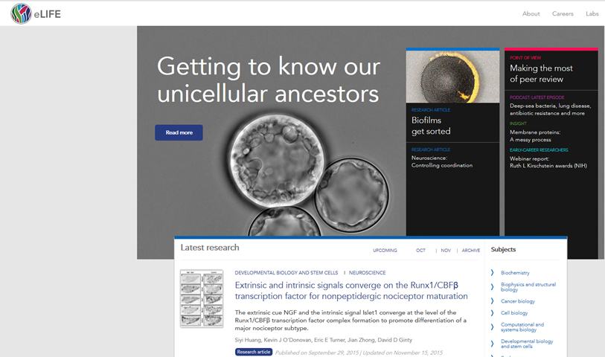
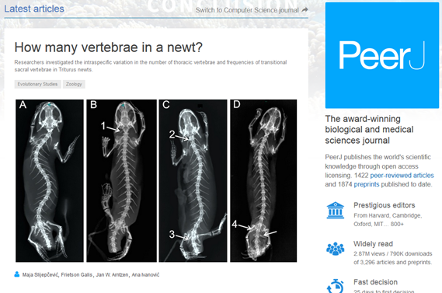
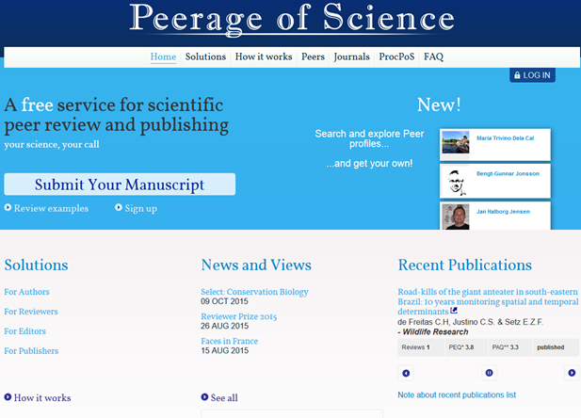
New directions
http://elifesciences.org/
https://peerj.com/
https://www.peerageofscience.org/

Slide 21
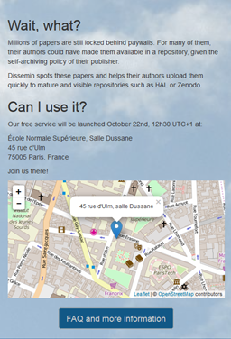
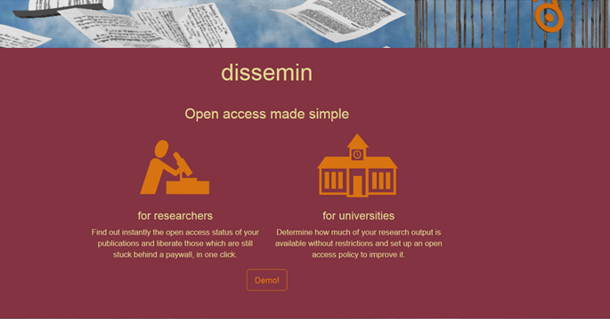
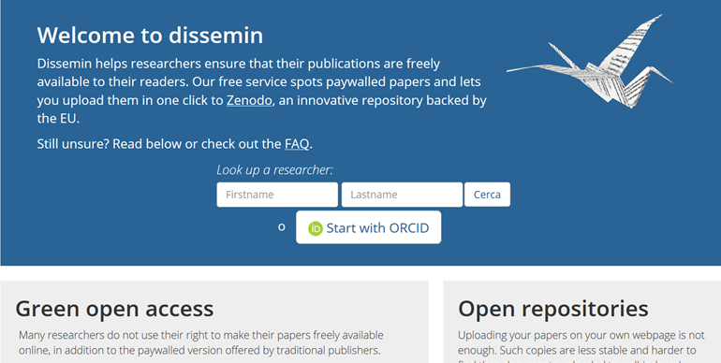
New infrastructures
http://dissem.in/

Slide 22
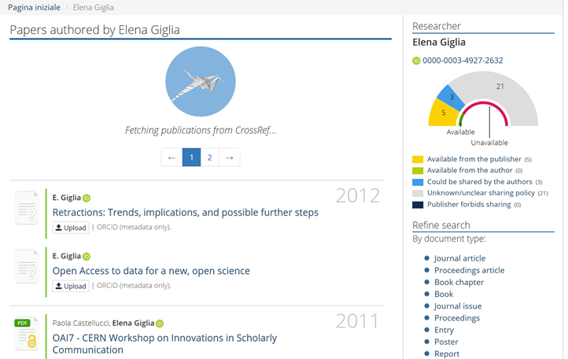
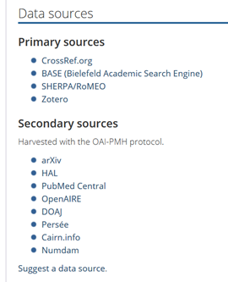
New services

Slide 23
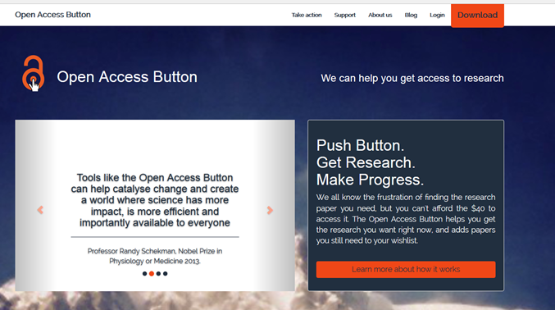
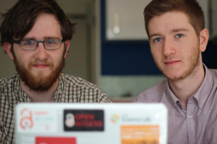
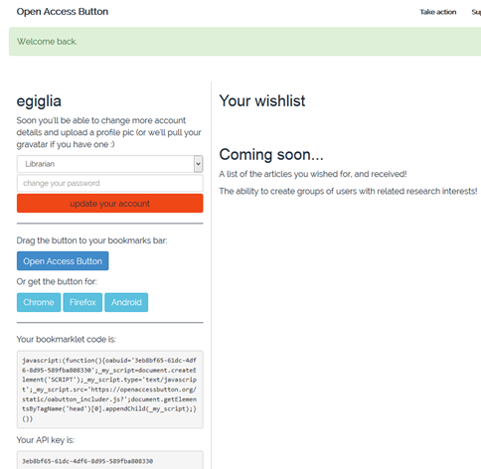
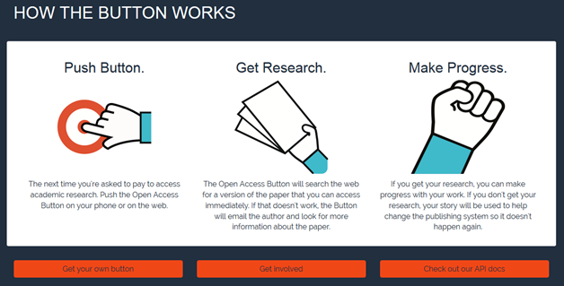

Slide 24
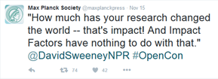
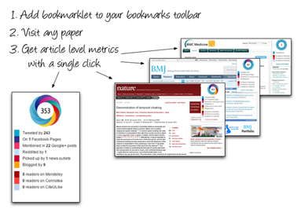
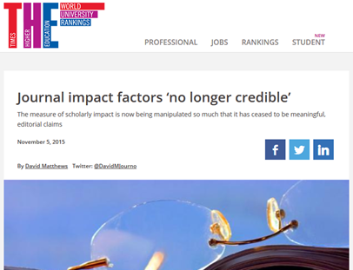
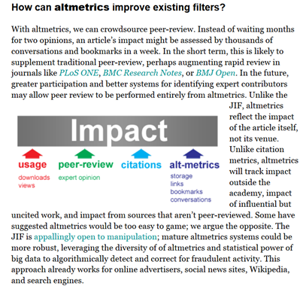
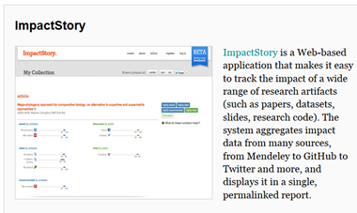
Why not… a new evaluation system which (actually) reflects impact
https://www.timeshighereducation.com/news/journal-impact-factors-no-longer-credible
http://www.altmetric.com/bookmarklet.php
https://impactstory.org/
http://altmetrics.org/manifesto/

Slide 25
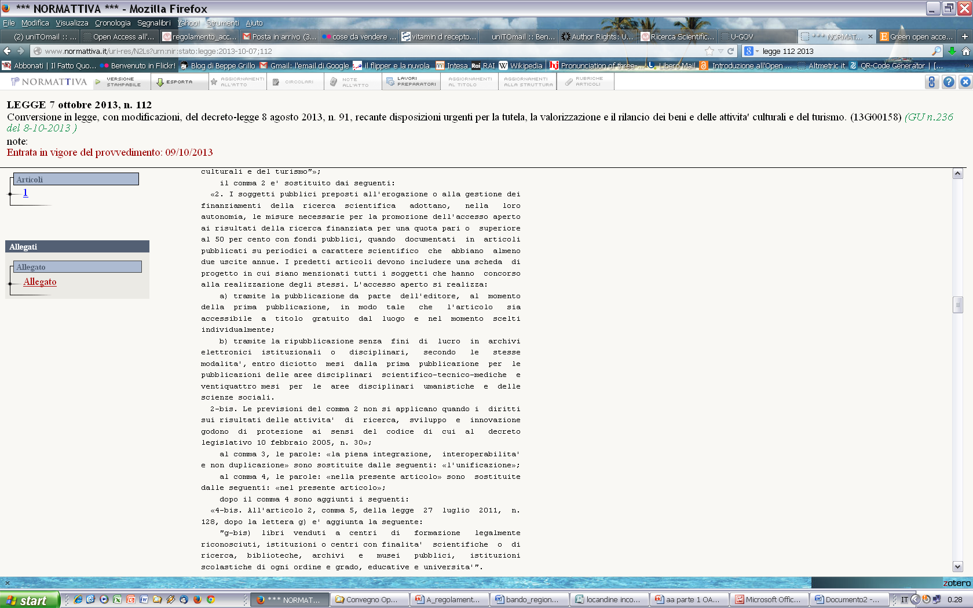
The Italian law
Law 112/2013

Slide 26
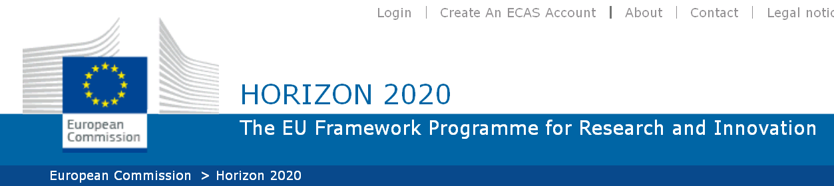
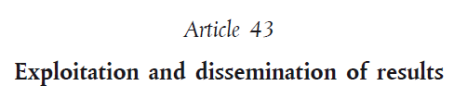
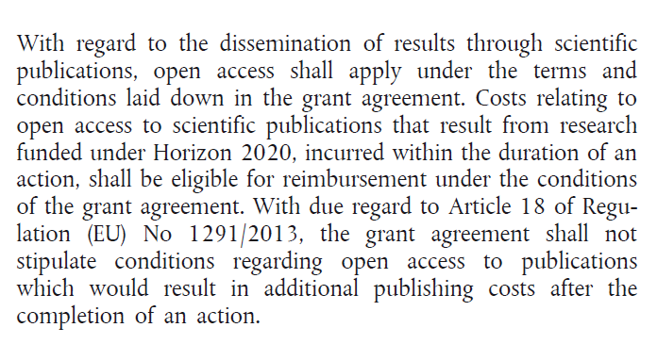
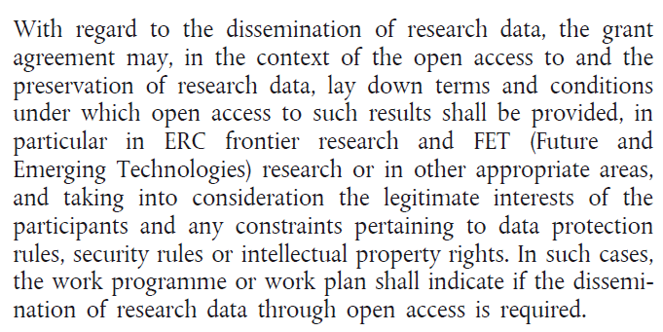
Horizon 2020: open by default
Open Access: shall apply
Open Data: may
DATA underlying an article, NOT new and unexploited data
http://ec.europa.eu/research/participants/data/ref/h2020/legal_basis/rules_participation/h2020-rules-participation_en.pdf

Slide 27
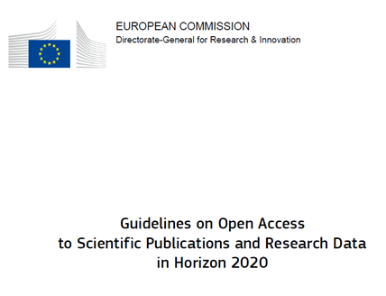
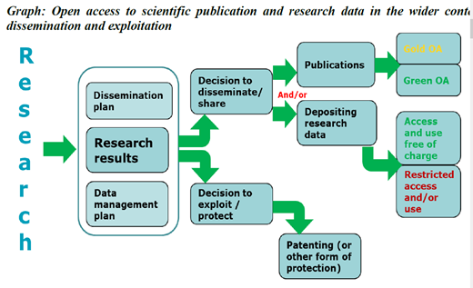


http://goo.gl/Lr1MXM

Slide 28




Slide 29



Slide 30



There is something on sight…
http://goo.gl/3VQE6W
http://www.leru.org/index.php/public/extra/signtheLERUstatement/

Slide 31



Optimizing Open Access policies
Harnad, S. Optimizing Open Access policies, sett. 2015

Slide 32

Openness
In science, OPENESS IS ESSENTIAL.
Open science doesn’t mean ignoring economic reality.
Of course we need business models to be sustainable. But that doesn’t mean we have to carry on doing things the way they have always been done.
So, wherever you sit in the value chain, wheter you’re a researcher or an investor or a policy maker,
my message is clear:
let’s invest in collaborative tools that let us progress…
Let’s tear down the walls that keep learning sealed off.
And let’s make science open.
N. Kroes, Let’s make science open, 2012

Slide 33
…now it’s up to you!
Thanks
elena.giglia@unito.it

