Slide 1


Introduction to Data Management Plans and DMPonline
Sarah Jones
Digital Curation Centre, Glasgow
sarah.jones@glasgow.ac.uk
Twitter: @sjDCC
Data Management Plans: principles and practice workshop, 19 November 2015, Bologna

Slide 2
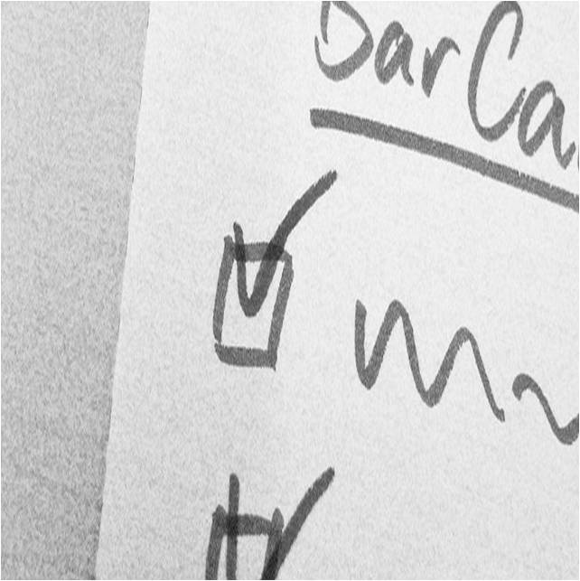
What is a DMP and why write one?
What is in this for you?
Image CC-BY-NC-SA by Ralf Appelt www.flickr.com/photos/adesigna/4090782772

Slide 3
What is a data management plan?
A brief plan written at the start of a project to define:
how the data will be created?
how it will be documented?
who will access it?
where it will be stored?
who will back it up?
whether (and how) it will be shared & preserved?
DMPs are often submitted as part of grant applications, but are useful whenever researchers are creating data.

Slide 4
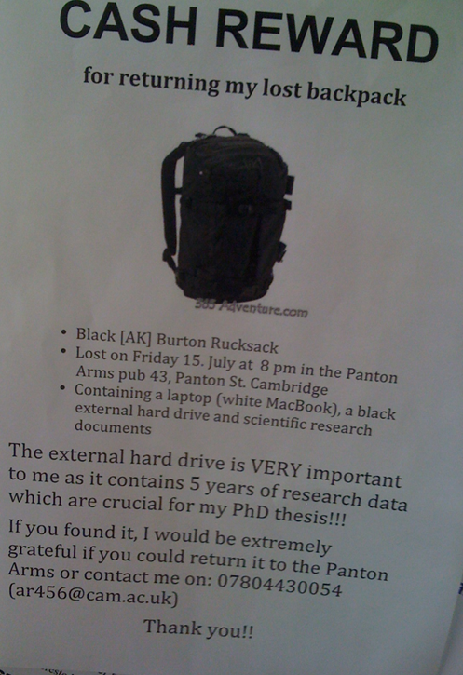
What if this was your laptop?
Why YOU need a Data Management Plan
http://blogs.ch.cam.ac.uk/pmr/2011/08/01/why-you-need-a-data-management-plan

Slide 5
How do DMPs help researchers?
Planning is useful whether or not a DMP needs submitted with a grant application, as it can help the researchers to…
  Make informed decisions to anticipate and avoid problems
  Avoid duplication, data loss and security breaches
  Develop procedures early on for consistency
  Ensure data are accurate, complete, reliable and secure
  Save time and effort to make their lives easier!

Slide 6
Benefits of DMPs for institutions
Opportunity to engage with researchers and improve RDM practice
Raise awareness of support available
Collate information to inform service delivery
Ensure the University is not exposed to risk
Ability to recover costs via grants

Slide 7
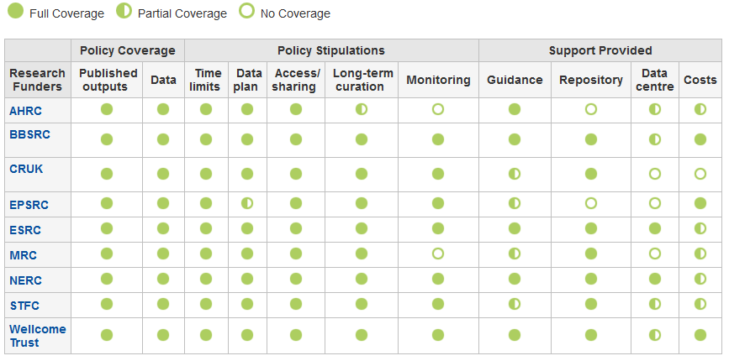
Which UK funders require a DMP?
n.b. Although the EPSRC doesn’t ask for a DMP in grant applications, it still expects one to be in place for every project
www.dcc.ac.uk/resources/policy-and-legal/ overview-funders-data-policies

Slide 8










Some other funders that require DMPs or equivalent

Slide 9
What do research funders want?
Usually a brief plan submitted in grant applications, and in the case of NERC, a more detailed plan once funded
The Horizon 2020 pilot is different as DMPs are deliverables to be submitted during the project
1-4 sides of A4 as attachment or a section in application form
Typically a prose statement covering suggested themes
An outline of data management and sharing plans, justifying decisions and any limitations

Slide 10

Different stages of a DMP
Outline DMP
Basic, short plan
Answer a few questions
Written at grant application stage
Full DMP
Detailed plan
Define procedures
Written in conjunction with data centres
www.nerc.ac.uk/research/sites/data/dmp

Slide 11
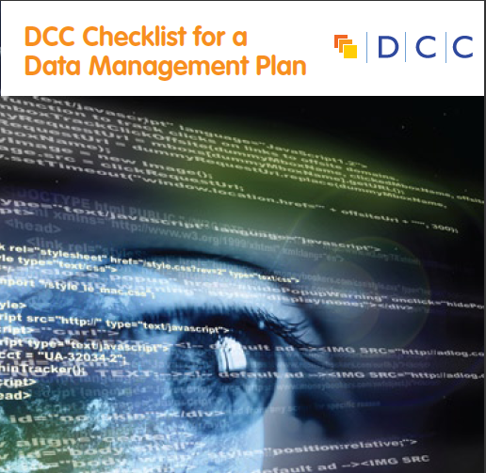
DCC Checklist for a DMP
The DCC assessed existing funder requirements, DMP templates and other best practice to see what should be included in plans. This was synthesised down into common themes and questions.
13 questions on what’s asked across the board
Prompts / pointers to help researchers get started
Guidance on how to answer
www.dcc.ac.uk/sites/default/files/documents/resource/DMP_Checklist_2013.pdf

Slide 12
Common themes in DMPs
  Description of data to be collected / created
  (i.e. content, type, format, volume...)
  Standards / methodologies for data collection & management
  Ethics and Intellectual Property
  (highlight any restrictions on data sharing e.g. embargoes, confidentiality)
  Plans for data sharing and access
  (i.e. how, when, to whom)
  Strategy for long-term preservation

Slide 13

DMPonline for writing DMPs
How the tool works and how it can help you
Image ‘tools’ CC-BY by zzpza www.flickr.com/photos/zzpza/3269784239

Slide 14
What is DMPonline?
A web-based tool to help researchers write
data management plans
A short history
Launched in April 2010 at the Jisc conference
Released v.2 in March 2011 with extra functionality
Released v.3 in April 2012 with revisions in light of the DMPTool and work from the Jisc MRD programme
Released v.4 in Dec 2013, incorporating major changes from an evaluation and extensive user testing
Subsequent point releases in 2014-2015 to add new features

Slide 15
Main features in DMPonline
Templates for different requirements (funder or institution)
Tailored guidance (funder, institutional, discipline-specific etc)
Ability to provide examples and suggested answers
Supports multiple phases (e.g. pre- / during / post-project)
Granular read / write / share permissions
Customised exports to a variety of formats
Shibboleth authentication

Slide 16
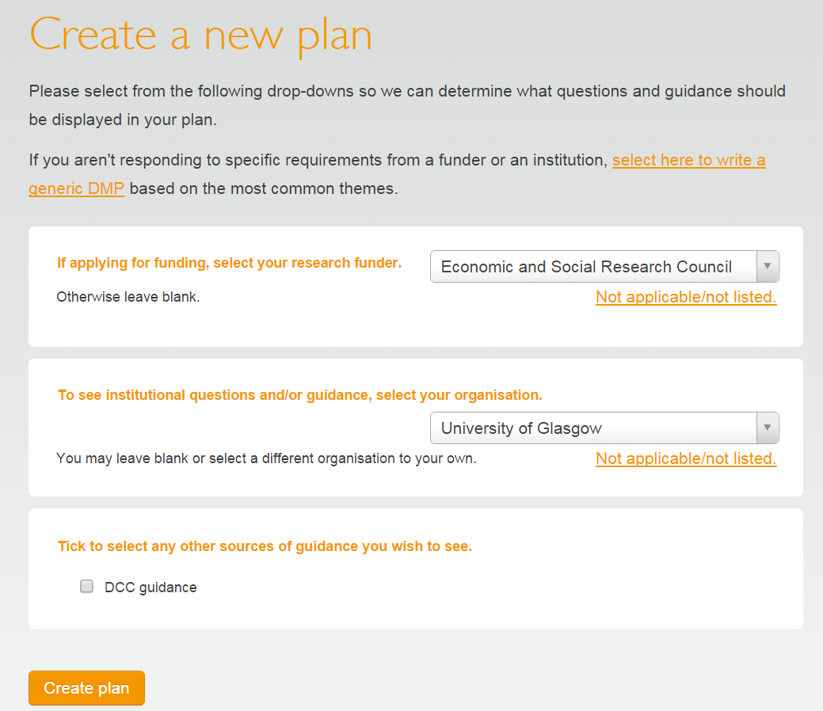
How the tool works
Click to write a generic DMP
Or choose your funder to get their specific template
Pick your uni to add local guidance and to get their template if no funder applies
Choose any additional optional guidance

Slide 17
Organisations can do a range of things
Create your own template(s)
Provide tailored guidance
Customise funder templates
Add logos and details in a banner

Slide 18
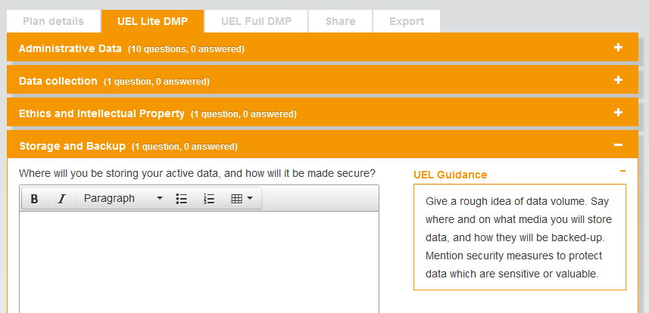
Organisations can add DMP template(s)

Slide 19
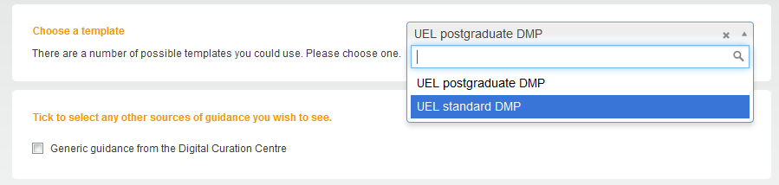
You can have more than one template
You may want to provide different templates for different audiences e.g. PhD students and research staff

Slide 20
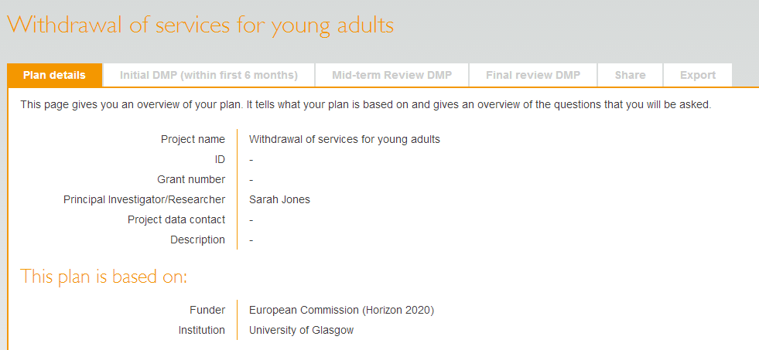
And templates can have multiple phases
Phases
This encourages researchers to actively update the Data Management Plan throughout the project

Slide 21
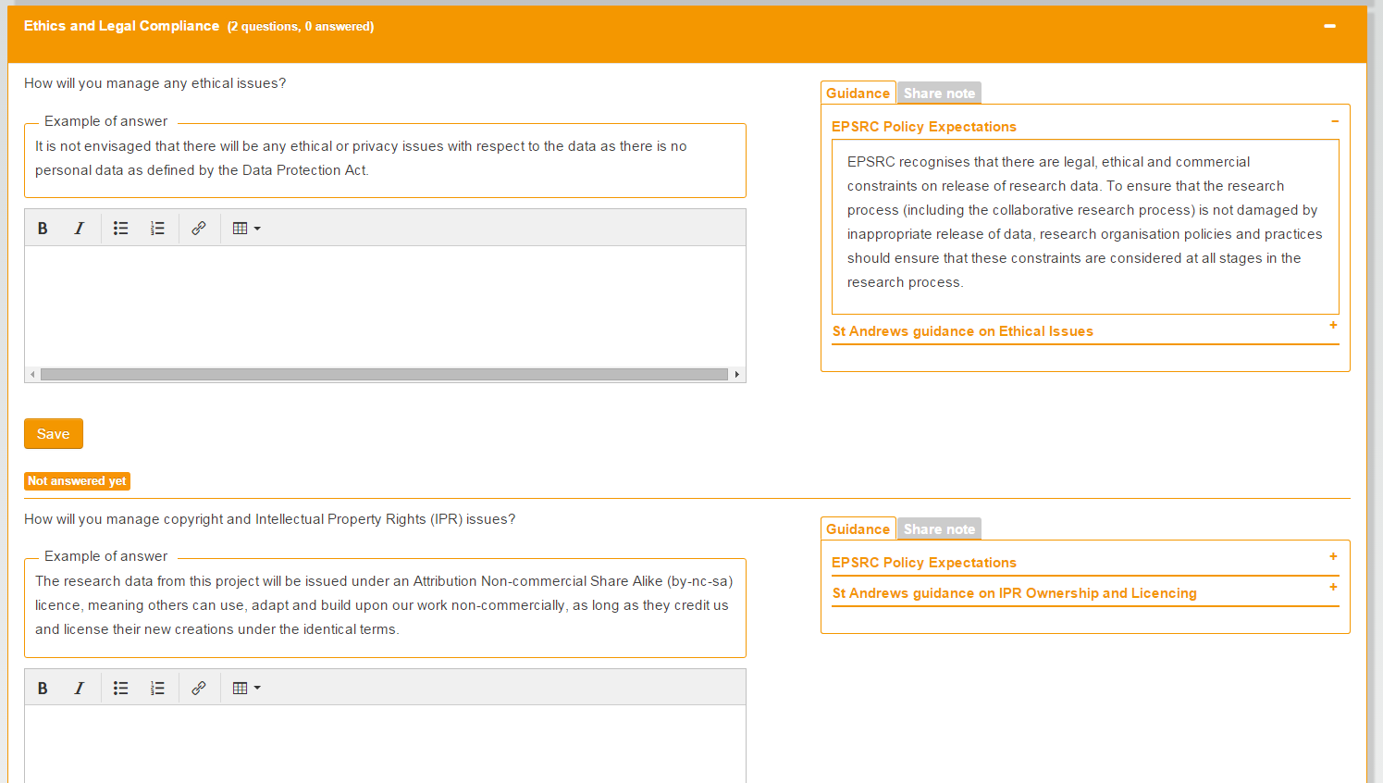
Provide examples answers
St Andrew’s University has added example answers for every question in the EPSRC template

Slide 22
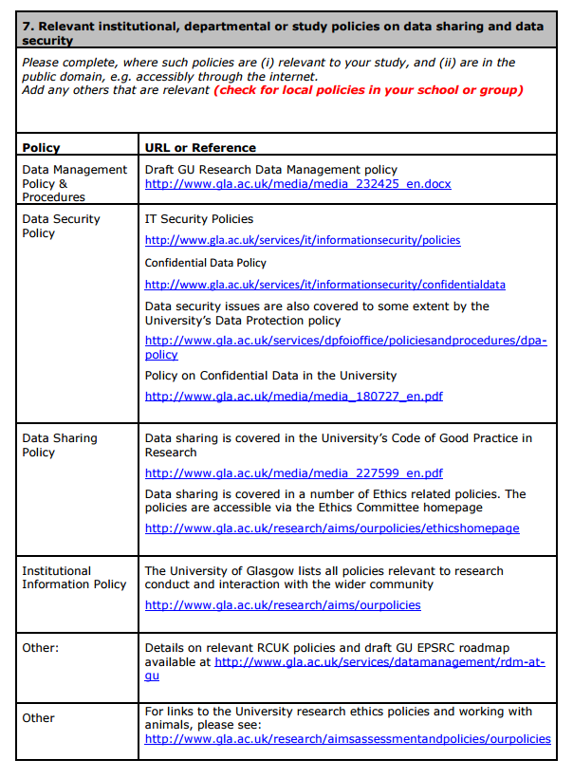
Suggested answers
The University of Glasgow has template answer for the policy question in the MRC template.
The table is prepopulated with links to all the University policies.

Slide 23
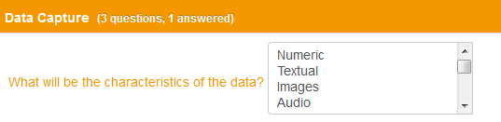
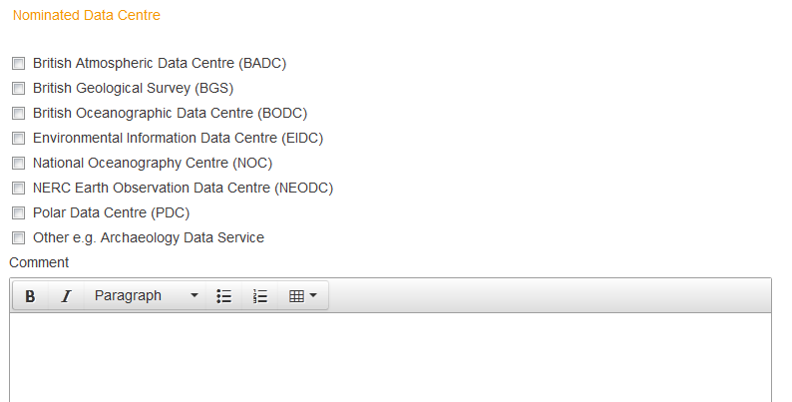
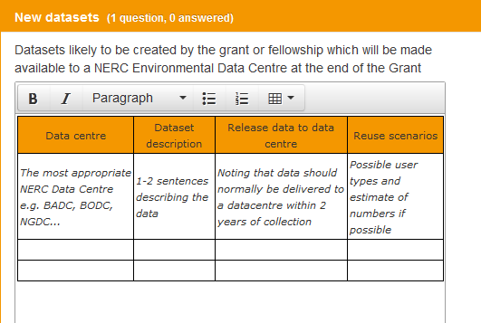
Dropdown options and default styles

Slide 24
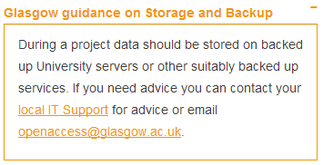
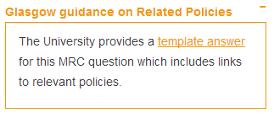
Provide organisational guidance
Guidance can be added by theme (to apply across the board) or can be written for specific questions
Themed guidance
Specific guidance
Guidance that pertains to MRC question 7 only
Guidance that is presented whenever researchers are asked about storage and backup

Slide 25
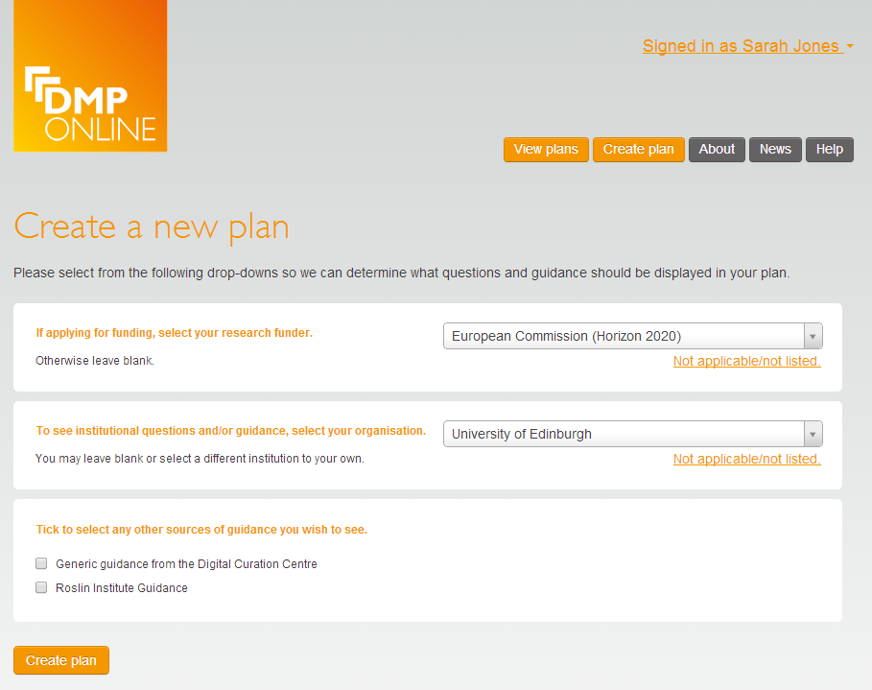
Guidance can be set at multiple levels
Options to have guidance at organisation and ‘unit’ level e.g. by discipline, group, department, institute…

Slide 26
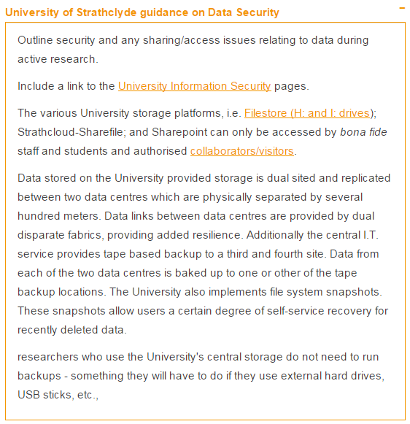
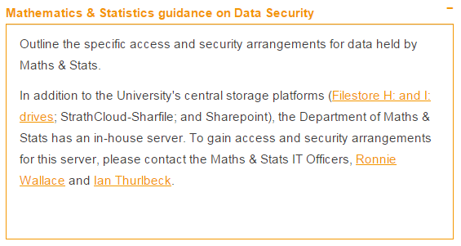
Custom guidance
Strathclyde University has guidelines for the whole institution and 3 departments:
School of Government and Public Policy
Social Work and Social Policy
Maths and Statistics

Slide 27
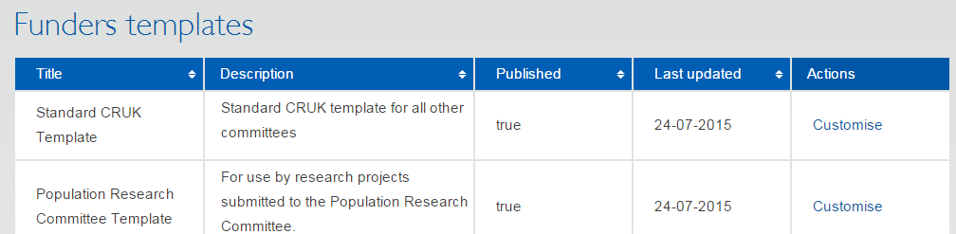
Customising funder templates
Add things you need to know that funders don’t ask e.g.
  What volume of data will you create? Does it exceed X GB?
  Are there any training requirements?
  Would you like help with your DMP & details of support services?
We plan to build in flags so you can trigger alerts

Slide 28
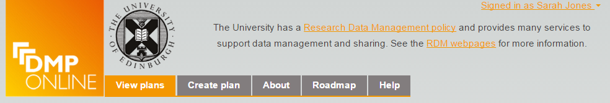
Institutional banner
Add your institutional logo
Provide some high-level text
Link to key resources e.g. RDM policy and webpages

Slide 29
What to do to customise DMPonline?
Define your requirements
Draft your institutional template
Customise existing funder templates
Draft your guidance, examples and suggested answers
Add content to DMPonline via the admin interface (email dmponline@dcc.ac.uk to request admin access)
If you require DMPs

Slide 30
Options for non-UK users
Use the main DCC hosted instance e.g. University of Minho and ZonMw (Dutch medical funder)
Download the code to install / run your own instance e.g. DMP Assistant in Canada
  https://portagenetwork.ca
Have the DCC run a national instance on your behalf (business models currently in development)

Slide 31
DMPonline internationalisation project
Enhancing the code to offer locale-aware support e.g.
list of institutions presented on registration
funder/other templates available in the tool
supported languages (in UI and DMPs)
date and time conventions
data format conventions e.g. currency
user authentication procedure
custom URLs
custom interface (branding / look and feel)

Slide 32
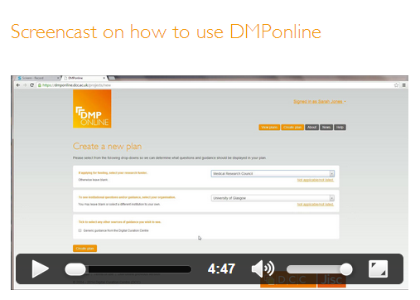


More information
Customising DMPonline
www.dcc.ac.uk/news/customising-dmponline-admin-interface-launches
http://www.screenr.com/PJHN
Get the code, amend it, run a local instance, flag issues, request features... https://github.com/DigitalCurationCentre/DMPonline_v4

Slide 33

Support for Data Management Plans
Image CC-BY by GotCredit www.flickr.com/photos/jakerust/16844834832

Slide 34
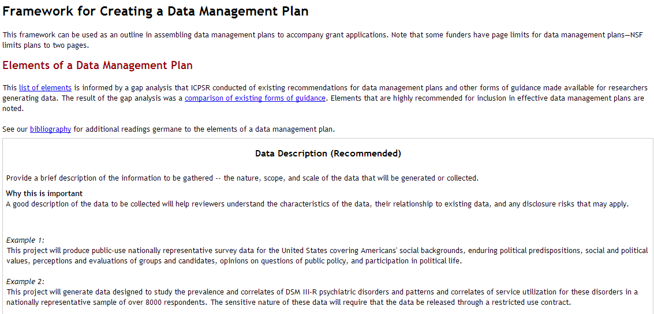
A useful framework to get started
Think about why the questions are being asked – why is it useful to consider that?
Look at examples to help you understand what to write
www.icpsr.umich.edu/icpsrweb/content/datamanagement/dmp/framework.html
Notes:
I recommend this ICPSR resource
It explains the importance of different questions as a pointer to how to answer
Examples are given. This is the most frequent request we get at DCC - examples help researchers think of what to write for their context

Slide 35
Tips for writing DMPs
Seek advice - consult and collaborate
Find out what help is available from IT support, library, data centres etc
Base plans on available skills & support
Consider good practice for your field
Use standards where available
Make sure implementation is feasible

Slide 36
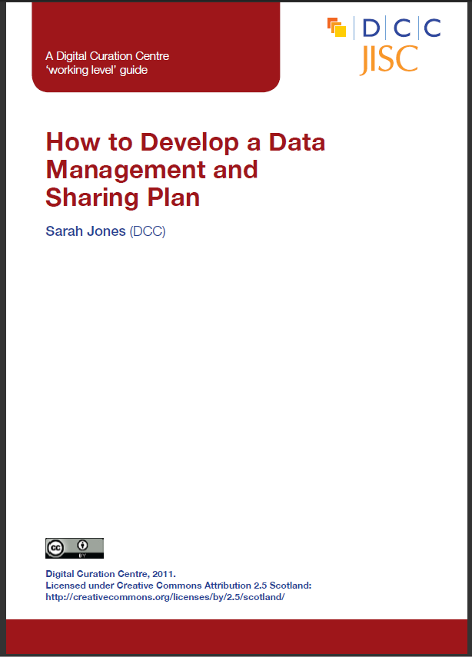

DCC support on DMPs
Webinars and training materials
How-to guides and other advisory documents
Checklist on what to cover in DMPs
Example DMPs
DMPonline
www.dcc.ac.uk/resources/data-management-plans

Slide 37

University guidance and support
Most university policies include a requirement for DMPs so they need to explain what to cover in plans via:
Templates listing themes/questions to cover
Custom guidance by uni or discipline
Example answers or boilerplate text
Links to local contacts and support
A library of successful DMPs to reuse

Slide 38
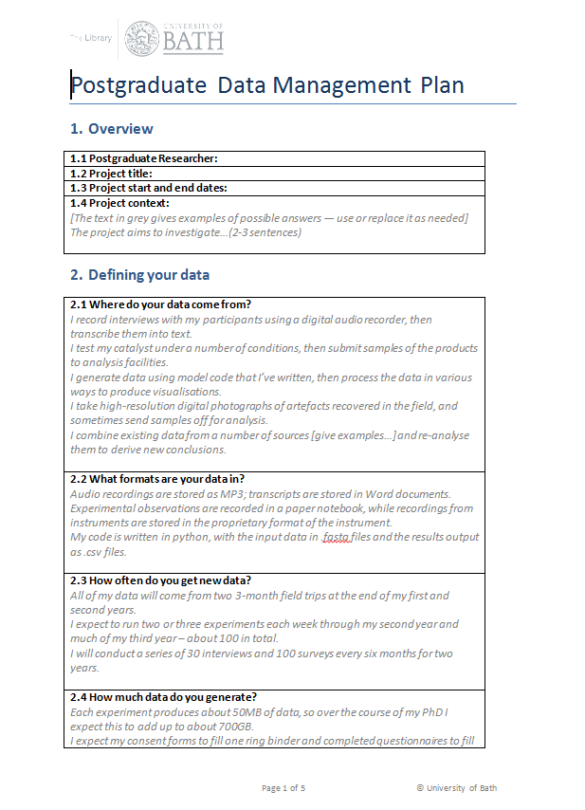
Example DMP templates
DCC Checklist (generic template) www.dcc.ac.uk/sites/default/files/documents/resource/DMP/DMP_Checklist_2013.pdf
Bath postgraduate template http://opus.bath.ac.uk/30772
DataTrain template www.lib.cam.ac.uk/preservation/ datatrain/documents.html
20 questions for RDM https://datamanagementplanning.wordpress.com/2012/03/07/twenty-questions-for-research-data-management
MRC template www.mrc.ac.uk/research/research-policy-ethics/data-sharing/data-management-plans

Slide 39
Example plans
108 DMPs from the National Endowment for the Humanities (USA)
www.neh.gov/divisions/odh/grant-news/data-management-plans-successful-grant-applications-2011-2014-now-available
20+ scientific DMPs submitted to the NSF (USA) provided by UCSD
http://libraries.ucsd.edu/services/data-curation/data-management/dmp-samples.html
2 Rural Economy & Land Use (RELU) programme examples (UK)
http://relu.data-archive.ac.uk/data-sharing/planning/examples
Further examples:
  www.dcc.ac.uk/resources/data-management-plans/guidance-examples

Slide 40

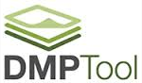
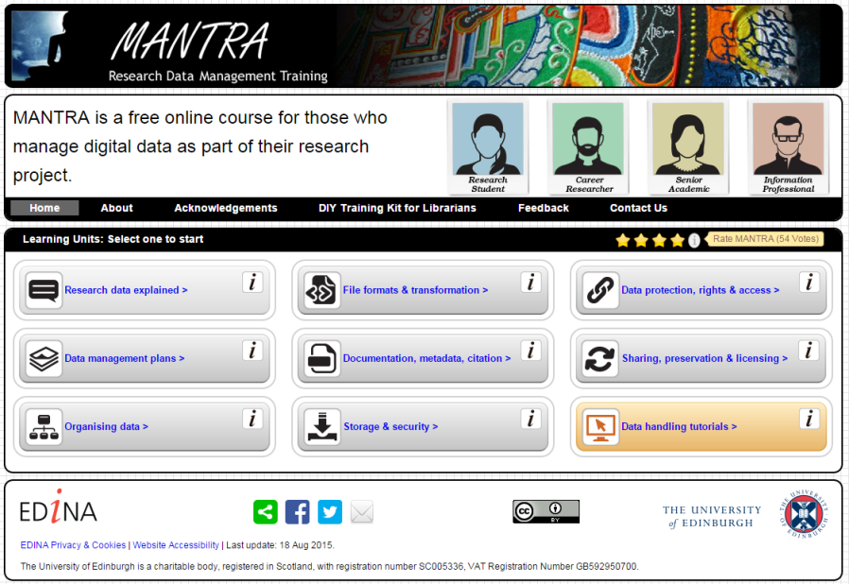

More in-depth support
Online tools
Training courses
Reviewing plans
Consultancy services

Slide 41
A range of DMP support services
For example, Stanford University offers:
Information on funding agency requirements
Guidance and best practice on writing a plan
An online tool (DMPTool)
Sample agency-specific plans
An FAQ and workshops
A DMP review service
http://library.stanford.edu/research/data-management-services/data-management-plans

Slide 42
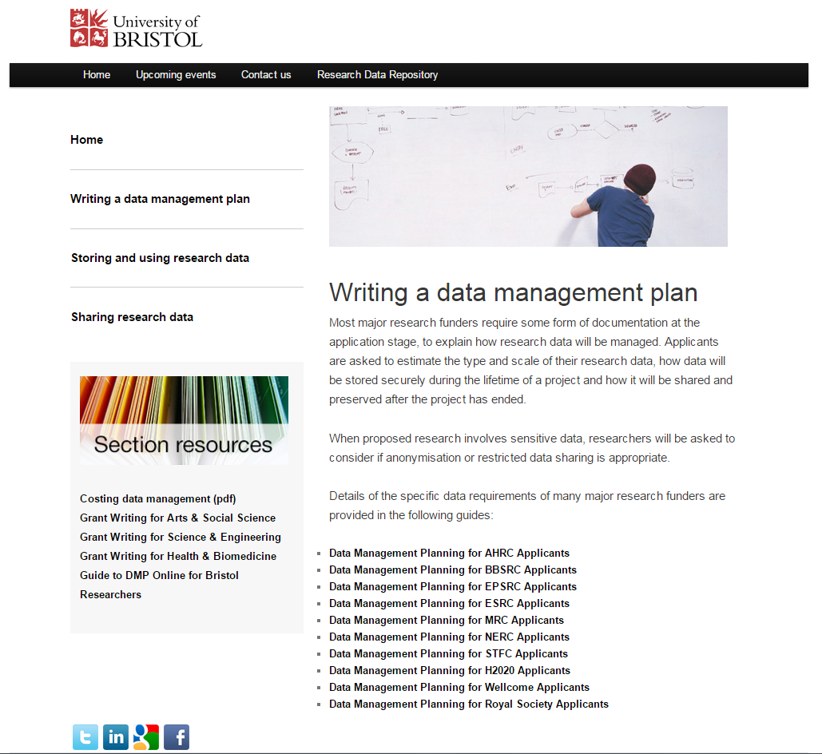
University of Bristol DMP services
https://data.bris.ac.uk/planningdata

Slide 43
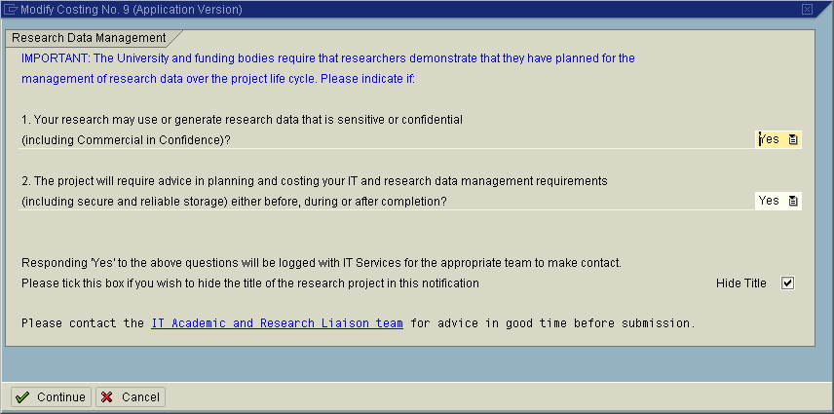
Integrating DMPs into workflows
Example of embedding flags into the grant costings system at the University of Leicester
www2.le.ac.uk/offices/itservices/about/news/old-news/2010/July/lucre-08-07-10

Slide 44
Using DMPs to define / allocate storage
The University of Manchester requires an outline DMP prior to a grant application
This asks questions about the storage requirements to plan activity / resourcing and allocate space
The outline DMP generates an RDM Plan Reference Number to include in the Research Application form. Researchers can’t proceed without this.
www.library.manchester.ac.uk/services-and-support/staff/research/ services/research-data-management/data-management-planning-tool

Slide 45
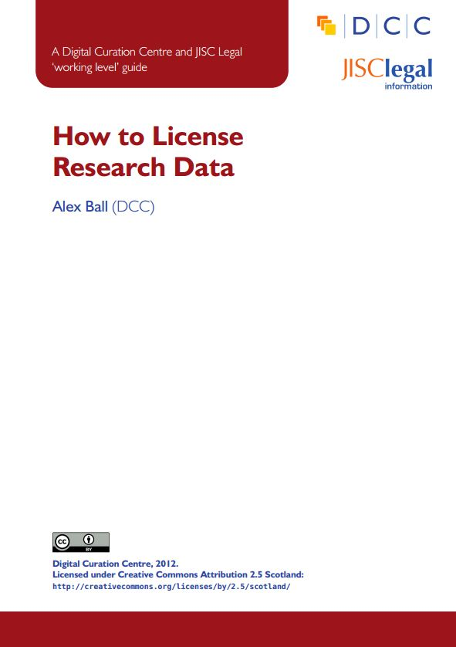
Reviewing DMPs
Useful guidelines
ESRC guidance for peer-reviewers www.esrc.ac.uk/_images/Data-Management-Plan-Guidance-for-peer-reviewers_tcm8-15569.pdf
Medical Research Council guidelines www.mrc.ac.uk/documents/pdf /data-management-plans-guidance-for-reviewers
Johns Hopkins grant reviewers sheet https://dmp.data.jhu.edu/resources/grant-reviewers-guide
How to assess DMPs forthcoming guide

Slide 46
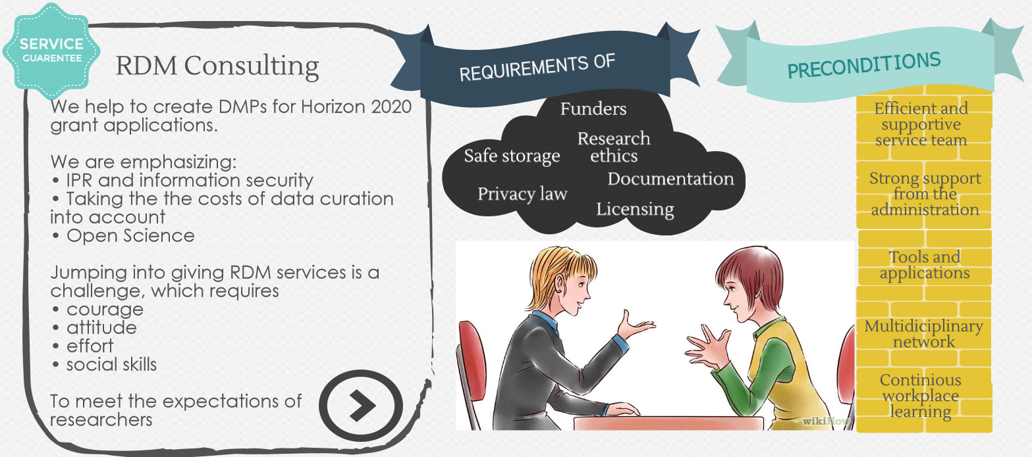
University of Helsinki example
Consulting, supporting and networking with researchers & all other interest groups
Slide content courtesy of Mari Elisa Kuusniemi (MEK), University of Helsinki Library

Slide 47
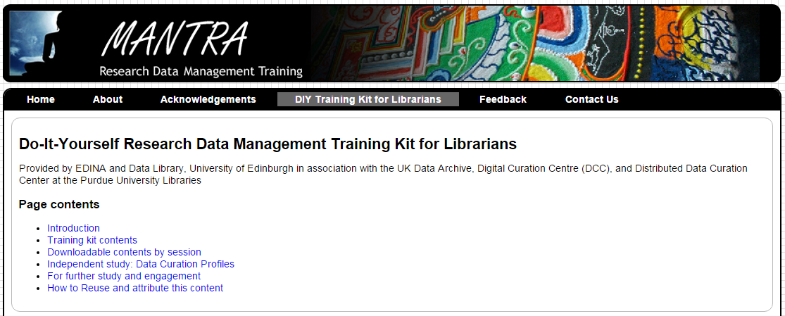
DIY training kit for librarians - MANTRA
Created by the data library at Edinburgh University
Builds on the MANTRA online training for RDM
Equips and empowers librarians to training themselves in groups to address RDM and provide support
http://datalib.edina.ac.uk/mantra/libtraining.html

Slide 48

Thanks for listening
DCC resources on DMPs:
www.dcc.ac.uk/resources/ data-management-plans
Follow us on twitter:
@digitalcuration and #ukdcc

Slide 49
Discussion exercise: supporting DMPs
Read the short case studies on supporting DMPs and discuss the merits of each approach:
Which approach do you favour?
What may be feasible to implement at your institution?
Are there other types of support you would consider providing?

