Slide 1
The European Framework: Horizon 2020 and the Open Research Data pilot
Sarah Jones
Digital Curation Centre, Glasgow
sarah.jones@glasgow.ac.uk
Twitter: @sjDCC
Data Management Plans: principles and practice workshop, 19 November 2015, Bologna

Slide 2
What is the Digital Curation Centre?
A UK service to support the Higher Education sector with Research Data Management (RDM)
“Helping to build capacity, capability and skills in data management and curation across the UK’s higher education research community.”
DCC Phase 3 Business Plan
Training | Events | Tools | Advocacy | Tailored Support | IJDC | International Conference
www.dcc.ac.uk

Slide 3
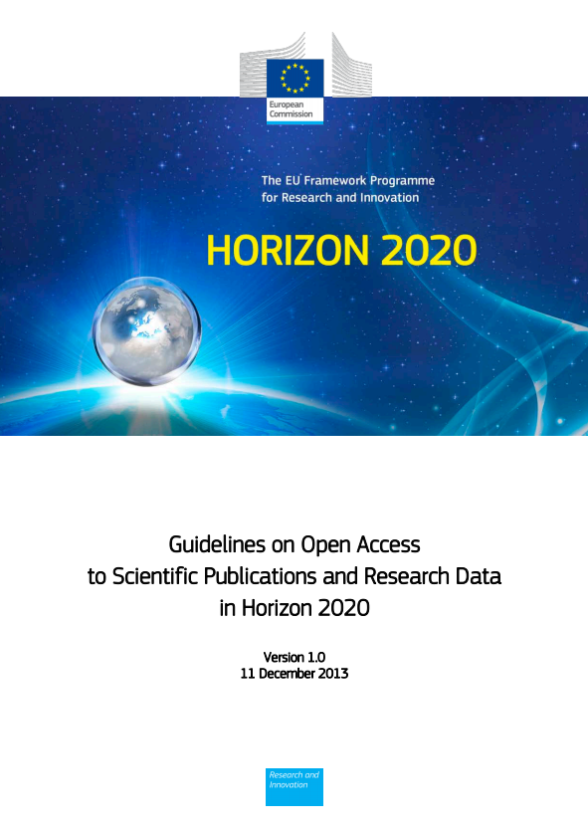
Why open access and open data?
“The European Commission’s vision is that information already paid for by the public purse should not be paid for again each time it is accessed or used, and that it should benefit European companies and citizens to the full.”
http://ec.europa.eu/research/participants/data/ ref/h2020/grants_manual/hi/oa_pilot/h2020-hi-oa-pilot-guide_en.pdf
Notes:
The background to this is about making the most of the data that has been created through publicly funded research. The guidelines speak of:
- Improved quality of results
- Greater efficiency
- Faster to market = faster growth
- Improved transparency of the scientific process
3

Slide 6
The EC and open science
Data-intensive
Citizens science
Open code
Open workflows
Pre-print
Analysis
Publication
Review
Conceptualisation
Data gathering
Open data
Open access
Open annotation
Alternative Reputation systems
Scientific blogs
Collaborative bibliographies

Slide 7
Development of EC Open Access policy
Pilot in FP7
Provision of support
OA mandate in H2020
Trialled in 7 areas
Expected to:
Deposit articles into a repository
Attempt to make these OA within 6 or 12 months
Choice between green and gold routes
OA fees are eligible for reimbursement
Pilot supported and monitored through OpenAIRE
Each beneficiary must:
Deposit machine-readable electronic copy in repository by the date of publication
Ensure OA via green/gold routes within 6 or 12 month embargo
Ensure bibliographic metadata is OA
Aim to deposit research data
Notes:
Moving from a ‘best-effort’ in FP7 to an ‘obligation’ under Horizon 2020
6 months embargo (science, technology, medicine) and 12 months (humanities and social sciences)
7

Slide 8
H2020 Open Research Data pilot
Guidelines on Data Management in Horizon 2020
http://ec.europa.eu/research/participants/data/ref/h2020/grants_manual/hi/oa_pilot/h2020-hi-oa-data-mgt_en.pdf
Pilot in H2020
Provision of support
?
Notes:
8

Slide 9
What changes in Horizon2020?
Update of EC guidelines
New clauses in Grant Agreements
OA to publications is mandatory for all projects
OA to data piloted for 7 selected areas
Member States are requested to develop and align national OA policies and infrastructures

Slide 10
Horizon 2020 and open access
What is required in terms of publications?

Slide 11
Grant Agreement: § 29.2 Open access to scientific publications
Each beneficiary must ensure open access (free of charge, online access for any user) to all peer-reviewed scientific publications relating to its results.
In particular, it must:
(a) as soon as possible and at the latest on publication, deposit a machine-readable electronic copy of the published version or final peer-reviewed manuscript accepted for publication in a repository for scientific publications;
Moreover, the beneficiary must aim to deposit at the same time the research data needed to validate the results presented in the deposited scientific publications.
(b) ensure open access to the deposited publication — via the repository — at the latest:
(i) on publication, if an electronic version is available for free via the publisher, or
(ii) within six months of publication (twelve months for publications in the social sciences and humanities) in any other case.
(c) ensure open access — via the repository — to the bibliographic metadata that identify the deposited publication.
The bibliographic metadata must be in a standard format and must include all of the following:
- the terms ["European Union (EU)" and "Horizon 2020"]["Euratom" and Euratom research and training programme 2014-2018"];
- the name of the action, acronym and grant number;
- the publication date, and length of embargo period if applicable, and
- a persistent identifier.

Slide 12
What does this mean?
Authors are free to choose between the two main and non-exclusive routes toward Open Access
Self-archiving (green open access): the published article or the final peer reviewed manuscript is uploaded in an online repository – access is often delayed (embargo period)
Open access publishing (gold open access): the article is immediately in open access mode, through the publisher. The associated costs (Article Processing Charges) are covered by the author/institution/funder.
The article must always be deposited in a repository, even if the gold route has been chosen.

Slide 13
What to deposit?
The final peer-reviewed manuscript, accepted for publication, including all modifications from the peer-review process
OR
A machine-readable copy of the published version (usually a PDF document)
In principle this applies to all kinds of publications, but emphasis is on peer-reviewed journal articles.

Slide 14
Where to deposit?
Institutional repository
Disciplinary repository (arXiv, Europe PubMed Central, etc.)
Zenodo (www.zenodo.org) if none of the above is available – a EC co-funded, multidisciplinary repository, for publications & data
You can find repositories via registries: ROAR http://roar.eprints.org or OpenDOAR http://www.opendoar.org
A list of publications on the project website is not sufficient.

Slide 15
When to deposit
OPEN ACCESS
Each beneficiary must deposit as soon as possible and at the latest on publication.
Open access must be ensured immediately or after an embargo period:
GREEN – 6-12 months depending on the research area and the choice of journal
GOLD – immediately
Some journals demand longer embargo periods of 6-36 months (compare SHERPA/RoMEO database).

Slide 16
Routes to open access publication
Publish in an open access journal
Pay Article Processing Charge (APC) - if required
Immediate open access (via publisher)
Researcher decides where to publish
GOLD OA ROUTE
GREEN OA ROUTE
Check SHERPA RoMEO to see what OA and self-archiving options are available
www.sherpa.ac.uk/romeo
Publish in a subscription-based journal
Search for a repository
http://opendoar.org
Self-archive in a repository, based on publisher policy.
Immediate or delayed open access, depending on publisher’s policy.
IF OPTION EXISTS
e.g. a ‘hybrid’ journal
(a subscription-based journal that has a paid open access option)
Pay Article Processing Charge (APC)
Immediate open access (via publisher)
Notes:
We also mentioned the importance of open access publishing, so I want to walk through the different options available. Essentially researchers may choose to publish in open access journals or traditional subscription-based journals. You can check what OA options are available by searching for your journal in the RoMEO directory.
If you publish in an open access journal, an Article Processing Charge may be applied. Your article will then be made immediately available via the publisher. This is often terms ‘gold OA’
Alternatively you may choose to publish with a traditional publisher. Some subscription based journals are termed ‘hybrid journals’ as they also have a gold OA option. Essentially you pay to make your individual article freely available alongside others that remain available only to subscribers. Again, once you pay the APC, your article will be freely available to all via the publisher’s website.
Another, cheaper route is to follow green OA. This essentially means that you take your copy of the paper (usually a pre-print, not the publisher’s final version) and deposit that in an OA repository. You can search for a repository via OpenDOAR, or check with your institution. There is usually a local institutional repository. Once you self-archive, your article will be freely available via the repository. This is often called delayed open access as publishers will normally impose an embargo in the region of 6-12 months so they can get money from providing access to the article first.
A final point to note is that gold and green routes are not mutually exclusive. You can pay an APC and also deposit in a repository. In fact, there may be an obligation / encouragement on you to do this from your funder or uni.

Slide 17
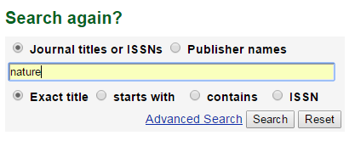
Sherpah RoMEO
Notes:
This is the Sherpah RoMEO service. You can search for your journal title and then see what is allowed.
In this example, the author can archive a pre-print but not the publisher’s final version, and certain restrictions apply e.g. a 6 month embargo.

Slide 18
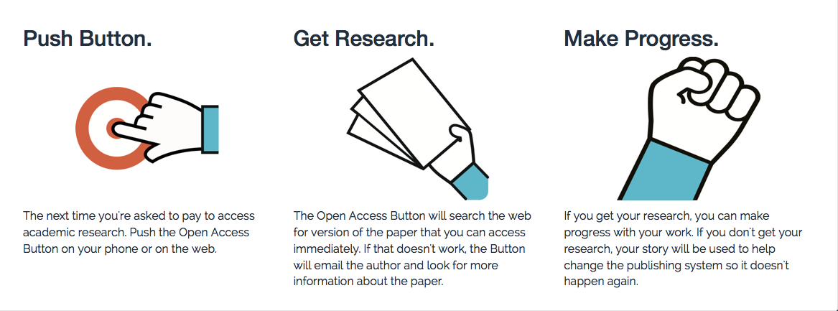
Open access button
The Open Access Button helps you get the research you want right now (without paying for it), and adds papers you still need to your wish list.
https://openaccessbutton.org

Slide 19
The Open Research Data Pilot
What is required and how to comply?

Slide 20
Open Research Data (ORD) Pilot
Pilot focuses on research data specifically
‘Research data’ refers to information, in particular facts or numbers, collected to be examined and considered as a basis for reasoning, discussion or calculation.
In a research context, examples of data include statistics, results of experiments, measurements, observations resulting from fieldwork, survey results, interview recordings and images. The focus is on research data that is available in digital form.
Guidelines on Open Access to Scientific Publications and Research Data in Horizon 2020 v.1.0, 11 December 2013, Footnote 5, p3

Slide 21
H2020 areas participating in the pilot
Future and Emerging Technologies
Research infrastructures (new: coverage of the whole area)
Leadership in enabling and industrial technologies – Information and Communication Technologies
Nanotechnologies, Advanced Materials, Advanced Manufacturing and Processing, and Biotechnology: ‘nanosafety’ and ‘modelling’ topics (new)
Societal Challenge: Food security, sustainable agriculture and forestry, marine and maritime and inland water research and the bioeconomy - selected topics as specified in the work programme (new)
Societal Challenge: 'Climate Action, Environment, Resource Efficiency and Raw materials' – except raw materials
Societal Challenge: 'Europe in a changing world – inclusive, innovative and reflective Societies'
Science with and for Society
Cross-cutting activities - focus areas – part Smart and Sustainable Cities (moved from Energy WP)
Projects in other areas can participate on a voluntary basis
Notes:
There are seven areas participating in the pilot. This corresponds to about €3 billion or 20% of the overall Horizon 2020 budget in 2014 and 2015.
Projects in others can take part on a voluntary basis. It’s an opt in / opt out basis.
21

Slide 22
Exemptions – reasons for opting out
If results are expected to be commercially or industrially exploited
If participation is incompatible with the need for confidentiality in connection with security issues
Incompatible with existing rules on the protection of personal data
Would jeopardise the achievement of the main aim of the action
If the project will not generate / collect any research data
If there are other legitimate reasons to not take part in the Pilot
Can opt out at proposal stage OR during lifetime of project
Should describe issues in the project Data Management Plan
Notes:
Projects in these seven areas aren’t forced to participate. There are various reasons to opt out e.g. if results can’t be shared due to confidentiality, legal restrictions or commercial opportunities.
Opt out is available at any point. It can also apply to certain parts of the data e.g. they could share some aspects but not others.
22

Slide 23
Approach:
as open as possible, as closed as necessary
Image: ‘Balancing rocks’ by Viewminder CC-BY-SA-ND www.flickr.com/photos/light_seeker/7780857224

Slide 24
Which data does the pilot apply to?
Data, including associated metadata, needed to validate the results in scientific publications
Other curated and/or raw data, including associated metadata, as specified in the DMP
Doesn’t apply to all data (researchers to define as appropriate)
Don’t have to share data if inappropriate – exemptions apply
Notes:
For those that do take part in the pilot, the starting point is to make all data that underpin publications open. After that, it’s for researchers to define what else should be shared and can be made open. This should be outlined in the DMP.
Sometimes sharing is not appropriate (e.g. due to ethical rules of personal data, intellectual property protection, commercial restrictions etc). It’s fine to apply restrictions in such cases. This could be an embargo period prior to publication or while a patent is sought, or controlling access and re-use to protect participants’ identities (e.g. via the use of secure data services / data enclaves or data sharing agreements). Restrictions should be outlined up-front in the DMP.
24

Slide 25
Key requirements of the open data pilot
Beneficiaries participating in the Pilot will:
Deposit data in a research data repository of their choice
Take measures to make it possible for others to access, mine, exploit, reproduce and disseminate the data free of charge
Provide information about tools and instruments necessary for validating the results (where possible, provide the tools and instruments themselves)
Notes:
So the specific requirements on projects that participate in the pilot are to:
- Deposit data in a repository
Enable reuse via open licensing
Provide any tools (or at least info on them) needed to validate the data
The focus is planning for data sharing and then facilitating that through deposit, licensing and enabling reproducibility
25

Slide 26
Data Management Plans
Projects participating in the pilot will be required to develop a Data Management plan (DMP), in which they will specify what data will be open.
Note that the Commission does NOT require applicants to submit a DMP at the proposal stage.
A DMP is therefore NOT part of the evaluation.
DMPs are a deliverable for those participating in the pilot.
Notes:
26

Slide 27
Info on RDM: what and when
PROPOSAL STAGE
IN PROJECT
Where relevant*, H2020 proposals can include a section on data management which is evaluated under the criterion ‘Impact’
What types of data will the project generate/collect?
What standards will be used?
How will this data be shared/made available? If not, why?
How will this data be curated and preserved?
* For “Research and Innovation actions” and “Innovation Actions”
DMPs are a project deliverable for those participating in the open data pilot.
Not a fixed document – should evolve and gain precision
Deliver first version within initial 6 months of project
More elaborate versions whenever important changes to the project occur. At least at the mid-term and final review.
Notes:
Although DMPs are a project deliverable and not required at the application stage, proposals can include a section on data management if desired. The info suggested here is similar to the preliminary DMP, so essentially gets that started.
27

Slide 28
Initial DMP (at 6 months)
The DMP should address the points below on a dataset by dataset basis:
Data set reference and name
Identifier for the data set to be produced
Data set description
Description, origin and scale of the data that will be generated or collected, and to whom it could be useful
Information on the existence (or not) of similar data and the possibilities for integration and reuse
Standards and metadata
Reference to existing suitable standards of the discipline. If these do not exist, an outline of how and what metadata will be created.
Data sharing
How the data will be shared - widely open or restricted to specific groups – or reasons why it cannot be shared
Access procedures, embargo periods (if any), and technical mechanisms for dissemination
Software and other tools necessary for re-use
Repository where data will be stored
Archiving and preservation (including storage and backup)
Procedures for long-term preservation
How long the data should be preserved
Final data volume
How associated costs will be covered
Notes:
This template should be filled in for each dataset
28

Slide 29
More elaborate DMP
Scientific research data should be easily:
1. Discoverable
Are the data and software discoverable and identifiable by a standard mechanism e.g. DOIs?
2. Accessible
Are the data accessible and under what conditions e.g. licenses, embargoes etc?
3. Assessable and intelligible
Are the data and software assessable and intelligible to third parties for peer-review? E.g. can judgements be made about their reliability and the competence of those who created them?
4. Useable beyond the original purpose for which it was collected
Are the data properly curated and stored together with the minimum software and documentation to be useful by third parties in the long-term?
5. Interoperable to specific quality standards
Are the data and software interoperable, allowing data exchange? E.g. were common formats and standards for metadata used?
Notes:
The second template is provided based on the G8 principles and focuses on the qualities/properties needed. These are that scientific research data should be easily discoverable, accessible, assessable and intelligible, usable beyond the original purpose for which it was created, and interoperable to specific quality standards.
29

Slide 32
Help and support from the EC

Slide 33
Ongoing coordination and support actions (FP7 funded)

Slide 34
RECODE
Policy RECommendations for Open Access to Research Data in Europe (RECODE)
Project developed a set of policy recommendations for
Funders
Research Institutions
Data Managers
Publishers
http://recodeproject.eu/wp-content/uploads/2015/01/ recode_guideline_en_web_version_full_FINAL.pdf
Notes:
Recommendations cover aligning policies, rewarding researchers, ensuring that there is funding and appropriate support infrastructure, ensuring data quality standards, harmonising open licensing frameworks and curriculum development

Slide 35
PASTEUR4OA
Open Access Policy Alignment Strategies for European Union Research
Help develop OA strategies and policies at the national level and facilitate their coordination among all Member States
Developed a policy typology and mapped existing policies
Analysed the effectiveness and growth of policies
Provided a number of visualisations
Programme of advocacy and engagement for policymakers
Establish the foundations of a Knowledge Net based key nodes
http://www.pasteur4oa.eu
Notes:
No. of OA policies worldwide
How many are mandatory?
Are they H2020 compliant?
Which mention APCs?

Slide 36
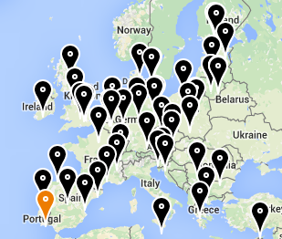
FOSTER
Facilitate Open Science Training for European Research
Network of open access trainers
Programme of open science courses
Portal to training materials
E-learning courses on open access, open data and open science forthcoming
www.fosteropenscience.eu

Slide 37
OpenAIRE
Open Access Infrastructure for research in Europe
aggregates data on OA publications
mines & enriches it content by linking thing together
provides services & APIs e.g.
to generate publication lists
www.openaire.eu
http://vimeo.com/108790101
Notes:
OpenAIRE is also worth checking out. This is an EC-funded project to provide infrastructure for open access. They’ve recently released a short video that tells you how they can help.
Essentially OpenAIRE aggregates metadata from different repositories to compile a complete list of publications and related outputs. They mine and enrich the content, de-duplicating entries and linking together publications with data, details about the project, authors, funders etc. OpenAIRE also provides a number of useful services & APIs, for example you can embed a publication list for your project in your website that is automatically updated whenever someone adds a new paper to a repository (this is harvested into OpenAIRE and pushed out to your list).

Slide 38
Discipline-specific infrastructure
Arts & Humanities
databank on health, ageing and retirement
Clinical research
Language research
Oceanography
Biological and life sciences
Translational medicine
Astronomy e-VLBI network
Materials science
Biological resources
Social science

Slide 39
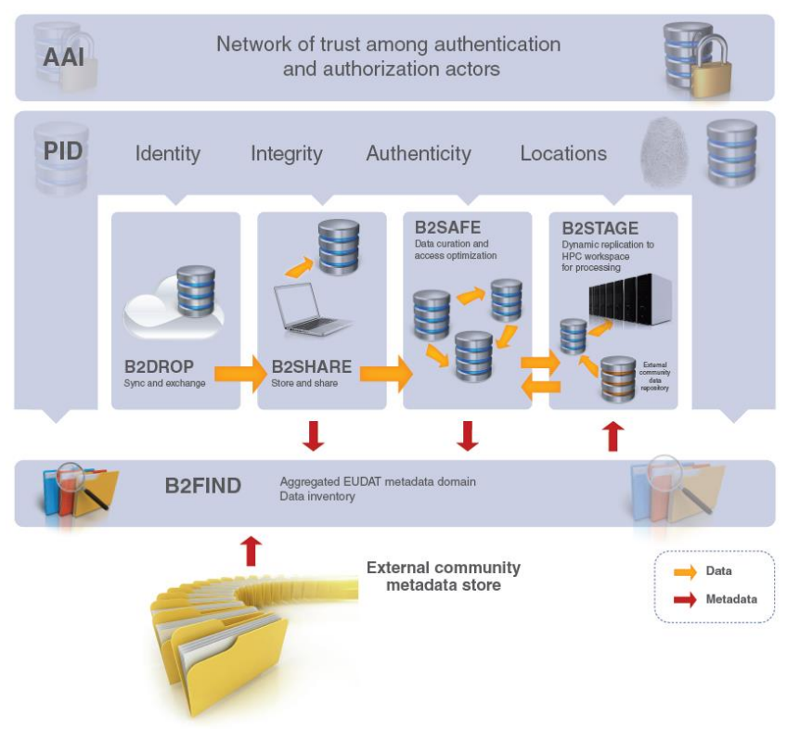
EUDAT services
EUDAT offers a pan-European solution, providing a generic set of services to ensure minimum level of interoperability
Building common data services in close collaboration with 25+ communities
www.eudat.eu
Notes:
All share common challenges:
– Reference models and architectures
– Persistent data identifiers
– Metadata management
– Distributed data sources
– Data interoperability

Slide 40
EUDAT B2 service suite
Covering both access and deposit, from informal data sharing to long-term archiving, and addressing
identification, discoverability and computability of both long-tail and big data, EUDAT’s services will address the full lifecycle of research data

Slide 41
Guidelines from the Commission
Factsheet on Open Access
https://ec.europa.eu/programmes/horizon2020/sites/horizon2020/files/FactSheet_Open_Access.pdf
Guidelines on Open Access to Scientific Publications and Research Data in Horizon 2020
http://ec.europa.eu/research/participants/data/ref/h2020/grants_manual/hi/oa_pilot/h2020-hi-oa-pilot-guide_en.pdf
Guidelines on Data Management in Horizon 2020
http://ec.europa.eu/research/participants/data/ref/h2020/grants_manual/hi/oa_pilot/h2020-hi-oa-data-mgt_en.pdf

Slide 42
Help on understanding the H2020 pilot
OpenAIRE guide on the Open Research Data Pilot
Are you supposed to deposit? > What to deposit > Where to deposit > When to deposit
https://www.openaire.eu/oa-in-h2020/h2020/h2020-oa-data-pilot
Joint statement by OpenAIRE, LIBER and COAR
http://www.slideshare.net/libereurope/horizon-2020-opendatapilot20130703final
Help from your research office and national agencies
e.g. http://www.ucl.ac.uk/research/europe/h2020
e.g. https://www.h2020uk.org/home

Slide 43
Thanks for listening
DCC resources:
www.dcc.ac.uk/resources
Follow us on twitter:
@digitalcuration and #ukdcc
Acknowledgement: many thanks to Daniel Spichtinger, Celina Ramjoue and colleagues for the EC-branded slides and to Birgit Schmidt for the details on the EC’s open access requirements, courtesy of the FOSTER project

