Slide 1
Managing data and being open
Sarah Jones
Digital Curation Centre, Glasgow
sarah.jones@glasgow.ac.uk
Twitter: @sjDCC
Data Management Plans: principles and practice workshop, 19 November 2015, Bologna

Slide 2
What is research data management?
Plan
Create
Document
Publish
Share
Use
“the active management and appraisal of data over the lifecycle of scholarly and scientific interest”
Data management is part of
good research practice
Notes:
2

Slide 3
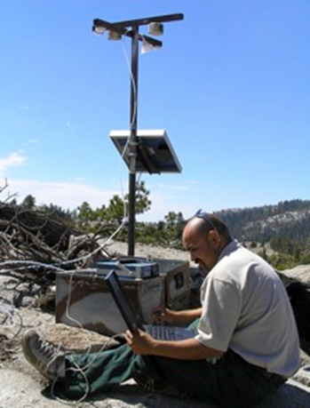
What does data management involve?
Data Management Planning
Creating data
Analysing data
Documenting data
Accessing / (re)using data
Storage and backup
Selecting what to keep
Sharing data
Data licensing and citation
Preserving data
…
CC-BY-NC-SA
CC-BY-NC-SA

Slide 4
Reasons to manage and share data
Benefits for researchers
To make research easier!
Stop yourself drowning in irrelevant stuff
Make sure you can understand and reuse your data again later
Advance your career – data is growing in significance
Research integrity
To avoid accusations of fraud or bad science
Evidence findings and enable validation of research methods
Meet codes of practice on research conduct
Many research funders worldwide now require Data Management and Sharing Plans
Potential to share data
So others can reuse and build on your data
To gain credit – several studies have shown higher citation rates when data are shared
For greater visibility, impact and new research collaborations
Promote innovation and allow research in your field to advance faster
Notes:
Learn good data habits now! You’ll need them later.

Slide 5
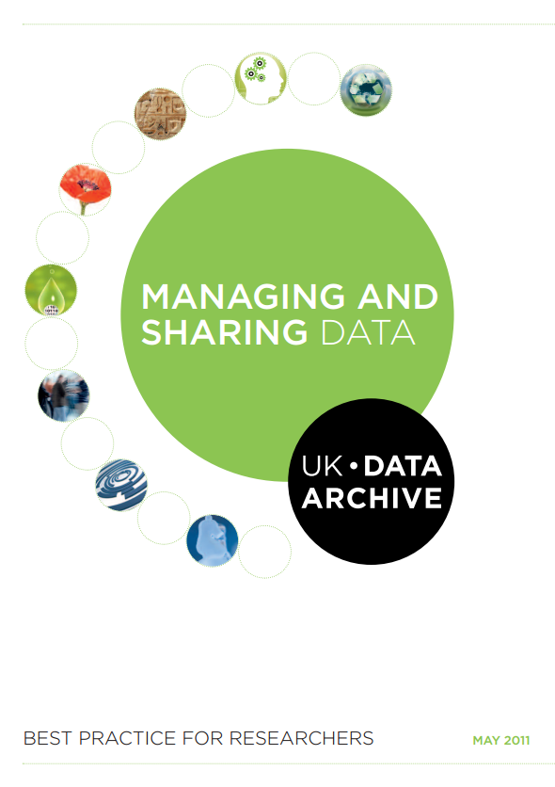
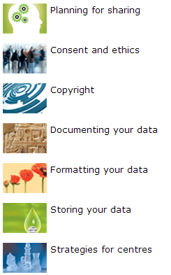
Managing and sharing data: a best practice guide
http://data-archive.ac.uk/media/2894/managingsharing.pdf

Slide 6
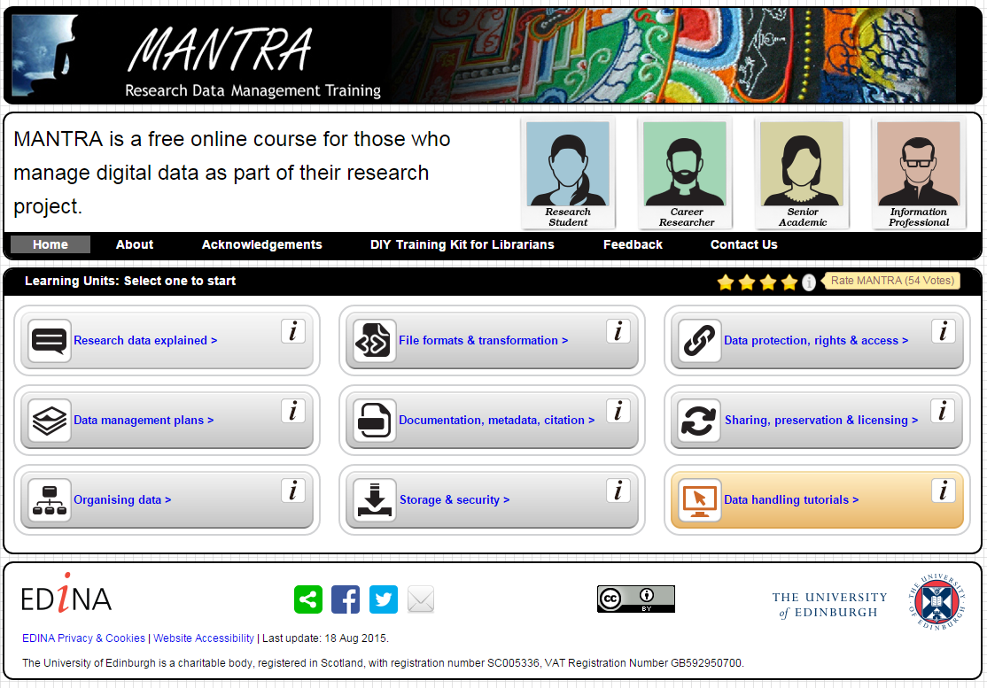
MANTRA online training for RDM
http://datalib.edina.ac.uk/mantra

Slide 7
DCC ‘How to’ guides
How to appraise and select research data
How to cite datasets and link to publications
How to develop a data management plan
How to license research data
How to track the impact of research data with metrics
How to write a lay summary
www.dcc.ac.uk/resources/how-guides

Slide 8
What does it mean to be open?
Image by biblioteekje CC-BY-NC-SA www.flickr.com/photos/biblioteekje/3992172265

Slide 9
What is open science?
“science carried out and communicated in a manner which allows others to contribute, collaborate and add to the research effort, with all kinds of data, results and protocols made freely available at different stages of the research process.”
Research Information Network, Open Science case studies
www.rin.ac.uk/our-work/data-management-and-curation/
open-science-case-studies

Slide 10
More than open access publishing
CC-BY Andreas Neuhold https://commons.wikimedia.org/wiki/File:Open_Science_-_Prinzipien.png

Slide 11
Open data
“Open data and content can be freely used, modified and shared by anyone for any purpose”
http://opendefinition.org
Tim Berners-Lee’s proposal for five star open data - http://5stardata.info
⬆ | make your stuff available on the Web (whatever format) under an open licence
⬆⬆ | make it available as structured data (e.g. Excel instead of a scan of a table)
⬆⬆⬆ | use non-proprietary formats (e.g. CSV instead of Excel)
⬆⬆⬆⬆ | use URIs to denote things, so that people can point at your stuff
⬆⬆⬆⬆⬆ | link your data to other data to provide context

Slide 12
Open methods
Documenting and sharing workflows and methods
Sharing code and tools to allow others to reproduce work
Using web based tools to facilitate collaboration and interaction from the outside world
Open netbook science – “when there is a URL to a laboratory notebook that is freely available and indexed on common search engines.”
http://drexel-coas-elearning.blogspot.co.uk/2006/09/open-notebook-science.html

Slide 13
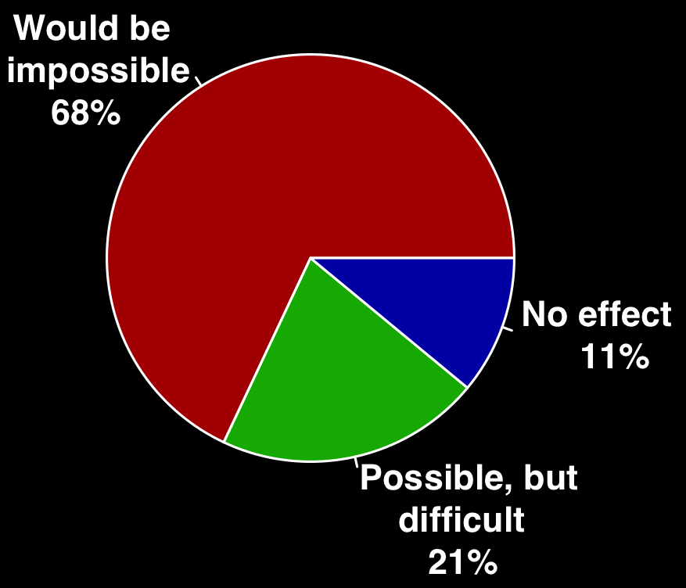
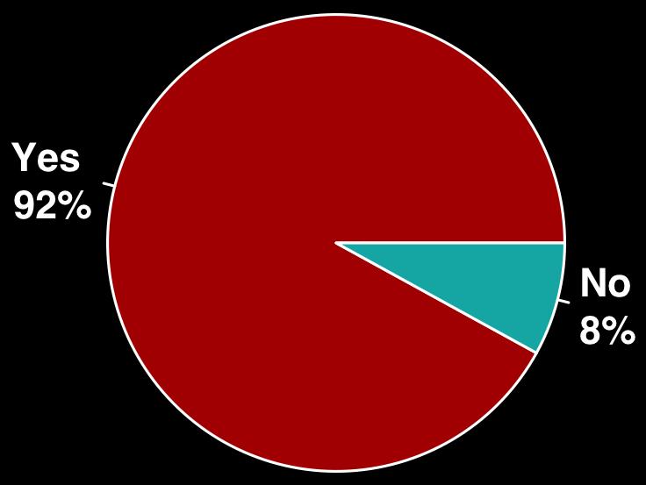
Reliance on specialist research software Slide from Neil Chue-Hong, Software Sustainability Institute
Do you use research software?
What would happen to your research without software
56%
Develop their own software
71%
Have no formal software training
Survey of researchers from 15 UK Russell Group universities conducted by SSI between August - October 2014. DOI: 10.5281/zenodo.14809
Notes:
In the last four years, we have investigated and understood the challenges of the UK research community.
Anecdotally, we had a lot of evidence for people working in this area that researchers relied on software, but there had been no studies conducted. So we did this ourselves.
Two areas of interest, do you use software and possibly more important, what would happen to your research without software – this is 170,000 researchers in the UK who could not conduct their software without software.
This is more than just a reliance on Word or web browsers – specialist software is written into the research workflows of people from psychology to physics, from the life sciences to literature. The reliance isn’t confined to the “traditionally” computationally intensive subjects, it’s a feature of all disciplines.
This means that 140,000 researchers are relying on their own coding skills.

Slide 14
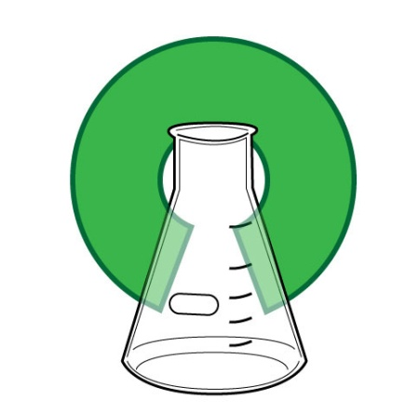
Openness at every stage
Design
Experiment
Analysis
Publication
Release
Change the typical lifecycle
Publish earlier and release more
Papers + Data + Methods + Code…
Support reproducibility
Open science image CC BY-SA 3.0 by Greg Emmerich www.flickr.com/photos/gemmerich/6365692655

Slide 15
Degrees of openness
Five star open data
⬆⬆⬆⬆⬆
Unable to share
Under embargo
Open Restricted Closed
Limits on who can use the data, how or for what purpose
Charges for use
Data sharing agreements
Restrictive licences
Peer-to-peer exchange
…
Content that can be
freely used, modified and shared by anyone
for any purpose

Slide 16
Managing RESEARCH data and making it open
Things to consider
Image CC-BY-NC-SA by Leo Reynolds www.flickr.com/photos/lwr/13442910354

Slide 17
How to make data open?
Choose your dataset(s)
What can you make open? You may need to revisit this step if you encounter problems later.
Apply an open license
Determine what IP exists. Apply a suitable licence e.g. CC-BY
Make the data available
Provide the data in a suitable format. Use repositories.
Make it discoverable
Post on the web, register in catalogues…
https://okfn.org

Slide 18
Licensing research data openly
This DCC guide outlines the pros and cons of each approach and gives practical advice on how to implement your licence
CREATIVE COMMONS LIMITATIONS
NC Non-Commercial
What counts as commercial?
ND No Derivatives
Severely restricts use
These clauses are not open licenses
Horizon 2020 Open Access guidelines point to:
or
www.dcc.ac.uk/resources/how-guides/license-research-data
Notes:
Guidance from the DCC can also help researchers to understand data licensing. This guide outlines the pros and cons of each approach e.g. the limitations of some CC options
The OA guidelines under Horizon 2020 point to CC-0 or CC-BY as a straightforward and effective way to make it possible for others to mine, exploit and reproduce the data. See p11 at: http://ec.europa.eu/research/participants/data/ref/h2020/grants_manual/hi/oa_pilot/h2020-hi-oa-pilot-guide_en.pdf
18

Slide 19
EUDAT licensing tool
Answer questions to determine which licence(s) are appropriate to use
http://ufal.github.io/lindat-license-selector

Slide 20
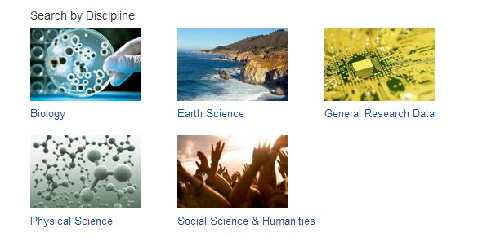
Metadata standards to use
Use relevant standards for interoperability
www.dcc.ac.uk/resources/metadata-standards
Notes:
To make sure their data can be understood by themselves, their community and others, researchers should create metadata and documentation.
Metadata is basic descriptive information to help identify and understand the structure of the data e.g. title, author...
Documentation provides the wider context. It’s useful to share the methodology / workflow, software and any information needed to understand the data e.g. explanation of abbreviations or acronyms
There are lots of standards that can be used. The DCC started a catalogue of disciplinary metadata standards which is now being taken forward as an international initiative via an RDA working group
20

Slide 21
Choosing appropriate file formats
If you want your data to be re-used and sustainable in the long-term, you typically want to opt for open, non-proprietary formats.
You may create your data in one format and covert it.
Type | Recommended | Avoid for data sharing
Tabular data | CSV, TSV, SPSS portable | Excel
Text | Plain text, HTML, RTF PDF/A only if layout matters | Word
Media | Container: MP4, Ogg Codec: Theora, Dirac, FLAC | Quicktime H264
Images | TIFF, JPEG2000, PNG | GIF, JPG
Structured data | XML, RDF | RDBMS
Further examples: www.data-archive.ac.uk/create-manage/format/formats-table

Slide 22
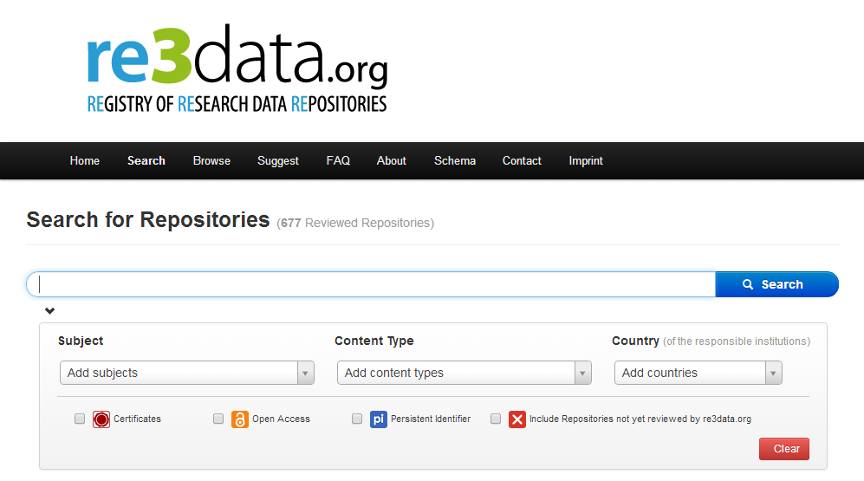
Data repositories
Does your publisher or funder suggest a repository?
Are there data centres or community databases for your discipline?
Does your university offer support for long-term preservation?
Zenodo
OpenAIRE-CERN joint effort
Multidisciplinary repository
Multiple data types
Publications
Long tail of research data
Citable data (DOI)
Links funding, publications, data & software
www.zenodo.org
http://databib.org
http://service.re3data.org/search
Notes:
22

Slide 23
Citing research data: why?
http://ands.org.au/cite-data

Slide 24
How to cite data
Key citation elements
Author
Publication date
Title
Location (= identifier)
Funder (if applicable)
www.dcc.ac.uk/resources/briefing-papers/introduction-curation/data-citation-and-linking

Slide 25
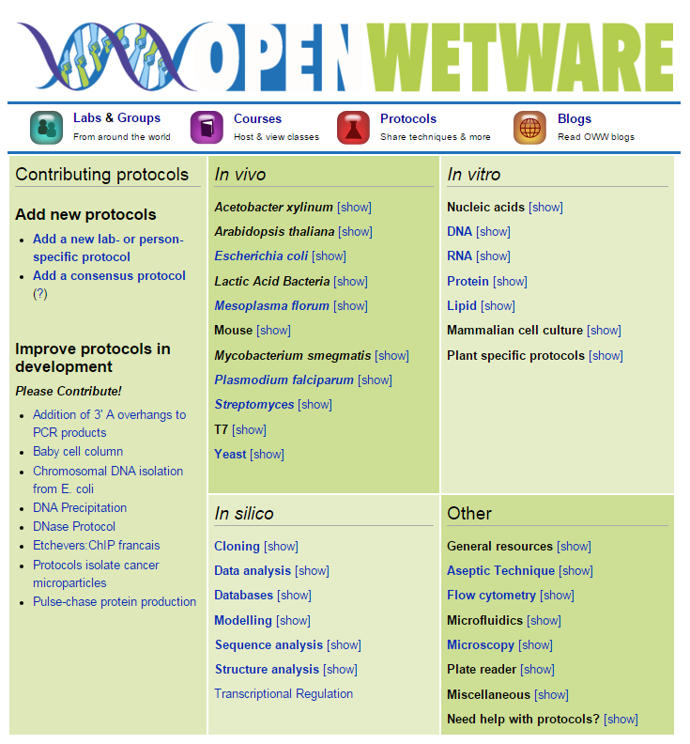
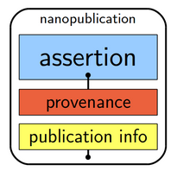
Conduct science in the open
Use open lab notebooks
Share protocols
Blog about your work
Publish assertions to get ideas out sooner (nanopublication)
http://openwetware.org

Slide 26
Collaborate & share: MyExperiment
www.myexperiment.org

Slide 27
Plan for openness from the outset
Many decisions taken early on in the project will affect whether the data can be made openly available
Think about where you want to publish and include APCs in grant applications if needed
Ensure consent agreements also include permission to archive and share data for reuse by others
Seek permissions for more than just the primary project purpose if signing licences to reuse third-party data. Derivative data may not be able to be shared if it includes somebody else’s IP
Explore the potential for openness when drafting agreements with commercial partners

Slide 28
Thanks for listening
DCC case studies and guidance documents:
www.dcc.ac.uk/resources
Follow us on twitter:
@digitalcuration and #ukdcc

