Slide 1
What does Open Science need?
Upgrade the Scholarly Infrastructure
Björn Brembs
Universität Regensburg
http://brembs.net - @brembs

Slide 2

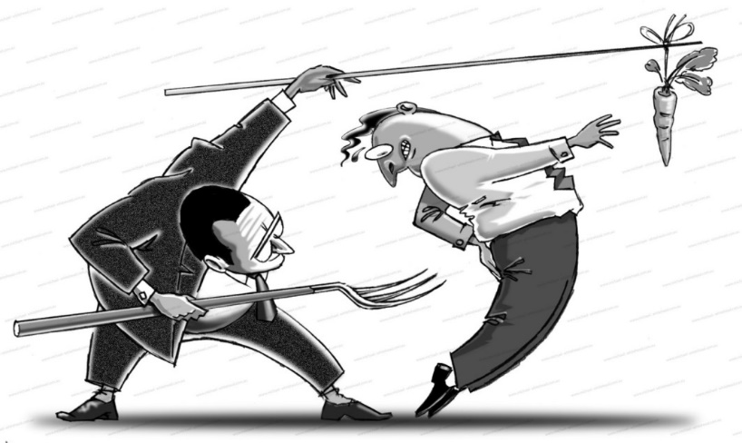
Scholarly Infrastructure
an obscenely expensive anachronism

Slide 3

Scholarship
Scientists produce publications, data and code

Slide 4
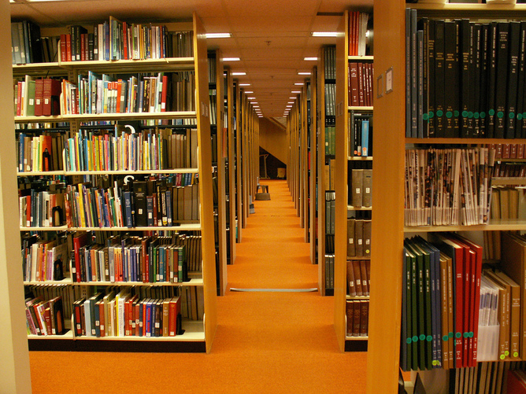
Problem I
Dysfunctional scholarly literature

Slide 5
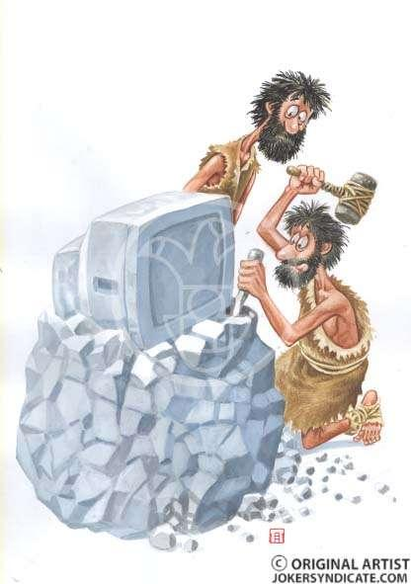
Antiquated Functionality
Limited access
Link-rot
No scientific impact analysis
Lousy peer-review
No global search
No functional hyperlinks
Useless data visualization
No submission standards
(Almost) no statistics
No content-mining
No effective way to sort, filter and discover
No semantic enrichment
No networking feature
etc.
…it’s like the web in 1995!

Slide 6
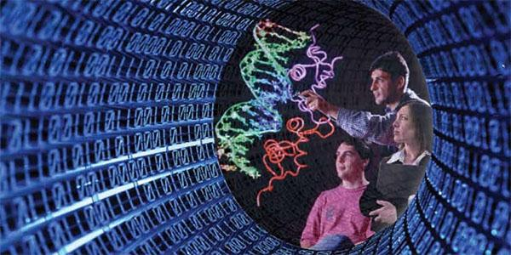
Problem II
Scientific data in peril

Slide 7
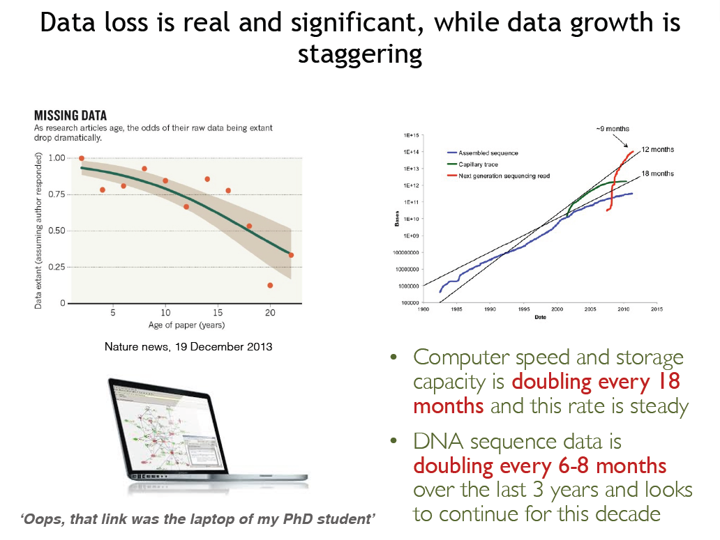

Slide 8
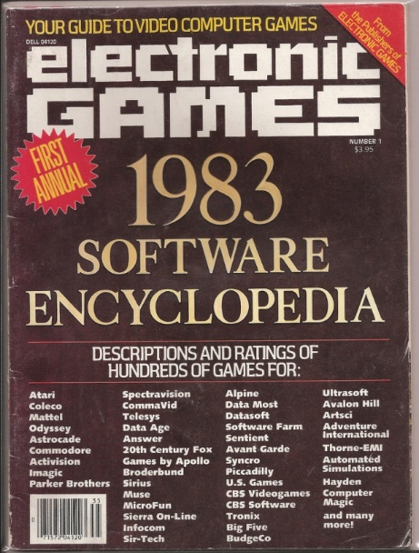
Problem III
Non-existent software archives

Slide 9
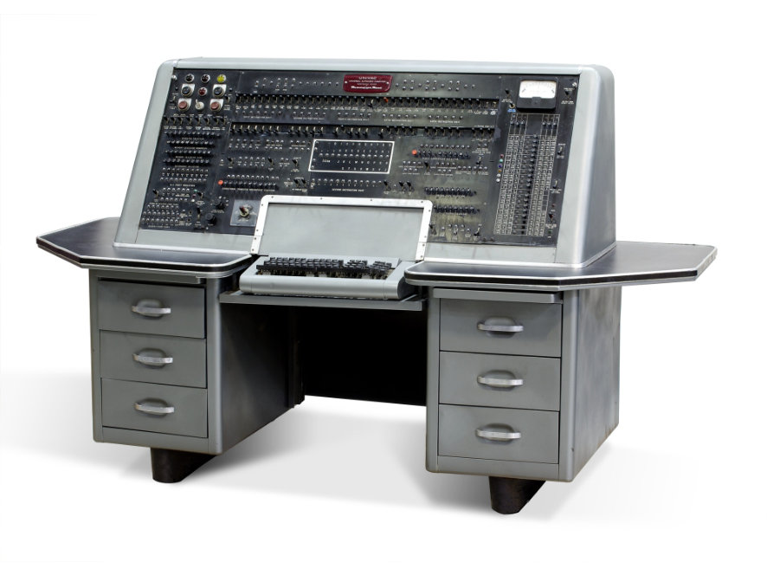
UNIVAC (A-2) 1953

Slide 10
Infrastructure
Antiquated and missing functionality

Slide 11
Publishers parasitize public funds
Costs [thousand US$/article]
Legacy OA (SciELO, Ubiquity, Scholastica, ScienceOpen, etc.)
(Sources: Van Noorden, R. (2013). Open access: The true cost of science publishing. Nature 495, 426–9; Packer, A. L. (2010). The SciELO Open Access: A Gold Way from the South. Can. J. High. Educ. 39, 111–126)

Slide 12
Money for Nothing
Wasting billions on a parasitic industry

Slide 14
Methodology
Quality
Journal Rank
Berghmans et al. (2002): doi: 10.1093/annonc/mdg203, Tressoldi et al. (2013) doi:10.1371/journal.pone.0056180, Brembs et al. (2013) doi:10.3389/fnhum.2013.00291, Fraley & Vazire (2014) doi:10.1371/journal.pone.0109019, Macleod et al. (2015) doi:10.1371/journal.pbio.1002273

Slide 15
Misconduct
Fraud
Journal Rank
Fang et al. (2012): Misconduct accounts for the majority of retracted scientific publications. doi: 10.1073/pnas.1212247109

Slide 16

Incentives
“High-Impact” journals attract the most unreliable research

Slide 17
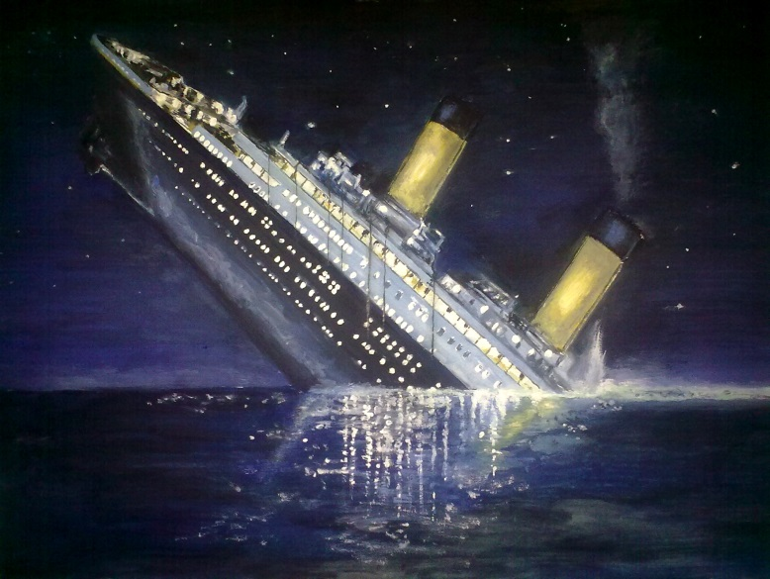
So much for that
The disaster that is our information infrastructure

Slide 18



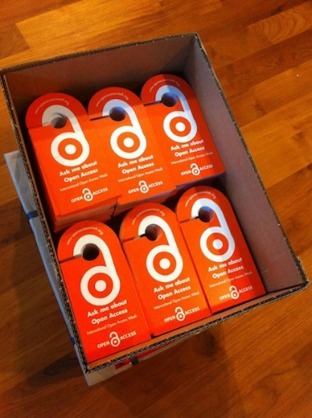
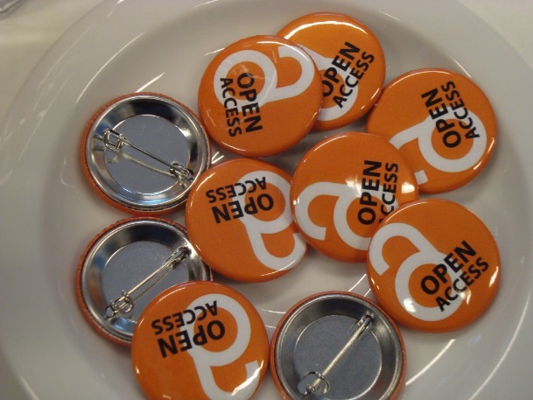


Open Access Activism
“Thou shalt be open!”

Slide 19
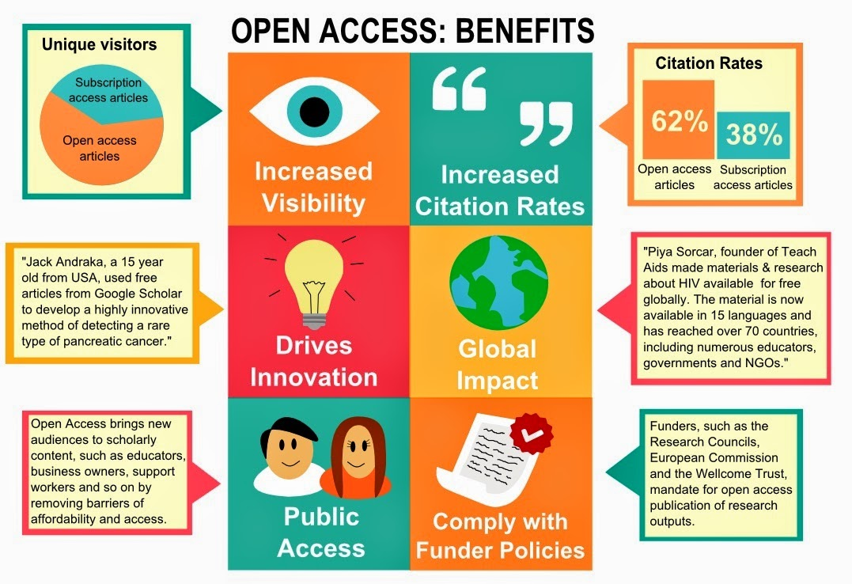

Slide 20
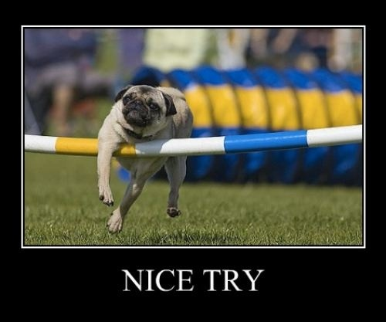

Slide 21
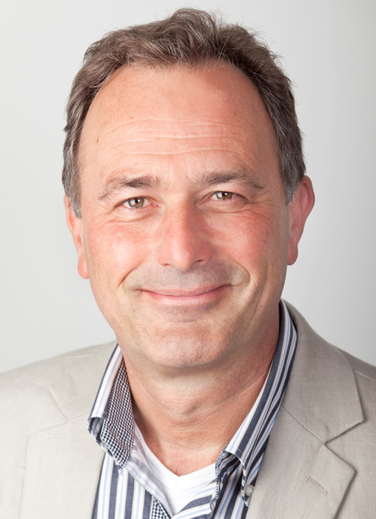
Barend Mons
The problem is social

Slide 22
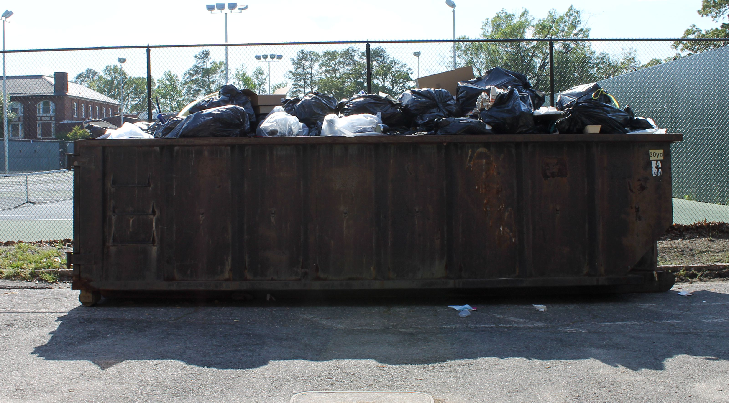

Slide 23
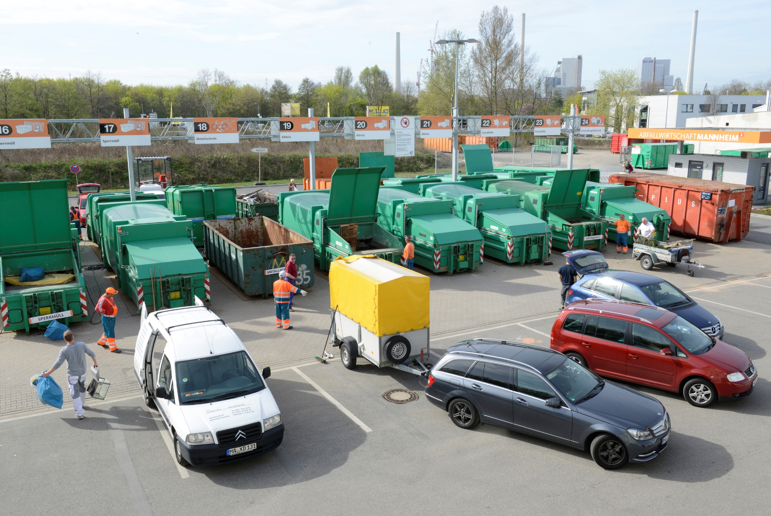

Slide 24
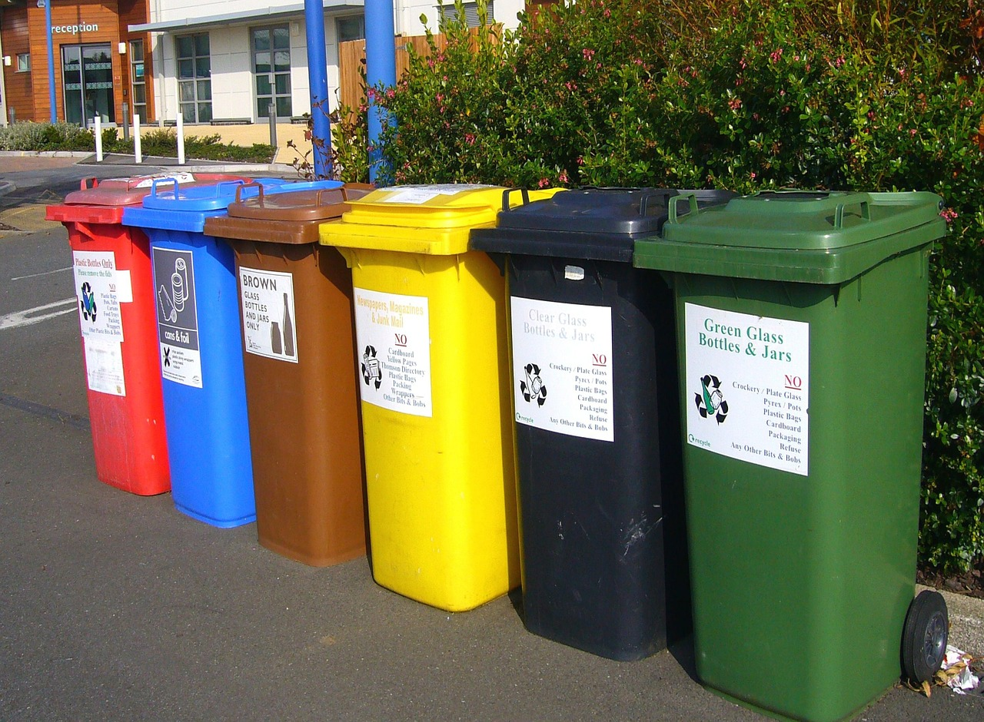

Slide 25
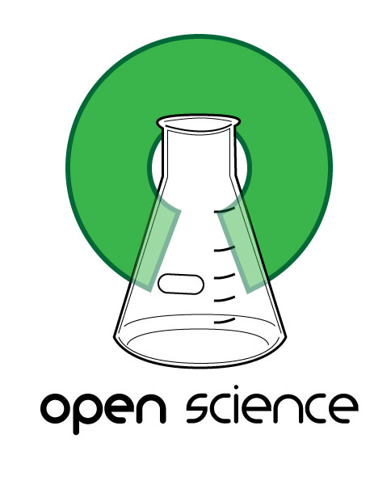
Open Science
Effortless, low-risk and by default:
FAIR

Slide 26
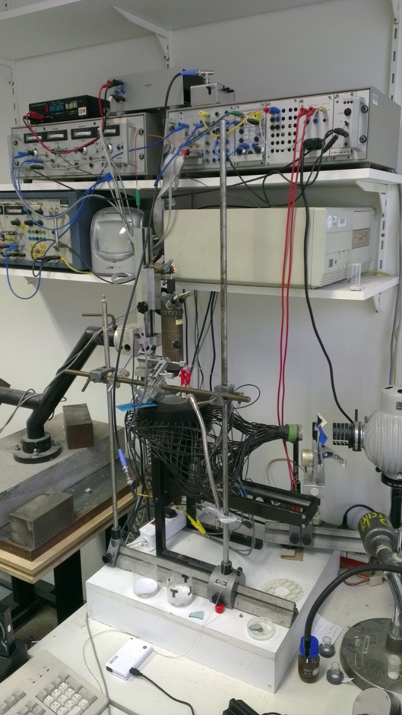
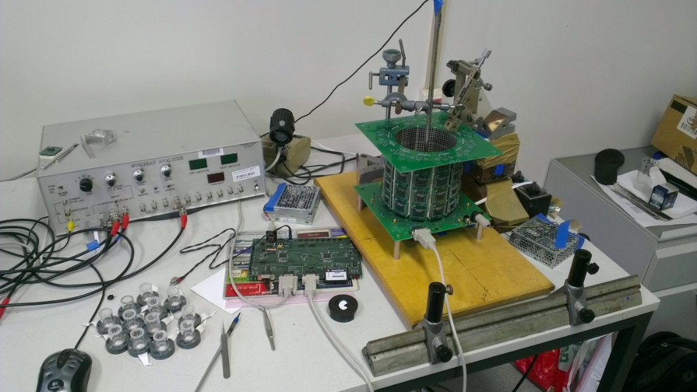
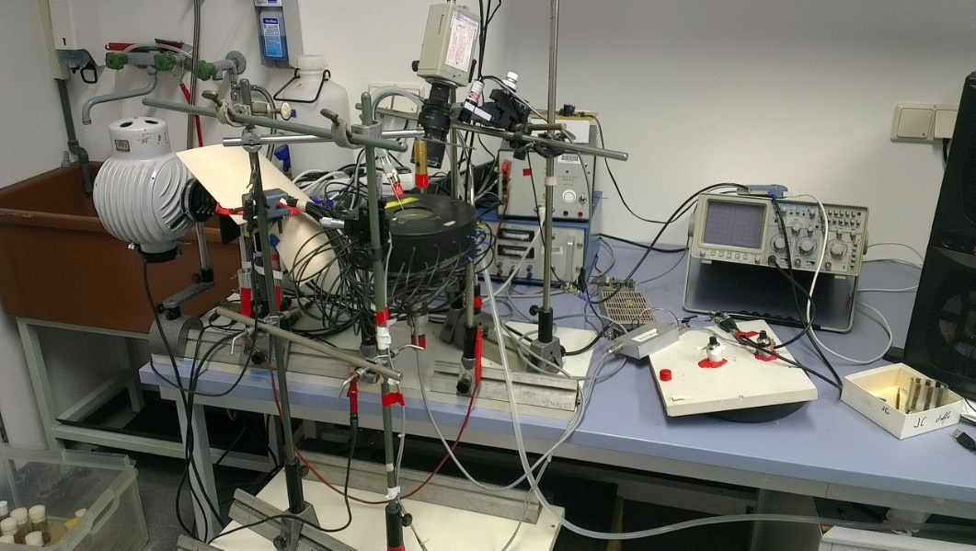

Slide 27
Software to control the experiment and save the data

Slide 28
Software to analyze and visualize the data

Slide 29
GitHub

Slide 30
Scientific Code with Persistent Identifiers

Slide 31
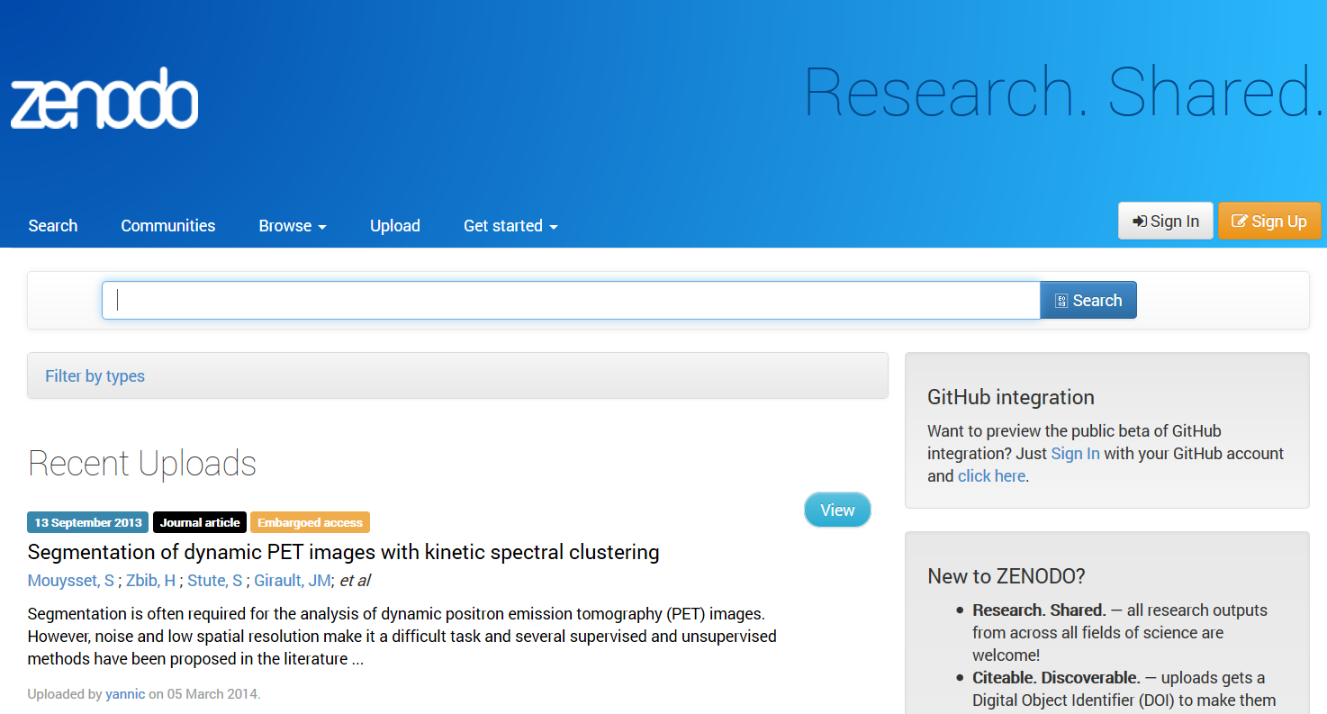

Slide 32
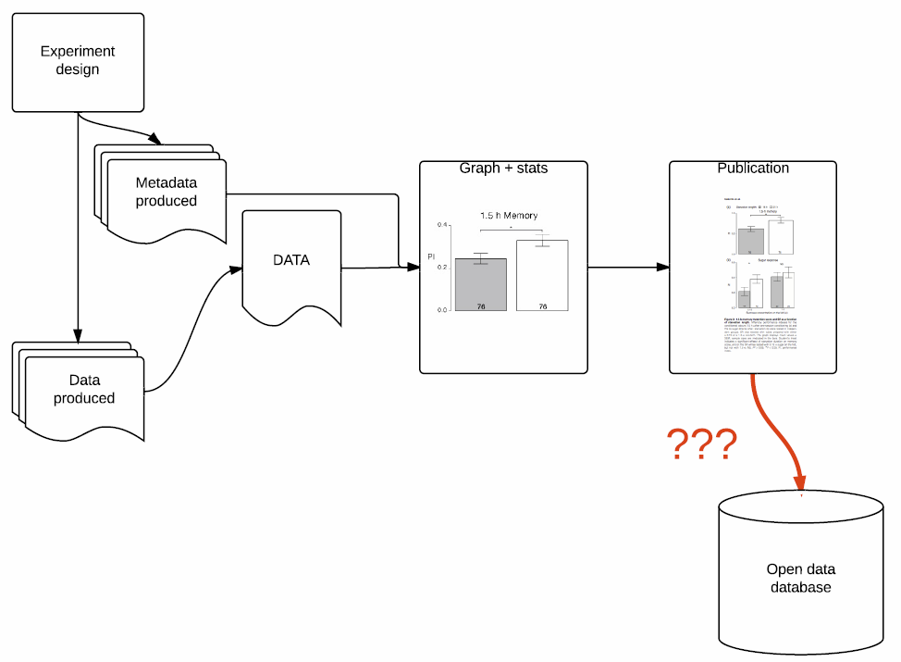

Slide 33
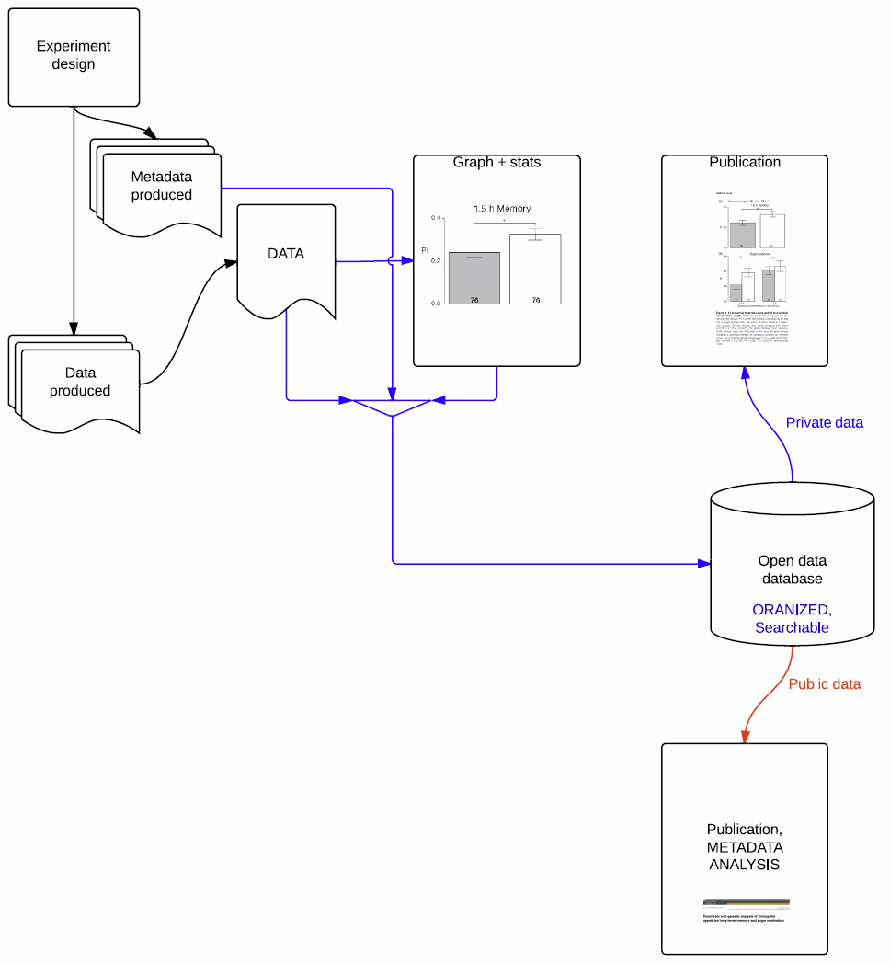

Slide 34


Slide 36


Slide 37
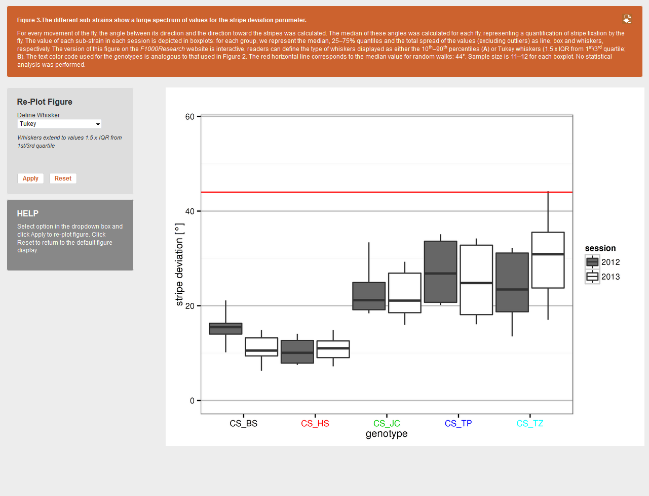

Slide 38
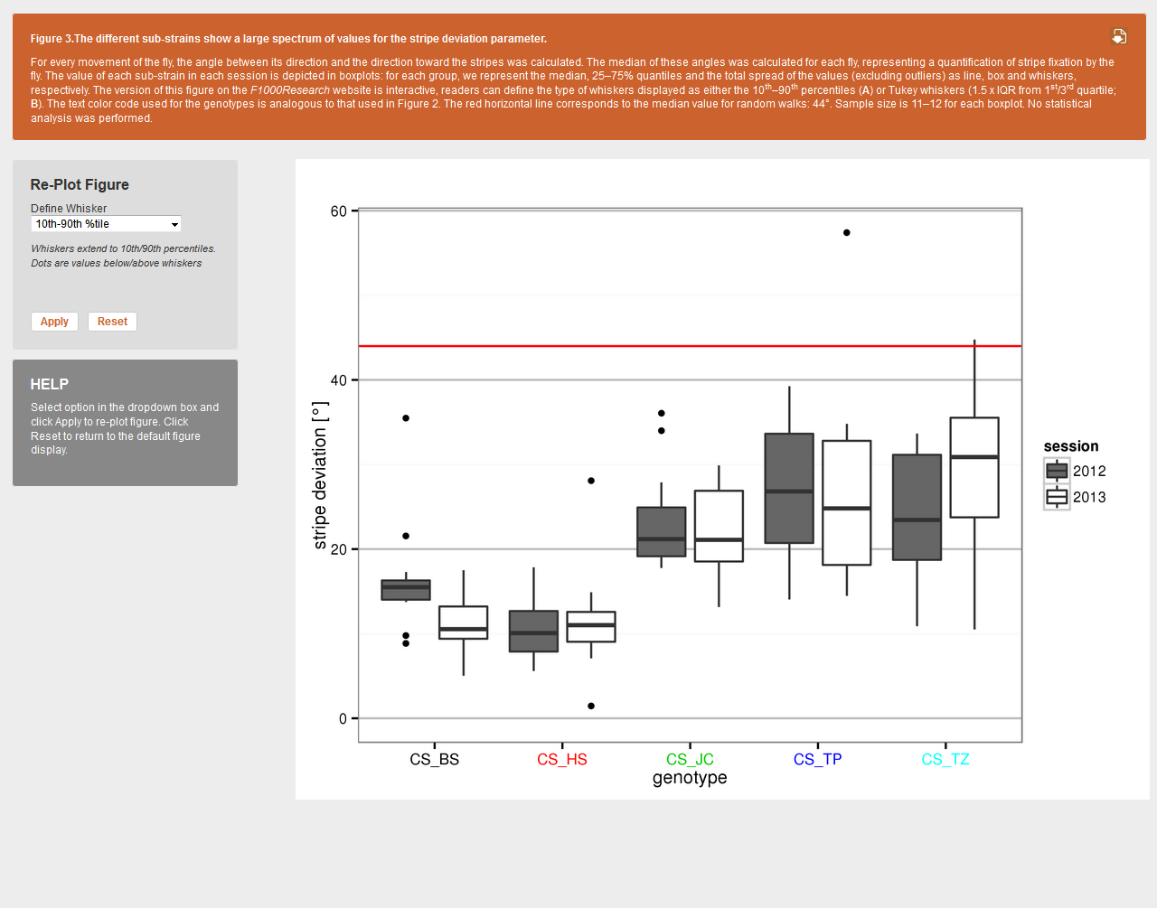

Slide 39
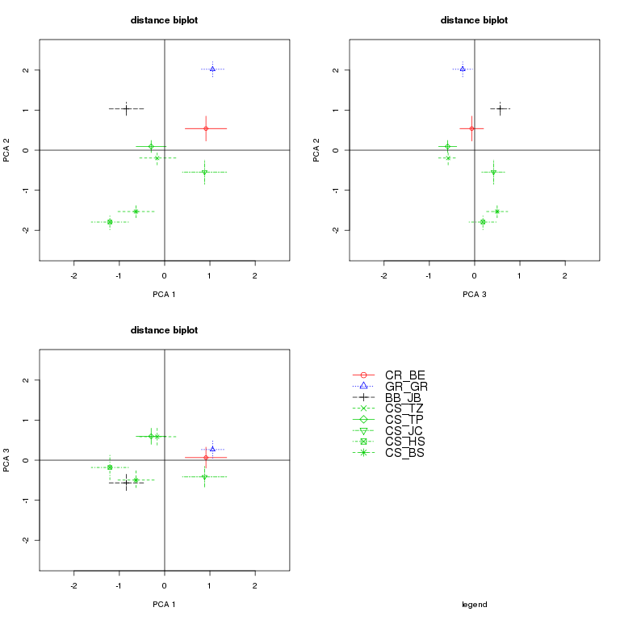

Slide 40
The Goal: Research Objects
Modified from: http://researchobject.org

Slide 41
575+ such solutions and counting…

Slide 42
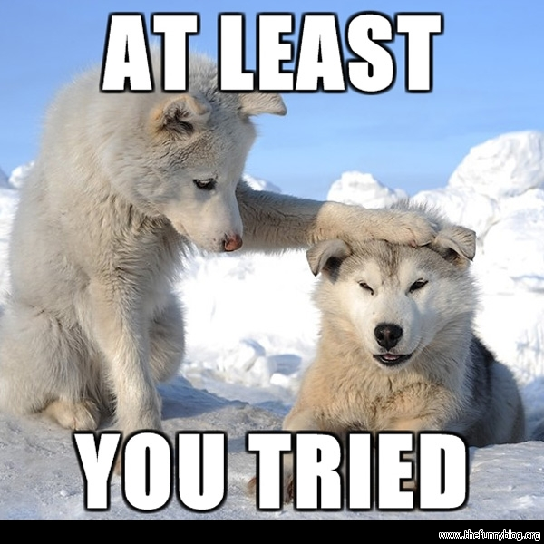

Slide 44
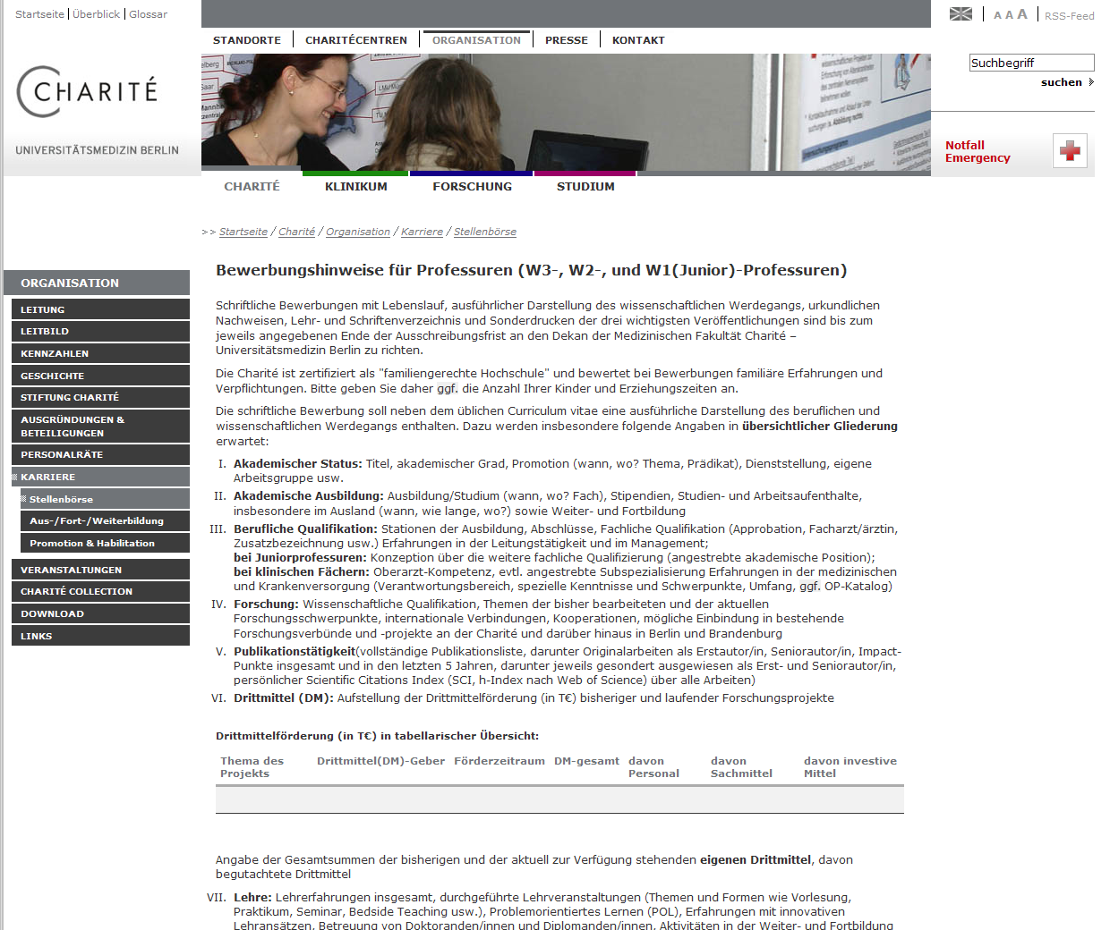
What can institutions do?

Slide 45
The Department of Psychology embraces the values of open science and strives for replicable and reproducible research. For this goal we support transparent research with open data, open material, and pre-registrations. Candidates are asked to describe in what way they already pursued and plan to pursue these goals.
versus
Complete list of publications, including original research papers as first author, senior author, impact points total and in the last 5 years, with marked first and last-authorships, personal Scientific Citations Index (SCI, h-Index according to Web of Science) for all publications.

Slide 47
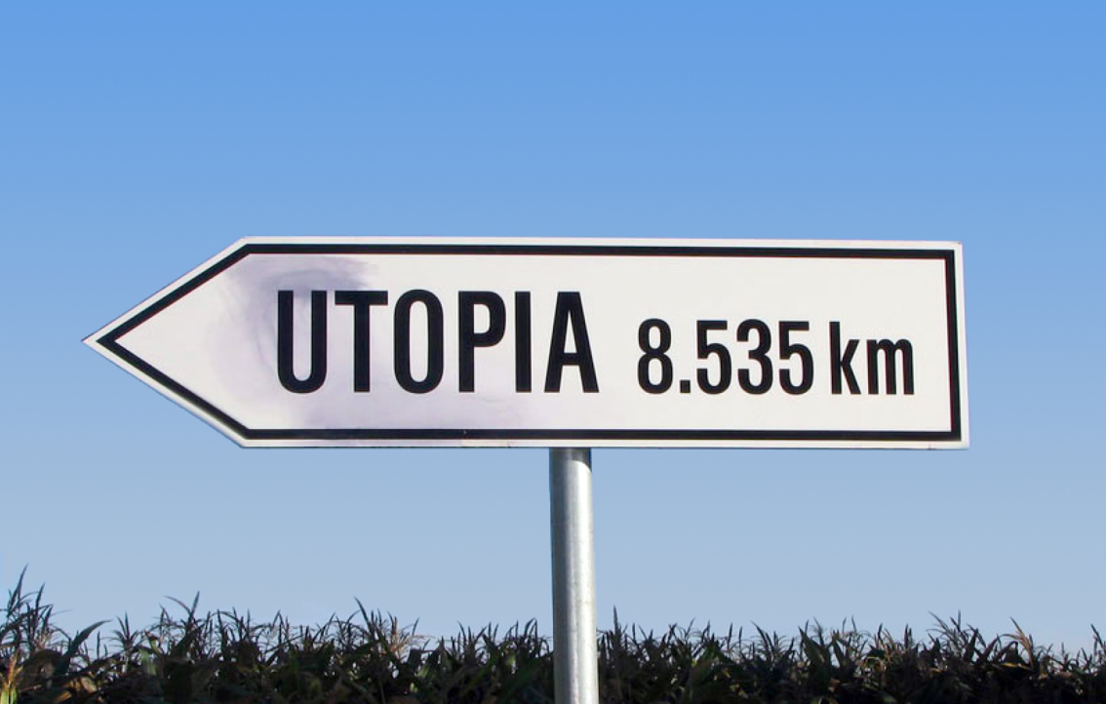

Slide 48
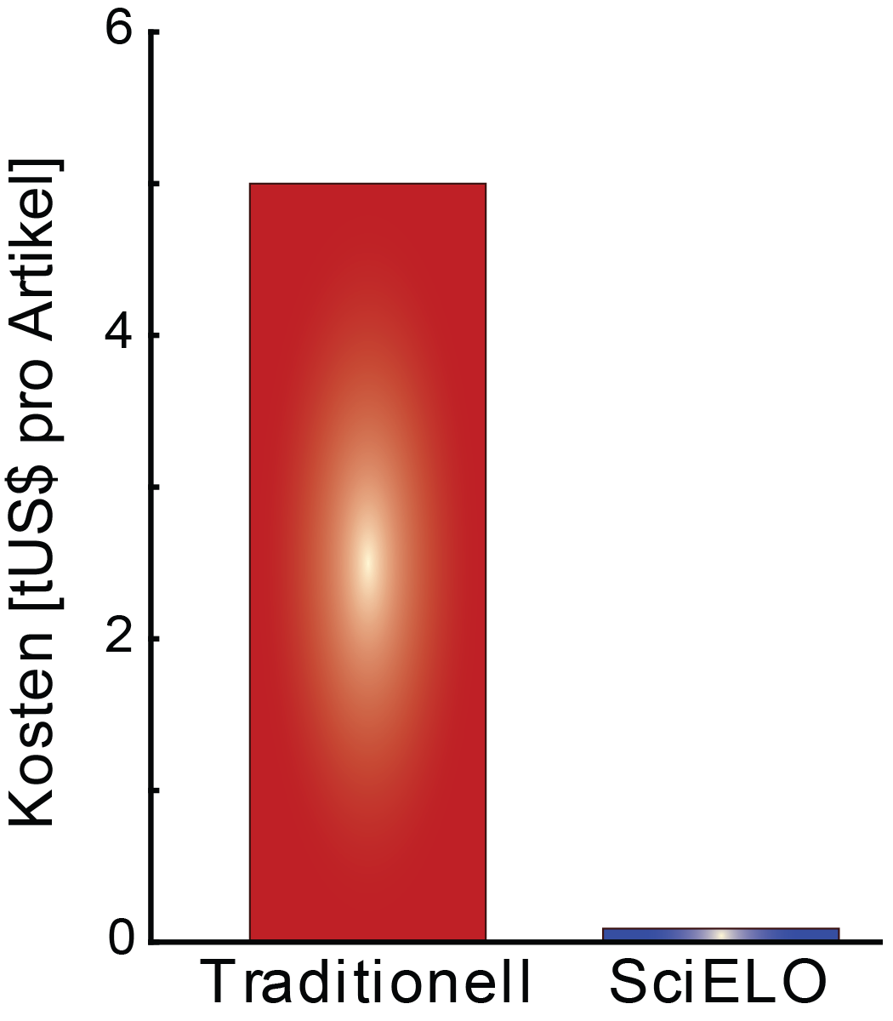
Potential for Innovation
Costs [thousand US$/article]
Potential for innovation: 9.8b p.a.
Legacy SciELO
(Sources: Van Noorden, R. (2013). Open access: The true cost of science publishing. doi:10.1038/495426a, Packer, A. L. (2010). The SciELO Open Access: A Gold Way from the South. Can. J. High. Educ. 39, 111–126)

Slide 49
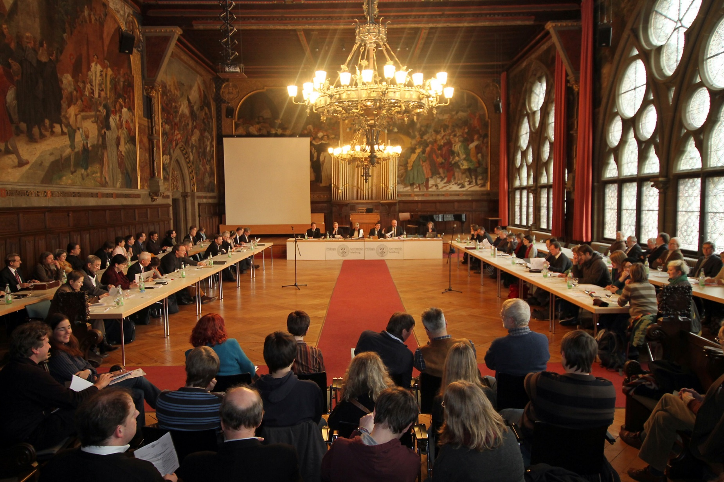
1. International Collaboration

Slide 50
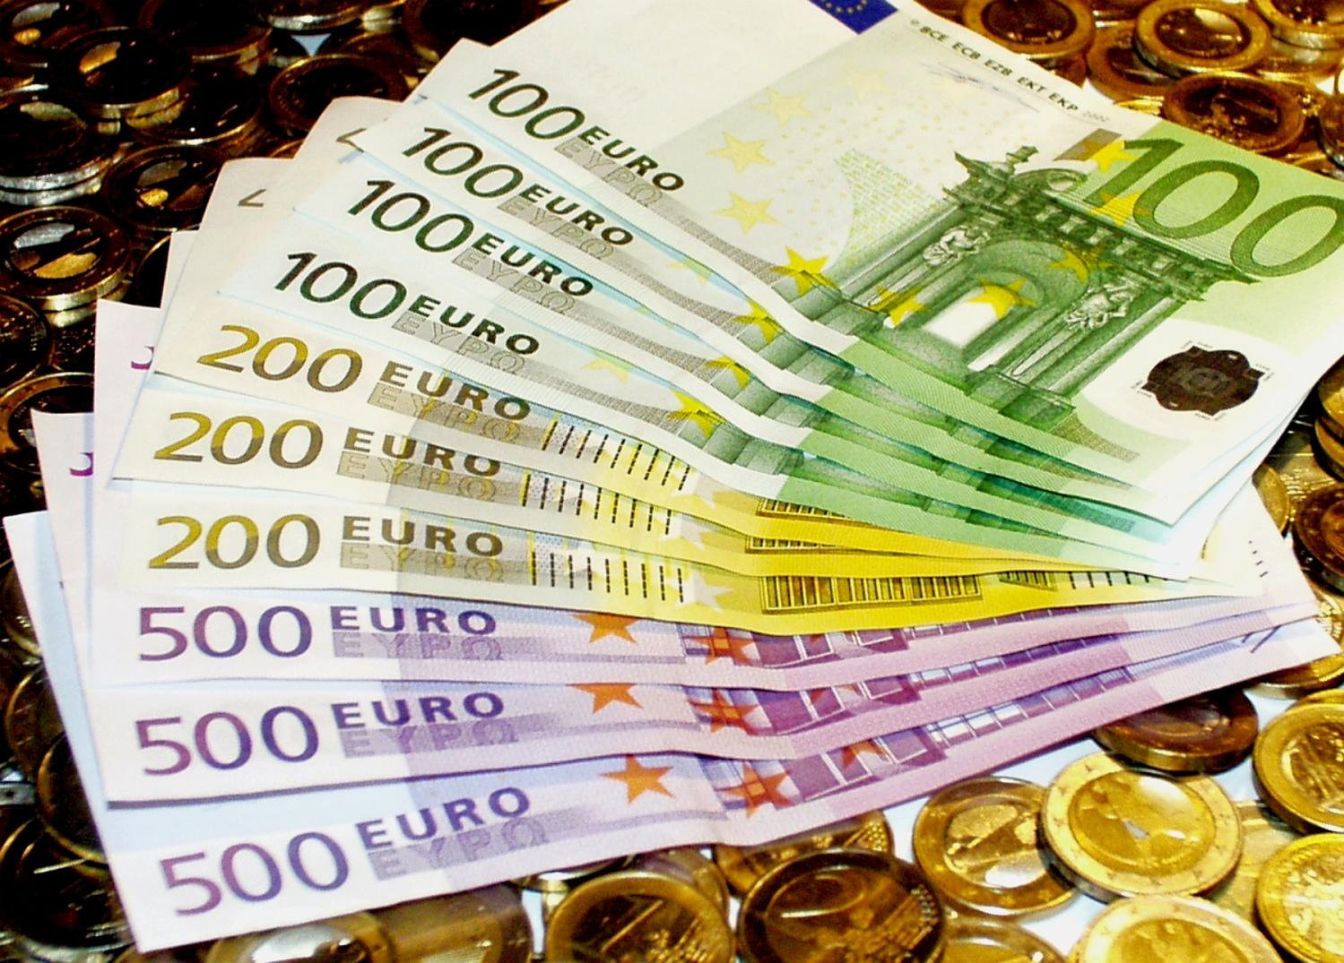
2. Cancel all subscriptions

Slide 51

3. Implement current technology

Slide 52
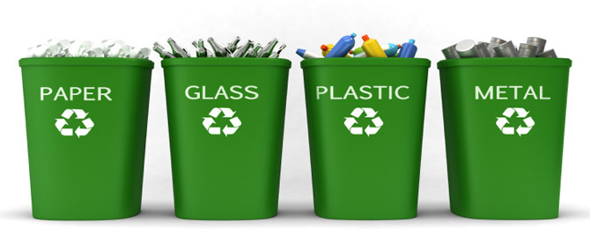
What now?
Save time and money by making science open by default as an added benefit

Slide 53
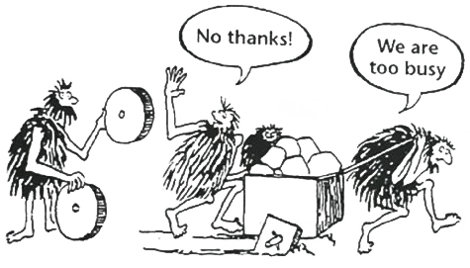
The square traversal process has been the foundation of scholarly communication for nearly 400 years!

