Slide 1

Where next?
Practical steps for you to move forward with DMPs
Sarah Jones
Digital Curation Centre, Glasgow
sarah.jones@glasgow.ac.uk
Twitter: @sjDCC
Open Research Data Management: policies and tools, Milan, 24-25 May 2017

Slide 2

#1 – provide guidance and support
Image CC-BY by GotCredit www.flickr.com/photos/jakerust/16844834832

Slide 3
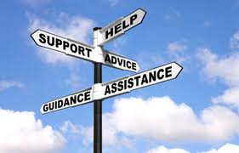
Basic guidance and support
Many UK university data policies include a requirement for DMPs so need to explain what to cover in plans:
Templates listing themes/questions to cover
Custom guidance by uni or discipline
Example answers or boilerplate text
Links to local contacts and support
A library of successful DMPs to reuse

Slide 4
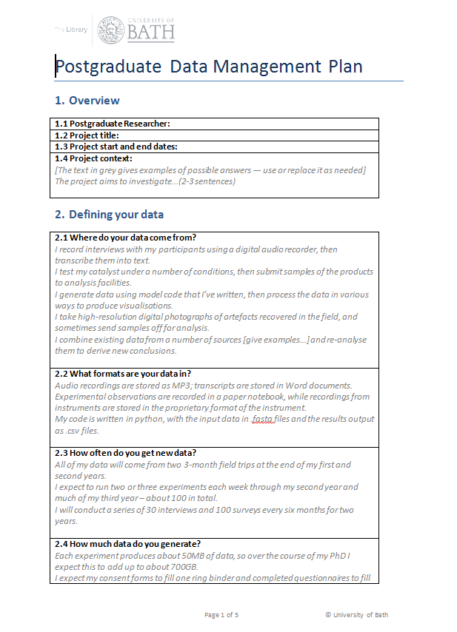
Example DMP templates
DCC Checklist (generic template) www.dcc.ac.uk/sites/default/files/documents/resource/DMP/DMP_Checklist_2013.pdf
Bath postgraduate template http://opus.bath.ac.uk/30772
DataTrain template www.lib.cam.ac.uk/preservation/ datatrain/documents.html
20 questions for RDM https://datamanagementplanning.wordpress.com/2012/03/07/twenty-questions-for-research-data-management
MRC template www.mrc.ac.uk/research/research-policy-ethics/data-sharing/data-management-plans

Slide 5
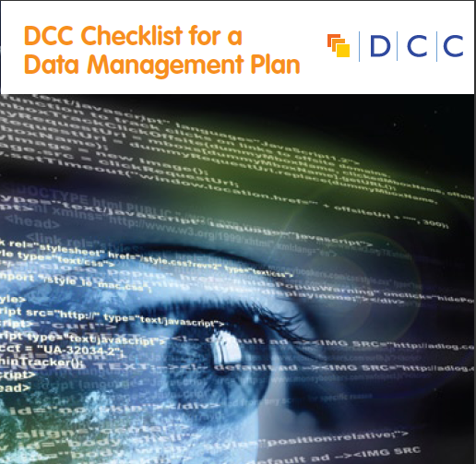
DCC generic template for a DMP
Data Collection
What data will you collect or create?
How will the data be collected or created?
Documentation and Metadata
What documentation and metadata will accompany the data?
Ethics and Legal Compliance
How will you manage any ethical issues?
How will you manage copyright and Intellectual Property Rights (IPR) issues?
Storage and Backup
How will the data be stored and backed up during the research?
How will you manage access and security?
Selection and Preservation
Which data should be retained, shared, and/or preserved?
What is the long-term preservation plan for the dataset?
Data Sharing
How will you share the data?
Are any restrictions on data sharing required?
Responsibilities and Resources
Who will be responsible for data management?
What resources will you require to deliver your plan?

Slide 6
Different templates and phases
University of East London has two templates
Postgraduate DMP
Standard DMP
Shorter – six sections
Less formal wording e.g. ‘looking after your data’
Straightforward guidance
2 phases – lite and full DMP
6-8 sections overall
Questions more formal / factual
Guidance longer and more directive

Slide 7
Focus on examples and guidance
Guidance at different levels
  Institutional guidance
  Departmental / group guidelines
  Disciplinary norms and best practices
Provide examples and suggested answers
  Boilerplate text to reuse
  Worked examples to show how to respond
  Dropdown options to select from

Slide 8
Example plans
108 DMPs from the National Endowment for the Humanities (USA)
www.neh.gov/divisions/odh/grant-news/data-management-plans-successful-grant-applications-2011-2014-now-available
20+ scientific DMPs submitted to the NSF (USA) provided by UCSD
http://libraries.ucsd.edu/services/data-curation/data-management/dmp-samples.html
DMPs published in RIOjournal - http://riojournal.com
Examples by funder / discipline:
  www.dcc.ac.uk/resources/data-management-plans/guidance-examples

Slide 9
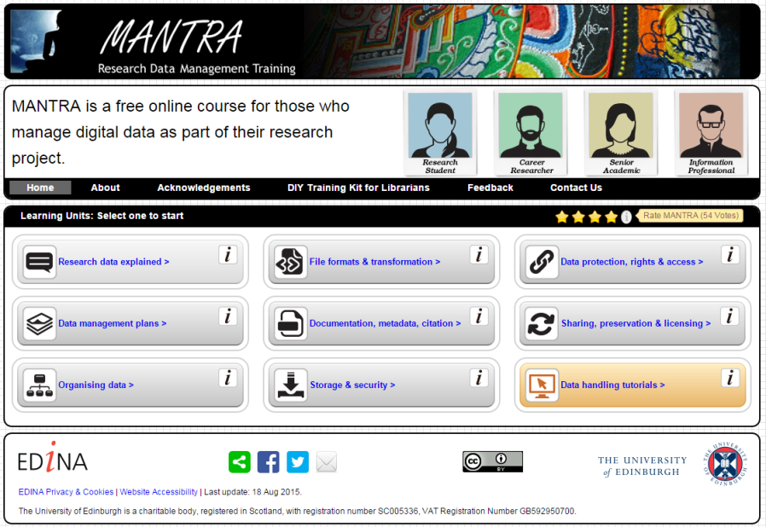

More in-depth support
Training courses
Tailored guides
Reviewing plans
Consultancy services

Slide 10
A range of DMP support services
For example, Stanford University offers:
Information on funding agency requirements
Guidance and best practice on writing a plan
An online tool (DMPTool)
Sample agency-specific plans
An FAQ and workshops
A DMP review service
http://library.stanford.edu/research/data-management-services/data-management-plans

Slide 11
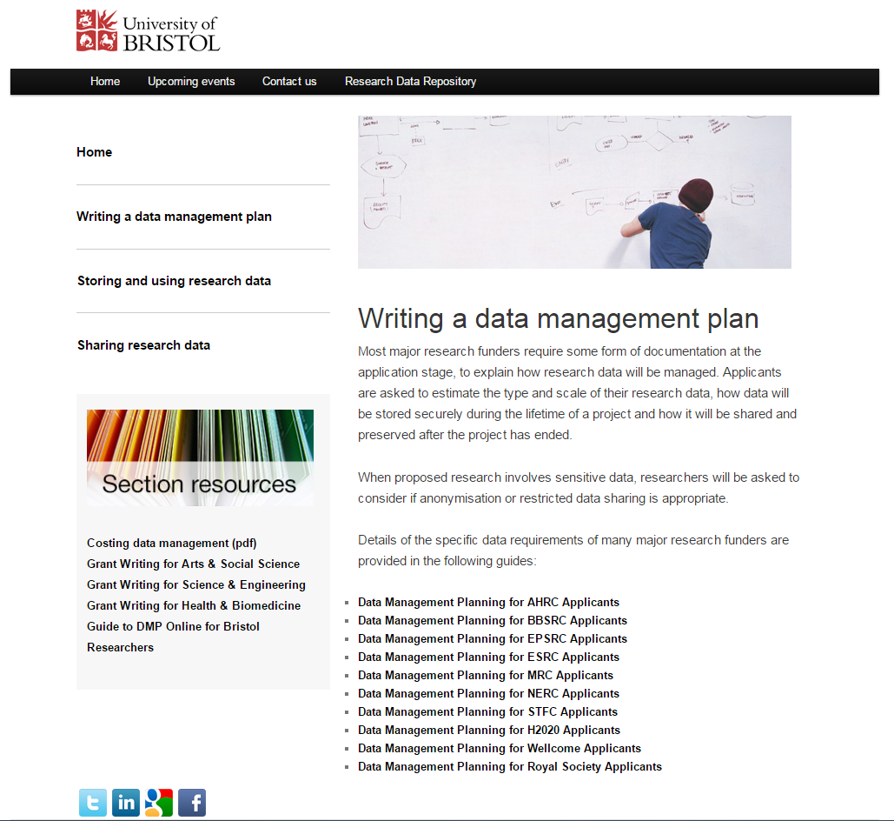
University of Bristol DMP services
https://data.bris.ac.uk/planningdata

Slide 12
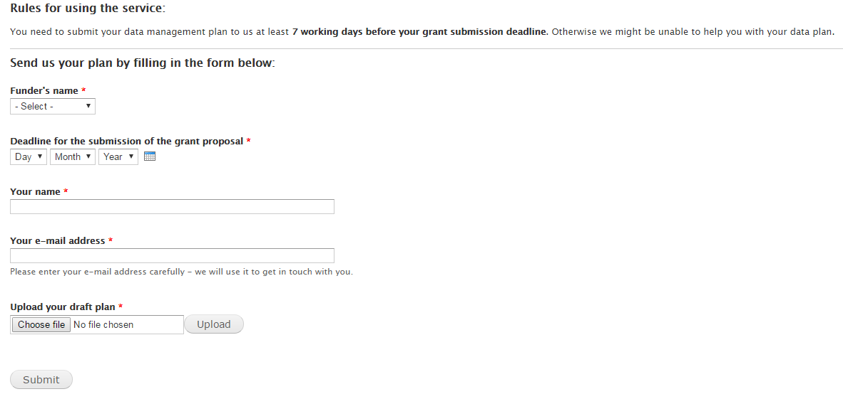

DMP review consultations
www.data.cam.ac.uk/DMPsupport

Slide 13

Cribsheets for reviewing DMPs
DART project in USA developed an analytic rubric to standardize the review of data management plans
UK rubrics project apply same principals to our funders. Community-led collaboration that checks compliance and has also achieved input from funders
https://research-data-network.readme.io/docs/compliance-tools

Slide 14

#2 – customise DMPonline
Image CC-BY-SA by Lauren www.flickr.com/photos/cuttlefish/4543879132

Slide 15
Organisations can do a range of things
Create your own template(s)
Provide tailored guidance
Customise funder templates
Add logos and details in a banner
Review basic usage statistics

Slide 16
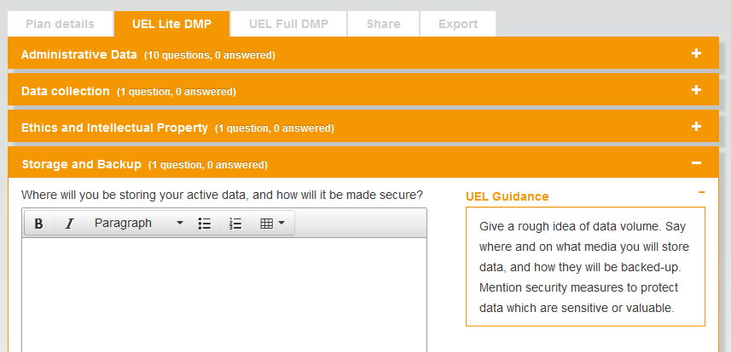
Organisations can add DMP template(s)

Slide 17
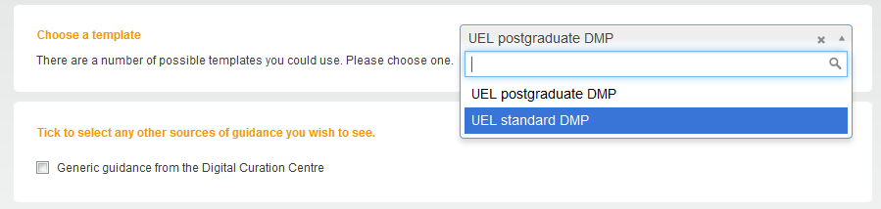
You can have more than one template
You may want to provide different templates for different audiences e.g. PhD students and research staff

Slide 18
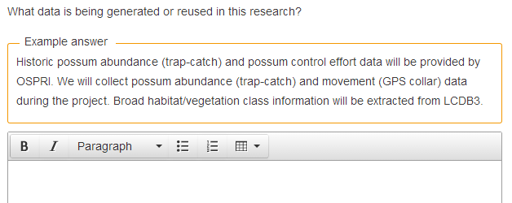
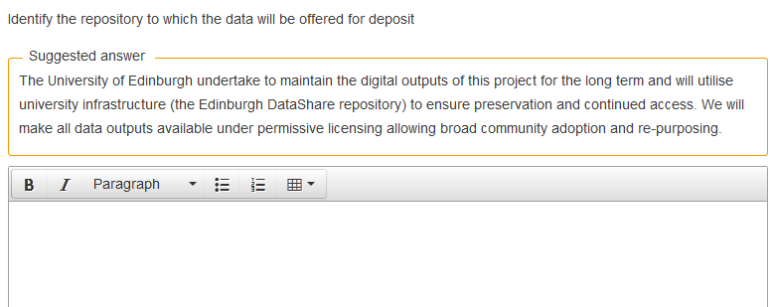
Provide examples and suggested answers

Slide 19
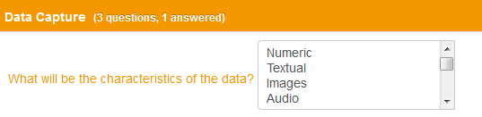
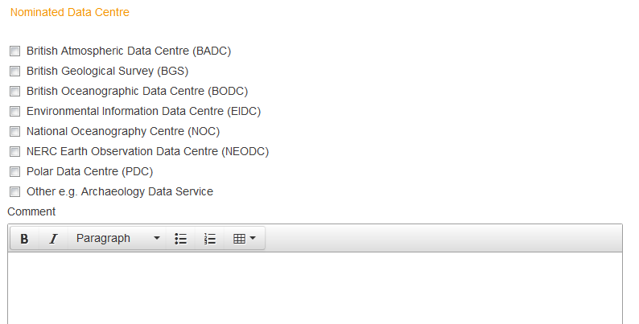
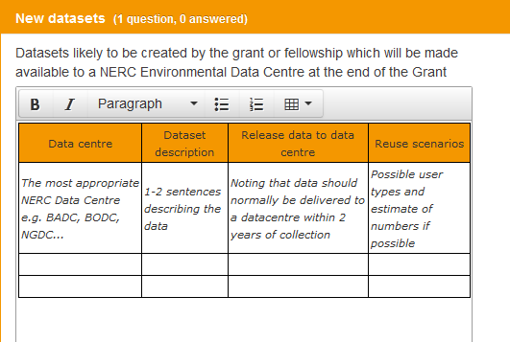
Dropdown options and default styles

Slide 20
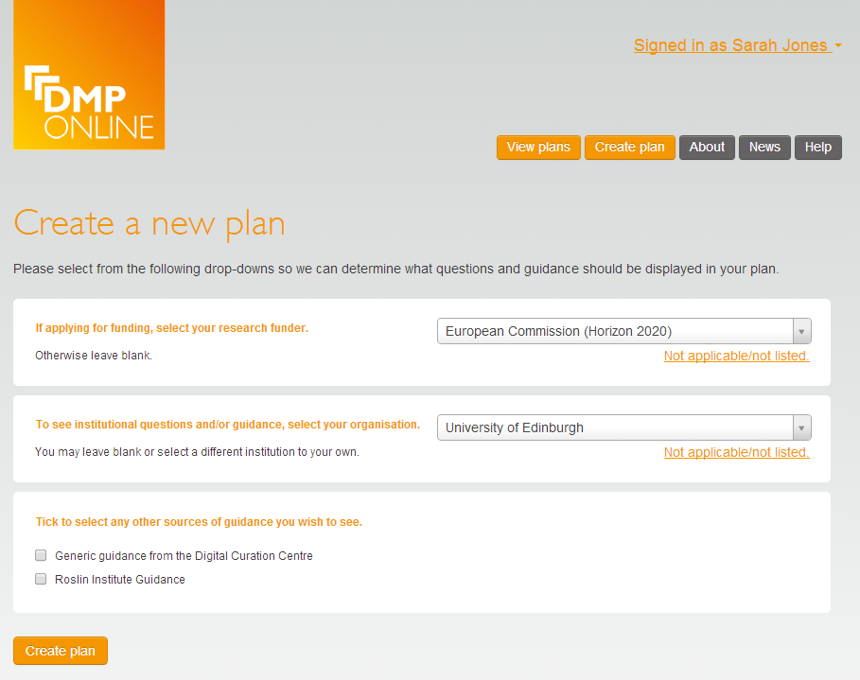
Guidance can be set at multiple levels
Options to have guidance at organisation and ‘unit’ level e.g. by discipline, group, department, institute…

Slide 21
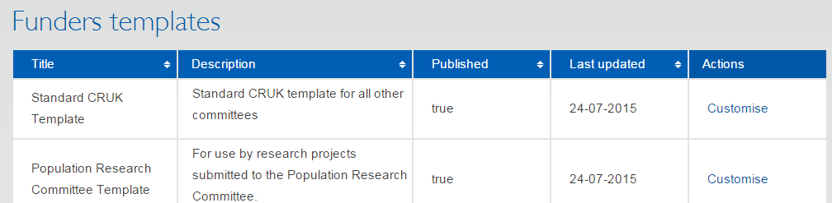
Customising funder templates
Add things you need to know that funders don’t ask e.g.
  What volume of data will you create? Does it exceed X GB?
  Are there any training requirements?
  Would you like help with your DMP & details of support services?
We plan to build in flags so you can trigger alerts

Slide 22

Institutional banner
Add your institutional logo
Provide some high-level text
Link to key resources e.g. RDM policy and webpages

Slide 23
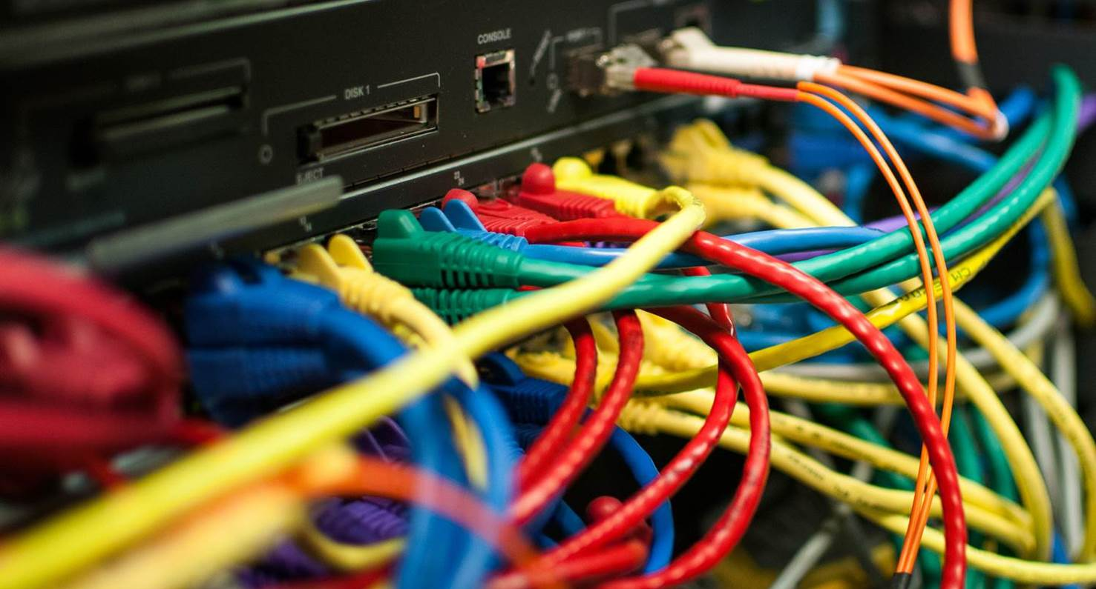
#3 – use existing infrastructure
Image CC-BY-NC ‘Data centre’ by Bob Mical www.flickr.com/photos/small_realm/15995555571

Slide 24

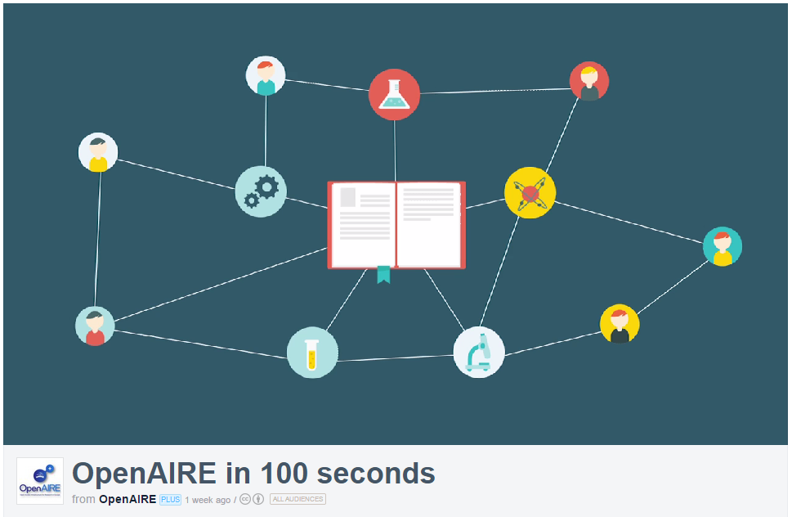
OpenAIRE
Open Access Infrastructure for research in Europe
aggregates data on OA outputs
mines & enriches it content by linking thing together
provides services & APIs e.g.
to generate publication lists
or support EC reporting
lots of guidelines on H2020
Open Data pilot and DMPs
  www.openaire.eu
http://vimeo.com/108790101

Slide 25

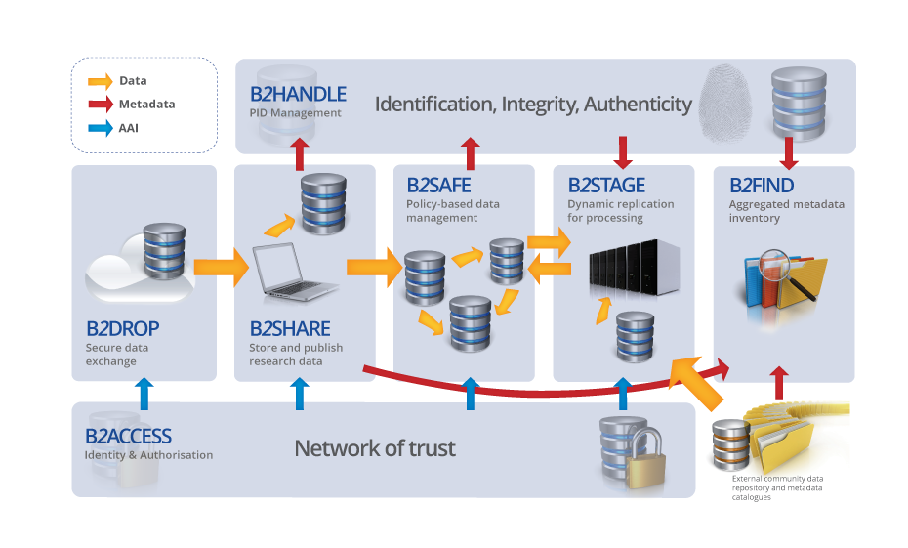
EUDAT services
EUDAT offers a pan-European solution, providing a generic set of services to ensure minimum level of interoperability
Building common data services in close collaboration with 25+ communities
www.eudat.eu

Slide 26





Discipline-specific infrastructure
ELIXIR in life sciences
BBMRI-ERIC (biobank and biomedical resources)
Euro Argo ERIC (oceanography)
CLARIN for language resources
DARIAH-EU for arts and humanities

Slide 27

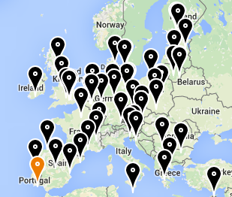
FOSTER and FOSTER+
Facilitate Open Science Training for European Research
Network of open access trainers
Programme of open science courses
Portal to training materials
E-learning courses
Focus on disciplinary materials in FOSTER+
www.fosteropenscience.eu

Slide 28
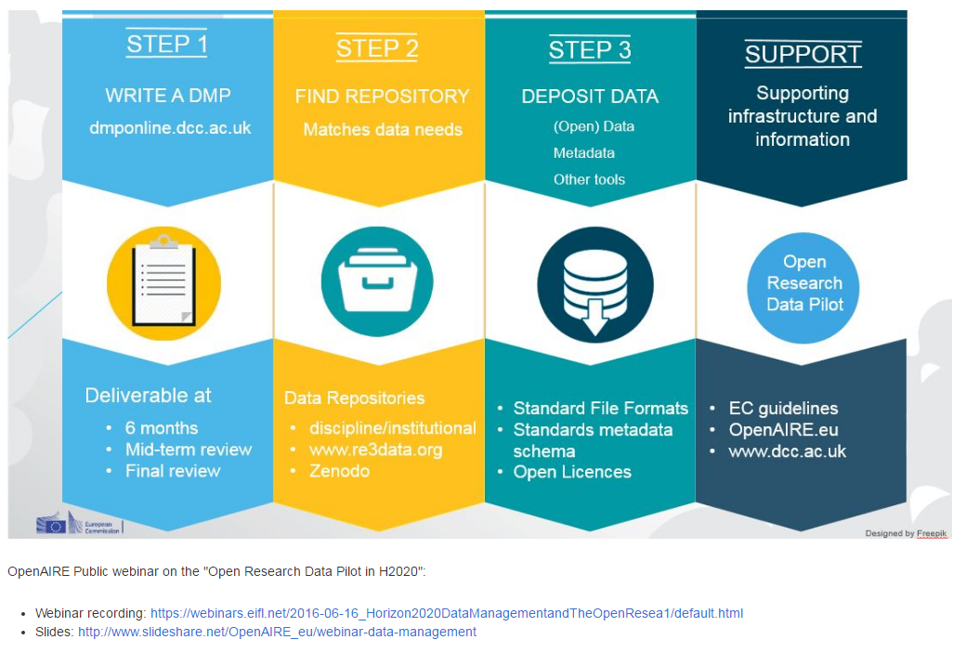
OpenAIRE & EUDAT webinars
www.openaire.eu/webinars

Slide 29
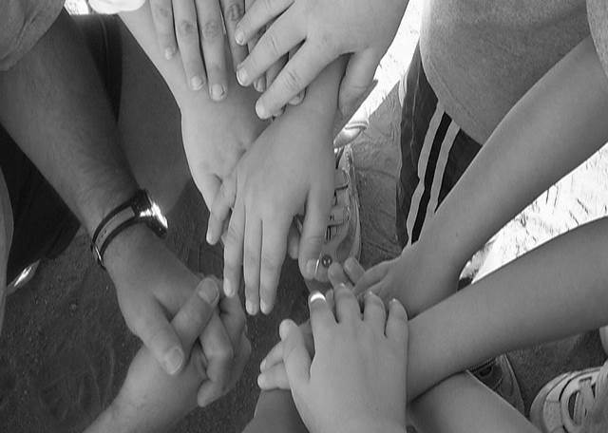
#4 – coordinate nationally
Image CC-BY-SA by Dawn Manser www.flickr.com/photos/dawnmanser/3532598208

Slide 30

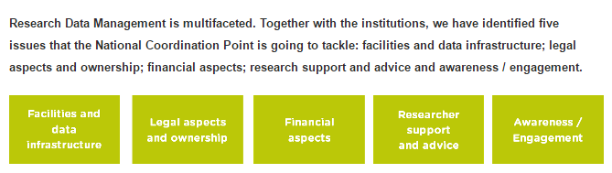
Dutch LCRDM model
National coordination point for RDM
Five working groups on key RDM topics
Brings together all stakeholders
https://www.surf.nl/en/lcrdm/issues

Slide 31
Other examples
Tuuli in Finland - https://wiki.helsinki.fi/display/Tuuli/DMPTuuli-project
Swiss DLCM project - https://www.dlcm.ch
German working group -http://www.forschungsdaten.org/index.php/UAG_Datenmanagementpläne
eInfrastructures Austria - https://www.e-infrastructures.at
…

Slide 32
Benefits of coordination
Define national level requirements
Work together to lobby funders
Collectively define / invest in infrastructure
Join up on guidance and support
Simplify landscape for researchers!

Slide 33
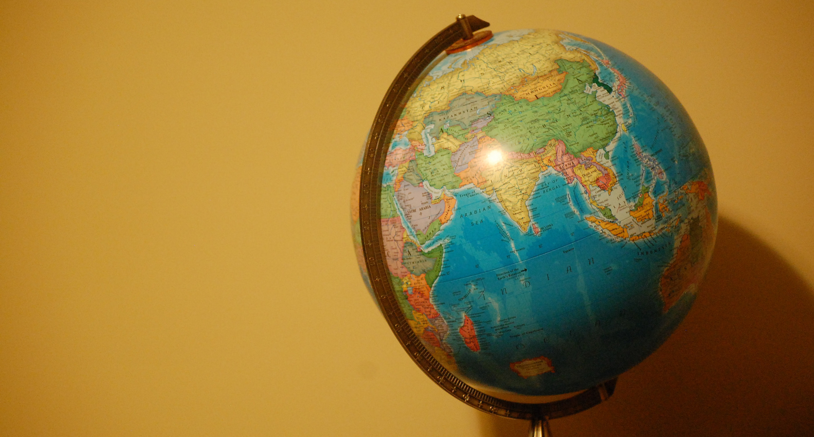
#5 – get involved internationally
Image CC-BY by Wendy Cope www.flickr.com/photos/litratcher/16420127780

Slide 34
RDA Active DMP Interest Group
Discussion group on all things DMP
Recently spun out various working groups
  Defining common standards for DMPs
  Publishing / depositing DMPs
  Domain/infrastructure specialisation
  Funder liaison
  Software management plans
  https://www.rd-alliance.org/group/active-data-management-plans-ig/wiki/plenary-9-session

Slide 35
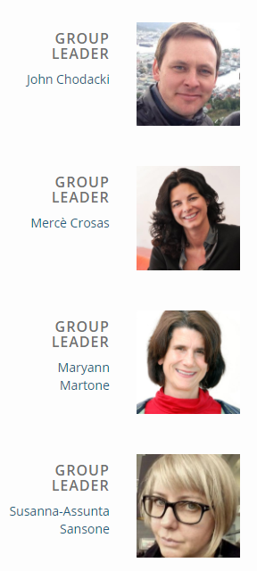
FORCE11 FAIR DMP group
Help coordinate efforts around the globe to provide tools and recommendations for creating data management plans
provide a simple set of principles
examples of domain implementations
recommendations for best practices
https://www.force11.org/group/fairdmp

Slide 36

OpenAIRE survey on H2020 DMP
What do you think of EC approach to DMPs?
How do you find the FAIR DMP template?
What works well or not?
Note priorities for future support
…..
www.surveymonkey.com/r/OpenAIRE_DMP_survey

Slide 37
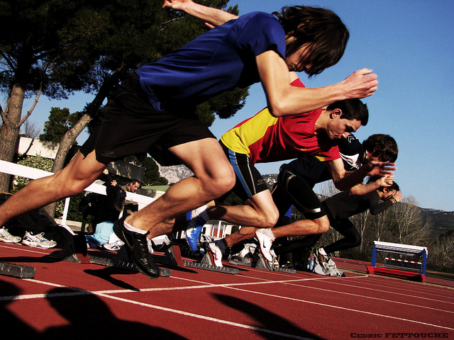
So what’s stopping you? Get started!
Image ‘Go !!’ CC-BY-NC-ND by Cédric Fettouche www.flickr.com/photos/cedmars/5405223203

