Slide 1

DMP nuts and bolts: the what, why and how of Data Management Planning
Sarah Jones
Digital Curation Centre, Glasgow
sarah.jones@glasgow.ac.uk
Twitter: @sjDCC
Open Research Data Management: policies and tools, Milan, 24-25 May 2017

Slide 2
Overview
Data Management Planning
  What is a DMP?
  Benefits and drivers
  How to plan?
The Horizon 2020 Open Research Data pilot
  What is the scope?
  What is required?
  How and when to opt out?
DMPonline: tools and support
  How the tool works
  Customising DMPonline
  International collaboration and future directions

Slide 3
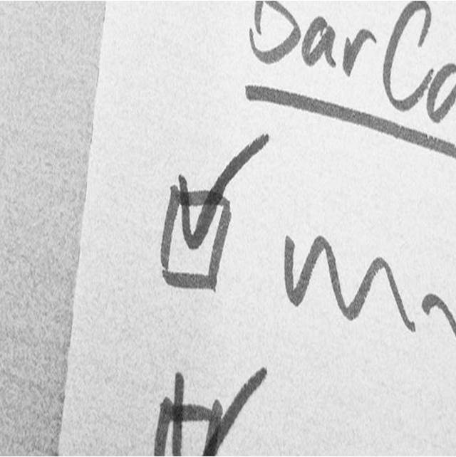
Data Management Planning
Image CC-BY-NC-SA by Ralf Appelt www.flickr.com/photos/adesigna/4090782772

Slide 4
What is a Data Management Plan?
A DMP is a brief plan to define:
how the data will be created
how it will be documented
who will be able to access it
where it will be stored
who will back it up
whether (and how) it will be shared & preserved
DMPs are often submitted as part of grant applications, but are useful whenever researchers are creating data.

Slide 5
How do DMPs help researchers?
Planning is useful whether or not a DMP needs submitted with a grant application, as it can help the researchers to…
  Make informed decisions to anticipate and avoid problems
  Avoid duplication, data loss and security breaches
  Develop procedures early on for consistency
  Ensure data are accurate, complete, reliable and secure
  Save time and effort to make their lives easier!

Slide 6
Benefits of DMPs for institutions
Opportunity to engage with researchers and improve RDM practice
Raise awareness of support available
Collate information to inform service delivery
Ensure the University is not exposed to risk
Ability to recover costs via grants

Slide 7

What are the risks of not doing it?
Bids with technical ambitions that can’t be delivered on
Legal non-compliance DPA, FOI…etc.
Inability to scrutinise → damage to research integrity, reputation, retractions
Loss of data or (re)usability
Research outputs lack visibility
Public communication diminished
Potential loss of research income
Loss of reputation, research record, value and ££

Slide 8
















Some funders that require DMPs

Slide 9
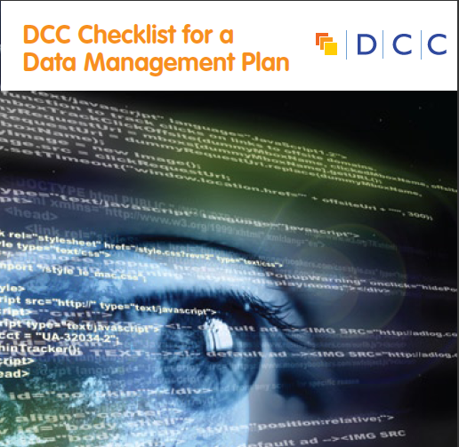
Common themes in DMPs
  Description of data to be collected / created
  (i.e. content, type, format, volume...)
  Standards / methodologies for data collection & management
  Ethics and Intellectual Property
  (highlight any restrictions on data sharing e.g. embargoes, confidentiality)
  Plans for data sharing and access
  (i.e. how, when, to whom)
  Strategy for long-term preservation
www.dcc.ac.uk/sites/default/files/documents/resource/DMP_Checklist_2013.pdf

Slide 10
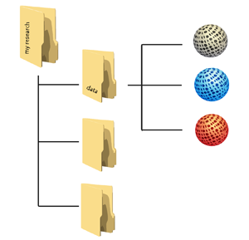

Planning trick 1: think backwards
What data organisation would a re-user like?
CREATING DATA
PROCESSING DATA
ANALYSING DATA
PRESERVING DATA
GIVING ACCESS TO DATA
RE-USING DATA

Slide 11
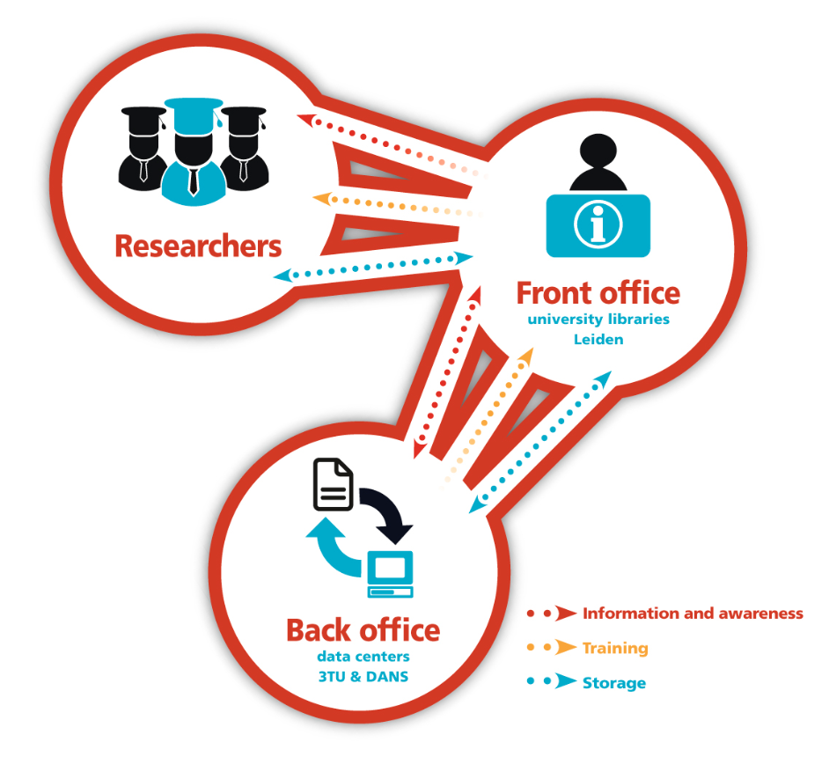



Planning trick 2: include RDM stakeholders
Commercial partners
Institution
RDM policy
Facilities
Publishers
Data Availability policy
€$£
Research funders
www.openaire.eu/briefpaper-rdm-infonoads

Slide 12


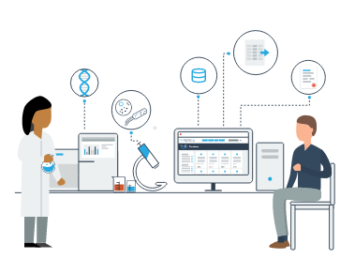
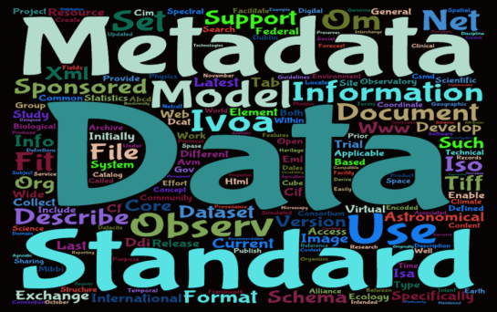

Planning trick 3: ground the DMP in reality
Base plans on available skills, support and good practice for the field – show it’s feasible to implement
Different services will be applicable depending on the stage of the research and nature and scale of your data….

Slide 13
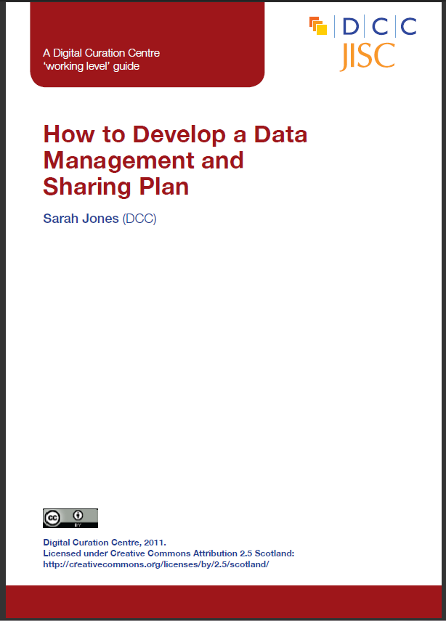

DCC support on DMPs
Webinars and training materials
How-to guides and other advisory documents
Checklist on what to cover in DMPs
Example DMPs
DMPonline
www.dcc.ac.uk/resources/data-management-plans

Slide 14

H2020 Open Research Data Pilot
Image CC-BY-NC-SA by Tom Magllery www.flickr.com/photos/lwr/13442910354

Slide 15
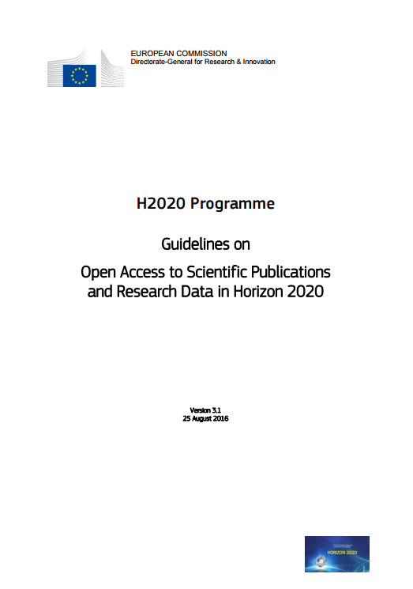
Why open access and open data?
“The Commission considers that there should be no need to pay for information funded from the public purse each time it is accessed or used. Moreover, it should benefit European businesses and the public to the full.”
https://ec.europa.eu/research/participants/data/ref/h2020/grants_manual/hi/oa_pilot/h2020-hi-oa-pilot-guide_en.pdf

Slide 16

Development of EC Open Access policy
Pilot in FP7
Provision of support
OA mandate in H2020
Trialled in 7 areas
Expected to:
Deposit articles into a repository
Attempt to make these OA within 6 or 12 months
OA fees are eligible for reimbursement
Pilot supported and monitored through OpenAIRE
Each beneficiary must:
Deposit machine-readable electronic copy in repository by the date of publication
Ensure OA via green/gold routes within 6 or 12 month embargo
Ensure bibliographic metadata is OA
Aim to deposit research data

Slide 17
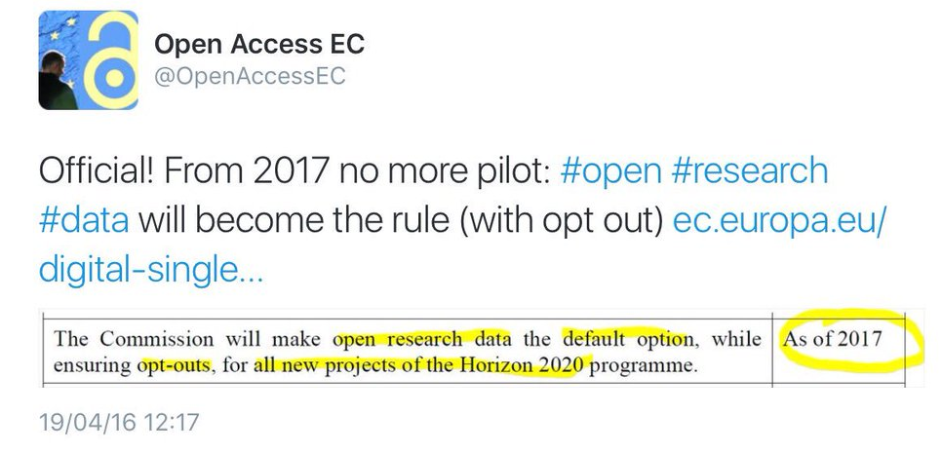
H2020 open data pilot
Guidelines on FAIR Data Management in Horizon 2020
http://ec.europa.eu/research/participants/data/ref/h2020/grants_manual/hi/oa_pilot/h2020-hi-oa-data-mgt_en.pdf
Pilot in H2020
Provision of support
?
Expanded to open data by default

Slide 18
Open Research Data (ORD) Pilot
Pilot focuses on research data specifically
  'Research data' refers to information, in particular facts or numbers, collected to be examined and considered and as a basis for reasoning, discussion, or calculation.
  In a research context, examples of data include statistics, results of experiments, measurements, observations resulting from fieldwork, survey results, interview recordings and images. The focus is on research data that is available in digital form.
Guidelines on Open Access to Scientific Publications and Research Data in Horizon 2020, v.3.1, 25 August 2016, p4

Slide 19
Which data does the pilot apply to?
Data, including associated metadata, needed to validate the results in scientific publications
Other curated and/or raw data, including associated metadata, as specified in the DMP
Doesn’t apply to all data (researchers to define as appropriate)
Don’t have to share data if inappropriate – exemptions apply
Notes:
19

Slide 20
Key requirements of the open data pilot
Beneficiaries participating in the Pilot will:
  Deposit data in a research data repository of their choice
  Take measures to make it possible for others to access, mine, exploit, reproduce and disseminate the data free of charge
  Provide information about tools and instruments necessary for validating the results (where possible, provide the tools and instruments themselves)
  Document and explain all these plans in a DMP
Notes:
20

Slide 21
Exemptions – reasons for opting out
If results are expected to be commercially or industrially exploited
If participation is incompatible with the need for confidentiality in connection with security issues
Incompatible with existing rules on the protection of personal data
Would jeopardise the achievement of the main aim of the action
If the project will not generate / collect any research data
If there are other legitimate reasons to not take part in the Pilot
Can opt out at proposal stage OR during lifetime of project
Should describe issues in the project Data Management Plan
Notes:
21

Slide 22
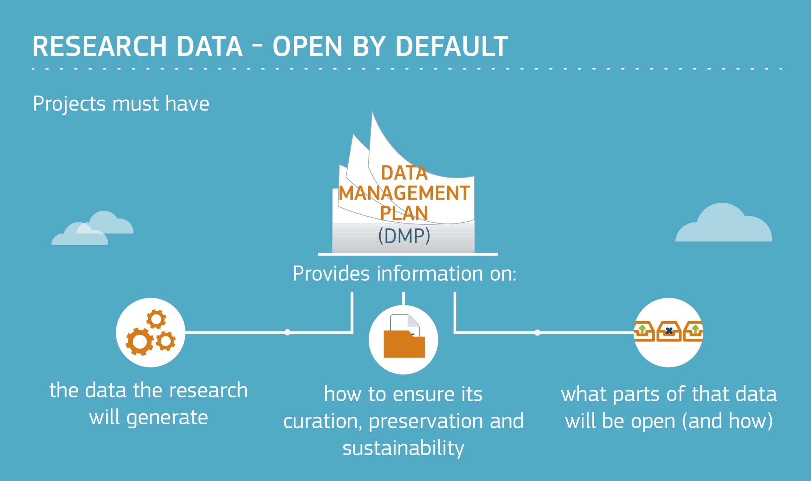

Slide 23
Key differences with DMPs in H2020
The Commission does NOT require applicants to submit a DMP at the proposal stage. It’s a deliverable (due by month 6).
A DMP is therefore NOT part of the evaluation
Optional section on data management in proposal is worth doing, especially to help justify costs
A DMP is a living or “active” document that should be updated whenever important changes occur (or at review times)
DMPs available online are typically quite long, but don’t necessarily have to be

Slide 24
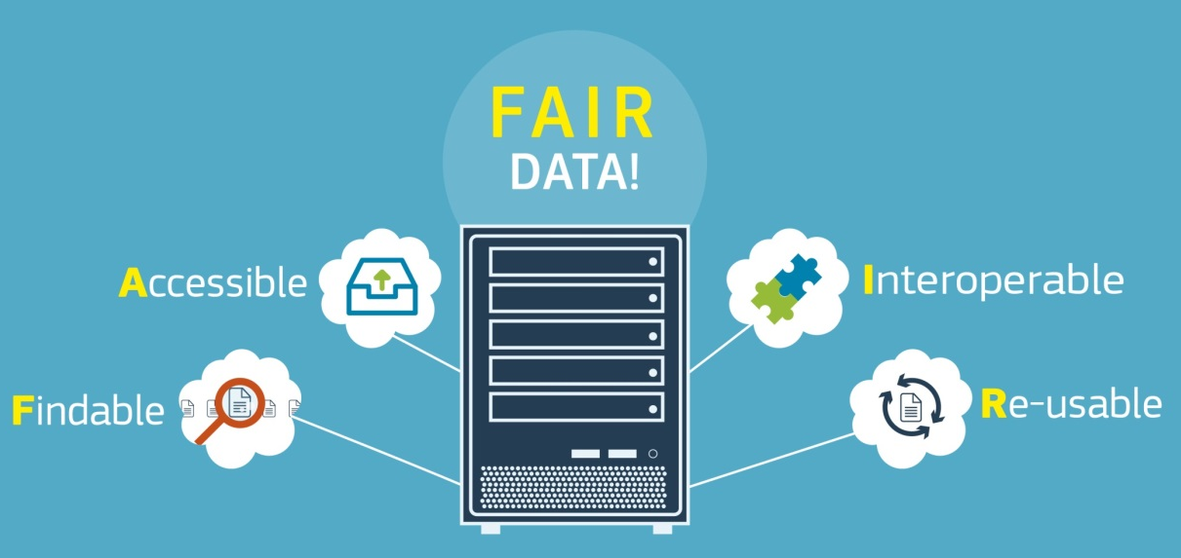
A FAIR approach to DMPs
Findable
  Assign persistent IDs, provide metadata, register in a searchable resource...
Accessible
  Retrievable by their ID using a standard protocol, metadata remain accessible even if data aren’t...
Interoperable
  Use formal, broadly applicable languages, standard vocabularies...
Reusable
  Rich metadata, clear licences,
  community standards
  provenance...
www.force11.org/group/fairgroup/
fairprinciples
Notes:
24

Slide 25
H2020 template
Data summary
FAIR data
  2.1 Making data findable, including provisions for metadata
  2.2 Making data openly accessible
  2.3 Making data interoperable
  2.4 Increase data re-use (through clarifying licences)
Allocation of resources
Data security
Ethical aspects
Other issues
http://ec.europa.eu/research/participants/data/ref/h2020/grants_manual/hi/oa_pilot/h2020-hi-oa-data-mgt_en.pdf

Slide 26

Reviewing DMPs in H2020
DMPs are a deliverable, checked primarily by project officers and in some cases external reviewers too
Guidelines are being developed to give reviewers pointers on what to check. These are based on the template.
The reviewer has access to the full project documentation
Process is only just evolving and this is a pilot so feedback may be variable initially

Slide 27

  Approach:
  as open as possible, as closed as necessary
Image: ‘Balancing rocks’ by Viewminder CC-BY-SA-ND www.flickr.com/photos/light_seeker/7780857224

Slide 28
The EC Open Research Data pilot
Key sources of information
Guidelines on Open Access to Scientific Publications and Research Data in Horizon 2020
  http://ec.europa.eu/research/participants/data/ref/h2020/grants_manual/hi/oa_pilot/h2020-hi-oa-pilot-guide_en.pdf
Guidelines on FAIR Data Management in Horizon 2020
  http://ec.europa.eu/research/participants/data/ref/h2020/grants_manual/hi/oa_pilot/h2020-hi-oa-data-mgt_en.pdf
Annotated model grant agreement, clause 29.3 http://ec.europa.eu/research/participants/data/ref/h2020/grants_manual/amga/h2020-amga_en.pdf
New infographic summarising key policy points http://ec.europa.eu/research/press/2016/pdf/opendata-infographic_072016.pdf
Notes:
28

Slide 29
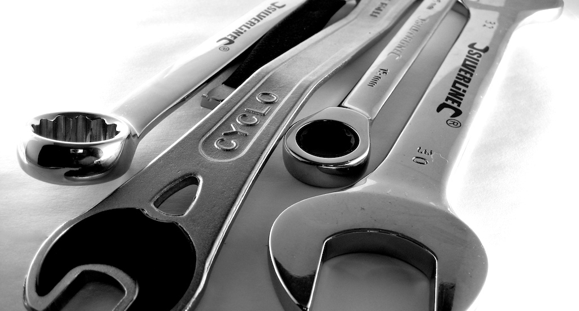
Tools and support: DMPonline
Image CC-BY by J https://www.flickr.com/photos/zzpza/3269784239

Slide 30

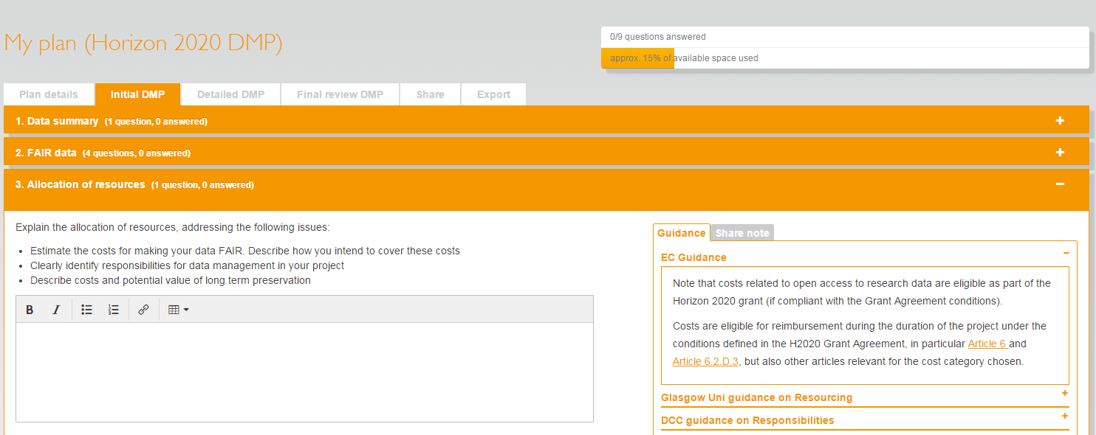
What is DMPonline?
A web-based tool to help researchers write DMPs
Includes a template for Horizon 2020
https://dmponline.dcc.ac.uk

Slide 31
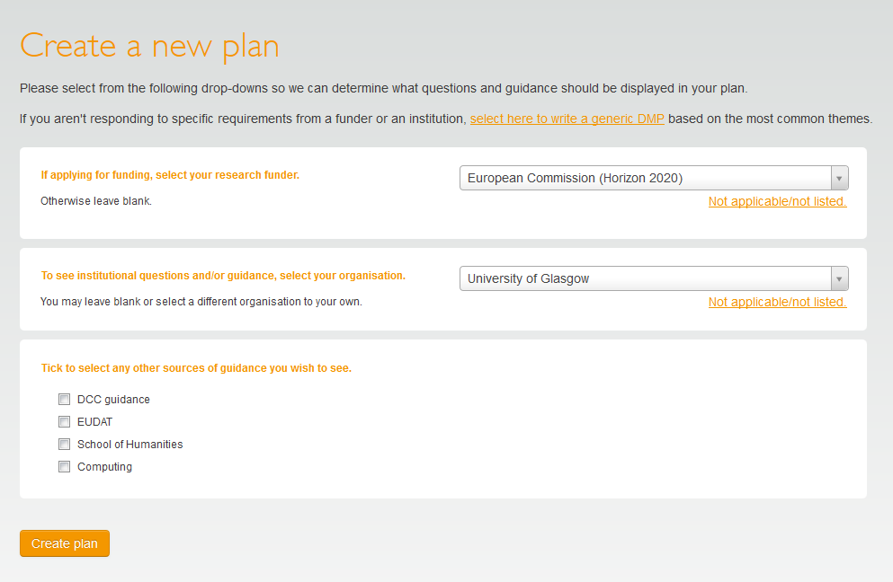
How the tool works
Click to write a generic DMP
Or choose your funder to get their specific template
Pick your uni to add local guidance and to get their template if no funder applies
Choose any additional optional guidance

Slide 32
Main features in DMPonline
Templates for different requirements (funder or institution)
Tailored guidance (funder, institutional, discipline-specific etc)
Examples and suggested answers
Ability to share plans and leave notes
Customised exports to a variety of formats
Multi-lingual support
Single sign on and ORCID authentication

Slide 33
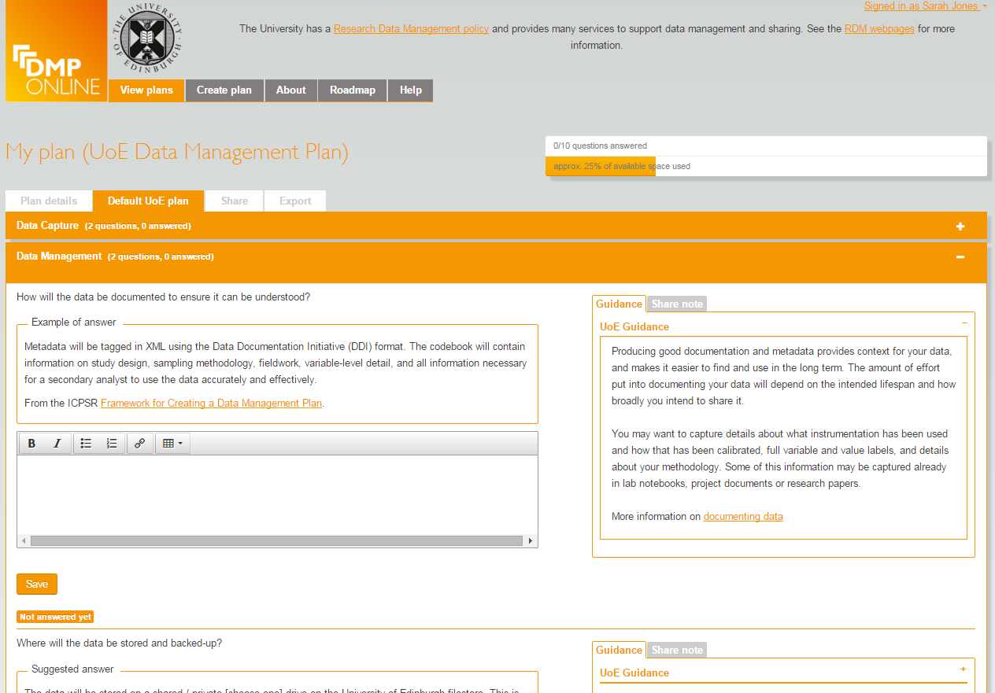
Options for unis to customise DMPonline
Organisations can:
Add their own template(s)
Customise existing funder templates
Provide example and suggested answers
Local guidance with links to support and services
Include their own logo and text in a banner
Review basic statistics
…

Slide 34

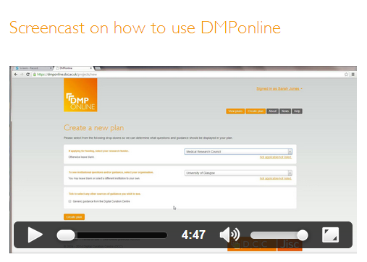


More information
Customising DMPonline
www.dcc.ac.uk/news/customising-dmponline-admin-interface-launches
http://www.screenr.com/PJHN
Get the code, amend it, run a local instance, flag issues, request features... https://github.com/DMPRoadmap/roadmap

Slide 35
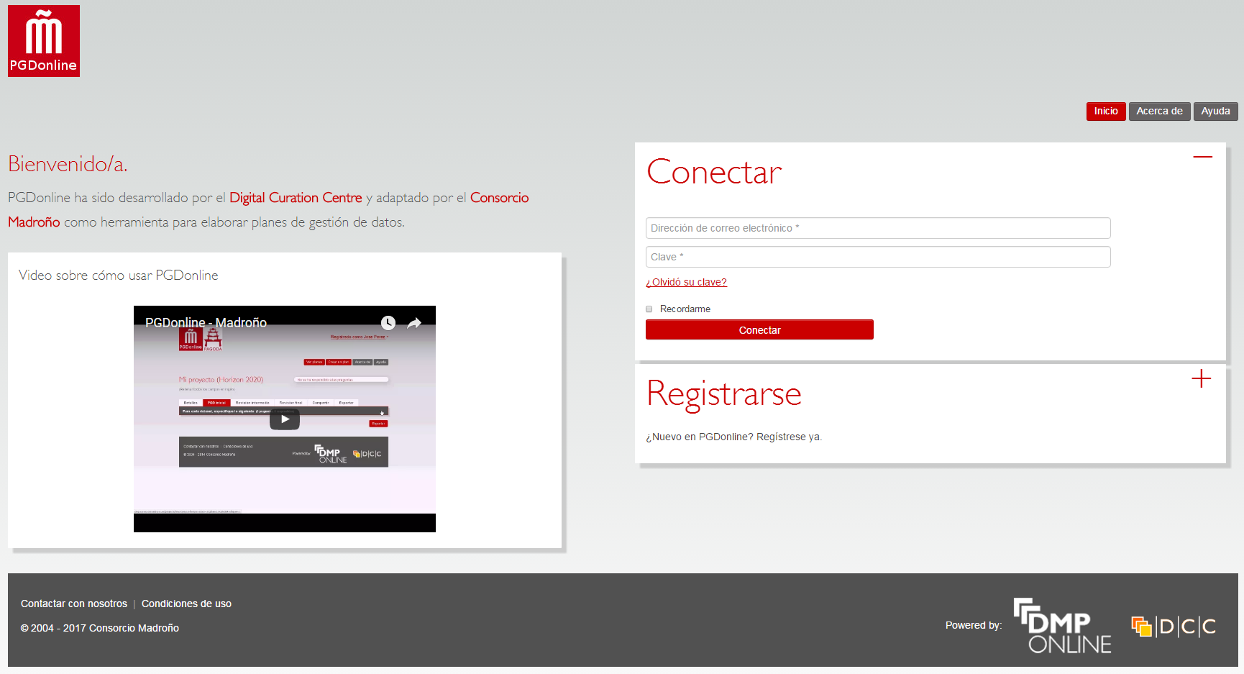
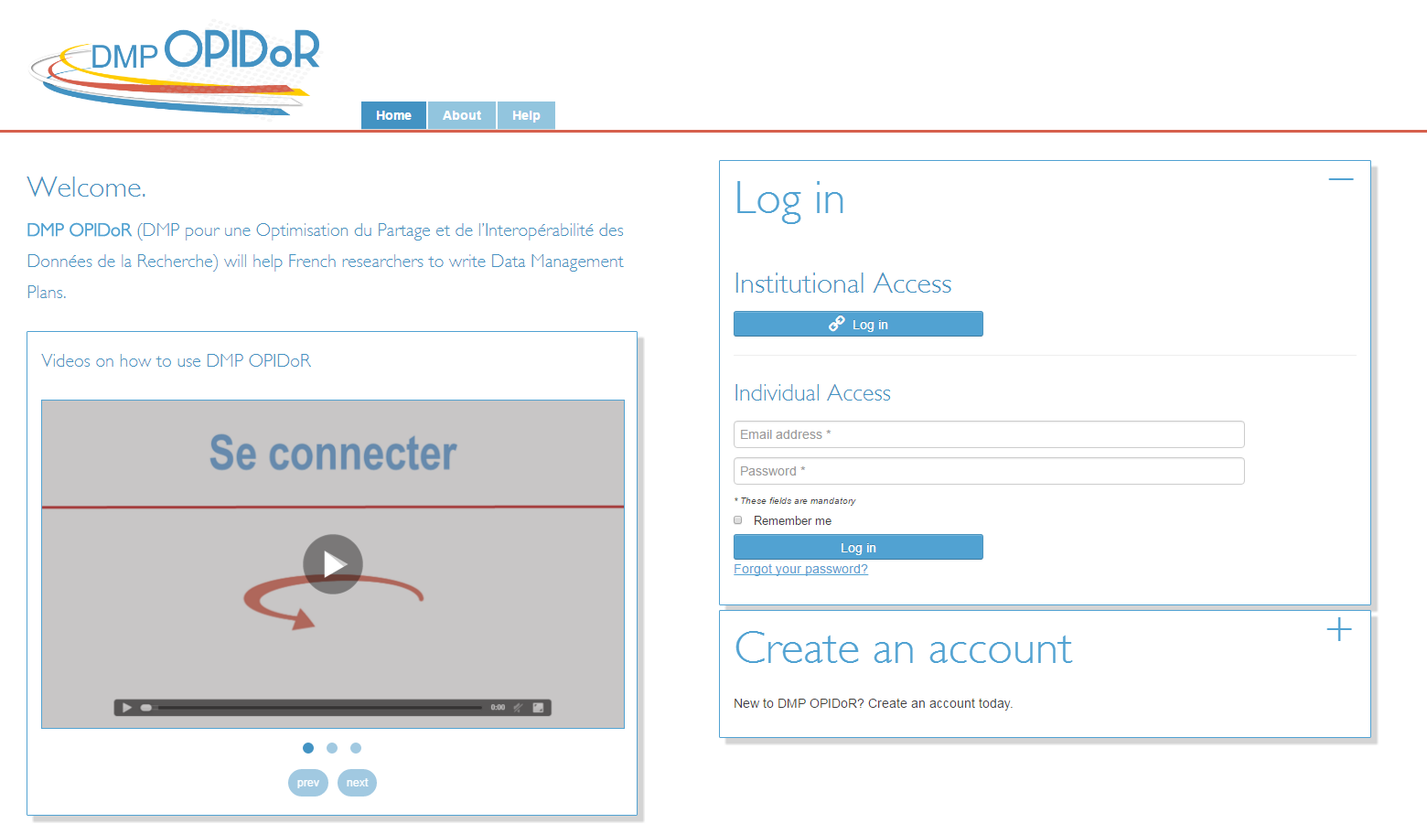
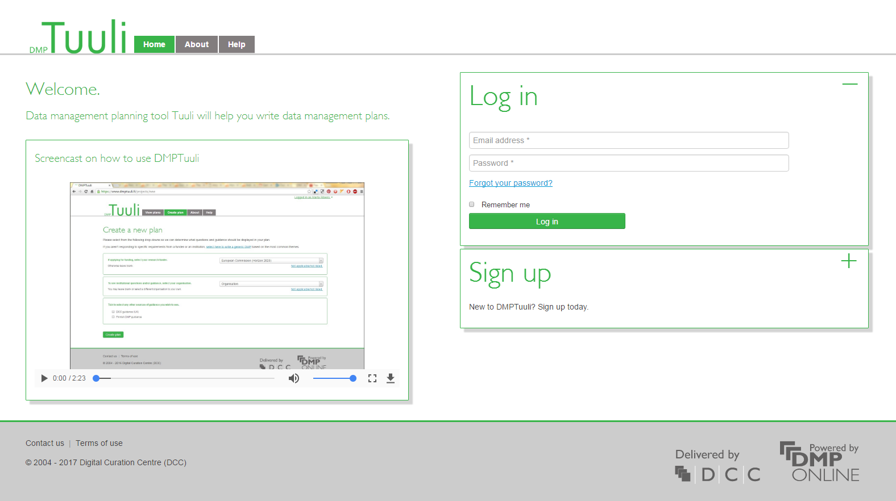
National / local DMP Tools
https://github.com/DMPRoadmap/roadmap/wiki/Local-installations-inventory

Slide 36


A single platform for all things DMP
Agreed to converge on a single codebase, based on DMPonline with additional features from DMPTool
Bring together features and strengths of each tool
Co-manage, co-develop and issue joint roadmap
DMPRoadmap: https://github.com/DMPRoadmap

Slide 37


Joint vision & international collaboration
Developing common standards and formats
Building connections between tools and systems
Advocacy for DMPs to train and improve practice
Engagement with research funders

Slide 38

Thanks for listening
DCC resources on Data Management
www.dcc.ac.uk/resources
Follow us on twitter:
@digitalcuration and #ukdcc

