Slide 1


Innovation in Scholarly Publishing:
time for new models
Liz Allen
Director of Strategic Initiatives, F1000
OpenAIRE | Turin | December 2018
@allen_liz

Slide 2
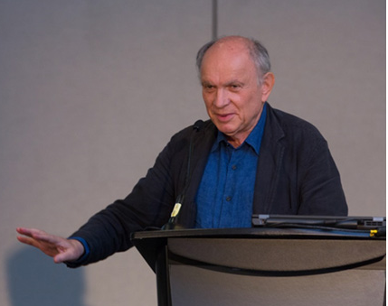
F1000: innovator in scholarly publishing space
“Plan S is the boldest advance since the first days of Open Access when BioMed Central, the first OA publisher and PubMed Central, the OA repository were launched.
We at F1000 Group support it fully.”
Vitek Tracz, founder of BioMed Central & Chairman of F1000 Group

Slide 3





What are the key functions of a research publishing ‘journal’?
Registering priority claims
Curating & branding
Reviewing & validating
Dissemination & discoverability
Archiving
Important to readers & research users
Important to readers & research users
Important to authors
Source: Leiden CWTS workshop 2017 – Allen; Hill; Plume; Shu; Walker; Waltman

Slide 4
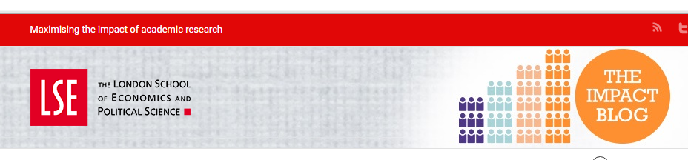




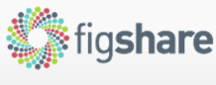



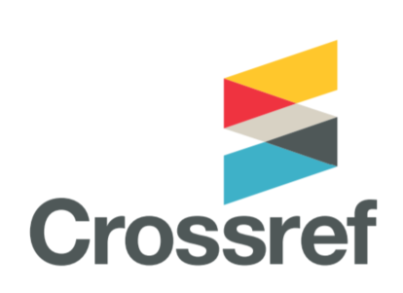


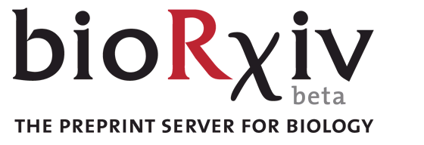
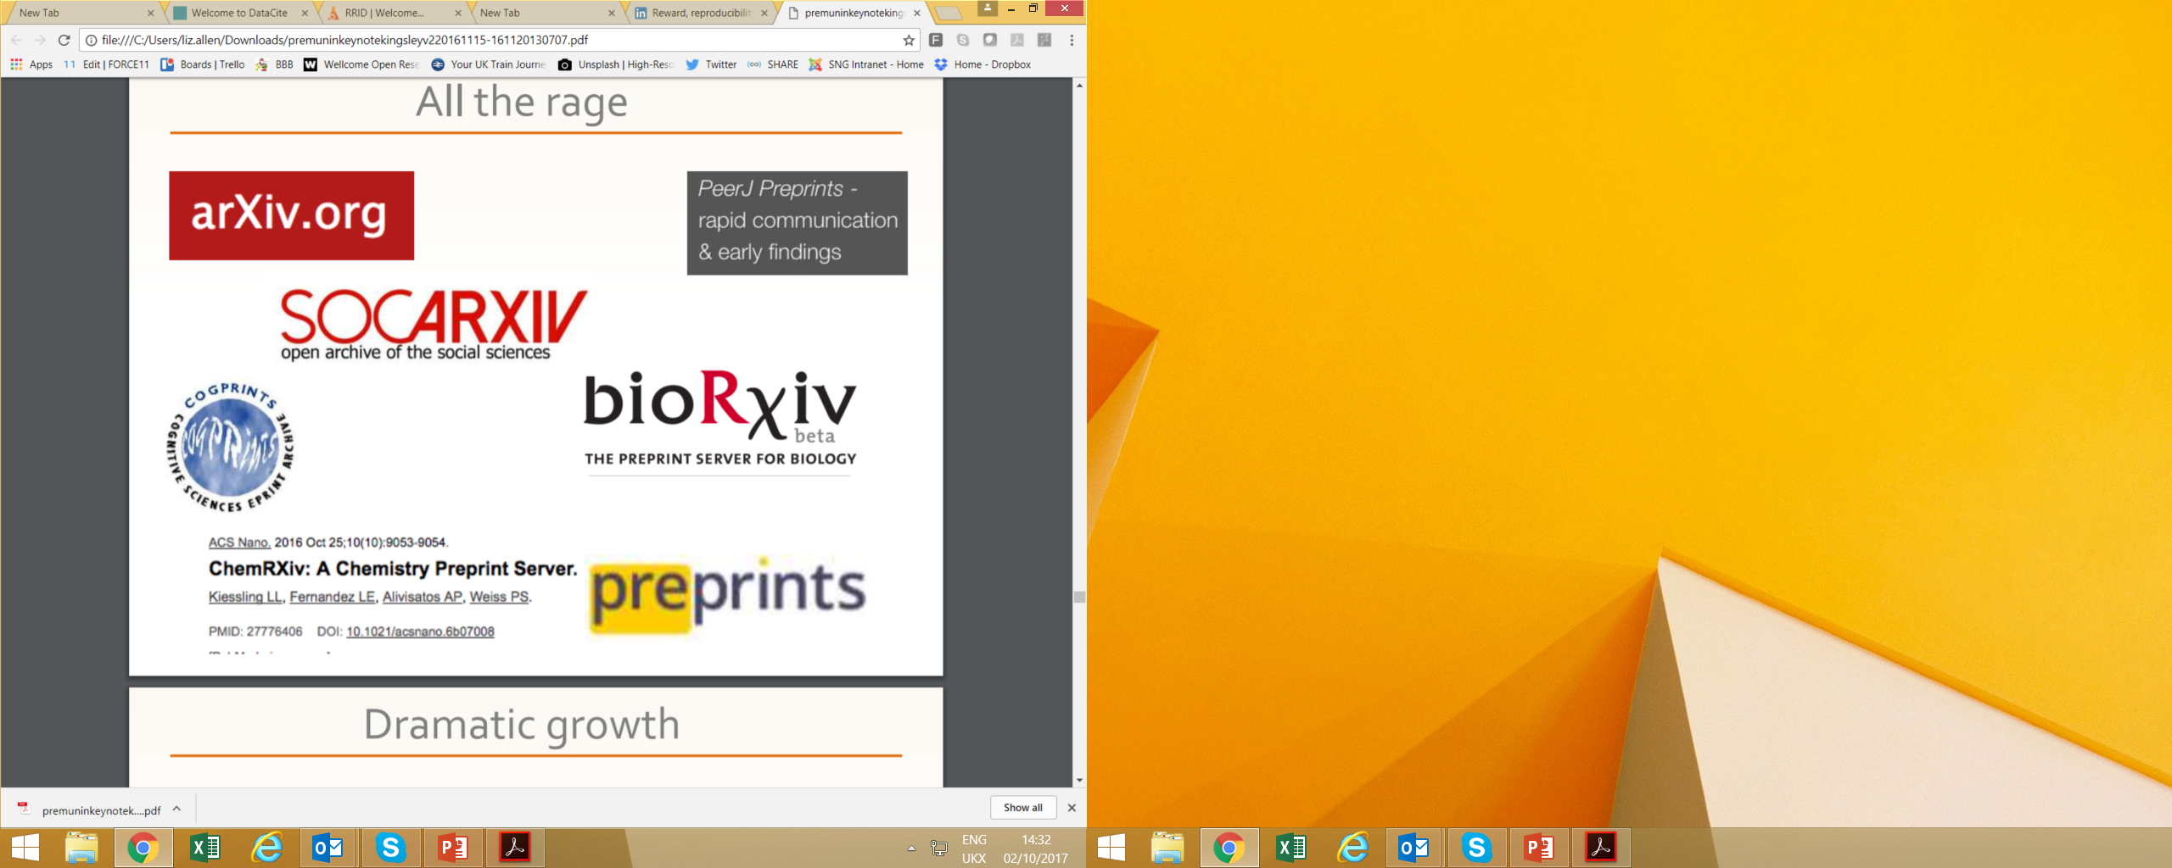












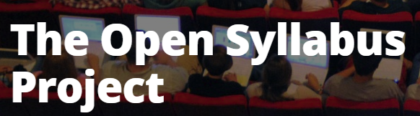



But how we share, discover & talk about science is evolving fast ...

Slide 5
changing landscape of science: changing context for a ‘journal’
Notes:
Major trends – particularly in life sciences but across all …

Slide 6
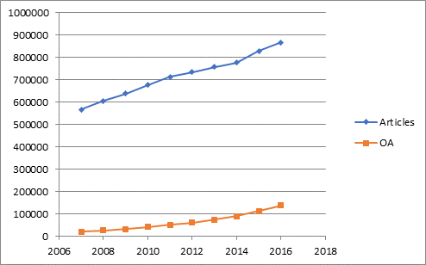
Growth in life & biomedical science output
^{Source:} ^{Web of Science (2017)}

Slide 7
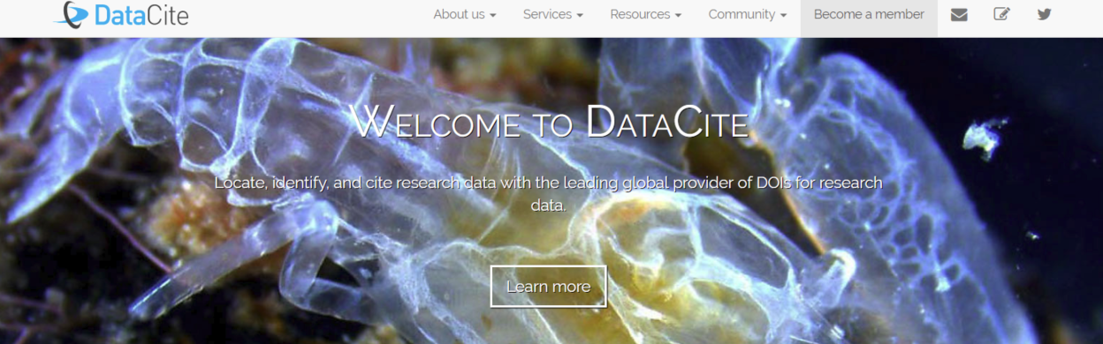
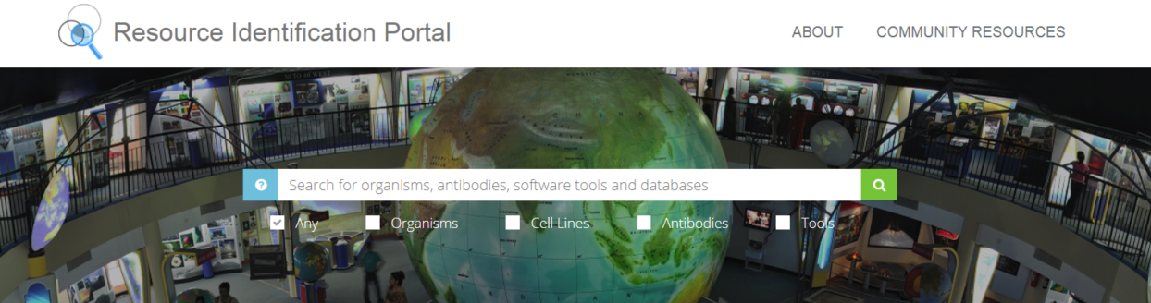
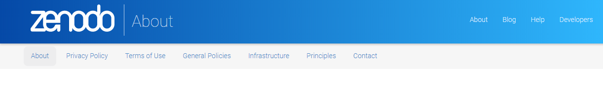
Widening range of research outputs available
Data
Resources
Software
all with a trackable & persistent DOIs

Slide 8
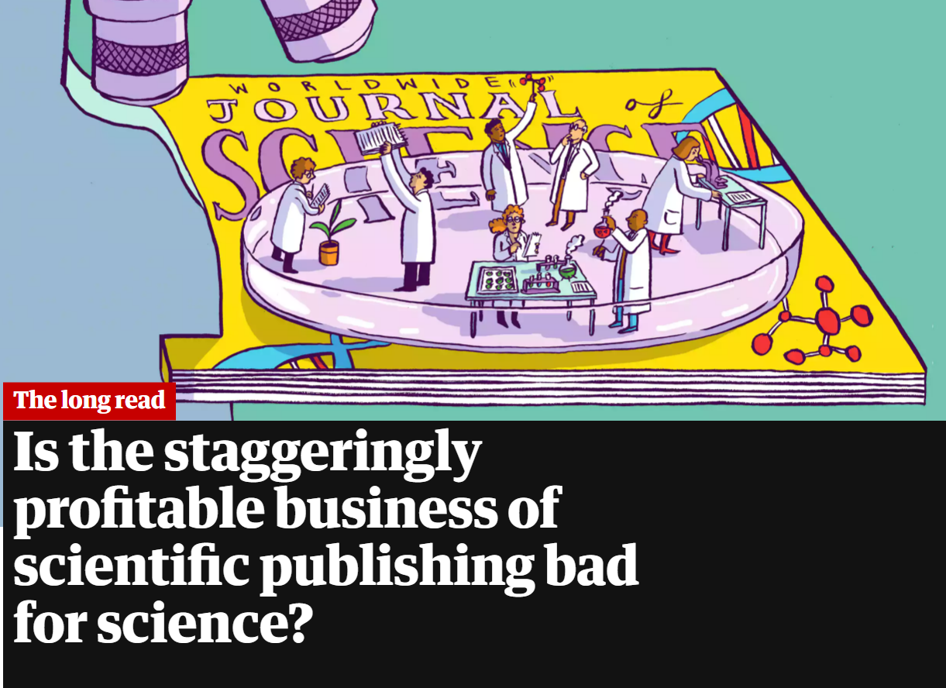
Massive ‘cost’ of publishing …
  Much research behind paywalls
  Long delays in publishing
  Peer review non-transparent
  Lack of access to data
  Much good research never published
  Significant research waste
Source: https://www.theguardian.com/science/2017/jun/27/profitable-business-scientific-publishing-bad-for-science

Slide 9
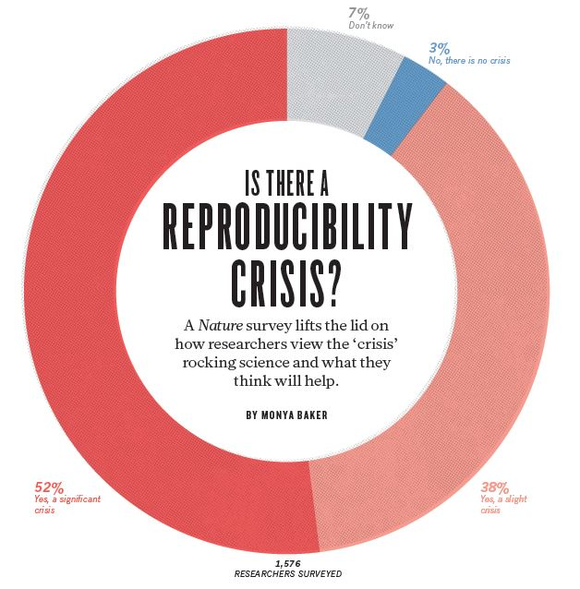
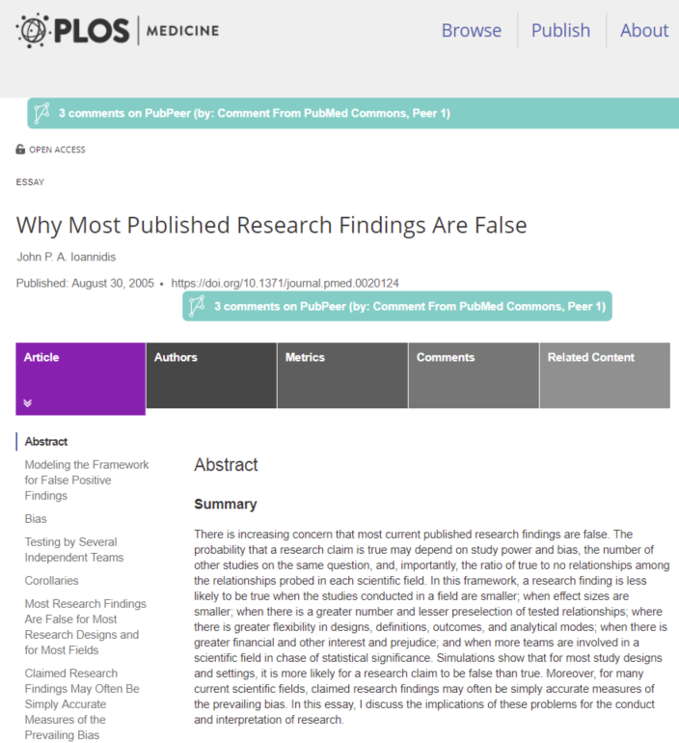
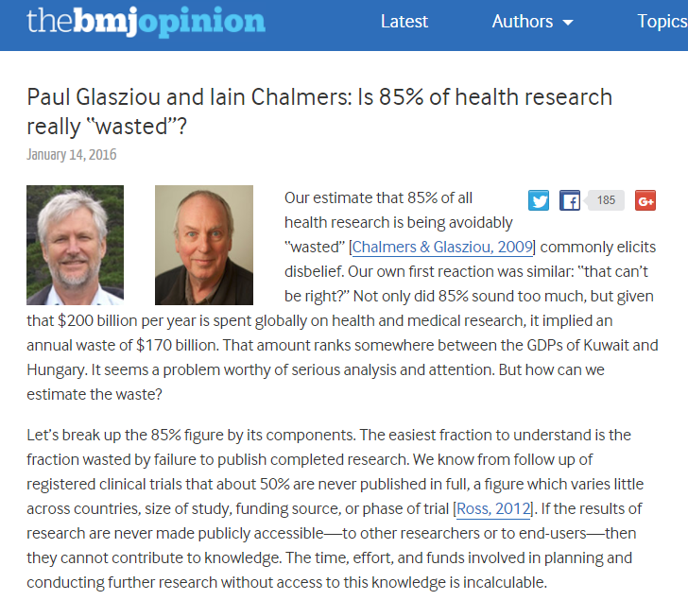
Recognition of (ir) reproducibility & research waste
^{Sources:} http://www.thelancet.com/journals/lancet/article/PIIS0140-6736(13)62329-6/

Slide 10
Rethinking how research is shared (‘published’)
(a) new models emerging
Notes:
Major trends – particularly in life sciences but across all …
Rethinking that preserves the functions – all the good bits but removes the ‘bad’ and unnecessary bits … and rewards the right bits!

Slide 11
Do we need ‘journals’ as currently configured to provide these?
Registering priority claims
Curating & branding
Reviewing & validating
Dissemination & discoverability
Archiving
Source: Leiden CWTS workshop 2017 – Allen; Hill; Plume; Shu; Walker; Waltman

Slide 12


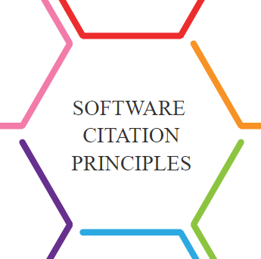





Evolving research funding & policy requirements
https://www.scienceeurope.org/coalition-s/

Slide 13
New approached & models of scholarly publishing focus on …
  Much research behind paywalls
    Open access
  Long delays in publishing
    Speed, rapid publication
  Peer review non-transparent
    Open peer review in many forms
  Lack of access to data
    Open data
  Much good research never published
    Fuller publication encouraged
  Significant research waste
    Cost minimisation/real
    Funders & institutions stepping in
    Drive to more holistic ‘evaluation’
Source: https://www.theguardian.com/science/2017/jun/27/profitable-business-scientific-publishing-bad-for-science

Slide 14












Moving to a more holistic & balanced research evaluation system
sfdora.org
@DORAssessment
Signed by >500 organizations and >12,500 individuals
Supporting organizations
Notes:
Key to incentivizing shift and adoption –
Leadership from those with £s – funders and institutions
Making it easy for researchers to get on with it
Provide infrastructure to support open, sharing, collaboration – and indicators ! (so removes reliance on solely journal based indicators and article as the main currency …. )
DORA is an initiative supported by nine organizations to push for real change in research assessment. The vision of DORA is to advance practical and robust approaches to research assessment globally and across all scholarly disciplines. Individuals and organizations can sign the declaration pledging to improve culture around research evaluation. DORA is collecting best practices to help members of the community learn from each other and create change. More information is on the website: sfdora.org
Journal-based metrics are often misused and ill applied in research and researcher evaluation. This is happens at key transition points during a researcher’s career, including hiring, promotion, and tenure.

Slide 15
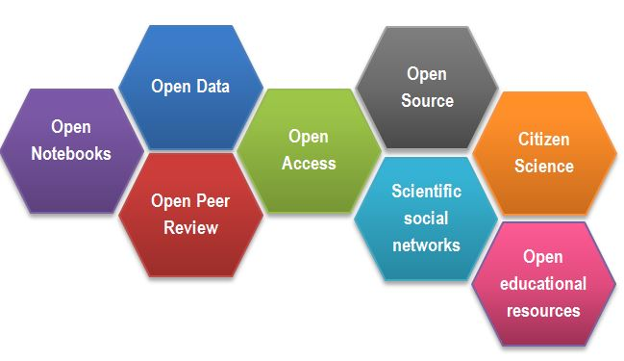

A shift to open & collaborative science
Source: https://www.fosteropenscience.eu/content/what-open-science-introduction

Slide 16
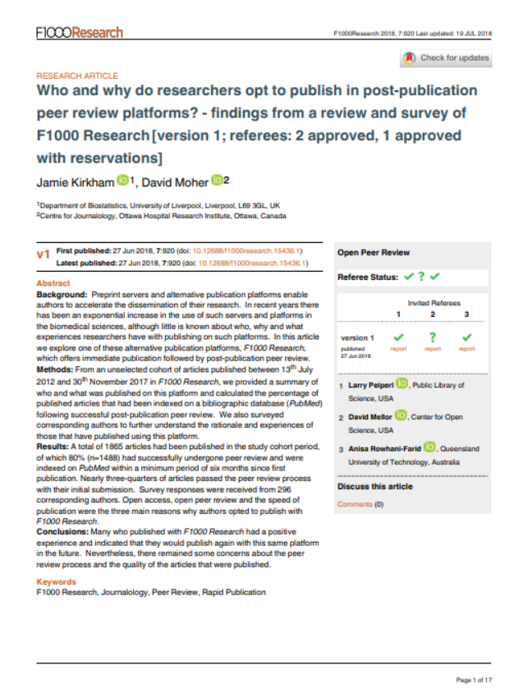
“ … undoubtedly an increase in the use of researchers publishing their research on alternative platforms for biomedical sciences …”
Kirkham J and Moher D. Who and why do researchers opt to publish in post-publication peer review platforms? - findings from a review and survey of F1000 Research F1000Research 2018, 7:920

Slide 17
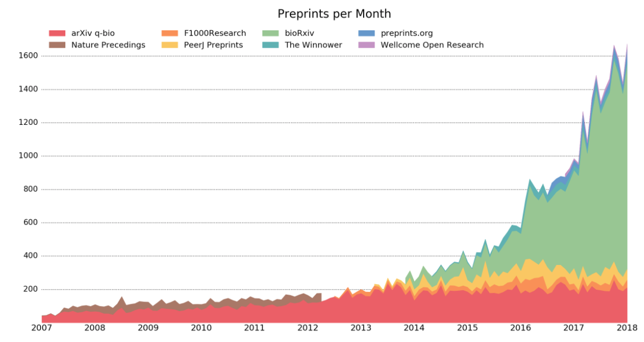
Growth in rapid publication models
Source: 2017 http://asapbio.org/

Slide 18


Open ‘platforms’
Post-publication peer review
Open peer review
Open data
Open access
Versioning
Living figures ….
Publish. Engage. Accelerate.
Notes:
- combining ‘pre-printing (speed) with QA (peer review) & transparency (open peer review)

Slide 19
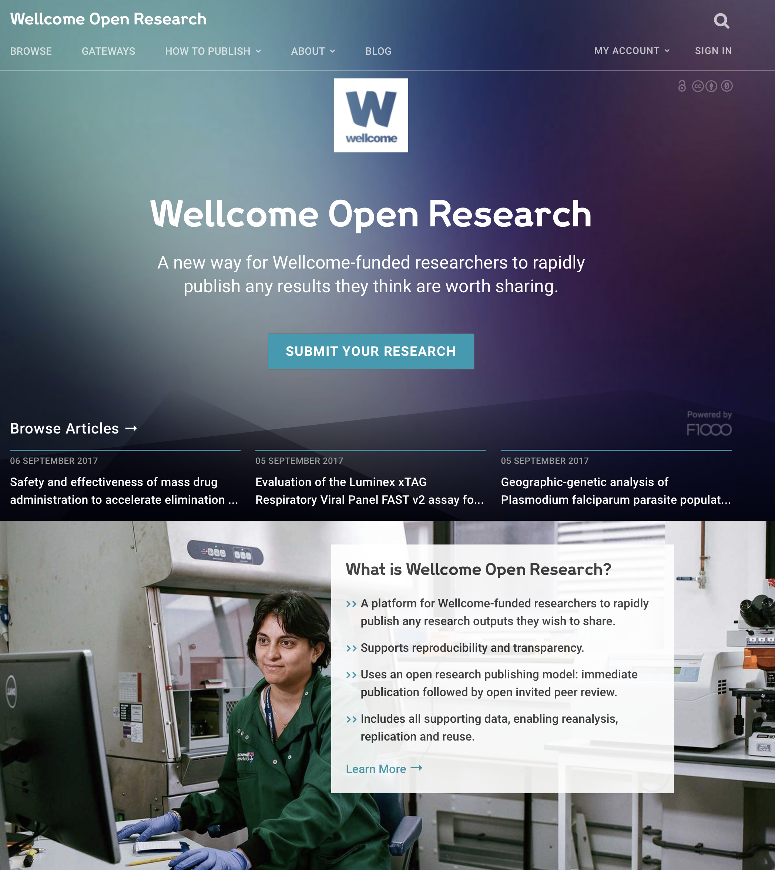




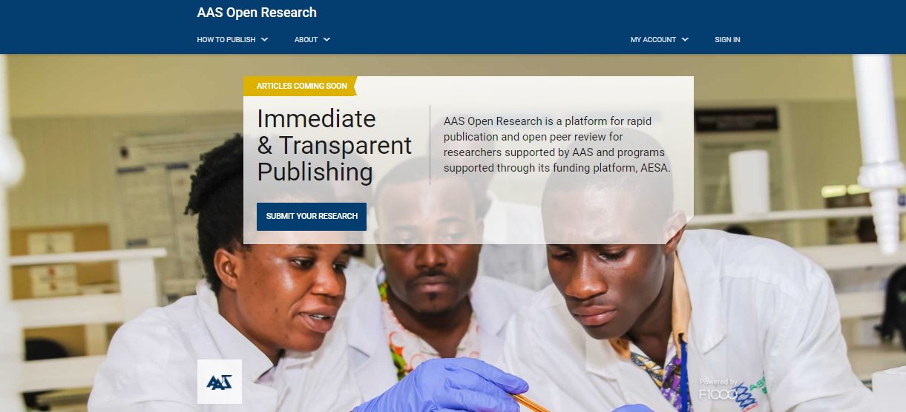
Publishers providing services directly for research funders

Slide 20


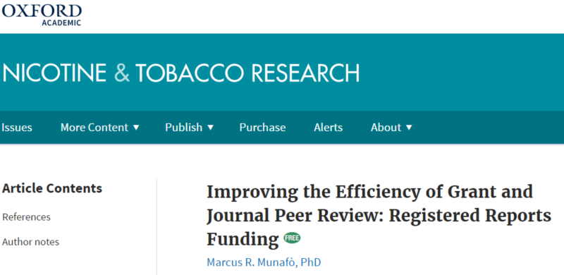
Combining grant & publishing peer review
Notes:
Funder choses grant – includes ‘an’ Editor
Selected researchers publish registered report/method – reviewed by grant reviewers
Helps researcher refine grant
Helps research components get published
Helps funder & researcher achieve aims?

Slide 21

Active support for engagement in outputs

Slide 22
Rethinking how research is shared (‘published’)
new models emerging
meta-data & digital footprint
Notes:
Major trends – particularly in life sciences but across all …
Rethinking that preserves the functions – all the good bits but removes the ‘bad’ and unnecessary bits … and rewards the right bits!

Slide 23



Slide 24
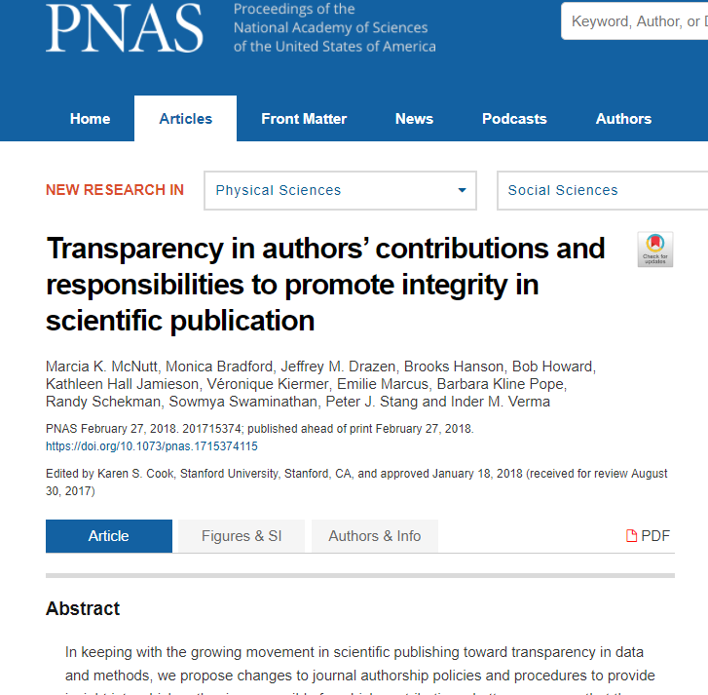
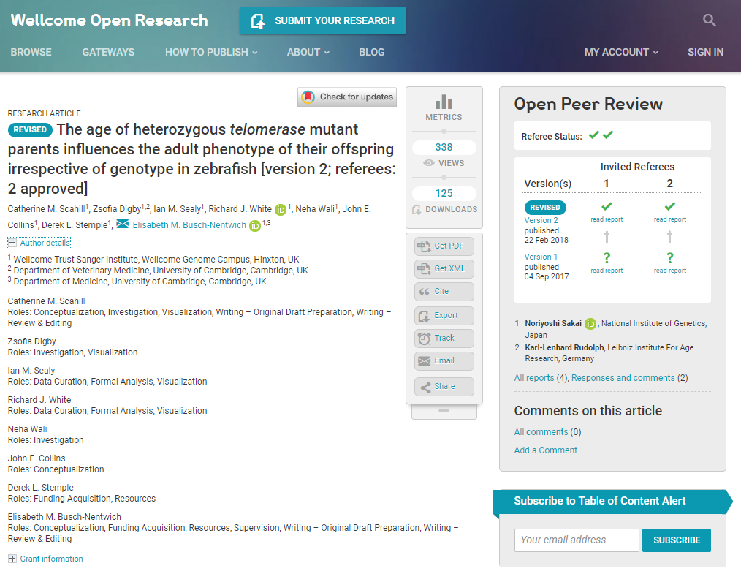
From static ‘authorship’ to recognition of contribution

Slide 25
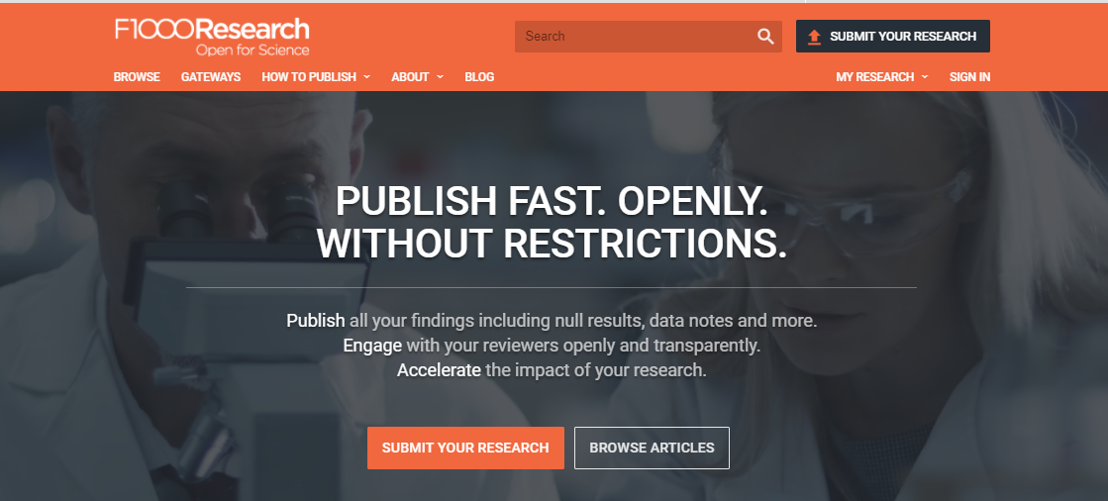
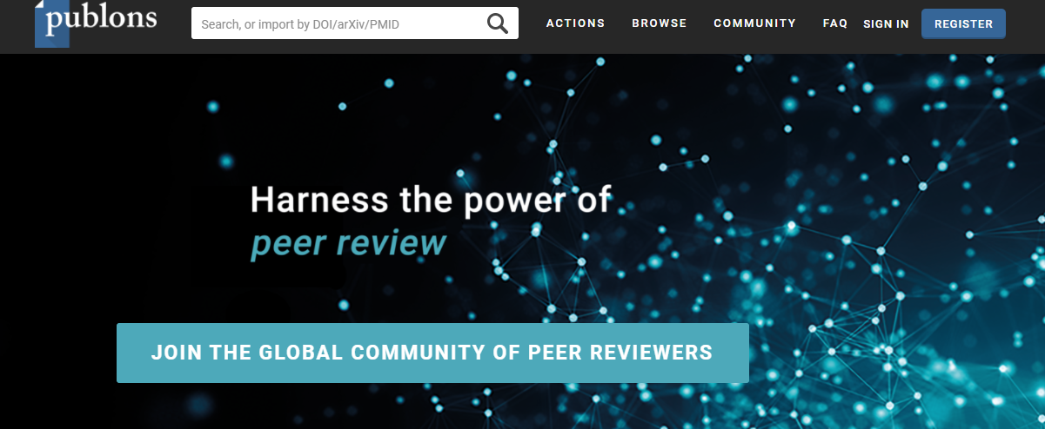
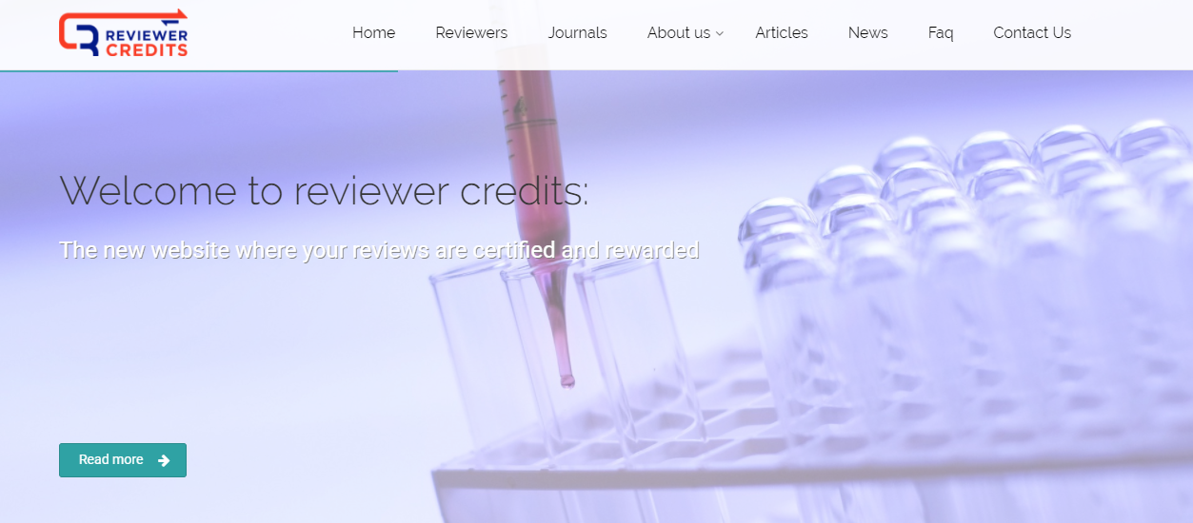
Recognition of peer review activity
Review activity with trackable & persistent DOIs & linked to ORCID & Crossref metadata

Slide 26
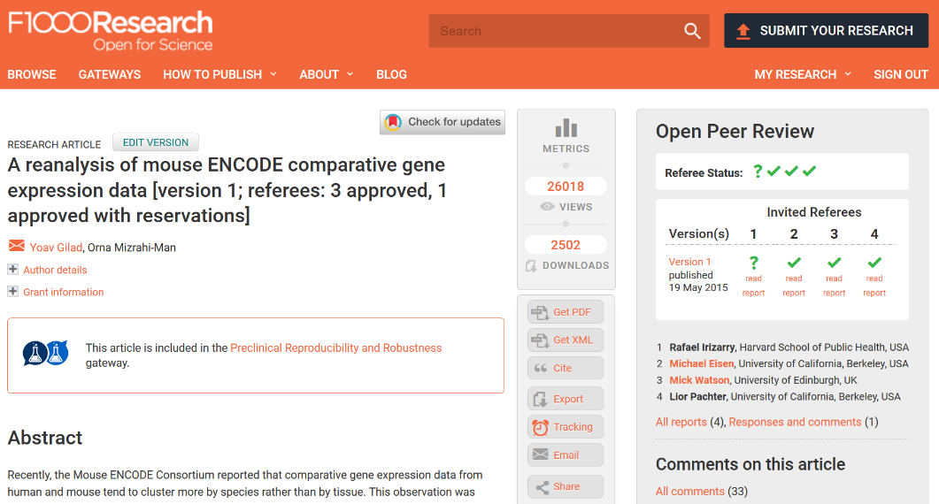
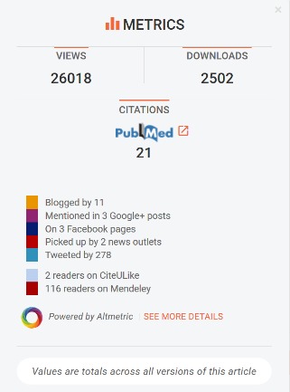
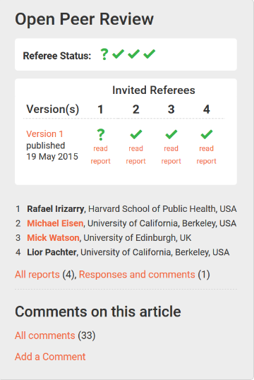
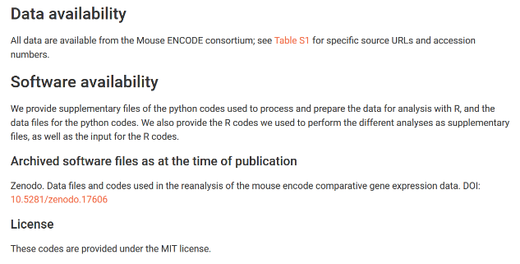
Range of outputs and associated metrics
Notes:
Articles on our platforms attract all the same other article-level metrics, including citations, views and downloads, altmetrics, media coverage etc.
The open peer review reports could possibly form a new type of metric as often reviewers may be the only people who truly read the article properly from beginning to the end and so it is a good opportunity to capture what they think the potential impact could be.
And because we also capture all the data and software and other outputs associated with the article, and ensure they also are independently citable from the article, we can track citations and usage of those outputs too, and not just the main narrative article.

Slide 27
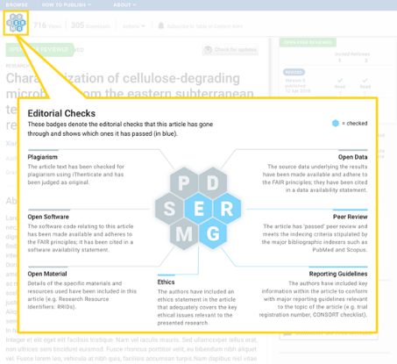
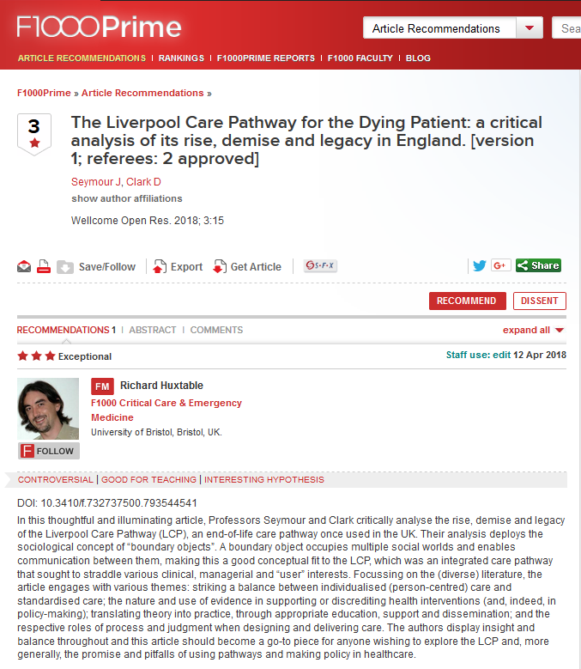
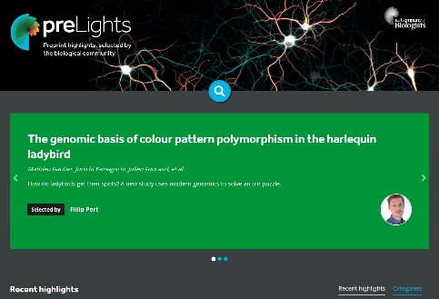
Indicators of ‘quality’ & value - & to support discoverability
  Publishing outlet credentials:
    descriptors of checks on content (e.g. plagiarism,ethics)
    expert peer review
  ‘basket’ of indicators (metrics) used responsibly:
    Reach
    Attention (‘talked about’)
    Use (including citation)
    Expert recommended (e.g. F1000Prime, PreLights, PreReview)

Slide 28
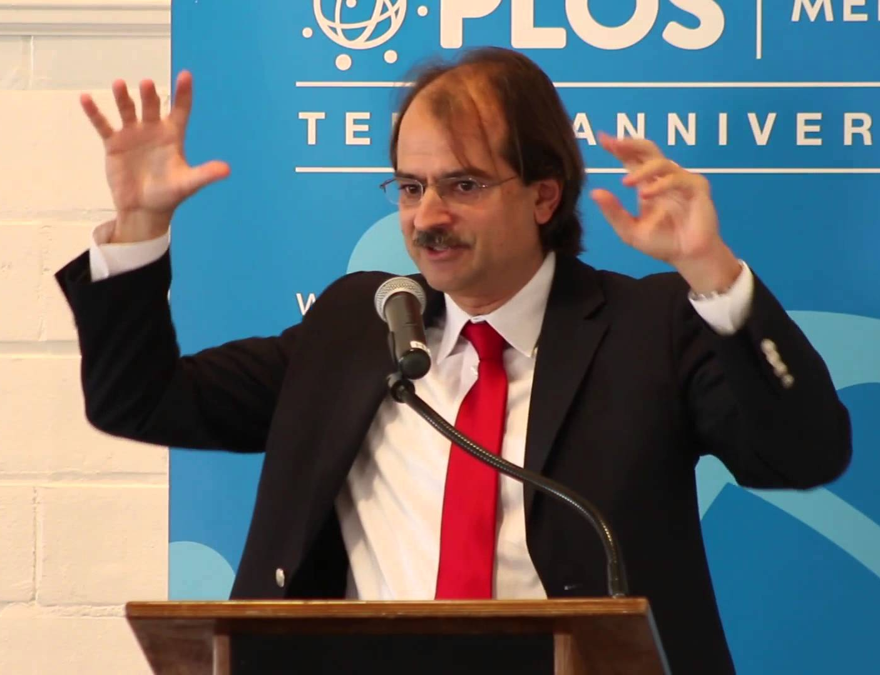
Build the evidence base: robust research on research
“Science remains the key driver of human progress, yet we have little evidence on how to best fund science and incentivize high-quality work.”
John Ioannides (2018), Professor of Medicine & Health Policy

Slide 29
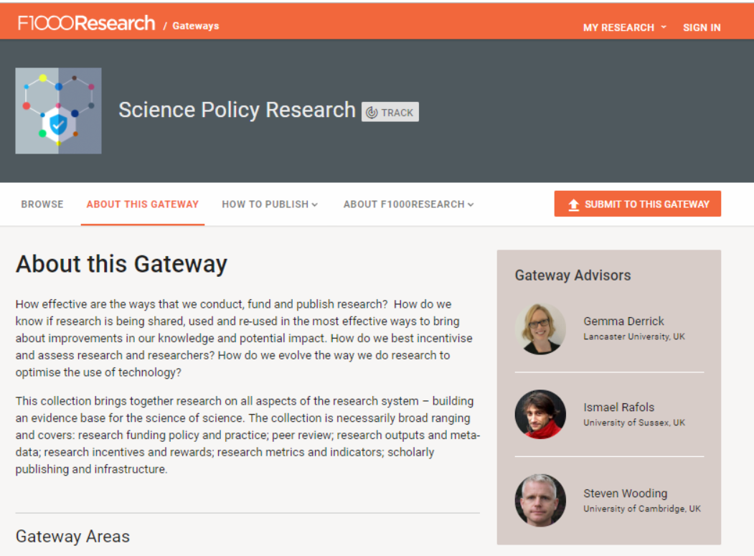
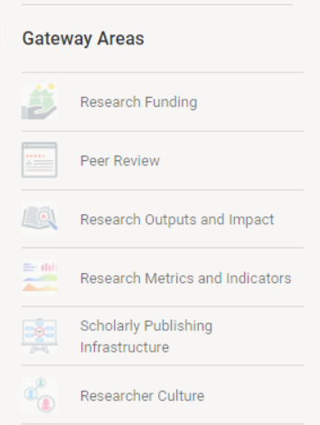
F1000Research Science Policy Research gateway

Slide 30
Changing landscape for science
Demand for speed, open, QA, impact
Widening range of research outputs available – support broader evaluation
Publishing & ecosystem needs to respond
Infrastructure & metadata around outputs crucial - to support discoverability, use, reuse & evaluation
Summary
Notes:
Major trends – particularly in life sciences but across all …

Slide 31
Thoughts? Questions?
Liz Allen
Director of Strategic Initiatives, F1000
OpenAIRE | Turin | December 2018
@allen_liz

