Slide 1
OpenAIRE national workshop Torino, 10 December 2018 elena.giglia@unito.it
OPERAS bringing the long tail of Social Sciences and Humanities into Open Science
This work is licensed under a Creative Commons Attribution-ShareAlike 4.0 International License.

Slide 2
Why Social Sciences and Humanities?
P.Mounier OPERAS. 2018

Slide 3
SSH: the book…
… a book is not just «another medium»… it’s organizing your thoughts in a different way
…and the book is changing
…impact of digital technologies and the Open Science paradigm…
…boundaries of the “scholarly record” now blurring…
…research monograph challenged by technical innovations (text and data mining, open annotations, data embedding, collaborative writing…)…

Slide 4
Publishing in SSH?
…fragmentation
a myriad of publishers
a myriad of initiatives
no single shop/database
extreme specialization
uneven quality
delay in going digital
lack of standards adoption
no synergies
no collaboration (reinventing the wheel)

Slide 5
SSH: fragmentation…
MULTILINGUALISM
fragmentation of research fields, across many disciplines and subdisciplines, usually grounded in regional, national and linguistic specific communities
SCARCE DISCOVERY AND REUSE
fragmentation of SSH data across different types, formats, languages, disciplines
SPECIFIC DATA CURATION
fragmentation of small and smart data which need to be precisely qualified, described, managed and curated

Slide 6
or disintegration?
when the actors playing in the field operate as isolated beings, unaware of what others are doing, reinventing the wheel in their own corner or even competing through unfair practices. In such circumstances, fragmentation turns into disintegration and the scientific community which needs efficient partners to circulate ideas and research findings across borders could be negatively impacted. The flaw is also apparent when the whole system experiences a global change in which all players need to redefine and renew their mission, the services they deliver, and consequently their workflow, business model and tools. The global change experienced by everyone is well known: the digital turn and its consequence: Open Science
P.Mounier, OPERAS Design Study, 2017

Slide 7
The global change is here: Open Science
March 13 2018

Slide 8
…are SSH ready to go?
The ecosystem is very fragile, and lacks resources (in terms of skills, know-how and funding) to efficiently manage the digital turn and the integration in the European Open Science Cloud.
OPERAS Design study, 2017

Slide 9
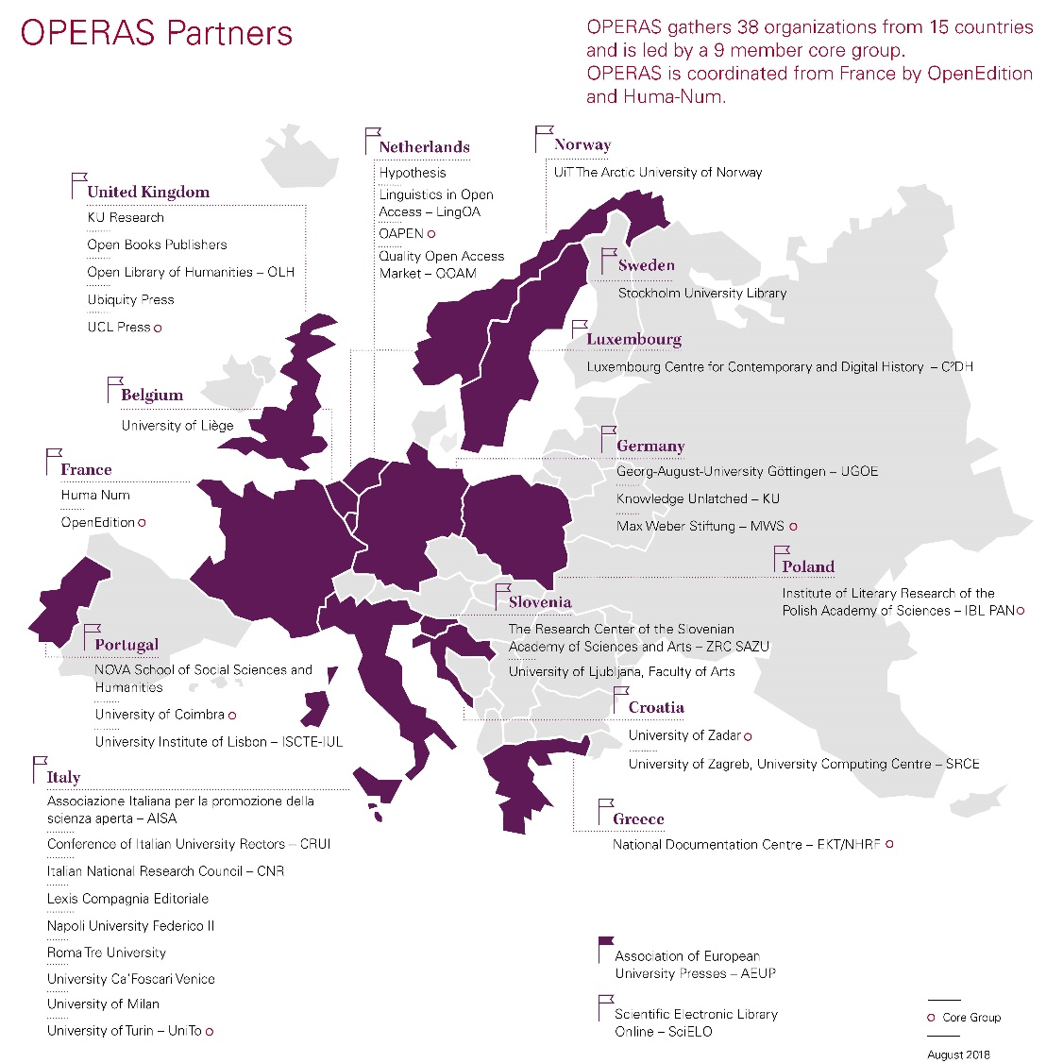
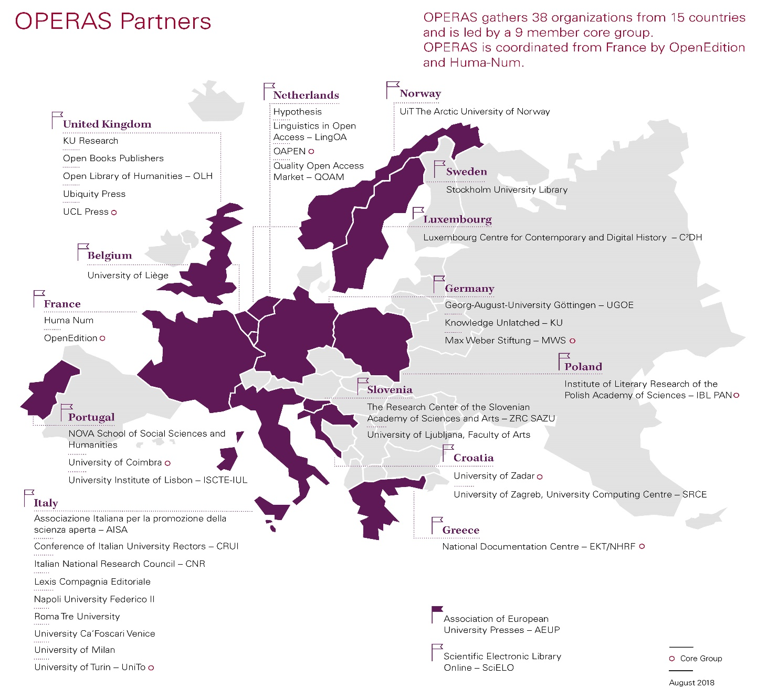
…OPERAS: a possible answer is integration and cooperation
38 organizations
15 countries
(9 in the Core group)
https://operas.hypotheses.org/partners

Slide 10
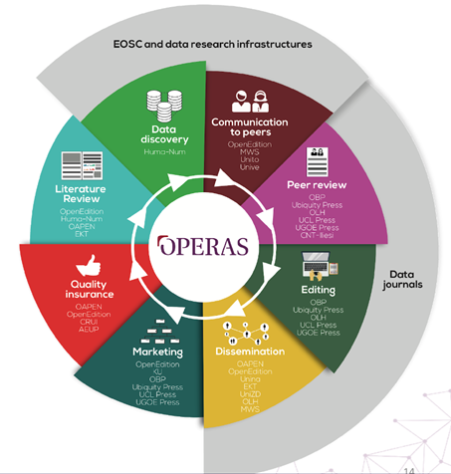
OPERAS: taking care of the whole cycle

Slide 11
OPERAS strategy
…not replacing but respecting the players
nurturing the players • coordinating services, aligning practices
sharing tools and know-how (principle of subsidiarity)
increasing the overall quality of the system

Slide 12
… a call
RESEARCHERS, PUBLISHERS, LIBRARIANS
WORKING TOGETHER
TO REGAIN CONTROL OVER SCHOLARLY COMMUNICATION

Slide 13
OPERAS: leveraging on existing realities to
CERTIFY RESEARCH
(peer review)
DISCOVER RESEARCH
(multilingual discovery tool)
ACTIVATE RESEARCH
(research and society blogging)

Slide 14
…bringing SSH into EOSC

Slide 15
…and supporting SSH FAIRification
…using some of the tools developed in HIRMEOS
FINDABLE
ACCESSIBLE
IDENTIFIERS
METADATA ENRICHMENT
MULTILINGUAL SEARCH
SINGLE POINT OF ACCESS
METADATA INTEGRATION
INTEROPERABLE
REUSABLE
STANDARD ADOPTION
COMMON SERVICES
LICENSING PRACTICES
ANNOTATION
MACHINE-READABILITY
…BEING A IMPLEMENTATION NETWORK as CO-OPERAS

Slide 16
…building together
Metadata enrichment; data publication crosslinking

Slide 17
OPERAS, we foresee…
OPERAS: a research infrastructure to rethink publishing, discovery and dissemination in the SSH of the future
…thank you!

