Slide 1
Plan S: the Wellcome way
OpenAire National Workshop, 10th December 2018
Robert Kiley
Head, Open Research
E: r.Kiley@wellcome.ac.uk; @robertkiley

Slide 2
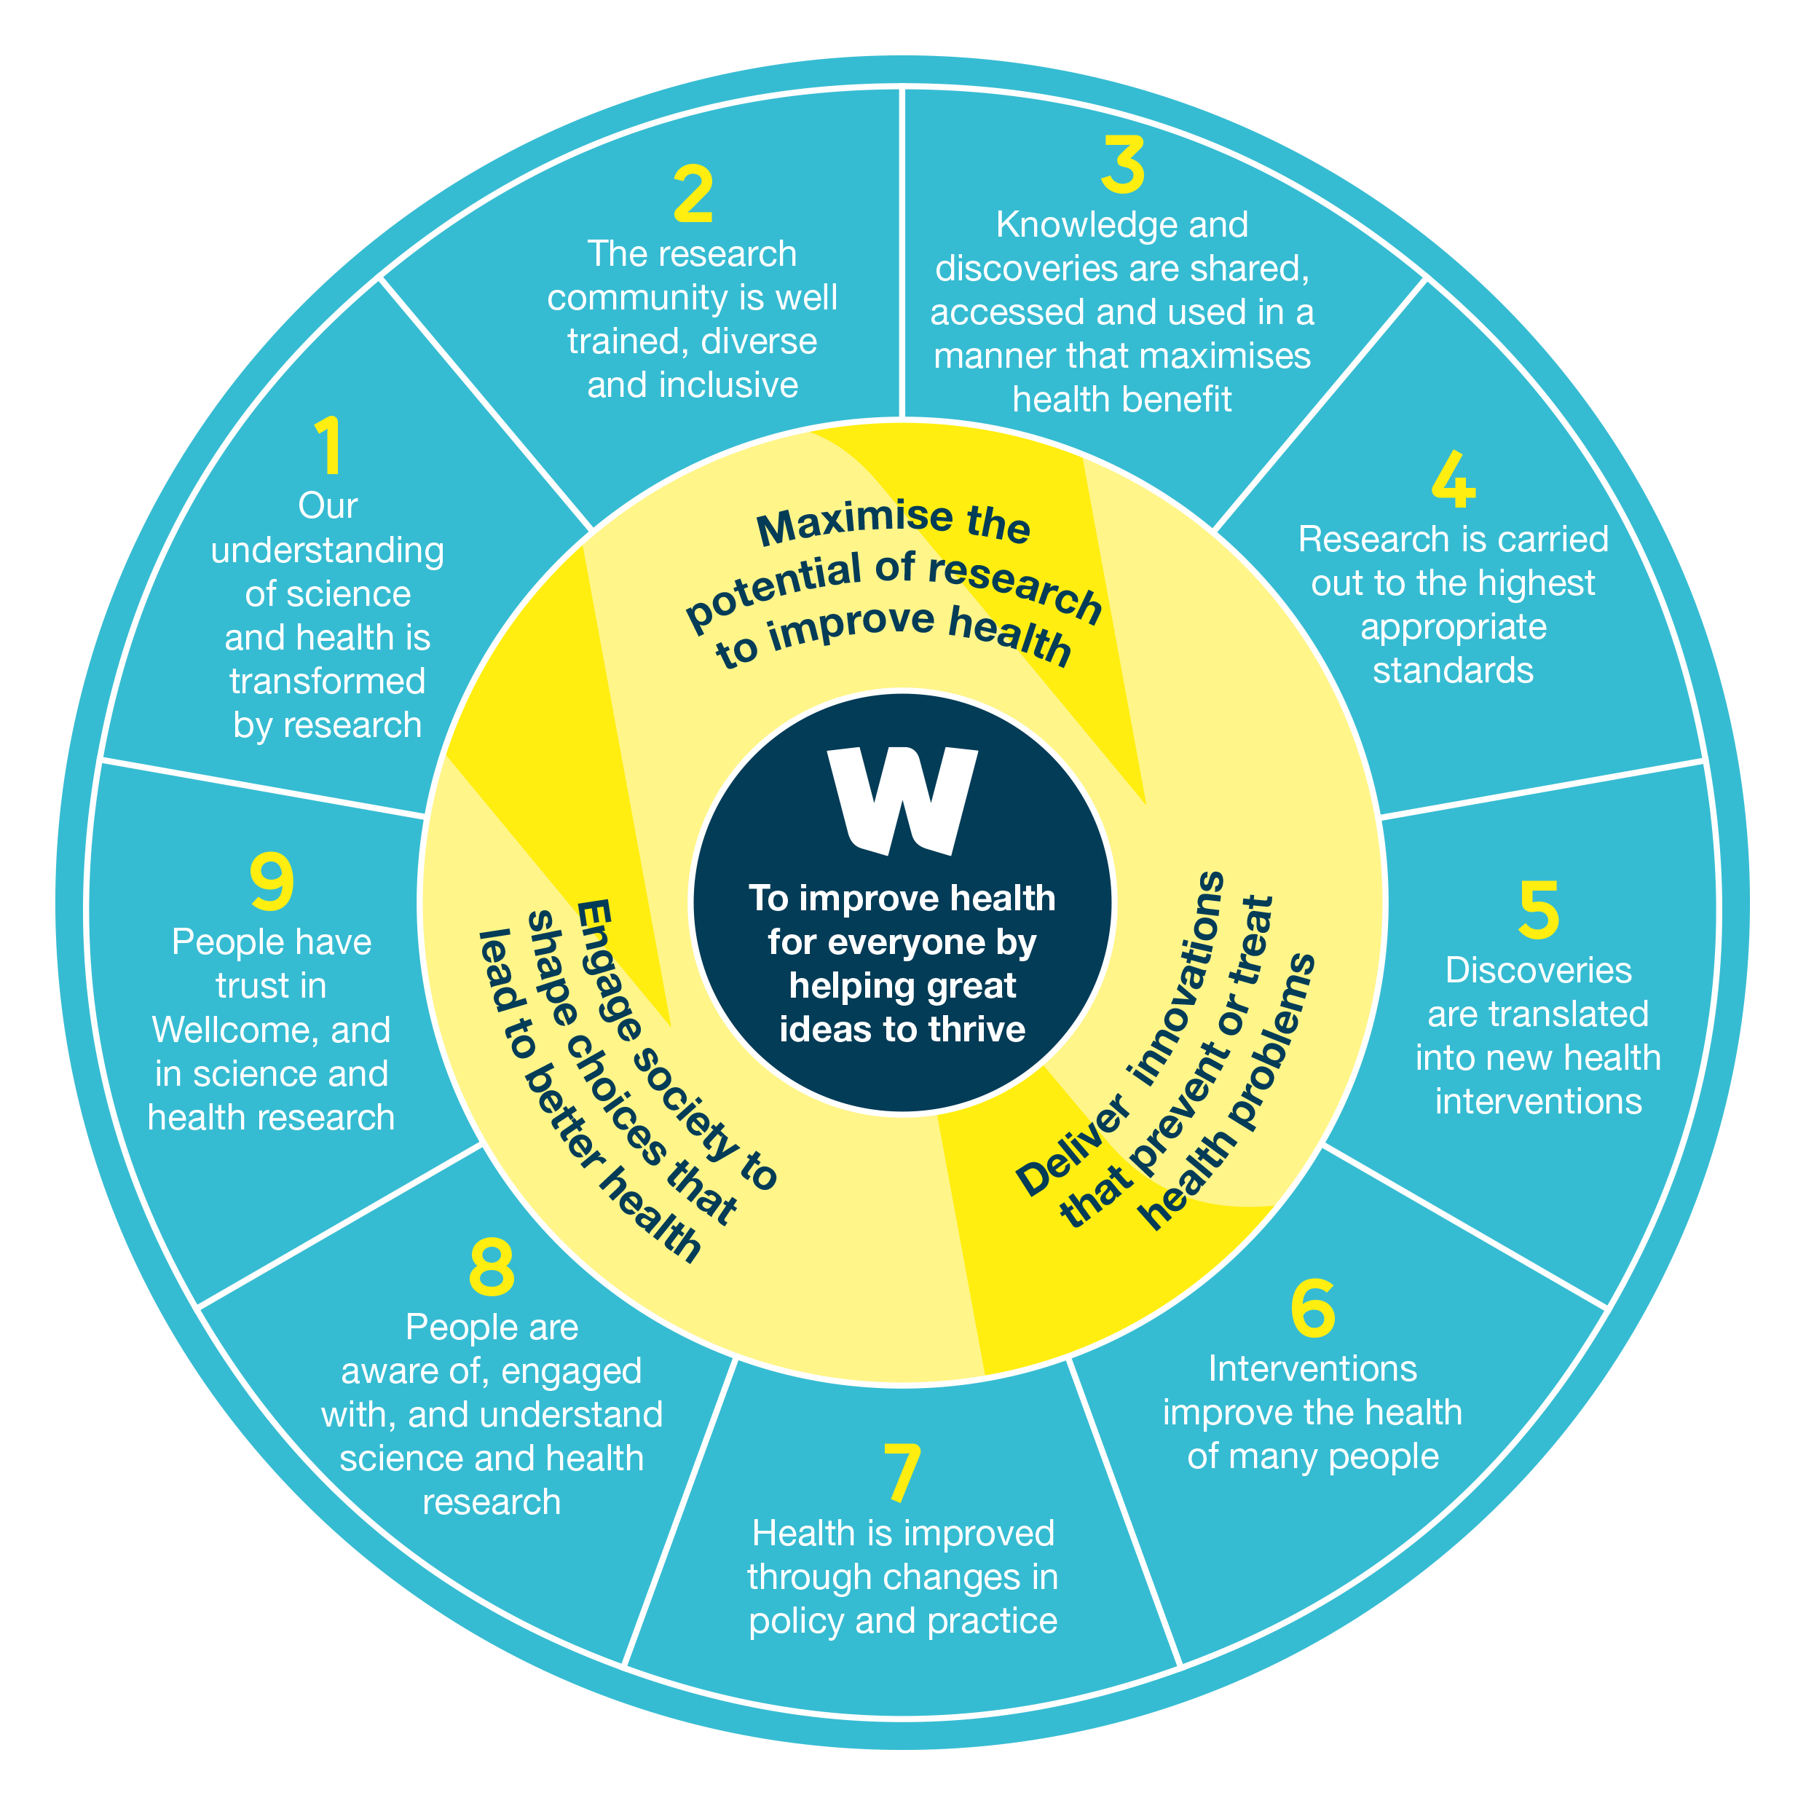
Context
Wellcome success framework
Changing scholarly communications landscape
Increasing cost of delivering OA
Knowledge and discoveries are shared, accessed and used in a manner that maximises health benefit.
Notes:
New publishing models
Increased use of preprints
New publisher business models
Other funders’ policies

Slide 3




Objectives of OA policy review
 | The policy should enable 100% of Wellcome-funded research publications to be made open access
 | The policy should seek to ensure the costs associated with the delivery of policy remain at a level acceptable to Wellcome
 | The policy should support a move to universal OA, where all research literature (regardless of funder) is OA. The policy should be clear, unambiguous and as straight forward as possible to comply with

Slide 4

Stakeholder consultation
Policy informed by significant stakeholder consultation
[Data available on Figshare]
Key takeaway from our researchers –align funder policies
We decided the final policy – based on how it would help us deliver on our mission

Slide 5

Policy summary
Require immediate open access
Previously we allowed a 6-month embargo
All articles must be published under a CCBY licence
Previously the CCBY only applied to Version of Record articles
Fund publication costs - for fully open access journals & platforms
Previously supported/funded hybrid OA; 2 year “sunset clause” for publishers that provide transformative agreements
Mandating pre-printing for public health emergencies
New requirement
Institutions in receipt of our funding to adhere to DORA principles
New requirement

Slide 6
Other elements of the policy (in brief)
Articles must include a statement explaining how others can access the data, software and materials underpinning the research
Page, colour charges will not be funded
Monitoing compliance – and applying sanctions for non-compliance – will remain
No changes to the existing monograph/book chapters policy. Will keep this under review
Policy effective 1st January 2020

Slide 7
What does this mean in practice to Wellcome-funded researchers?
Under this policy Wellcome-funded researchers can publish:
In any OA journal/platform indexed by DOAJ (and which has an Agreement to deposit final version articles in PMC)
In any subscription journal, where the publisher allows researcher to deposit the Author Accepted Manuscript in PMC/EPMC at the time of publication with CCBY licence (e.g. Royal Society)
In any subscription journal where the publisher has negotiated a “transformative OA agreement” (as specified by Jisc Collections, or equivalent) and the researchers’ host institution has “subscribed” to that deal.

Slide 8
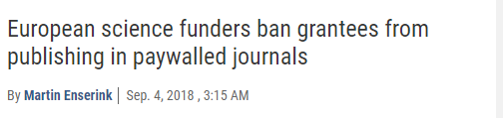
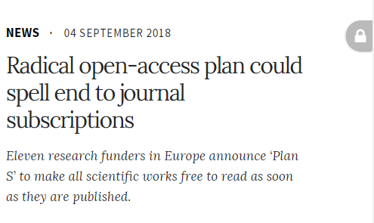
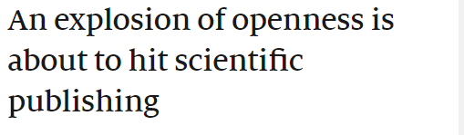
Alignment with “Plan S”
New plan from Science Europe and EC to deliver OA by 2020
Key principle
After 1 January 2020 scientific publications on the results from research funded by public grants provided by national and European research councils and funding bodies, must be published in compliant Open Access Journals or on compliant Open Access Platforms
Now endorsed by 16 funders - including UKRI, EC/ERC, Gates and Wellcome

Slide 9
Other supporting activities
Working with UKRI and ALPSP to fund a study to explore how learned societies can adapt and thrive under Plan S
Call for tenders [closing date 14th January 2019]
Plan S signatories agreed to commission:
Gap analysis to identify fields/disciplines where there is a need to increase number of OA journals and platforms and will establish incentives to fill this gap
Study of OA APC costs
Working with Jisc Collections on agreeing which “transformative agreements” are Wellcome compliant
Highly likely Wiley will have a compliant agreement, thus ensuring that researchers who wish to publish with this company can continue to do so (at least until 2022)
  an independent study on Open Access publication costs and fees (including APCs).

Slide 10

Questions

