Slide 1


Research data management and FAIR sharing: Why we need the big picture
Dr. ir. Shalini Kurapati
Data Steward
Faculty of Technology, Policy and Management
OpenAIRE National Workshop, Turin, 10 Dec 2018

Slide 2
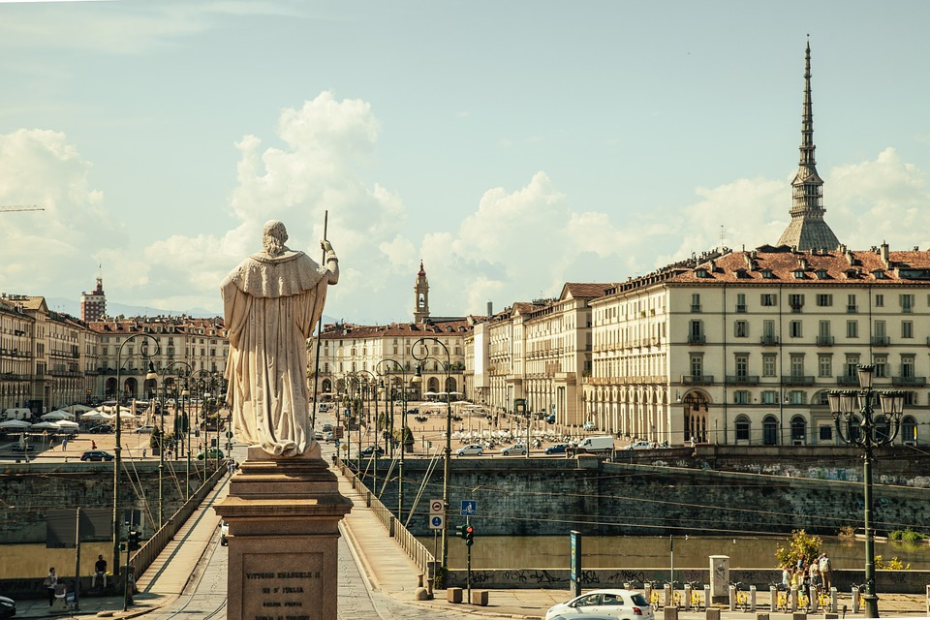
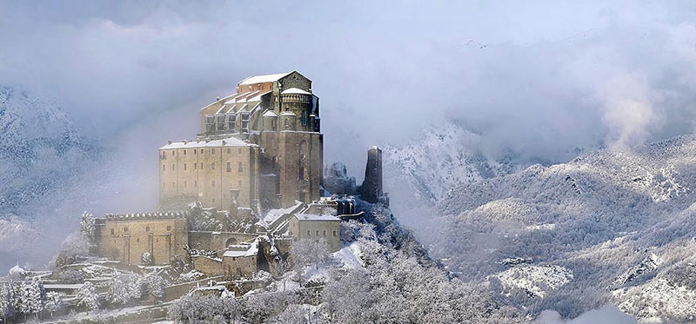
On a personal note
Elio Pallard [CC BY-SA 4.0 (https://creativecommons.org/licenses/by-sa/4.0)]

Slide 3
Outline of my talk
Open Science: Why should you care
Research data management and FAIR data sharing
Institutional good practice:
TU Delft data stewardship
Need for the picture: Potential for EOSC
Today’s slides: https://bit.ly/2PucPAv

Slide 4
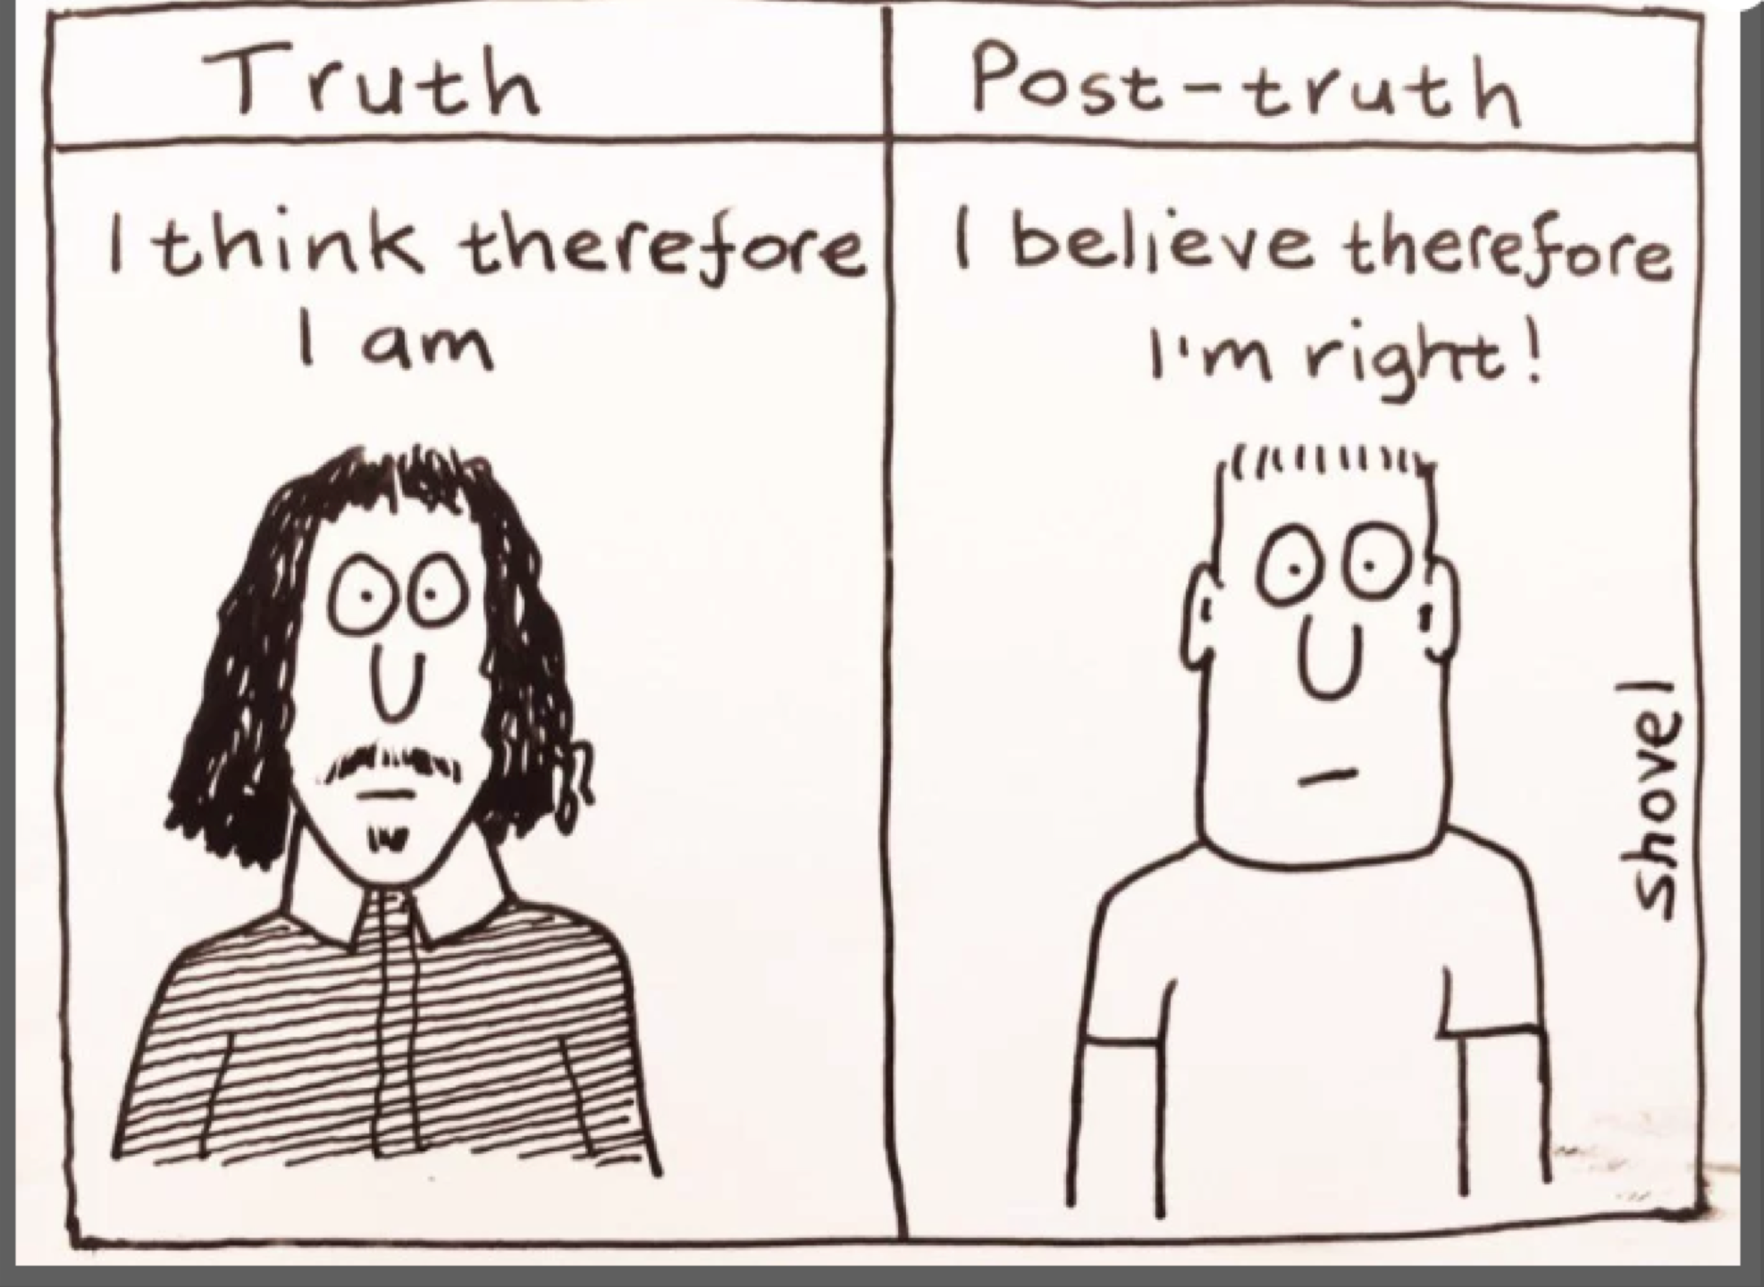
Open Science: Why should you care?
The credibility of science is under threat
Idea source: Dr. Danny Kingsley
https://www.repository.cam.ac.uk/handle/1810/276106
Comic by https://thenorwichradical.com/2017/01/12/post-truth-politics-and-the-war-onintellect/

Slide 5
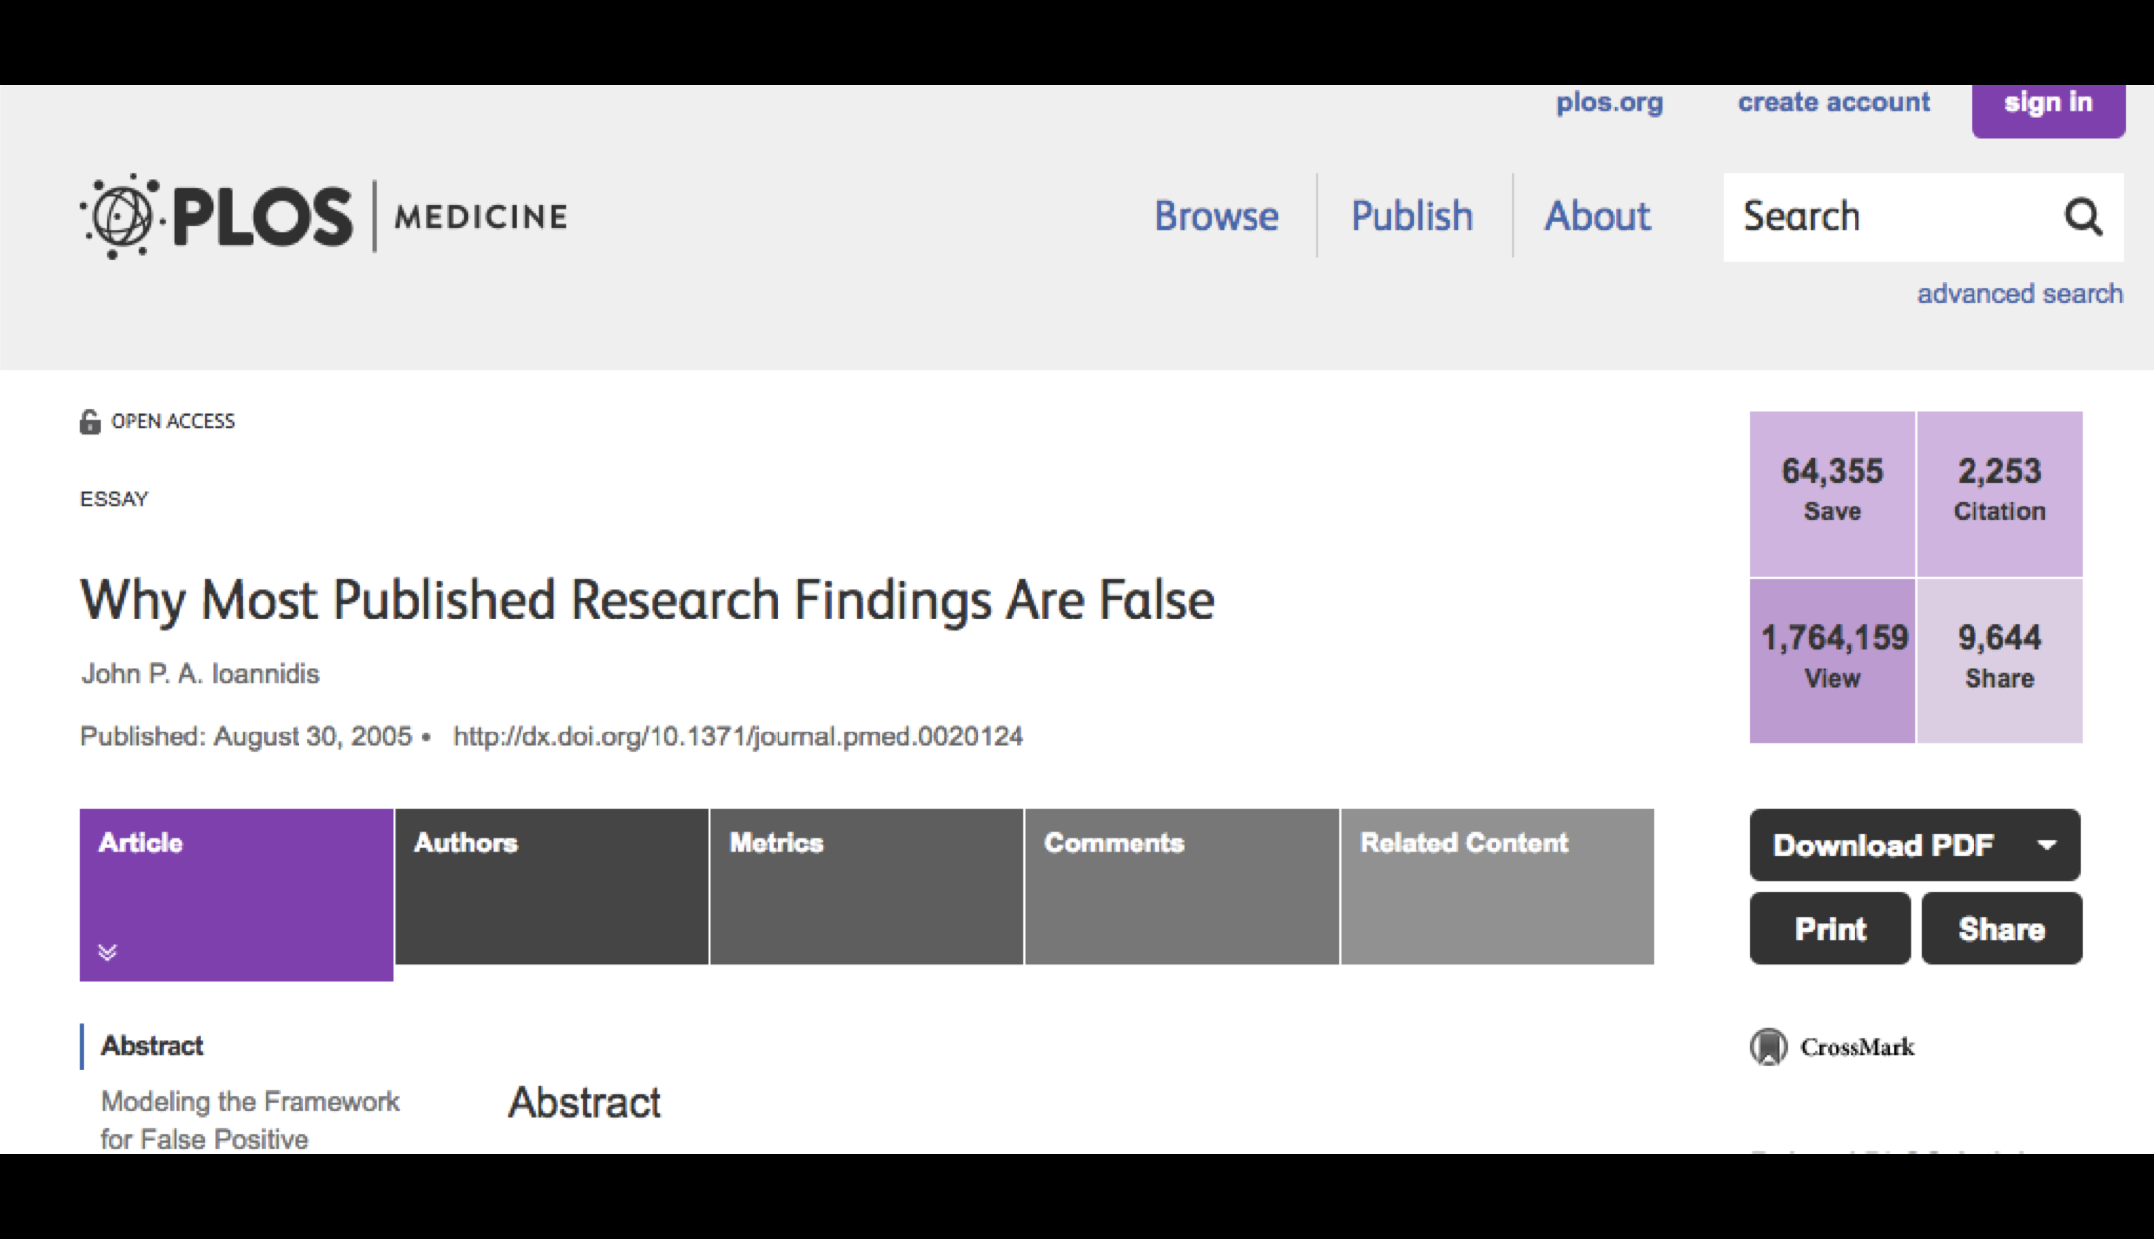
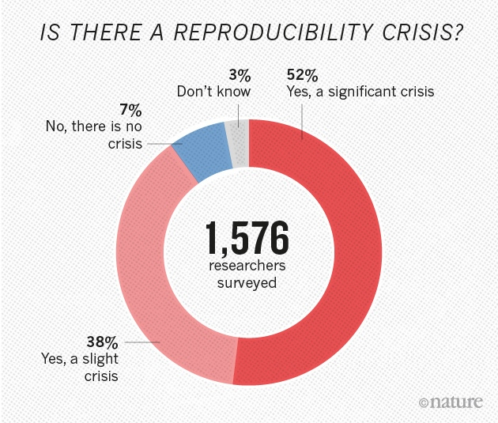
Research reproducibility crisis
http://journals.plos.org/plosmedicine/article?id=10.1371/journal.pmed.0020124
Nature 533, 452–454 (26 May 2016) doi:10.1038/533452a

Slide 6
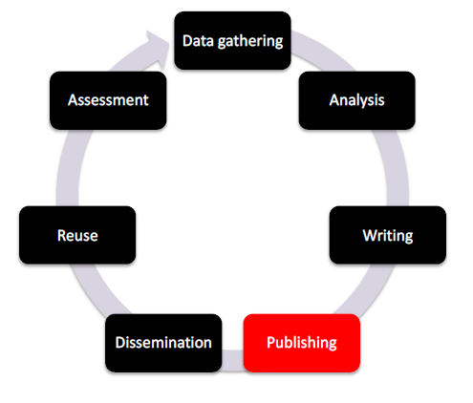
How did we get there
The only thing that counts in academia is
publication of novel results in high impact
journals
Source: Dr. Danny Kingsley
https://www.repository.cam.ac.uk/handle/1810/276106

Slide 7
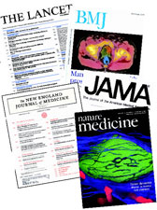
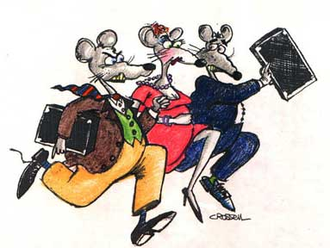
Pressure to publish positive results...
Design the study
Collect data
Analyze data as prespecified
Oops! P> 0.05?
  Torture data until it confesses
Then, and only then… write the manuscript
Adapted from:
Turner, Erick (2016): https://doi.org/10.6084/m9.figshare.3381379.v1
Notes:
Turner, Erick (2016): Peer review After Results are Known: Are we “PARKing” the Cart Before the Horse?. figshare. Presentation.
https://doi.org/10.6084/m9.figshare.3381379.v1

Slide 8
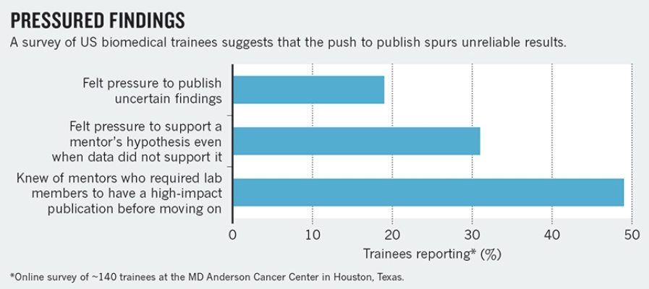
“In many laboratories, the incentives to be first can be stronger than the incentives to be right.”
Nature 525, 25–27 (03 September 2015) doi:10.1038/525025a
Notes:
https://www.nature.com/news/robust-research-institutions-must-do-their-part-for-reproducibility-1.18259?WT.mc_id=TWT_NatureNews

Slide 9
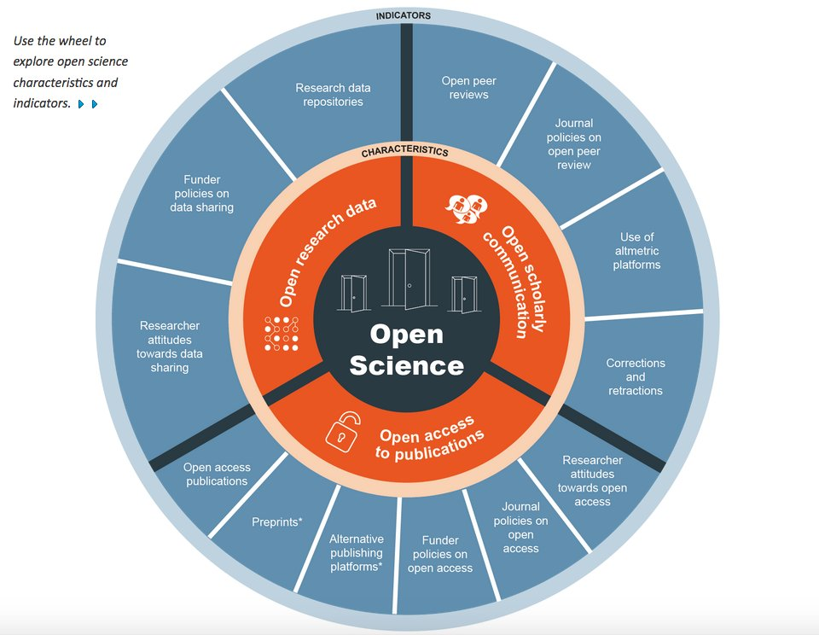
Open Science, RDM & FAIR data can be a solution
http://ec.europa.eu/research/openscience/index.cfm?pg=home&section=monitor

Slide 10
Have you ever thought?
What if someone asks you for data supporting your publication?
What if someone asks you for data supporting your publication, 5 year after publication?
What if the request comes 10 years later?

Slide 11
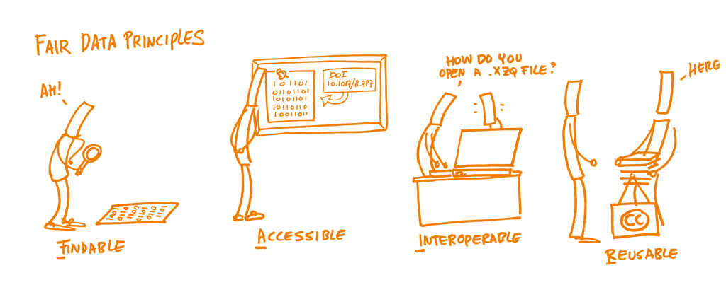
Findable Accessible Interoperable Reusable
Hochstenbach, P. (2018). Open Research Data Material - FAIR data principles. [image] Available at: https://hochstenbach.wordpress.com/ [Accessed 26 Apr. 2018].

Slide 12

Good data management is a prerequisite to open science
It’s not easy, and researchers need support!

Slide 13

Data Stewardship at TU Delft
Aim: to develop mature practices for research data management across the campus.

Slide 14
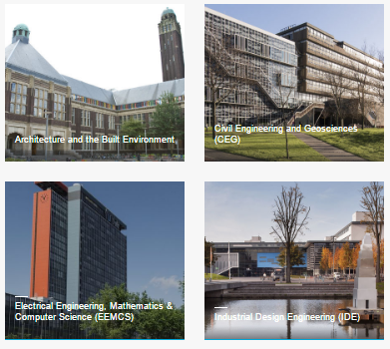
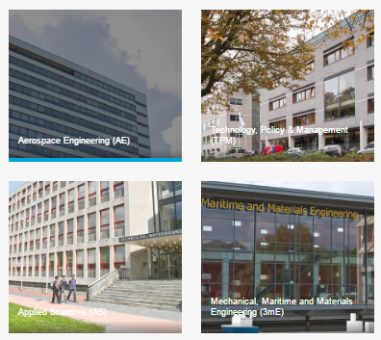
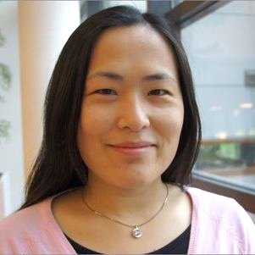
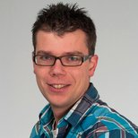
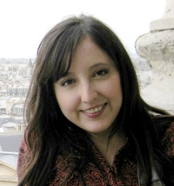
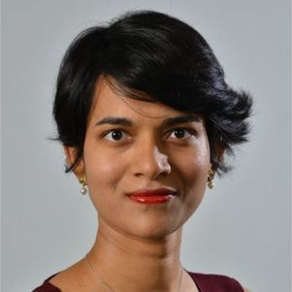
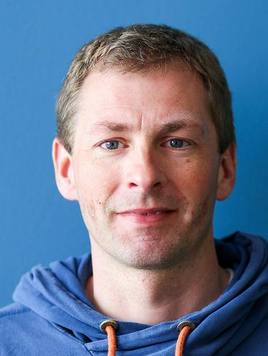
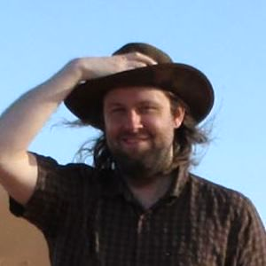
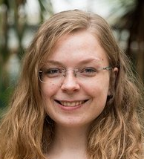
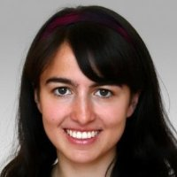
For support to be relevant, it needs to be discipline-specific
We appointed a dedicated Data Steward at every faculty:
all have a PhD (or equivalent)
Training in data management provided: https://openworking.wordpress.com/2017/09/18/training-for-data-stewards/

Slide 15

Who are the data stewards?
First contact points for any data questions
Advocacy and training
Research is central
Consultants, not police!

Slide 16







Data Stewardship at TU Delft
Secure data storage, data sharing, citation, impact
For data management in grant proposals
Advice and templates
Request workshops, information sessions
Data Management Plans
Advice
Archiving
Costs
Compliance
Tools
Training
4TU.Centre for Research Data or disciplinary repositories
With funders' and journals’ policies
For data and software management
http://tudelft.nl/library/datastewards

Slide 17


Raising awareness on archiving solutions: 4TU.Centre for Research Data
  Consortium of three technical universities:
    TU Delft, TU Eindhoven and Twente University, Wageningen university (not a full member)
    But open to everyone
  Certified and trusted research data repository
  Datasets preserved for at least 15 years
  Each Dataset is assigned a DOI
    Over 7,500 datasets
  Data Refinement Fund: €5,000 / dataset
http://researchdata.4tu.nl/en/home/

Slide 18

Community building: Data champions
Community of researchers actively
engaged with open/FAIR science

Slide 19
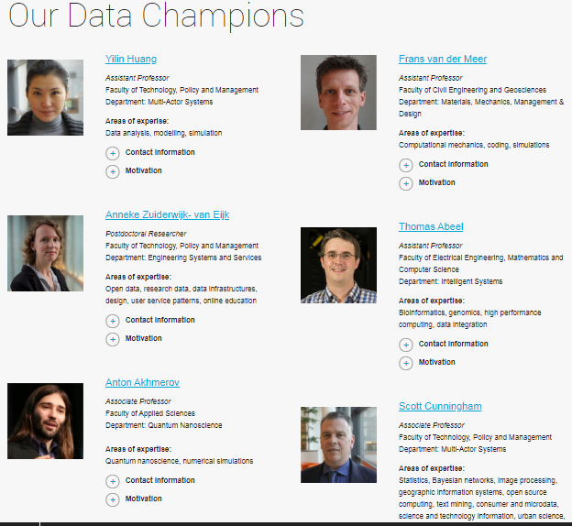
Data champions: Grassroots advocacy
https://www.tudelft.nl/library/our-datachampions

Slide 20
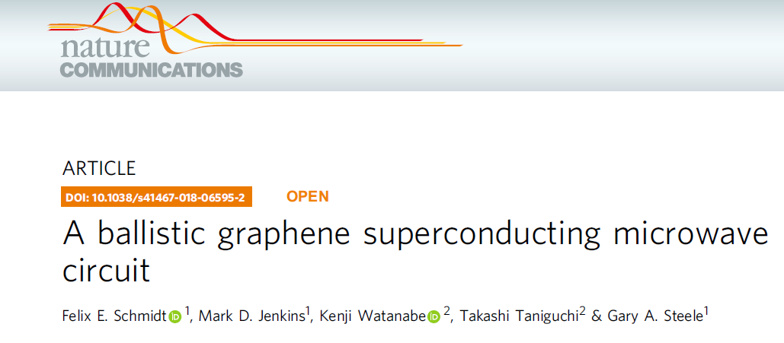
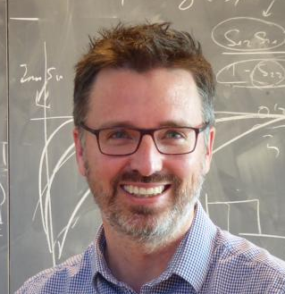
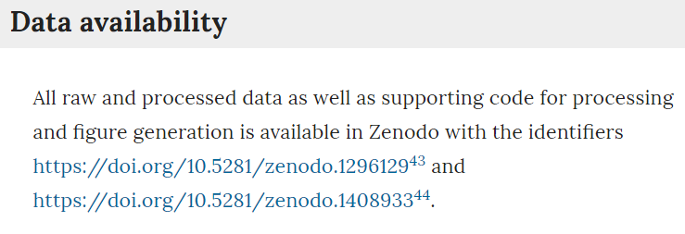
Front Runners: Data Champions

Slide 21
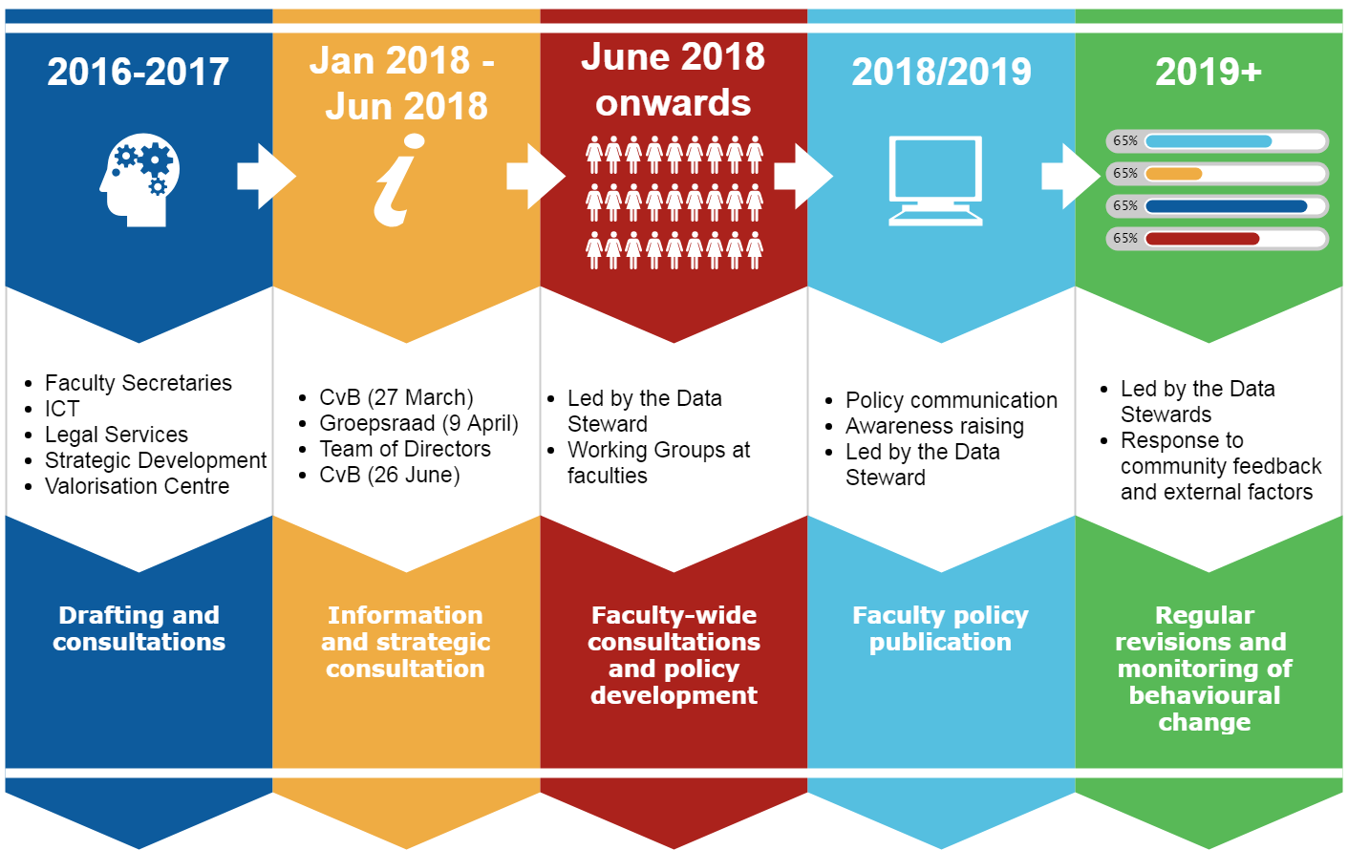
Data stewards lead RDM policy development

Slide 22
These institutional efforts are great but...
The only thing that counts in academia is
publication of novel results in high impact
journals
Source: Dr. Danny Kingsley
https://www.repository.cam.ac.uk/handle/1810/276106

Slide 23
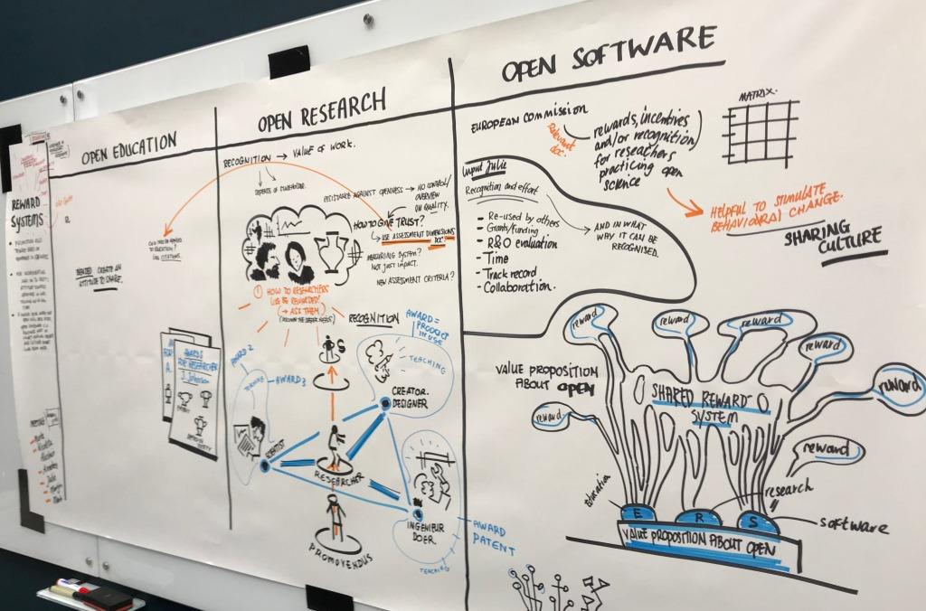
Rewarding researchers for quality (reproducible) research
Copyright: Mark van Huystee
The sketch will be available at:
https://opensketching.weblog.tudelft.nl/

Slide 24

We cannot do this alone
Need for international collaboration

Slide 25
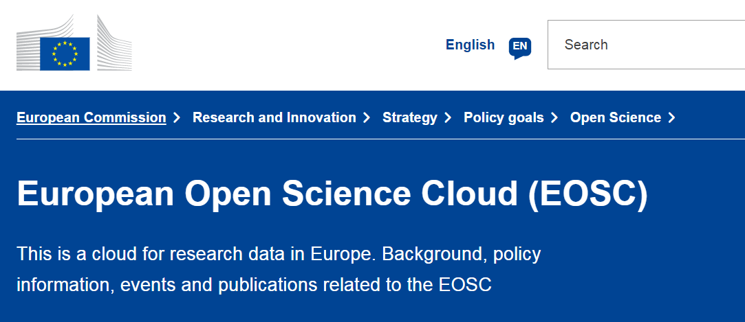
European Open Science Cloud: Can we tap into this opportunity?
http://ec.europa.eu/research/openscience/index.cfm?pg=open-science-cloud#

Slide 26
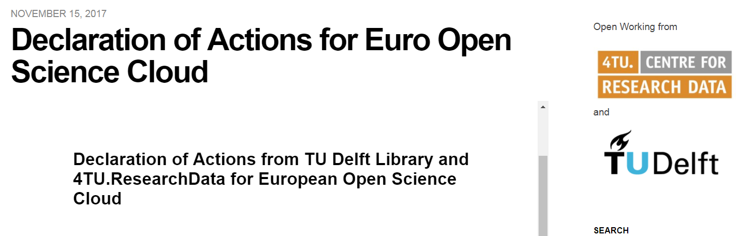
TU Delft endorsed EOSC principles and declared actions
https://openworking.wordpress.com/2017/11/15/declaration-of-actions-for-euro-open-science-cloud/

Slide 27
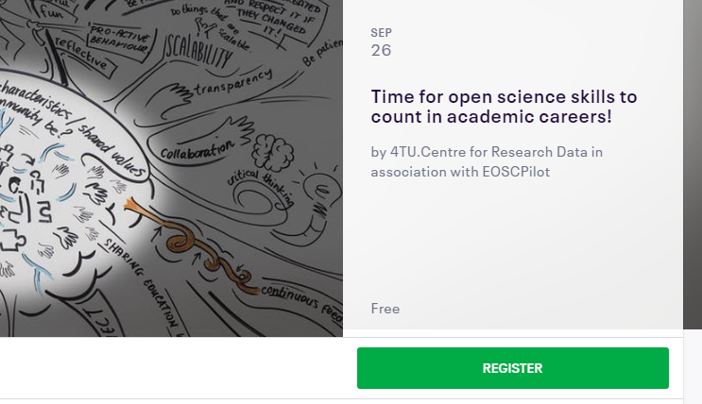
Recent efforts: Open science skills

Slide 28
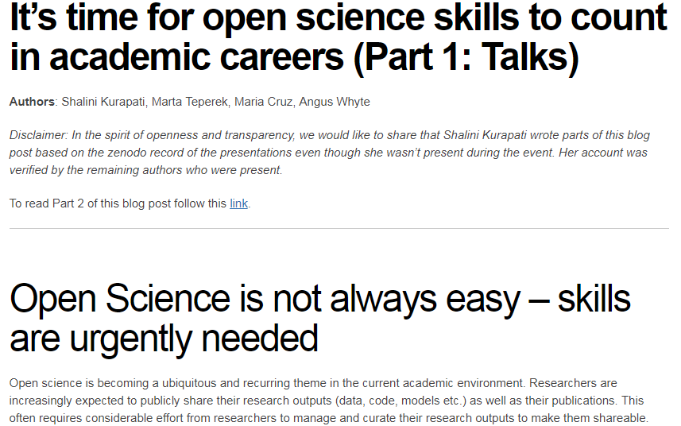
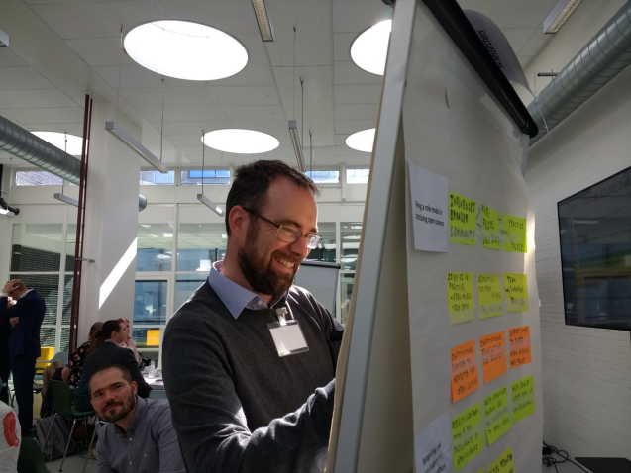
Open science skills workshop
26 Sep 2018 in Delft with EOSCpilot
Researchers at various levels: PhD students, post-docs, tenure trackers and professors together with librarians, support staff, policy makers
Hands-on workshop to identify the key open science science at various career levels
https://openworking.wordpress.com/2018/12/03/its-time-for-open-science-skills-to-count-in-academic-careers-part-1-talks/

Slide 29
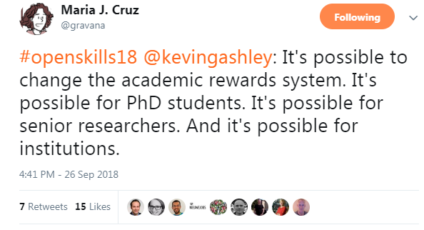
Open Science skills workshop: Main takeaways
Need for proper infrastructure and policy support from institutions
Recognition is the main drivers for both scientific and non-scientific staff to pursue open science
Outputs will be applied in EOSCpilot to help its Skills Framework
And most importantly: everyone can contribute to changing cultures and daily practices.

Slide 30

Taking open science forward, together.
Sharing case studies, good practice, expertise and infrastructure
Advertisement of EOSC resources and services available to the research community
Providing suggestions and community feedback to EOSC

Slide 31
Summary
The importance of open science, RDM and FAIR sharing in today’s world
Experiences from TU Delft data stewardship project
Institutional efforts are great but researchers need to be rewarded everywhere
The need for collaboration and coordinated effort: The EOSC opportunity

Slide 32
And finally..
“Not everything that can be counted counts.
Not everything that counts can be counted.”
― William Bruce Cameron
Questions/ Comments?
Shalini Kurapati
S.Kurapati@tudelft.nl
@shalini_kr
Today’s slides: https://bit.ly/2PucPAv

