Slide 1
cOAlition S: Making full and immediate Open Access a reality
Moving torwads the Implementation of Plan S
OpenAIRE National Workshop
Torino, Italy – 10 December 2018

Slide 2
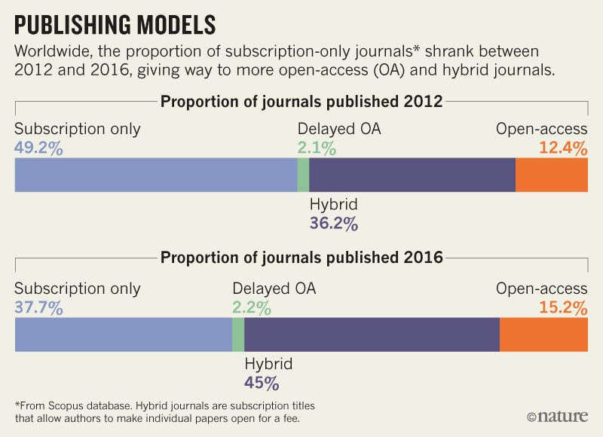
The Reality after 30 years of Open Access

Slide 3
cOAlition S aims for:
Full and immediate Open Access (OA) to publications from publicly funded research
Shift towards new models of academic publishing
A system for scholarly publications that is more transparent, efficient and fair
cOAlition S invites research funders, institutions, researchers, learned societies, and publishers to work together to make this happen

Slide 4


Who is cOAlition S?
Austria: FWF France: ANR Finland: Academy Ireland: SFI Italy: INFN Luxembourg: FNR Netherlands: NWO Norway: RCN Poland: NCN Slovenia: ARRS Sweden: FORMAS, FORTE UK: UKRI | Wellcome Trust Bill and Melinda Gates Foundation Rijksbankens Jubileumsfond (Sweden) Supported by: European Research Council European Commission Coordinated by:

Slide 5
The main principle of Plan S – launched Sept 4 2018
“After 1 January 2020 scientific publications on the results from research funded by public grants provided by national and European research councils and funding bodies, must be published in compliant Open Access Journals or on compliant Open Access Platforms.”

Slide 6

The 10 Principles of Plan S
Authors retain copyright of their publication with no restrictions. All publications must be published under an open license, preferably the Creative Commons Attribution Licence CC BY. In all cases, the license applied should fulfil the requirements defined by the Berlin Declaration; The Funders will ensure jointly the establishment of robust criteria and requirements for the services that compliant high quality Open Access journals and Open Access platforms must provide; In case such high quality Open Access journals or platforms do not yet exist, the Funders will, in a coordinated way, provide incentives to establish and support them when appropriate; support will also be provided for Open Access infrastructures where necessary; Where applicable, Open Access publication fees are covered by the Funders or universities, not by individual researchers; it is acknowledged that all scientists should be able to publish their work Open Access even if their institutions have limited means; | When Open Access publication fees are applied, their funding is standardised and capped (across Europe); The Funders will ask universities, research organisations, and libraries to align their policies and strategies, notably to ensure transparency; The above principles shall apply to all types of scholarly publications, but it is understood that the timeline to achieve Open Access for monographs and books may be longer than 1 January 2020; The importance of open archives and repositories for hosting research outputs is acknowledged because of their long-term archiving function and their potential for editorial innovation; The ‘hybrid’ model of publishing is not compliant with the above principles; The Funders will monitor compliance and sanction non-compliance.

Slide 7
Is Plan S different from other initiatives?
Plan S aims to align national OA policies Plan S entails mandating OA by funders Funders commit to cover costs (APCs, platforms, journal flipping) Plan S sets a clear timeline: 2020, with transition periods Plan S is about principles, not about particular publication models

Slide 8
Plan S : Strong principles
No publication should be locked behind a paywall OA must be immediate, i.e. no embargo periods Publication under an open license; no transfer/licensing of copyright No hybrid model of publication, except as a transitional arrangement with a clearly defined endpoint

Slide 9
Roads to compliance with Plan S
cOAlition S «Guidance to Implementation» specify the roads to compliance
cOAlition S members will ensure financial support for OA publishing via the prescribed routes to compliance
In 2023 cOAlition S will review the effects of Plan S on achieving a transition to full and immediate OA
Open Access journals or Open Access platforms | Deposition of scholarly articles in Open Access repositories without embargo | Hybrid journals under Transformative agreements

Slide 10
Requirements for compliance
CC-BY 4.0 license required
Scholarly articles reviewed according to the standards within the relevant discipline, and according to the standards of the Committee on Publication Ethics (COPE)
Open Access journals or Open Access platforms | Deposition of scholarly articles in Open Access repositories without embargo | Hybrid journals under Transformative agreements
DOAJ registered | Version of Record (VoR) or Author's Accepted Manuscript (AAM) OpenDOAR registered | Journal committed to a full OA transition

Slide 11
Authors retain copyright of their publication with no restrictions
  For scholarly articles the public should be granted a worldwide, royalty-free, non-exclusive, irrevocable license to share and adapt the work for any purpose, including commercially, provided proper attribution is given to the author.
  For scholarly articles, cOAlition S requires the use of the Creative Commons Attribution (CC BY) 4.0 license.

Slide 12
Robust criteria and requirements for the services provided by OA Journals and OA Platforms
The journal/platform must be registered in the Directory of Open Access Journals (DOAJ)
All scholarly content without exception must be openly accessible and free to read and download immediately upon publication
The journal/platform must enable authors to publish under a CC BY 4.0 licence
The journal/platform must offer authors/institutions the option of full copyright retention without any restrictions, i.e. no copyright transfer or license to publish that strips the author of essential rights;

Slide 13
Support mechanisms for establishing
OA Journals/Platforms and open infrastructures
  cOAlition S will
    commission a gap analysis of Open Access journals to identify fields and disciplines where there is a need to increase the share of OA journals.
    collectively provide incentives for establishing OA journals/platforms or flipping existing journals to OA, in particular where there are gaps and needs.

Slide 14
Open Access Publication fees (APCs)
  Recognise the importance of ‘fee-free’ OA Journals and Platforms
  Pay a fair and reasonable APC level that reflects the costs involved in the quality assurance, editing and publishing process, and including equitable waiver policies
  Calls for full transparency and monitoring of Open Access publication costs and fees.
  To help inform the potential standardisation of fees and/or APC caps, cOAlition S will commission an independent study on OA publication costs and fees (including APCs)

Slide 15
Open archives and repositories - requirements for authors and publishers
A copy of the published work must be openly available in a compliant repository under the Plan S conditions without cost for the depositor/author if it is not available in an OA journal or platform
Version of Record (VoR) or at least the Author’s Accepted Manuscript (AAM); no embargo period; Authors/ institutions must retain copyright and articles available under CC BY 4.0 license
The self-archiving ('green OA') policy of the venue must be registered in Sherpa/Romeo
The repositories must be registered in the directory of open access repositories open DOAR or in the process of being registered.

Slide 16
Hybrid model of publishing
Funding for publishing in hybrid journals is only supported if the journals concerned are part of transformative agreements
From 2020 onwards, new agreements will need to fulfil certain conditions to achieve compliance with Plan S, including how the publication will be converted to full OA after the contract expires
Mirror journals with one part being subscription based and the other part being Open Access are not compliant with Plan S unless they are a part of a transformative agreement

Slide 17
Timeline – options for cOAlition S members
Implementation of Plan S will take place from January 1 2020, having impact on either
  existing grants
  new projects/grants
  new calls

Slide 18
Public consultation
cOAlition S invites all stakeholders to participate in open consultation from November 27 2018 to the end of February 2019.
cOAlition S will the update the Guidance document during the spring of 2019
Individual cOAlition S member organizations will then implement through their policies and contractual requirements in their different contexts from 2020

