Slide 1
Emma Lazzeri
OpenAIRE National Open Access Desk – Italy
Istituto di Scienza e Tecnologie dellInformazione CNR, Pisa, Italy
OpenAIRE
An e-infrastructure for European Research

Slide 2

Why OpenAIRE?

Slide 3



Open Access Infrastructure for Research in Europe
OpenAIRE was born in 2007 thanks to the participation of 28 european countries to support the implementation of the Open Access European Commission Pilot Programme that formally started in 2008.
OpenAIRE National Workshop,
The future of scholarly communication in Europe
| Torino | 10 December 2018

Slide 4
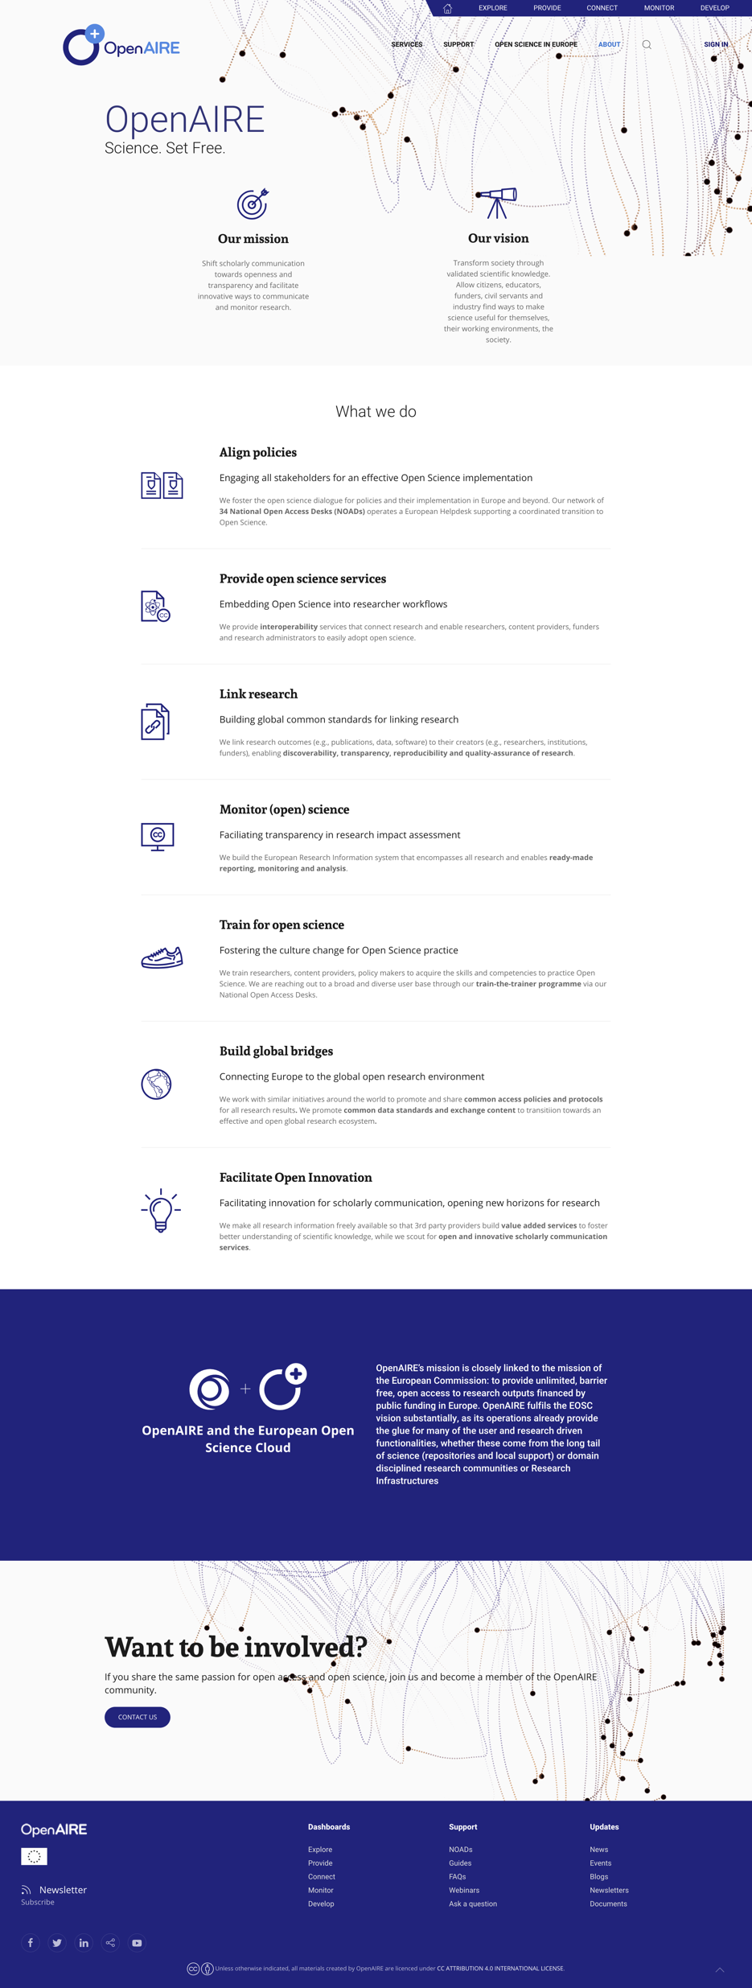
What does OpenAIRE do?
Implement and align Open Science policies across Europe and the world
Deploy services to embed Open Science into researcher workflows
Train for Open Science, for FAIR Science
Develop global open standards for linking all research
Monitor Open Science in Europe
Connect European Open Science to the World
Foster open innovation for added value services on open research
OpenAIRE National Workshop,
The future of scholarly communication in Europe
| Torino | 10 December 2018

Slide 5

OpenAIRE is not just about open access to publications…
Open research data
Open software
Open methodologies/protocols
Open educational resources
Open processes
Open research to non-researchers
All linked together -
360⁰ view of research
Courtesy of Natalia Manola, OpenAIRE
OpenAIRE National Workshop,
The future of scholarly communication in Europe
| Torino | 10 December 2018
Notes:
Risorse didattiche
Citisen science and Open Innovation programmes

Slide 6
How does it work?

Slide 7


















Funding
Research Products
Research
Idea
Open Repository
Monitor
Share
Search
Re-use
OpenAIRE National Workshop,
The future of scholarly communication in Europe
| Torino | 10 December 2018

Slide 8
Funding
Research Products
Research
Idea
Open Repository
Monitor
Share
Search
Re-use
OpenAIRE National Workshop,
The future of scholarly communication in Europe
| Torino | 10 December 2018

Slide 9



















Funding
Research Products
Research
Idea
Open Repository
Monitor
Share
Search
Re-use
OpenAIRE National Workshop,
The future of scholarly communication in Europe
| Torino | 10 December 2018

Slide 10
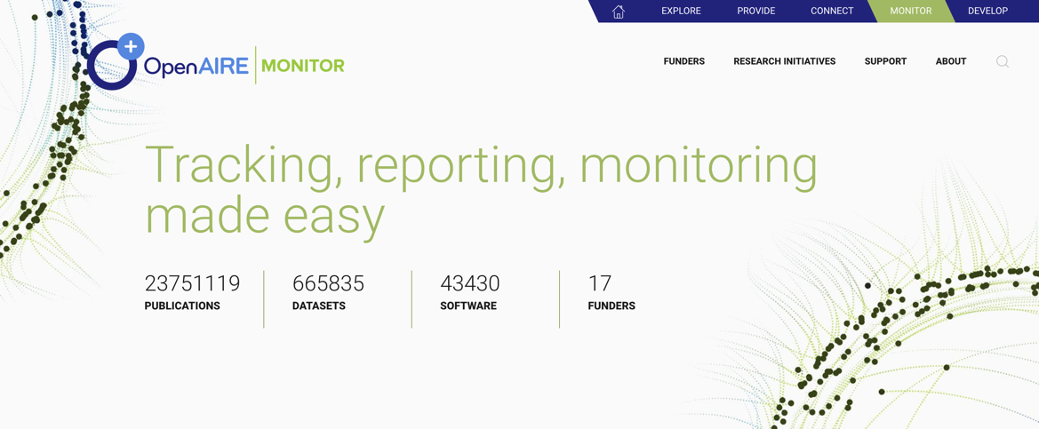
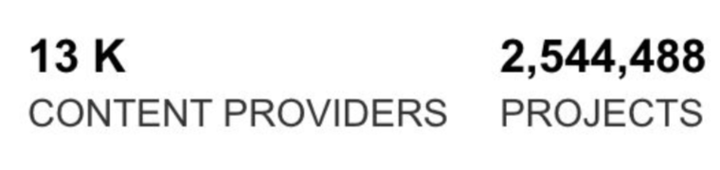
Soon also MIUR
PRIN and SIR programmes
OpenAIRE National Workshop,
The future of scholarly communication in Europe
| Torino | 10 December 2018

Slide 11
What we do for Open Science
Monitor
Open Science
Research outcomes
Accelerate
Interoperability
Exchange
Support
OS Helpdesk
RDM services
For funders, institutions, RIs, initiatives
For Content providers, RIs
Services &
Support
For Researchers, …
OpenAIRE National Workshop,
The future of scholarly communication in Europe
| Torino | 10 December 2018

Slide 12


People

Slide 13
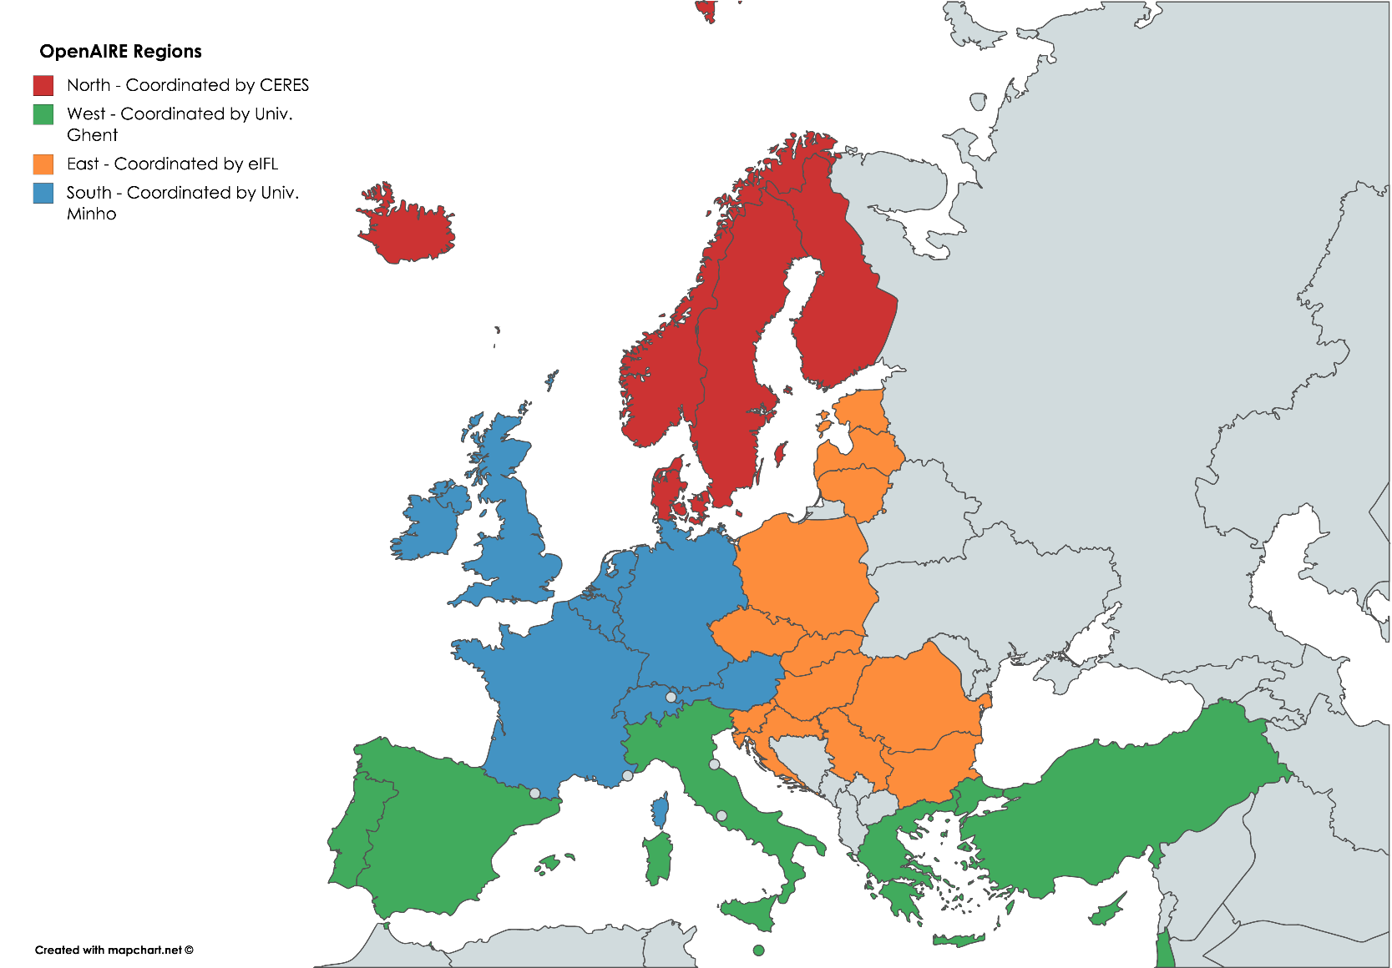
National Open Access Desks (NOADs)
Facts
Research is global, support is local
Diversity in culture & maturity of national/local infras
Not one size fits all in OA and open science
Our pan-European network
⇢ 34 countries
Key national organizations
⇢ 4 area coordinators
Moving to OS
Linked to infras around the world
OpenAIRE National Workshop,
The future of scholarly communication in Europe
| Torino | 10 December 2018
Courtesy of Natalia Manola, OpenAIRE

Slide 14
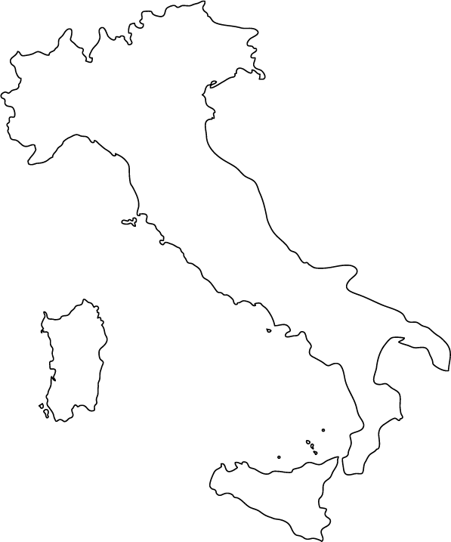


OpenAIRE NOAD in Italy
Elena Giglia
Unità di progetto Open Access
Direzione Ricerca e Terza Missione
Universita' degli Studi di Torino
noad-it@openaire.eu
Emma Lazzeri
CNR – Istituto di Scienze e
Tecnologie dell’Informazione
Pisa
It’s people that makes the difference!
OpenAIRE National Workshop,
The future of scholarly communication in Europe
| Torino | 10 December 2018

Slide 15
What we support
OS policies
Harmonization for policy makers
Infrastructure
Interoperability
Open Research Data
FAIR
OA to publications
Guides
Training
Support
Connectivity
Setup
Repositories
Open data
Compliance
Licenses
Compliance
Legal
Tools
Tools/repositories
OpenAIRE National Workshop,
The future of scholarly communication in Europe
| Torino | 10 December 2018
Courtesy of Natalia Manola, OpenAIRE

Slide 16
How we support
Distributed and hierarchical training: train-the-trainers
NOADs ⇢ National / research infras, organizations ⇢ Researchers
RESOURCES
TRAINING
HELPDESK
FAQs
OA guides
Copyright issues
Factsheets
Webinars
Workshops
Ask a question
OpenAIRE National Workshop,
The future of scholarly communication in Europe
| Torino | 10 December 2018
Courtesy of Natalia Manola, OpenAIRE
Notes:
OpenAIRE supports the various Open Access policies in the European Research Area. OpenAIRE offers a variety of resources and support info materials, and if you still have questions – helpdesk.

Slide 17
Services

Slide 18
OpenAIRE Advance
One of the main goals in the new phase of OpenAIRE is to repackage services providing them as complete products.
OpenAIRE National Workshop,
The future of scholarly communication in Europe
| Torino | 10 December 2018

Slide 19
How?
Listen to end users
To provide Dashboard
Working to bundle the current services into products to address specific stakeholders’ needs and Product Management processes.
For Research Communities
Content Providers; Monitor: for funders, institutions and projects. Plus Explore service for All.
OpenAIRE National Workshop,
The future of scholarly communication in Europe
| Torino | 10 December 2018

Slide 20







Services for All
Funders OA Mandates Support
OA to Pubblications
and Data support
OS Policy Support
Providers compatibility
DMP training
and support
Dashboard
Monitor
Dashboard
Open Innovation Programme
Dashboard
Dashboard
OS Policy Support
Community outreach
Monitor
OpenAIRE National Workshop,
The future of scholarly communication in Europe
| Torino | 10 December 2018
Notes:
Supportare l’adozione di policy nelle istituzioni,
Avere contatti e lavorare con CRUI, con ANVUR per aumentare la sensibilizzazione su questi temi.
promuovere la creazione di collaborazione anche tra atenei e tra enti di ricerca e atenei sui temi dell'Open Science
Webinar informativi/formativi con un taglio pratico a partire da settembre
MIUR come funder di OpenAIRE

Slide 21
15+ Services
From basic infrastructure level to value added

Slide 22





















OpenAIRE National Workshop,
The future of scholarly communication in Europe
| Torino | 10 December 2018
Courtesy of P. Principe and I. Fava, OpenAIRE

Slide 23
one stop shop for all
OpenAIRE content providers
Services for repository managers, OA publishers
DASHBOARD
FOR CONTENT PROVIDERS

Slide 24
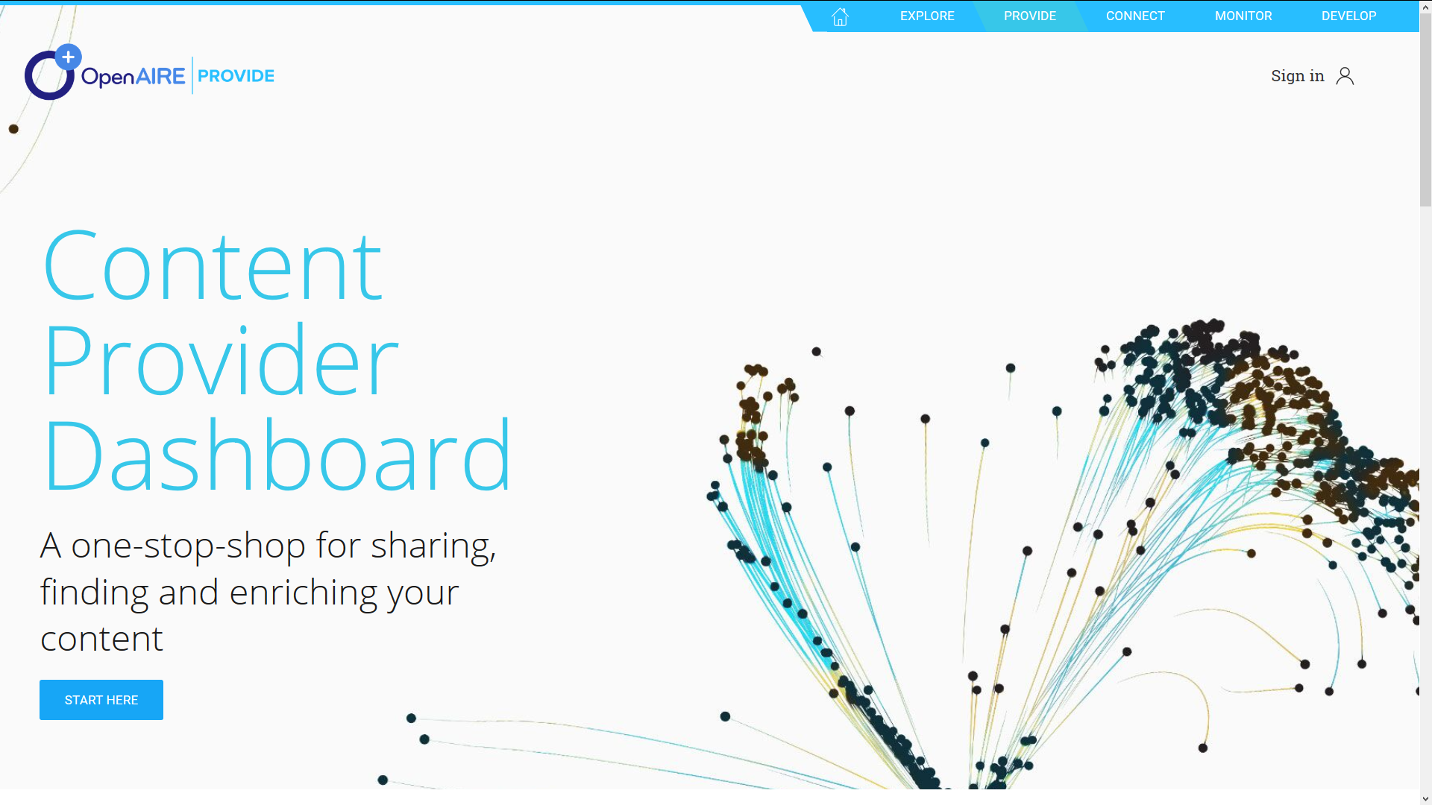
provide.openaire.eu
OpenAIRE National Workshop,
The future of scholarly communication in Europe
| Torino | 10 December 2018
Courtesy of P. Principe and I. Fava, OpenAIRE

Slide 25
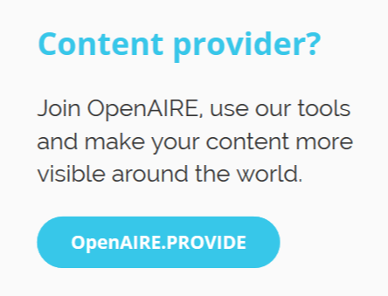
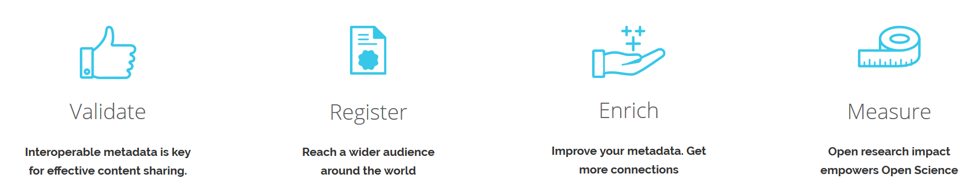
OpenAIRE National Workshop,
The future of scholarly communication in Europe
| Torino | 10 December 2018
Courtesy of P. Principe and I. Fava, OpenAIRE

Slide 26
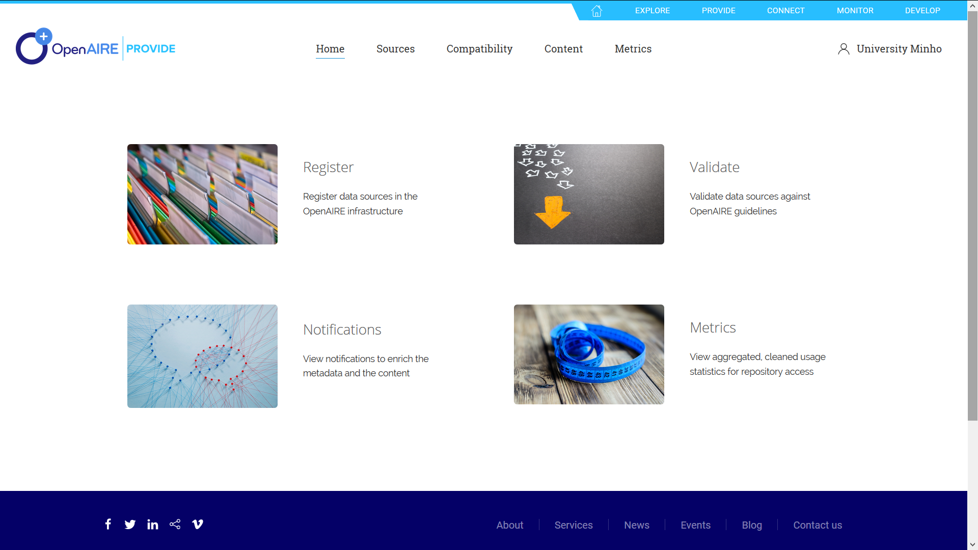
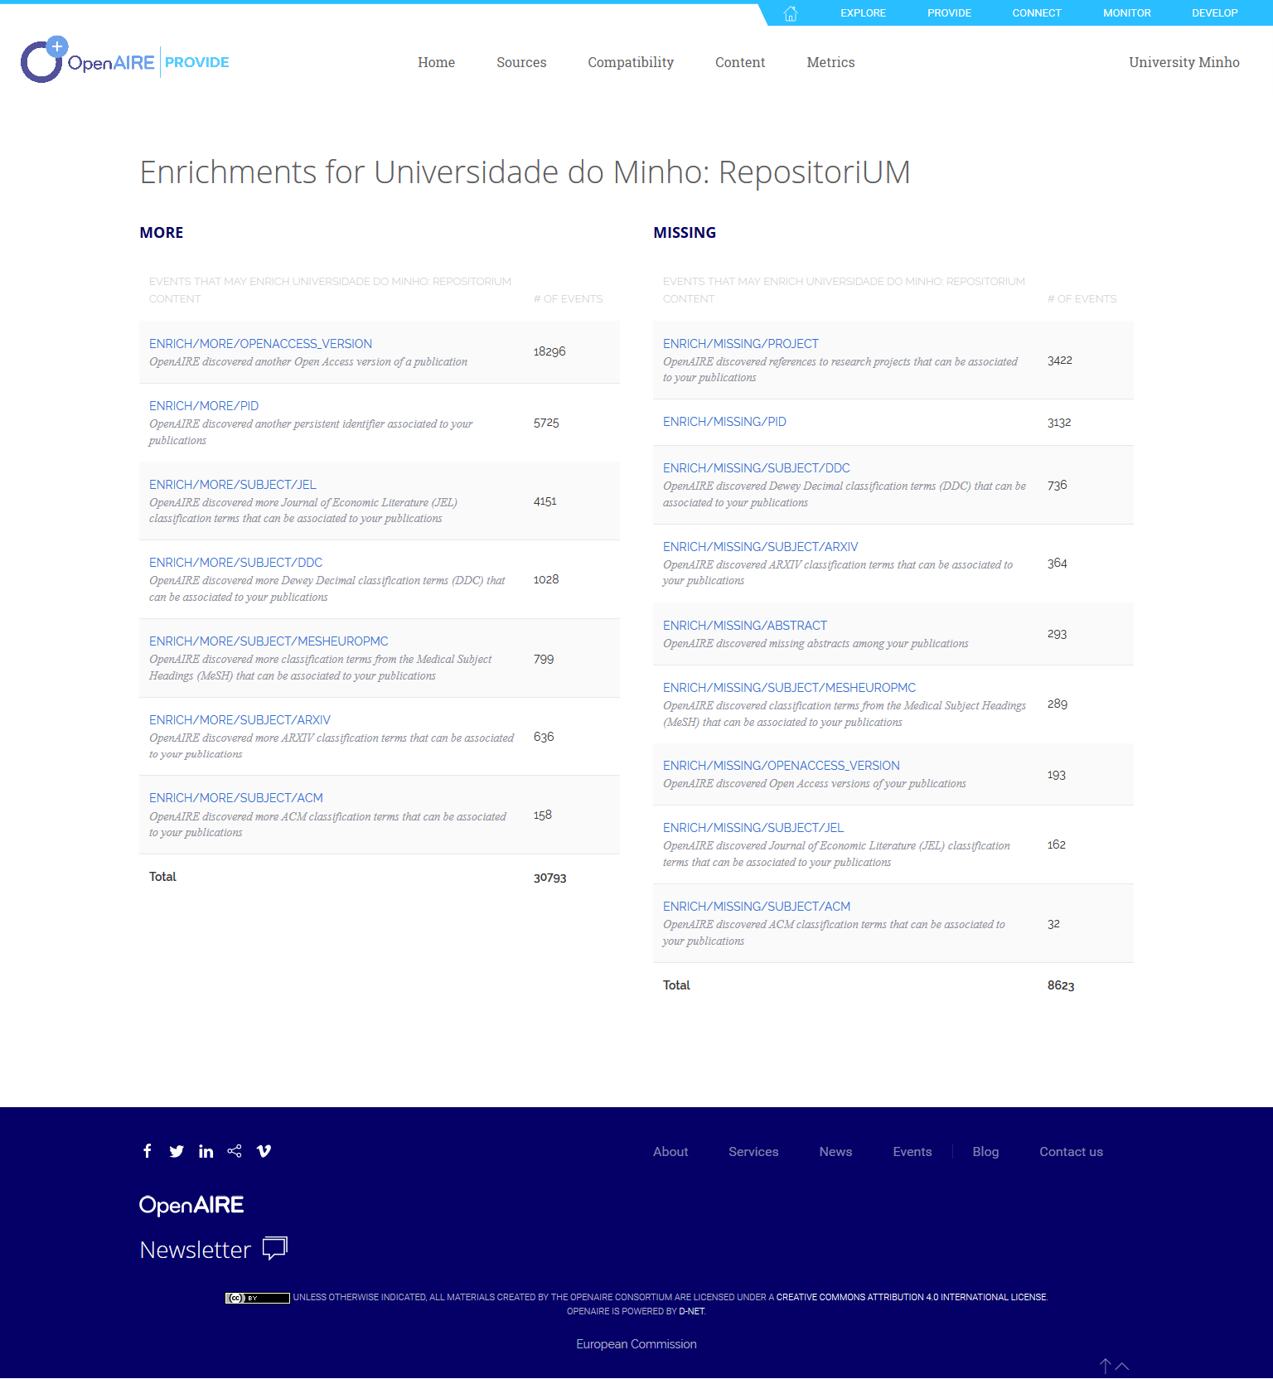
METADATA ENRICHMENTS FROM THE OPENAIRE BROKER SERVICE (monthly notifications)

Slide 27
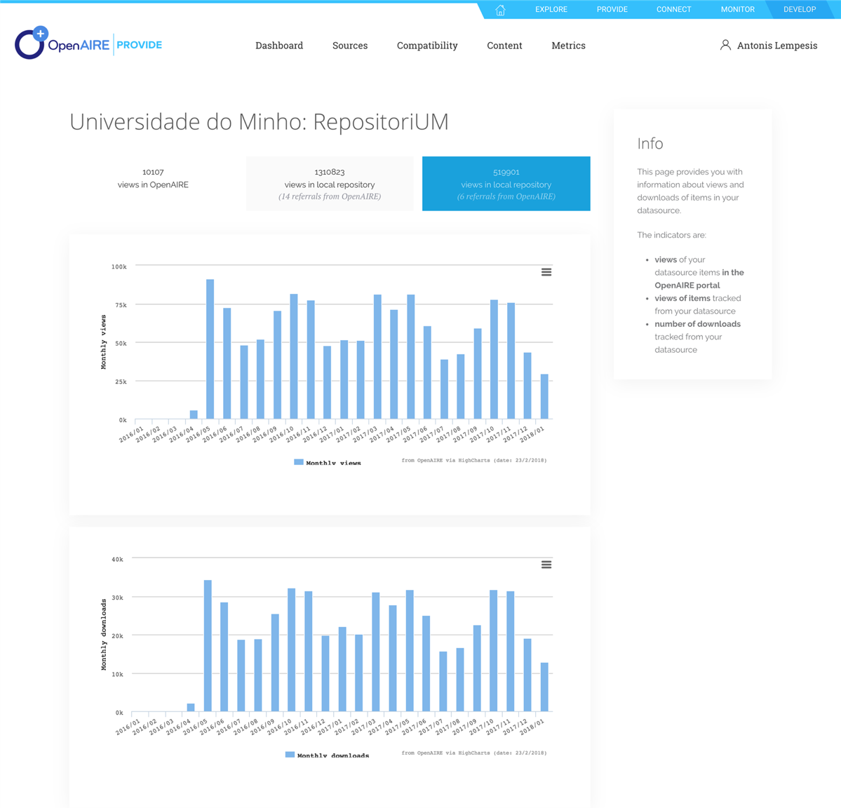
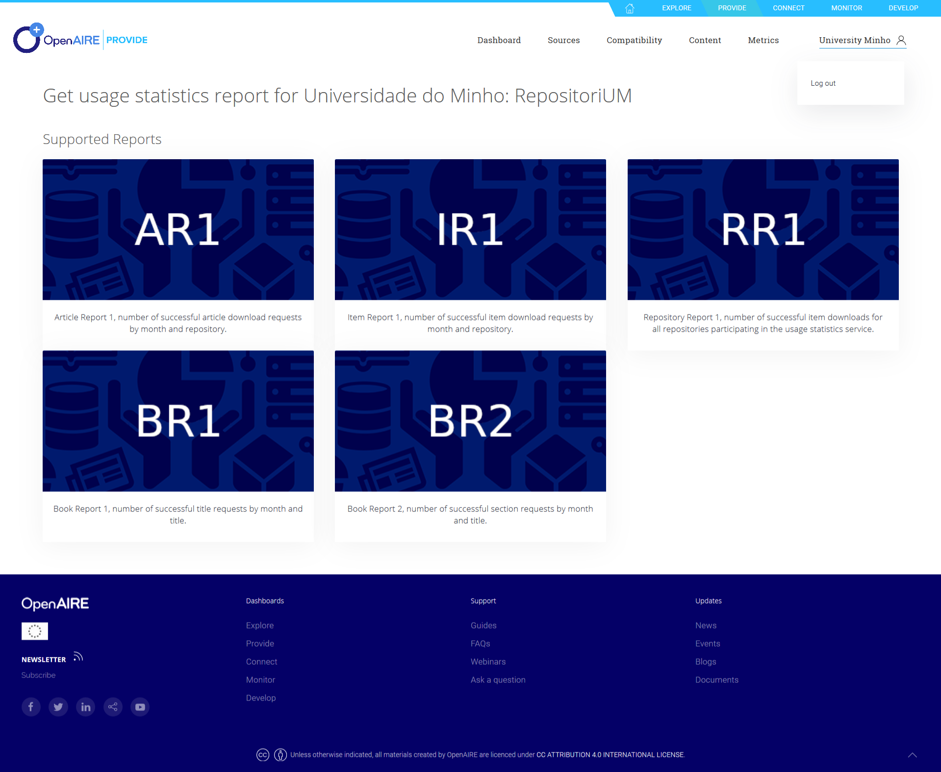
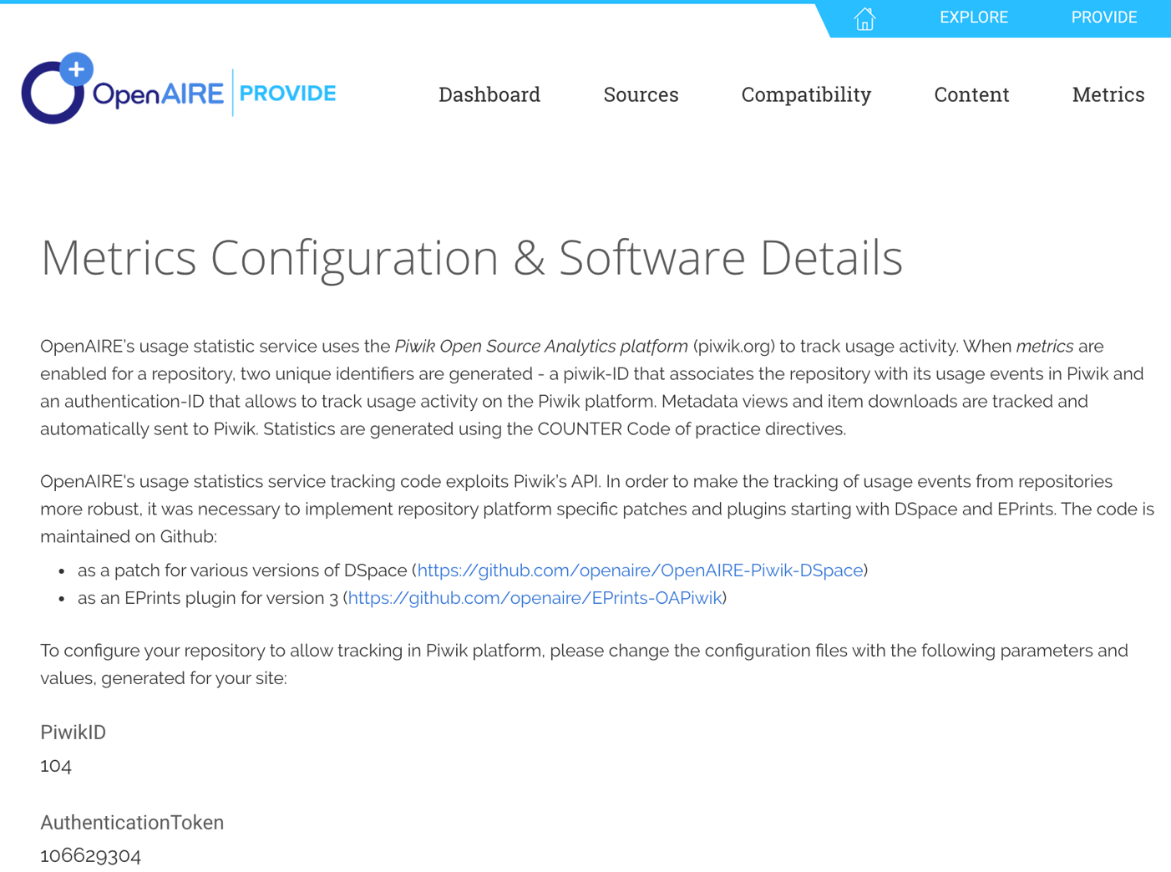
THE SERVICE COLLECTS AND EXPLOITS USAGE METRICS LIKE DOWNLOADS AND METADATA VIEWS.
Courtesy of P. Principe and I. Fava, OpenAIRE

Slide 28
one stop shop for your
Open Science needs
A window to community’s research. Open Science as a Service
RESEARCH COMMUNITY DASHBOARD

Slide 29
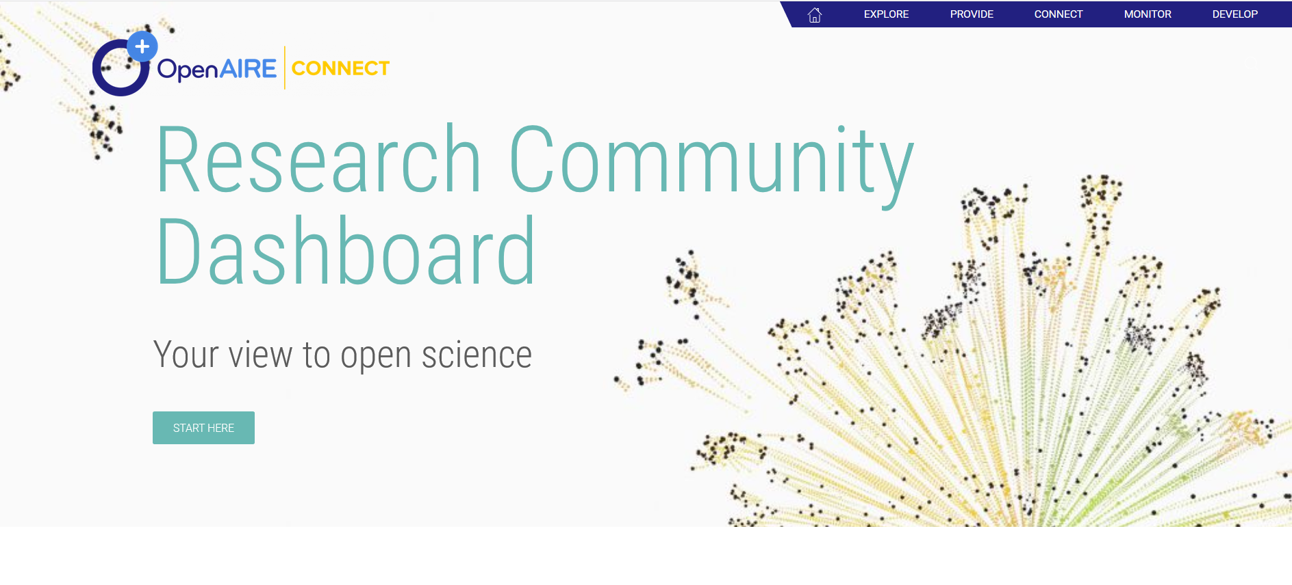
connect.openaire.eu
OpenAIRE National Workshop,
The future of scholarly communication in Europe
| Torino | 10 December 2018
Courtesy of P. Principe and I. Fava, OpenAIRE

Slide 30
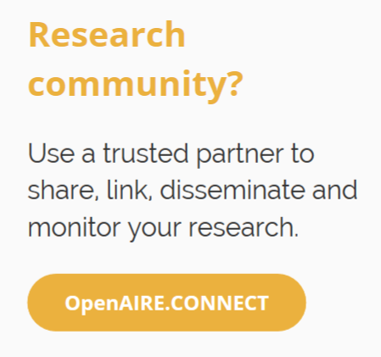
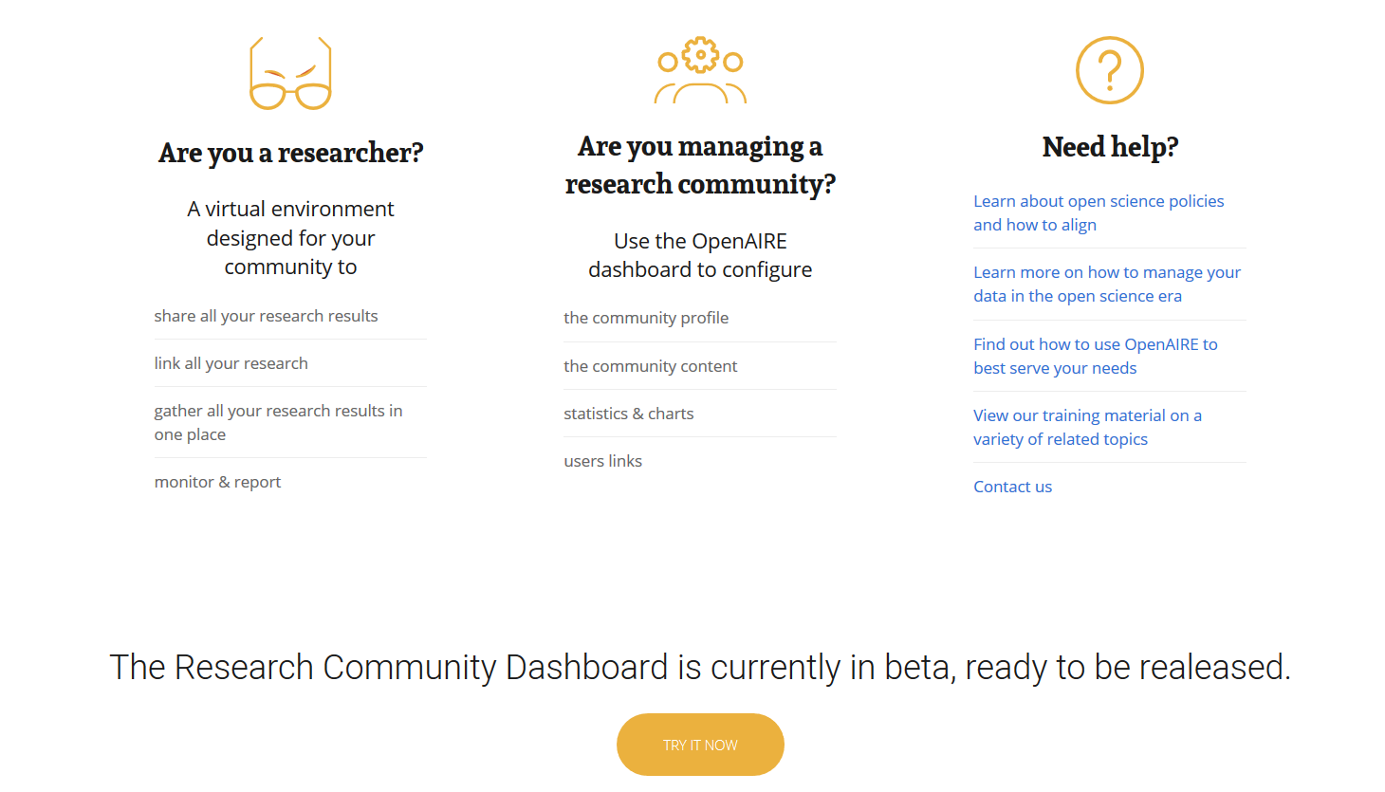
Courtesy of P. Principe and I. Fava, OpenAIRE

Slide 31
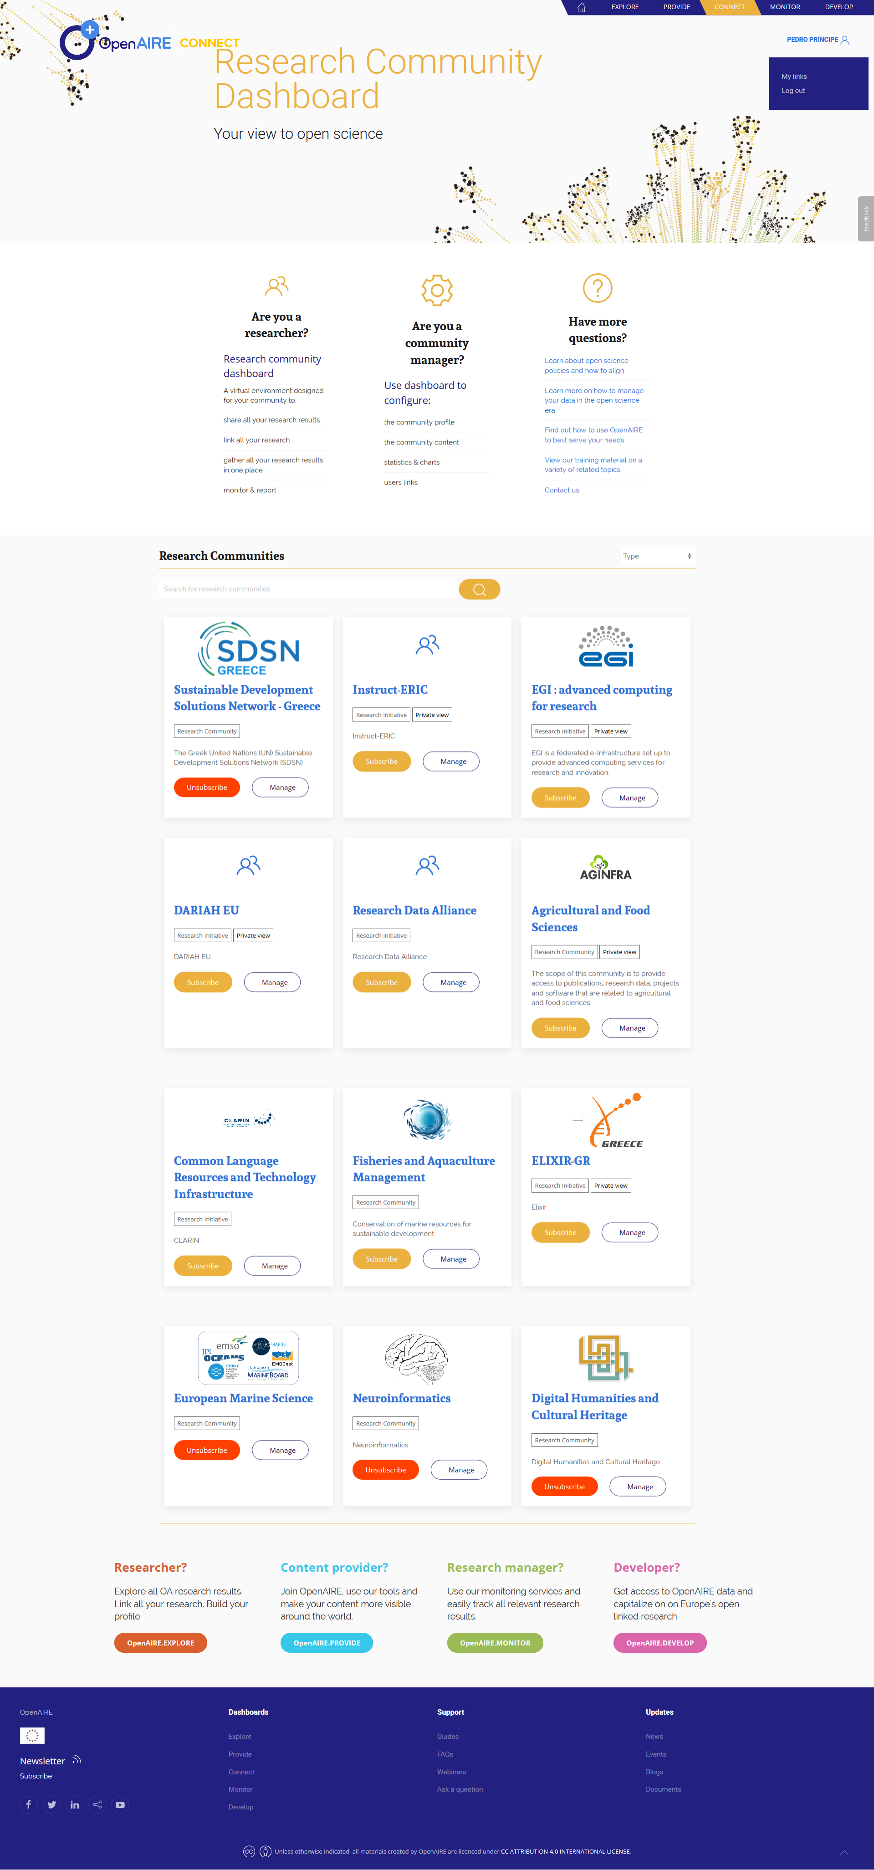
RESEARCH INITIATIVES & INFRASTRUCUTRES
RESEARCH COMMUNITIES
Courtesy of P. Principe and I. Fava, OpenAIRE

Slide 32
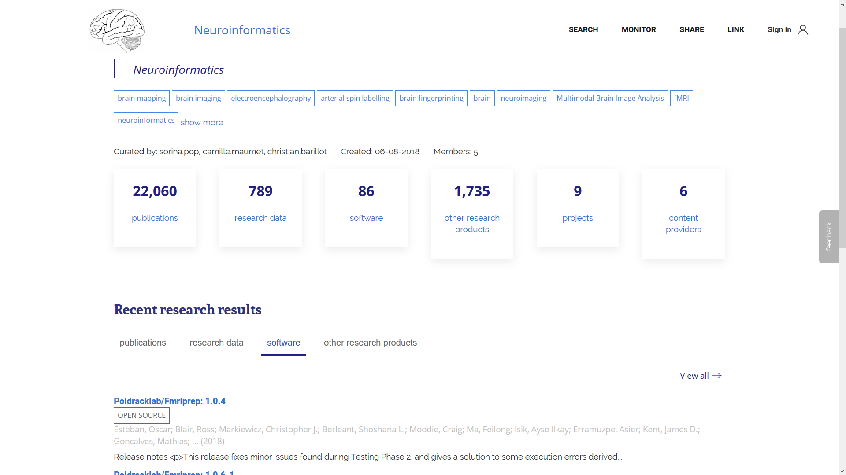
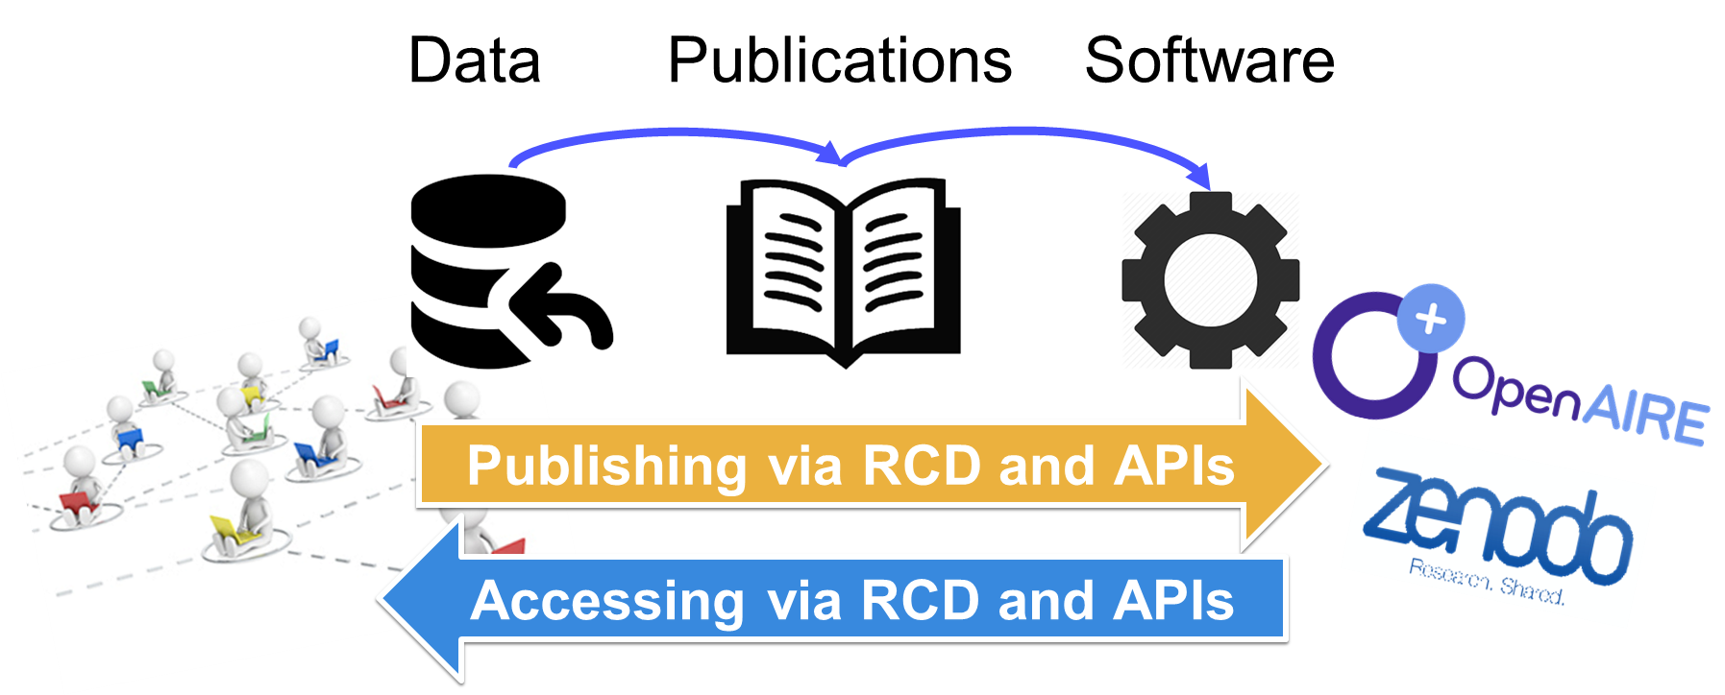
OpenAIRE National Workshop,
The future of scholarly communication in Europe
| Torino | 10 December 2018
Courtesy of P. Principe and I. Fava, OpenAIRE

Slide 33
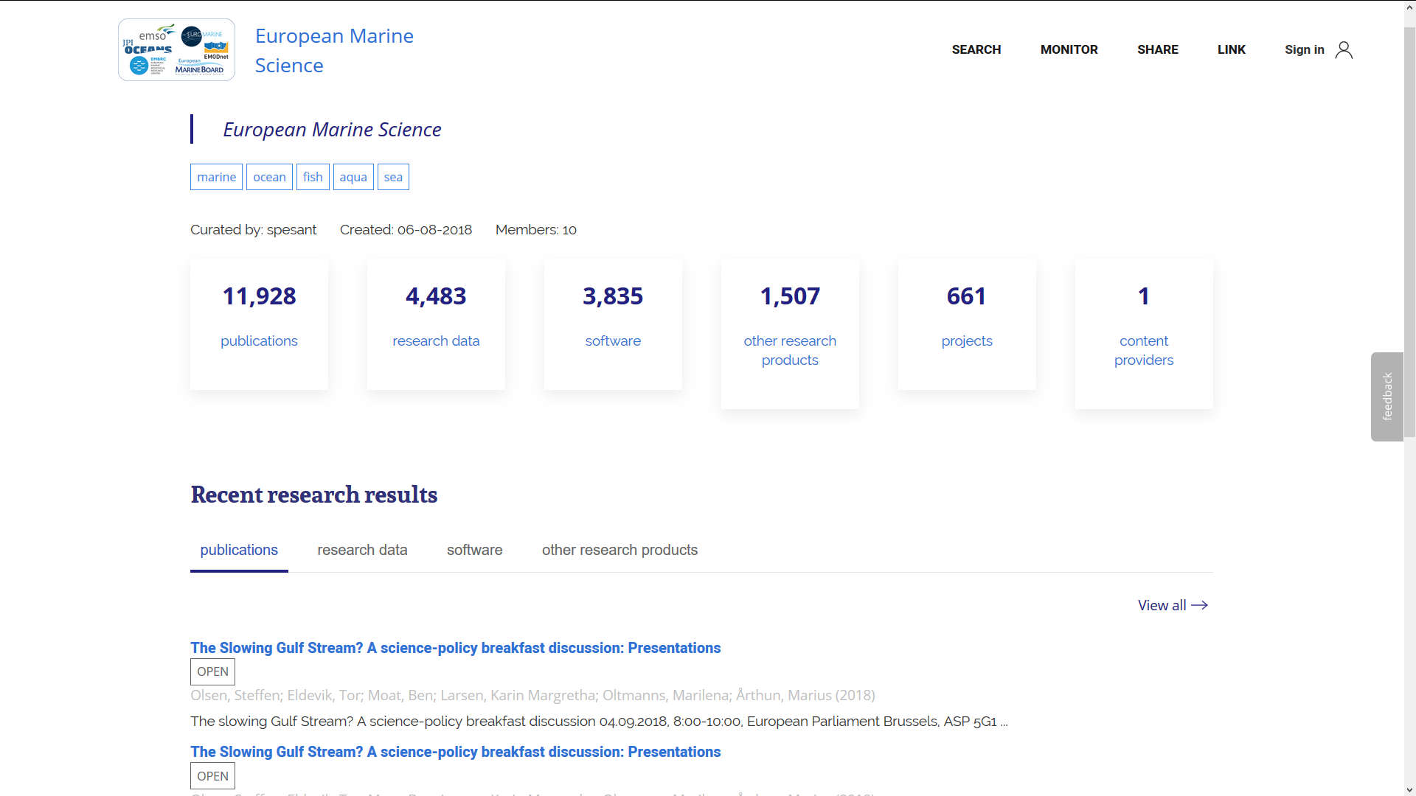
Courtesy of P. Principe and I. Fava, OpenAIRE

Slide 34
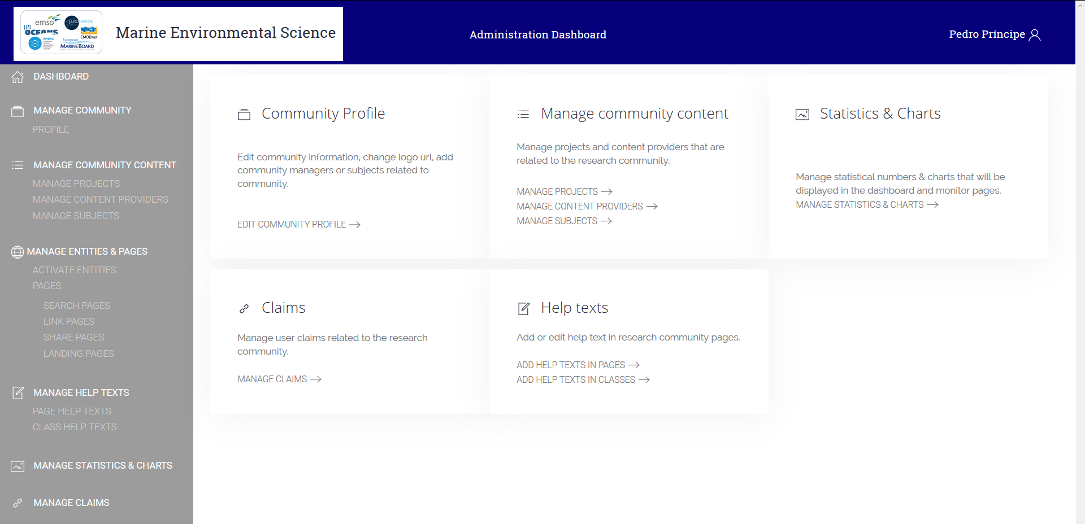
Courtesy of P. Principe and I. Fava, OpenAIRE

Slide 35
simplified tracking and monitoring
Services for funders, projects and institutions.
MONITOR
DASHBOARD

Slide 36
monitor.openaire.eu
OpenAIRE National Workshop,
The future of scholarly communication in Europe
| Torino | 10 December 2018
Courtesy of P. Principe and I. Fava, OpenAIRE

Slide 37
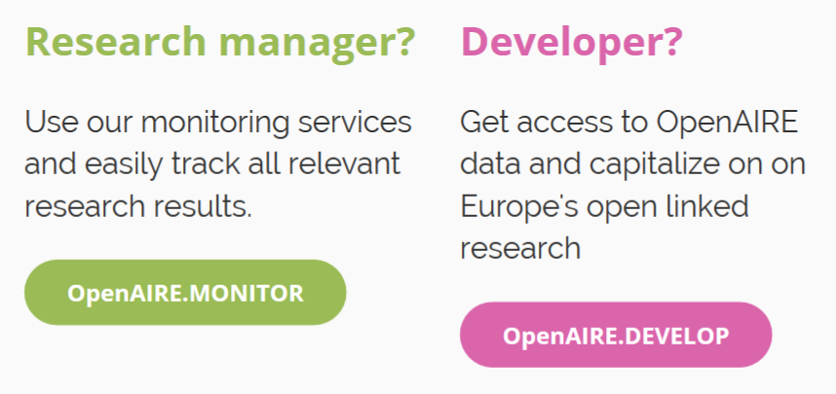
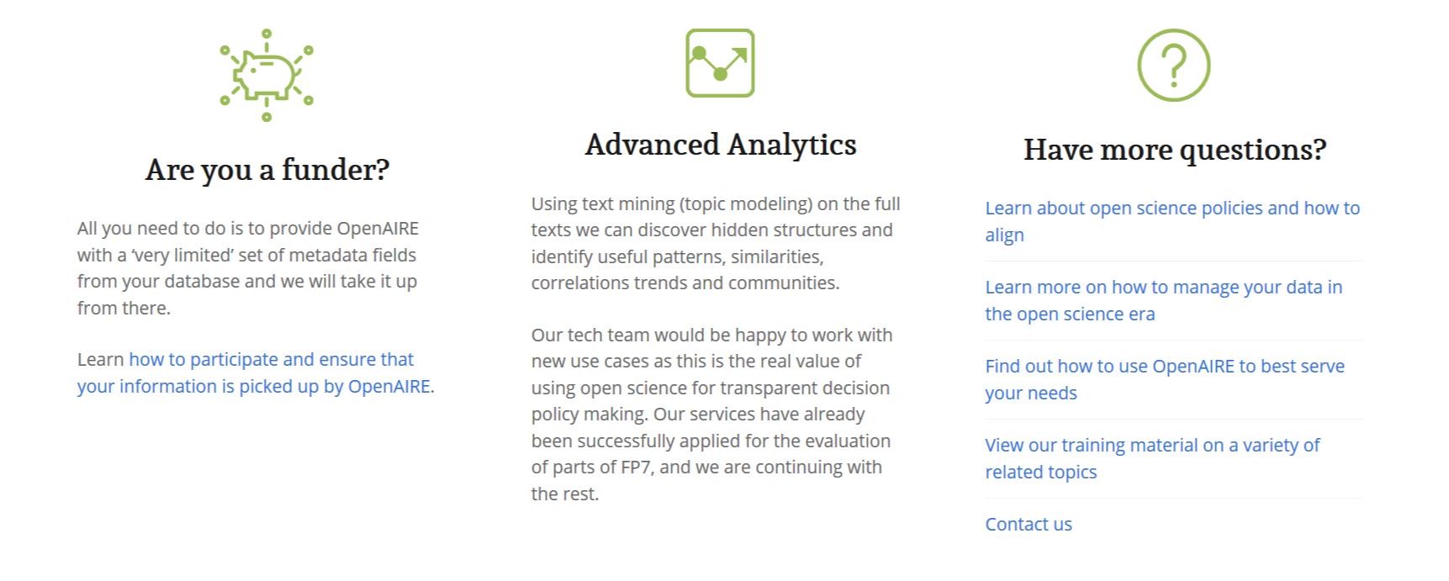
OpenAIRE National Workshop,
The future of scholarly communication in Europe
| Torino | 10 December 2018
Courtesy of P. Principe and I. Fava, OpenAIRE

Slide 38
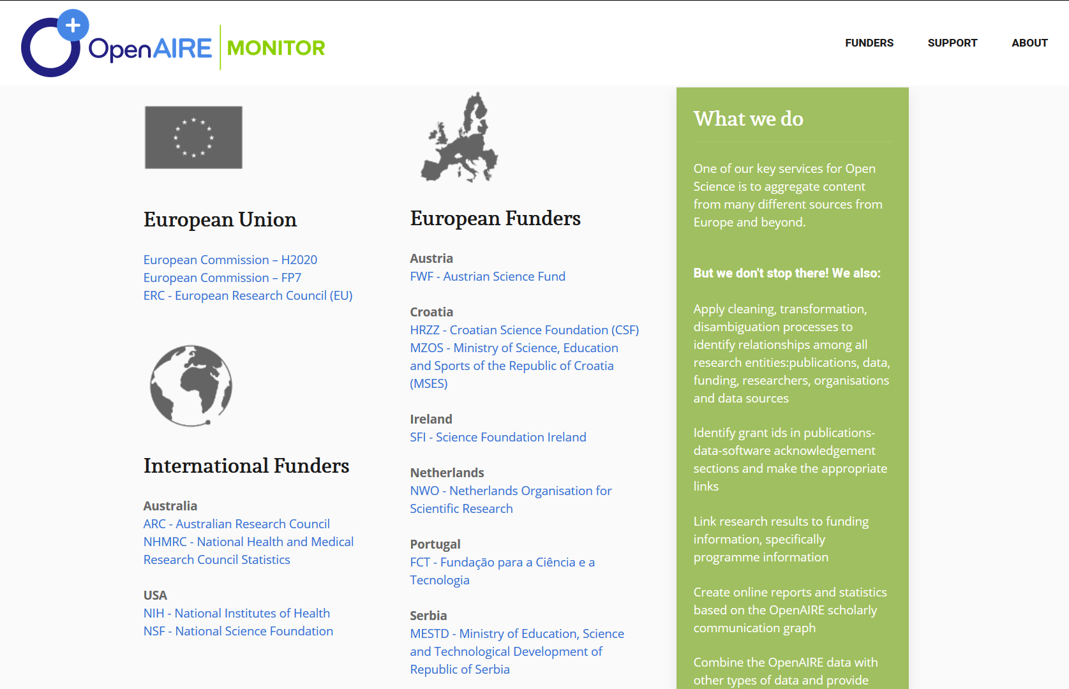
Over 20 funders in production + 5 in beta
Courtesy of P. Principe and I. Fava, OpenAIRE

Slide 39
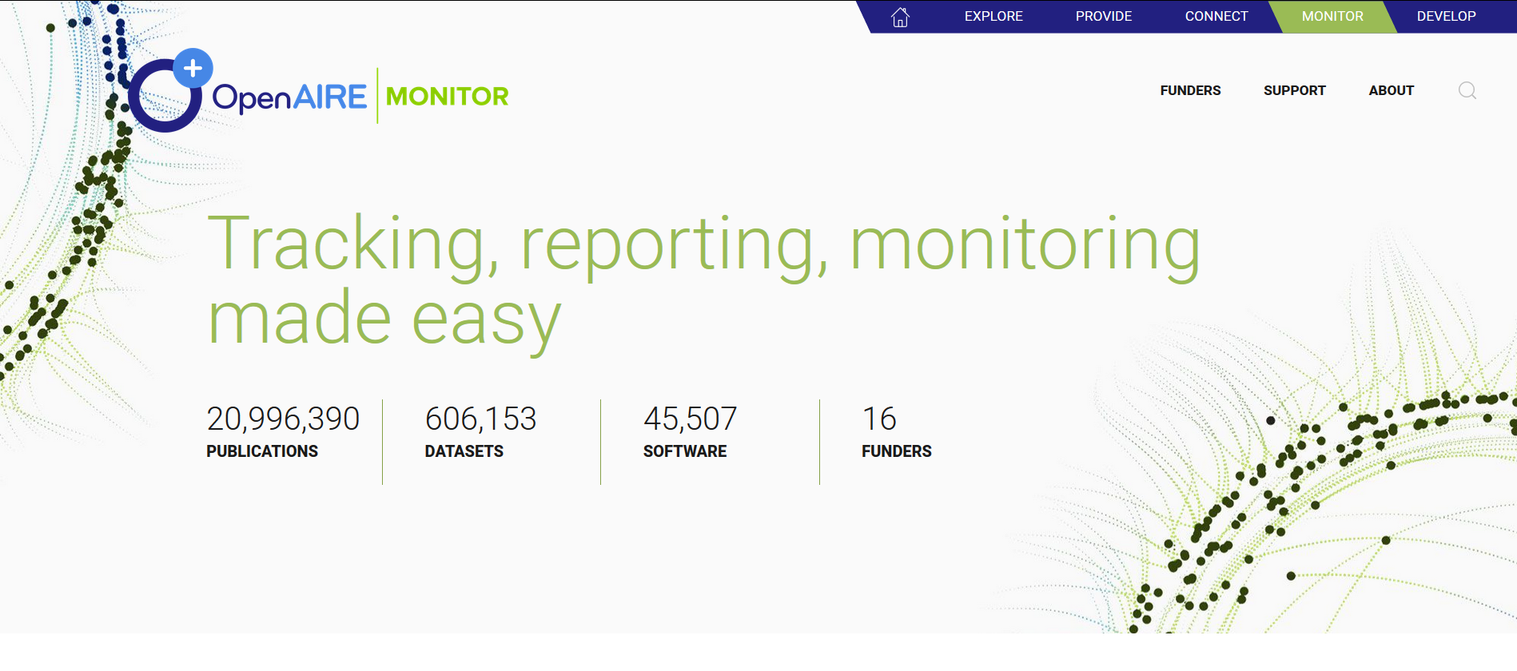
Monitor: Funder dashboard – aims
Funding Impact
Open Access/Science Impact
Publications, research data, software published thanks to grants awarded by the funder
Monitoring of Open Science impact: data/software FAIRness, reproducibility trends
OpenAIRE National Workshop,
The future of scholarly communication in Europe
| Torino | 10 December 2018
Courtesy of P. Principe and I. Fava, OpenAIRE

Slide 40
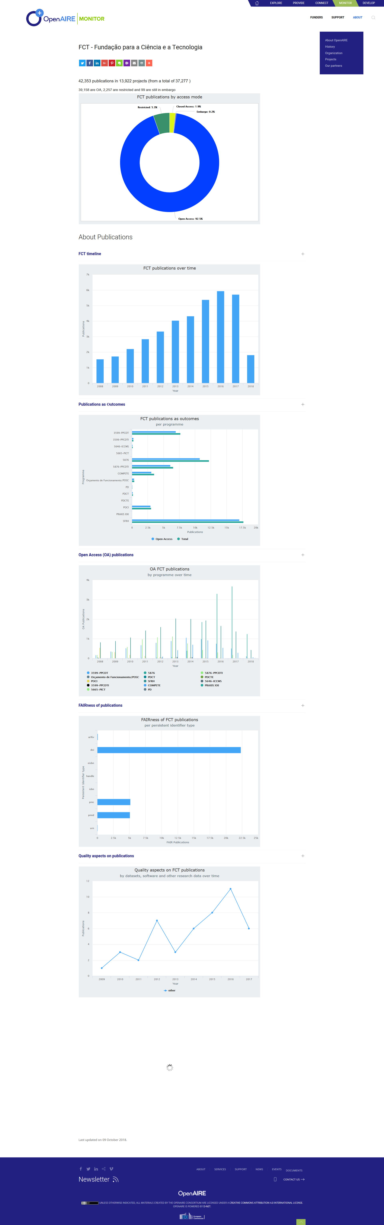
Funder Dashboard

Slide 41
Monitor: Institutional dashboard – aims
Research Impact
Service capacity impact
Funding Impact
Ability of researchers affiliated with the institution to produce innovative and quality scientific products
Ability of services maintained and operated by the institution to support researchers at producing or storing scientific products
Ability of institution to reach funding from different funders and disciplines
OpenAIRE National Workshop,
The future of scholarly communication in Europe
| Torino | 10 December 2018
Courtesy of P. Principe and I. Fava, OpenAIRE

Slide 42
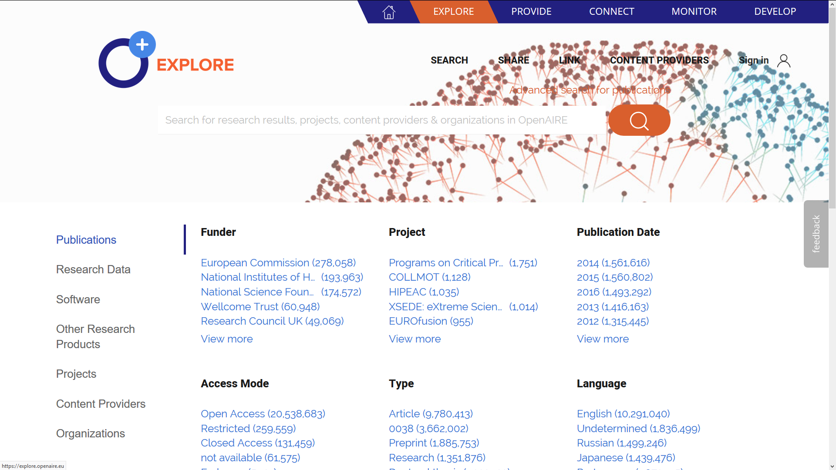
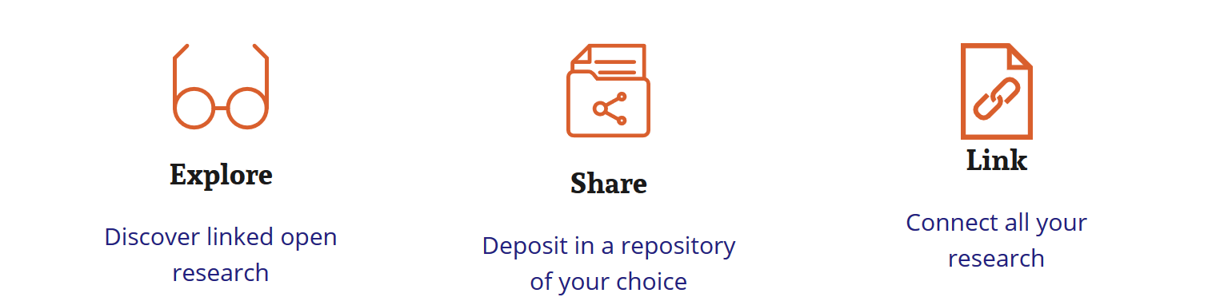
Courtesy of P. Principe and I. Fava, OpenAIRE

Slide 43
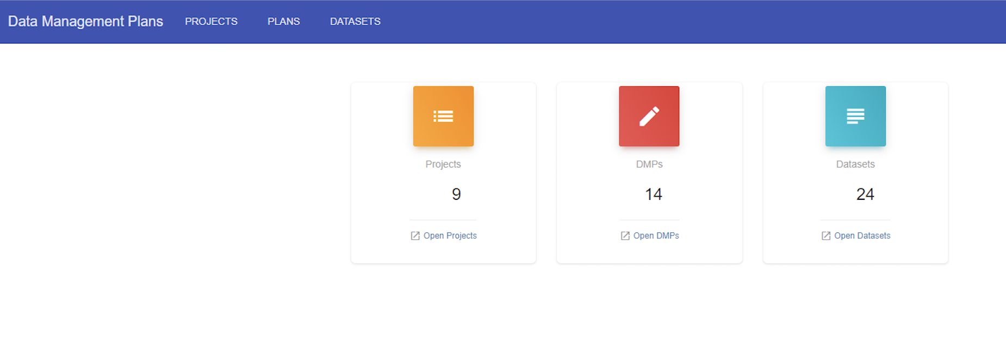

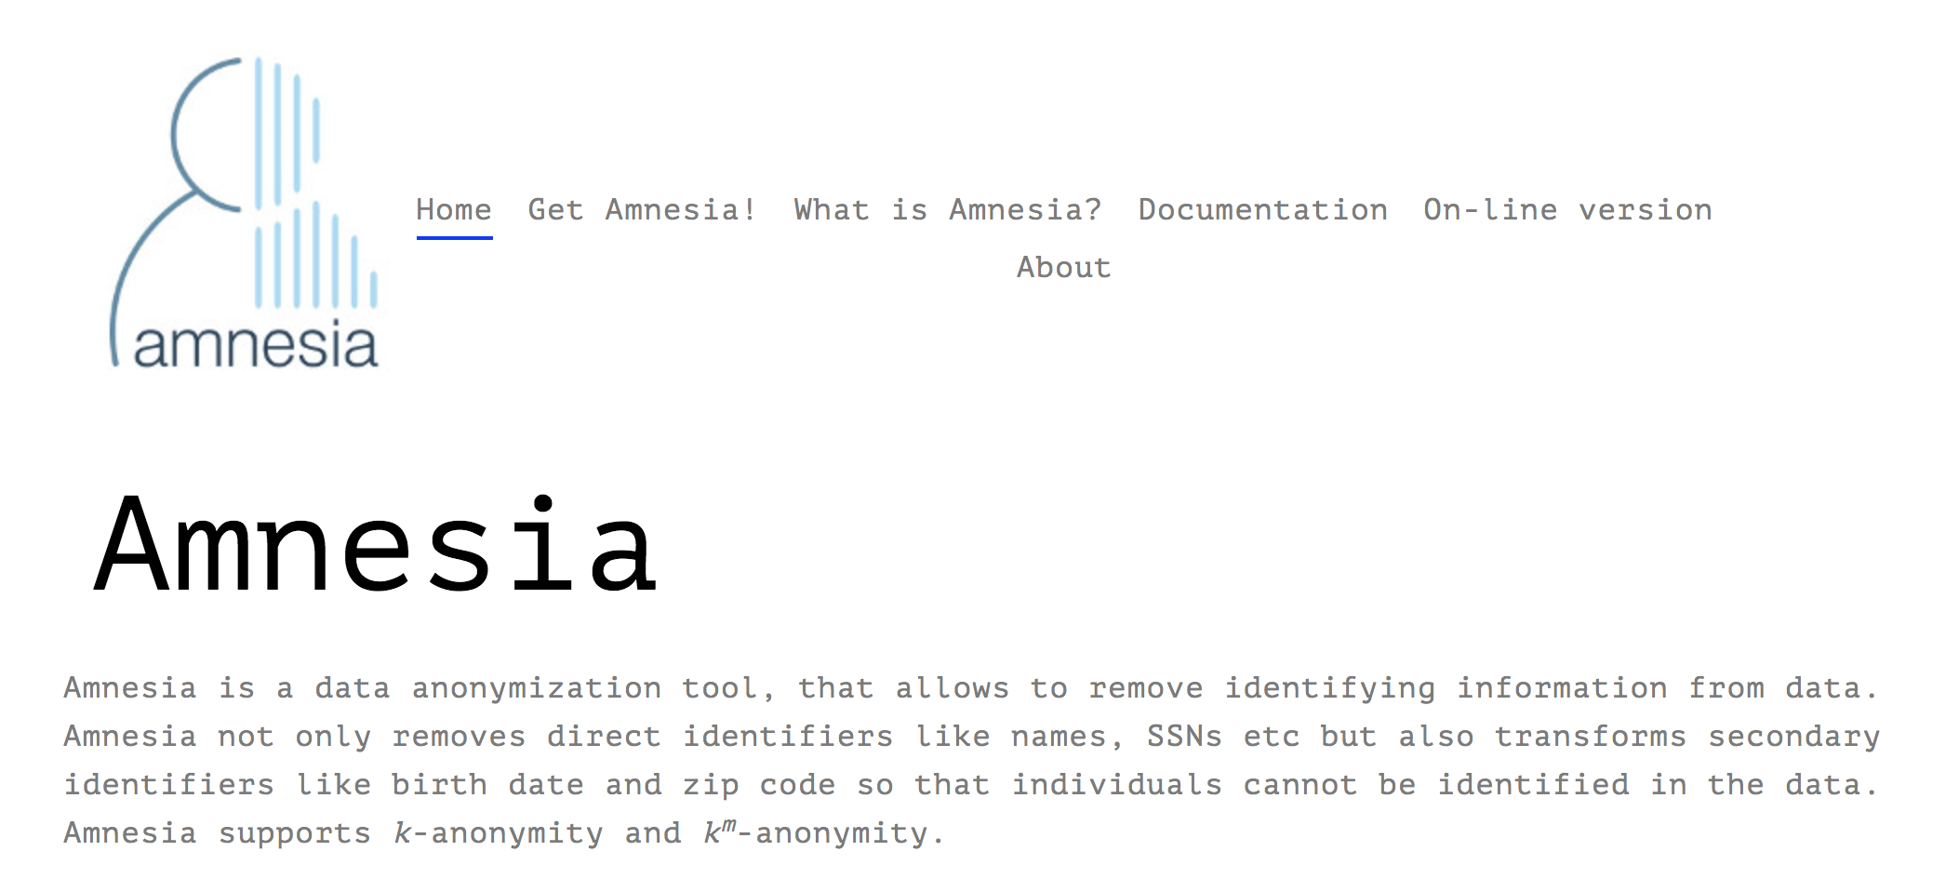
Services for RDM & FAIR data
Courtesy of P. Principe and I. Fava, OpenAIRE

Slide 44
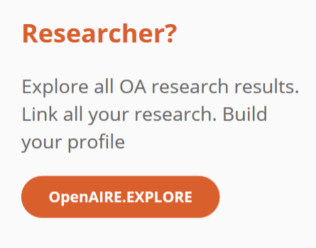
www.openaire.eu
provide.openaire.eu
monitor.openaire.eu
connect.openaire.eu
explore.openaire.eu
develop.openaire.eu
Courtesy of P. Principe and I. Fava, OpenAIRE

Slide 45
Emma Lazzeri
emma.lazzeri@isti.cnr.it

