Slide 1
Open Science: the EC perspective, policies and initiatives
OpenAIRE national workshop
December 10, 2018
Alea López de San Román, DG RTD, B.2. Open Science

Slide 2
The rationale…

Slide 3
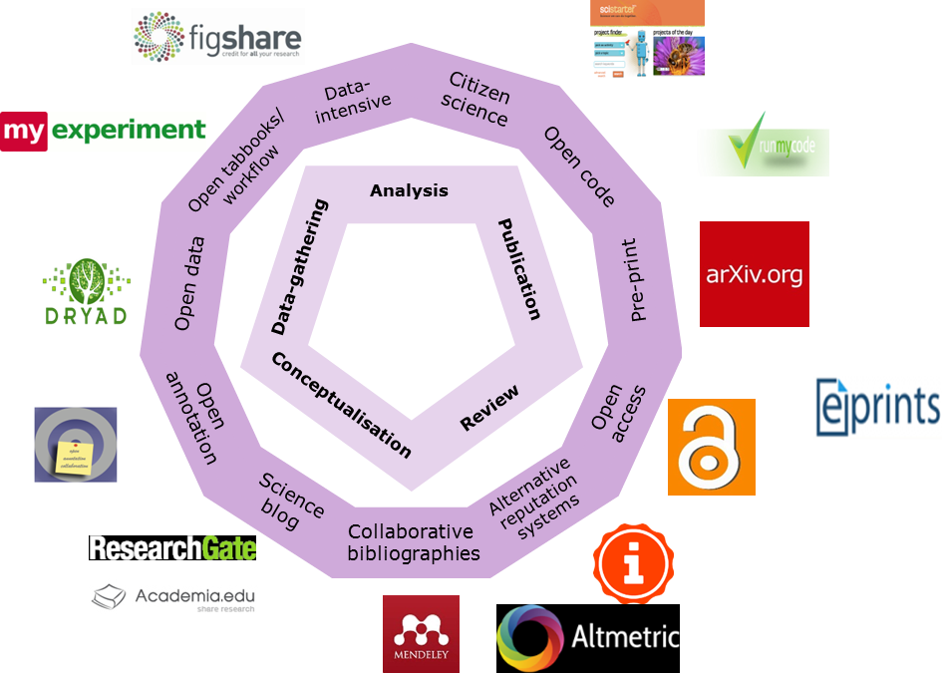
Open Science
The nature of science (modus operandi) is changing from a closed system to an open and sharing one
  It affects virtually all components of doing science and research
  It shifts in particular the focus from "publishing as fast as possible" to "sharing knowledge as early as possible"
Illustration: Ron Dekker, CESSDA

Slide 4
Open Science
=
Systemic transition of the science system which affects the way
research is performed
knowledge is shared/diffused/preserved
research projects/results are evaluated
research is funded
researchers are rewarded
future researchers are trained
Affecting the whole research cycle and all its stakeholders

Slide 5
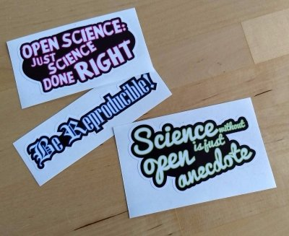
How to describe Open Science?
There are many definitions but maybe Open Science is:
  A system of practices that moves towards a more open, collaborative, data-intensive and networked way of doing research and sharing research results, enabled by developments in ICT and related infrastructures and the increasing proliferation of data.
Or Open Science is:
  Just science done right!
  Excellent science!
Stickers: Melanie Imming, ImmingImpact

Slide 6
Why is Open Science so important?
It's good for science: efficiency, verifiability, transparency, inter-disciplinarity
It's good for the economy: access to and re-use of scientific information by industry, innovation
It's good for society: broader, faster, transparent & equal access for citizens, increased societal impact of science and research

Slide 7
The goals…

Slide 8
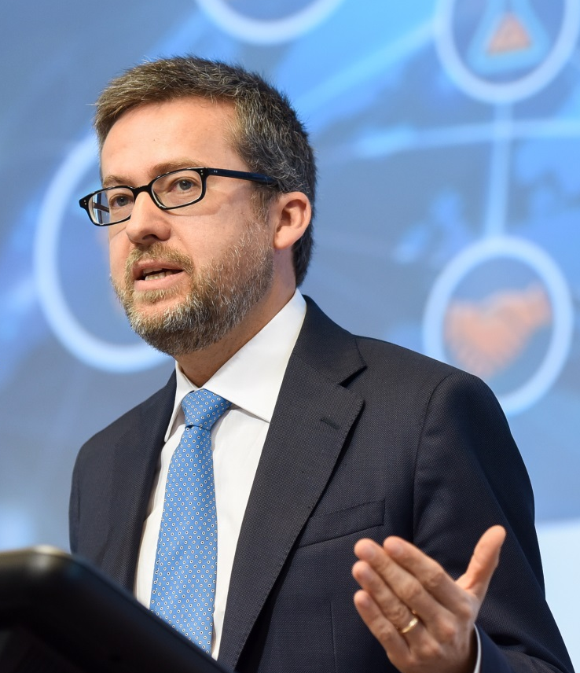

Top level policy
"As I see it, European success now lies in sharing as soon as possible, (…). The days of open science have arrived."
Speech at "Presidency Conference Open Science", 04 of April, 2016, Amsterdam

Slide 9
Member States support Open Science
The Council Conclusions of 26-27 May 2016:
  ACKNOWLEDGES that open science has the potential to increase the quality, impact and benefits of science and to accelerate advancement of knowledge by making it […] better understandable by society and responsive to societal challenges […]
  AGREES to further promote the mainstreaming of open access to scientific publications by continuing to support a transition to immediate open access as the default by 2020
  Research data: 'as open as possible, as closed as necessary'.

Slide 10
Going together in the same direction
Amsterdam Call for Action on Open Science
  EU Dutch Presidency conference on Open Science of April 2016 (key principles and goals)
  Follow up on its way: national plan on Open Science, various initiatives etc.
Open Science Policy Platform
  The EC bringing stakeholders at the same table

Slide 11
Holistic policy agenda: Scope & ambitions
8 policy priorities
agreed in 2016
Use & management of research results and data
Open Data: FAIR data sharing is the default for funding scientific research
European Open Science Cloud: All EU researchers are able to deposit, access and analyse European scientific data through the open science cloud, without leaving their desk. DSM strategy.
Altmetrics: Alternative metrics (next generation metrics) to complement conventional indicators for research quality and impact (e.g. Journal Impact Factors and citations)
Future of scholarly communication: All peer reviewed scientific publications are freely accessible and early sharing of different kinds of research outputs is encouraged
Research actors (researchers, institutions and funders)
Rewards: The European research career evaluation system fully acknowledges Open Science activities
Research Integrity: All publicly funded research in the EU adheres to commonly agreed Open Science Standards of Research Integrity
Education and skills: All young scientists in Europe have the necessary skills and support to apply Open Science research routines and practices
Citizen Science: Citizens significantly contribute and are recognised as valid knowledge producers of European science

Slide 12
Milestones...

Slide 13
EC longstanding, systematic and growing support for open science
2007
EC Communication on Scientific Information
2008
FP7 OA Pilot
2012
Recommendation on OA to and preservation of scientific information
2014-
Communication on European Research Area (ERA)
Horizon 2020 OA and Open Research Data (ORD) policies
2015
Digital Single Market (DSM) strategy
2016
European Cloud Initiative Communication (ECI)- The European Open Science Cloud
2018
Revision of the 2012 Recommendation in conjunction with recast of PSI Directive
2018-
Preparing Open Science for Horizon Europe
2018
Launch of the first phase of the EOSC

Slide 14
Open Science in FPs

Slide 15
Open Science starts with open access
Open access = the practice of providing on-line access to scientific information that is free of charge to the user and that is re-usable
No single definition but some well-accepted, authoritative ones e.g. the Budapest Declaration (2002) and the Berlin Declaration (2003).
  These definitions describe 'access' in the context of open access as including not only basic elements such as the right to read, download and print, but also the right to copy, distribute, search, link, crawl, and mine
Open access to research outputs: publications, data, software and other outputs

Slide 16
What is the EC mandate in Horizon 2020 for OA to scientific publications and research data?

Slide 17
Scientific publications in H2020
(Art. 29.2 MGA)
Mandatory open access to peer-reviewed publications through repositories
  What to do? Deposit + open access

Slide 18
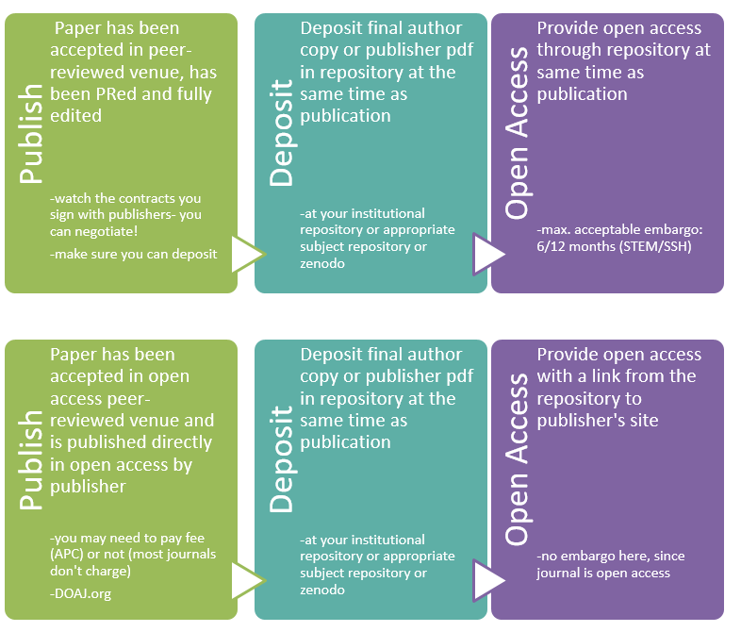
Subscription
Publisher
Open access
Publisher

Slide 19
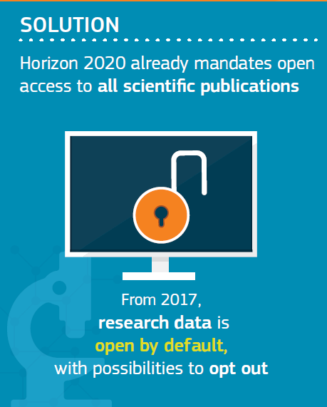
What about data in Horizon 2020?

Slide 20
Research data in H2020
(Art. 29.3 MGA) a.k.a. the Open Research Data Pilot (ORD)
Not so much a pilot any more! By default in!
Addresses several things at once:
  Open access to research data- as open as possible, as closed as necessary!
  Streamlining Research Data Management (RDM) as a standard practice through Data Management Plans (DMPs)- required as deliverable
Costs for open access to research data fully eligible during the duration of the project

Slide 21
Open Research Data pilot
  What to do?
  Data Management Plan
  +
  deposit in a research data repository
  +
  take measures to make it possible for third parties to access, mine, exploit, reproduce and disseminate free of charge
  +
  provide information via the repository to validate results

Slide 22
The Open Research Data Pilot will apply to all thematic areas of Horizon 2020 from the start of the 2017 work programme.
However, not all instruments are suitable for research data sharing. The following instruments are excluded:
●"co-fund" and "prizes" instruments
●"ERC proof of concept" grants
●"ERA-Nets" that do not produce data
●SME instrument, phase 1
Coordination and support actions are included in the Open Research Data Pilot, as many of them produce relevant data.
For 2-stage calls, information on participation in the Pilot will be requested only at stage 2.

Slide 23
Data Management Plans
●Projects need to create a DMP, except if they opt-out (although they still can on a voluntary basis).
●DMP=early deliverable within 6 months of the start of the project
●Living document! To be updated

Slide 24
  But not all data can be open
  “as open as possible, as closed as necessary!”
Projects can therefore partially or totally opt out at any stage (either before or after signing the grant) or stay in and have their data closed (and “just” have a DMP) if they explain that:
●participation is incompatible with the obligation to protect results that can reasonably be expected to be commercially or industrially exploited
●participation is incompatible with the need for confidentiality in connection with security issues
●participation is incompatible with rules on protecting personal data

Slide 25
●participation would mean that the project's main aim might not be achieved
●the project will not generate / collect any research data or
●there are other legitimate reasons (you can enter these in a free-text box at the proposal stage)

Slide 26
The evolution of the EU funding programmes for R&I
2021
FP7
OA Pilot
Deposit and open access
H2020
OA Mandatory
Deposit and open access
& ORD/DMP Pilot
H2020
OA Mandatory
Deposit and open access
& ORD/DMP by default
(opt-out)
2017
Horizon Europe
OA Mandatory
Deposit and open access
DMP + FAIR data Mandatory
OD by default (opt-out)
& Open Science embedded
2014
2008

Slide 27
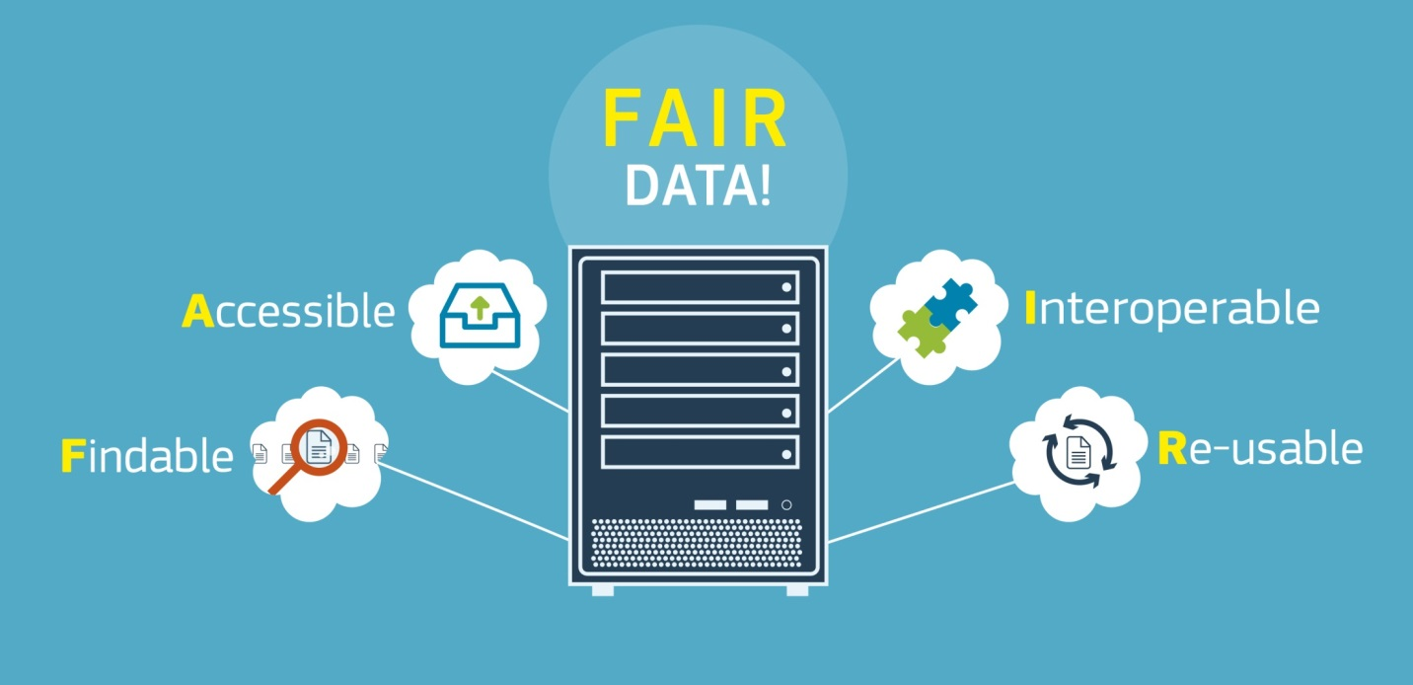
What is FAIR data?

Slide 28
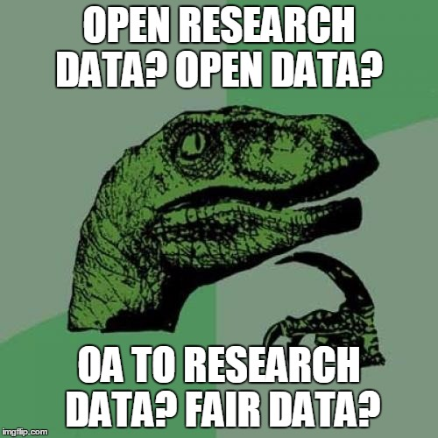
Research data: what terminology?
FAIR: Findable, Accessible, Interoperable and Re-usable
In Horizon 2020 the policy mainly addresses the 'accessibility' part of FAIR
  Started off with 'open access to research data'
  Moved towards 'open (research) data' with the ORD pilot (which also covered further aspects)
  We are now seeing openness as one component of FAIR data and aim to address all of the FAIR aspects in Horizon 2020
Horizon Europe will be clearer ☺

Slide 29
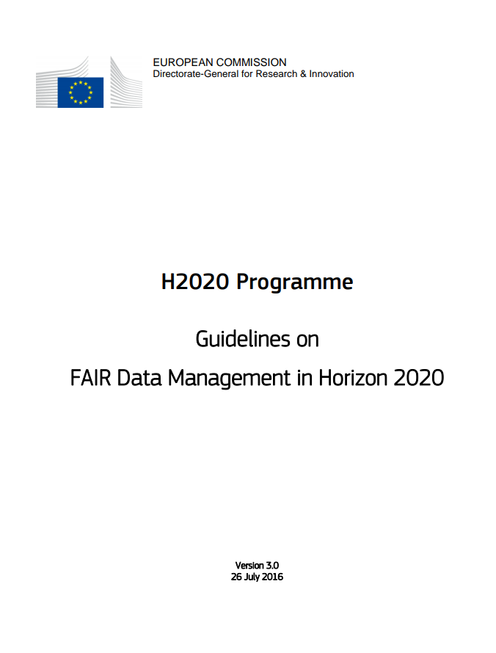
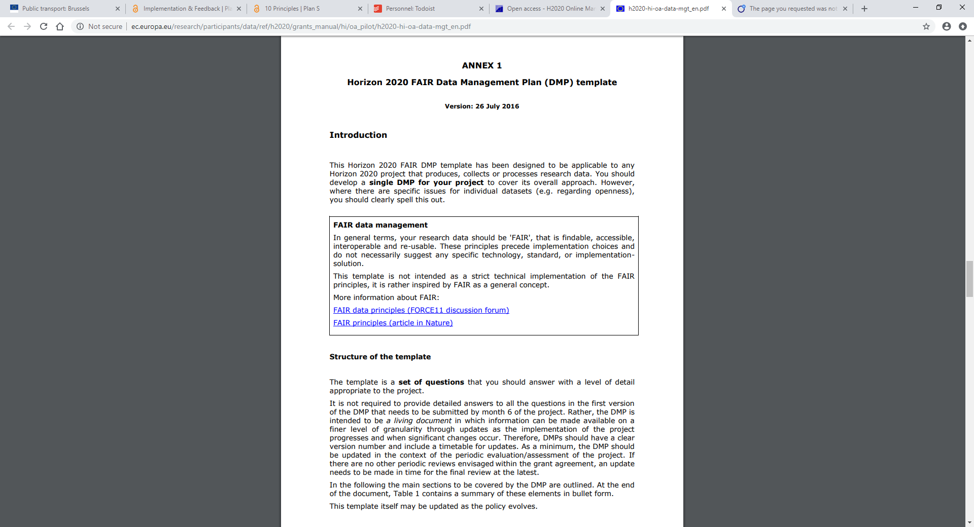

Slide 30
Some misconceptions…..
about Horizon 2020 and OA

Slide 31
"H2020 is forcing me to disclose all of my data!"

Slide 32
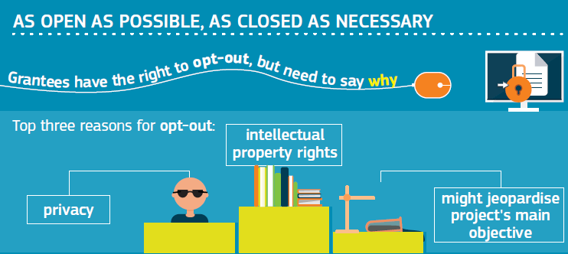

Slide 33
"H2020 is forcing me to publish!"

Slide 34
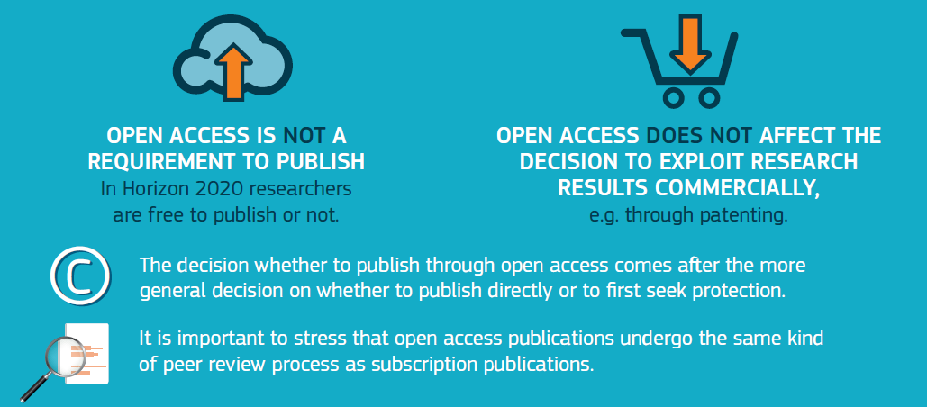

Slide 35
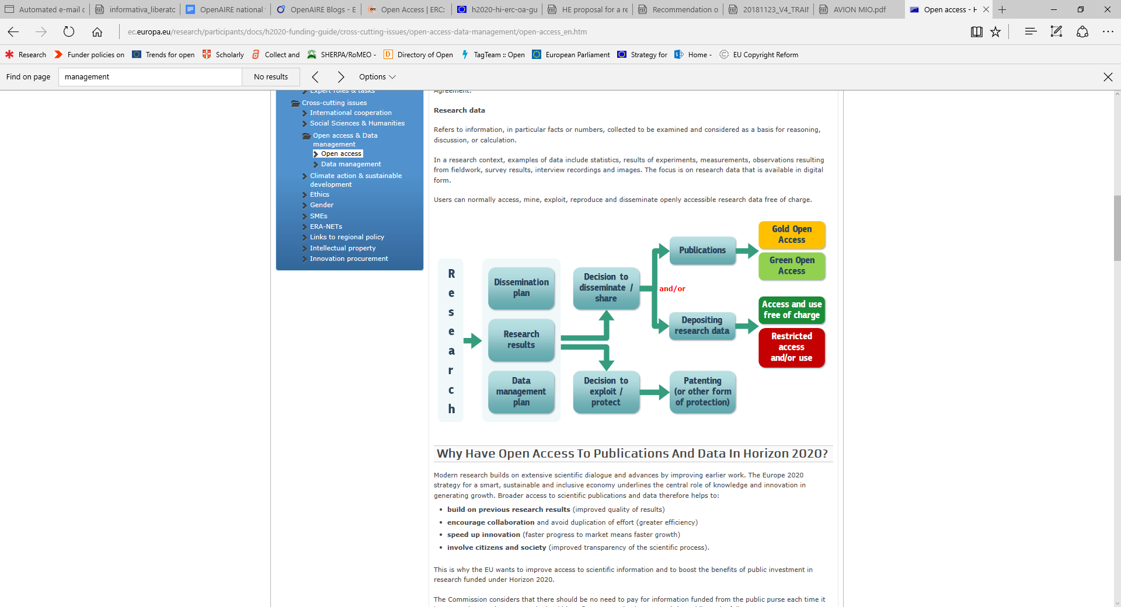

Slide 36
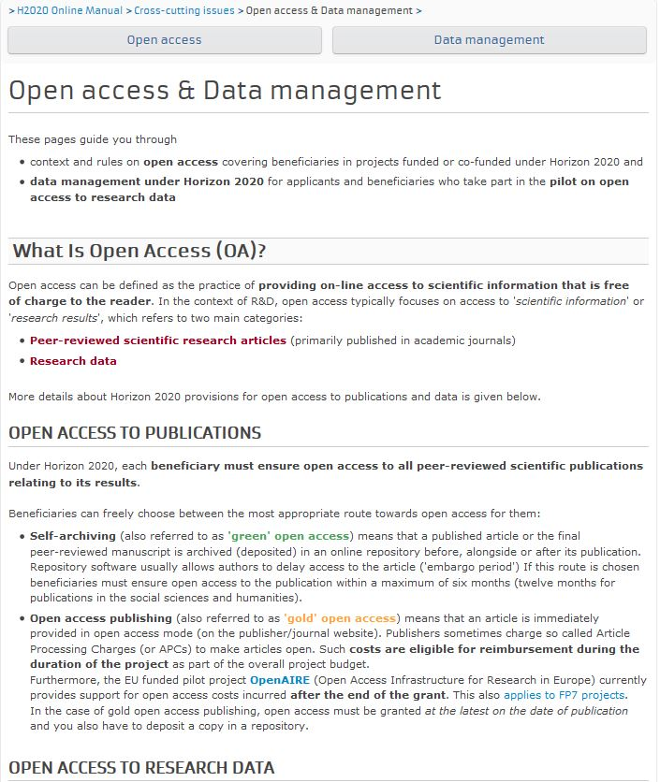
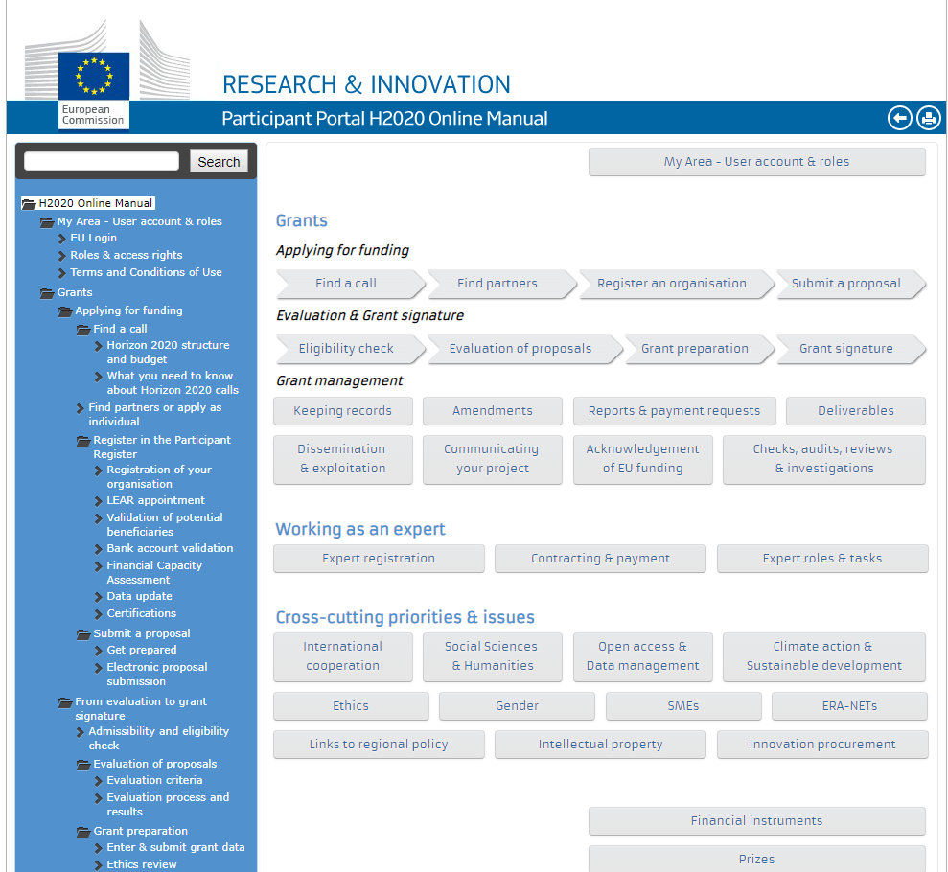
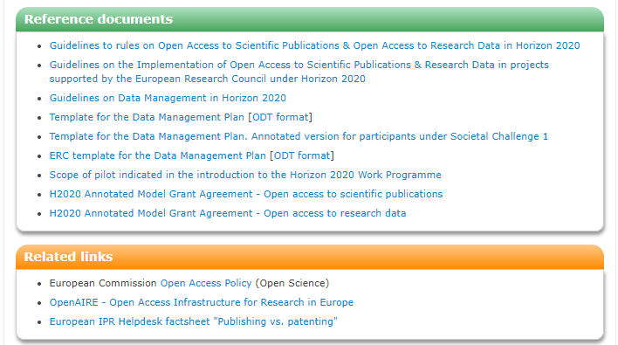
Resources
Participant Portal: online guide on open access

Slide 37
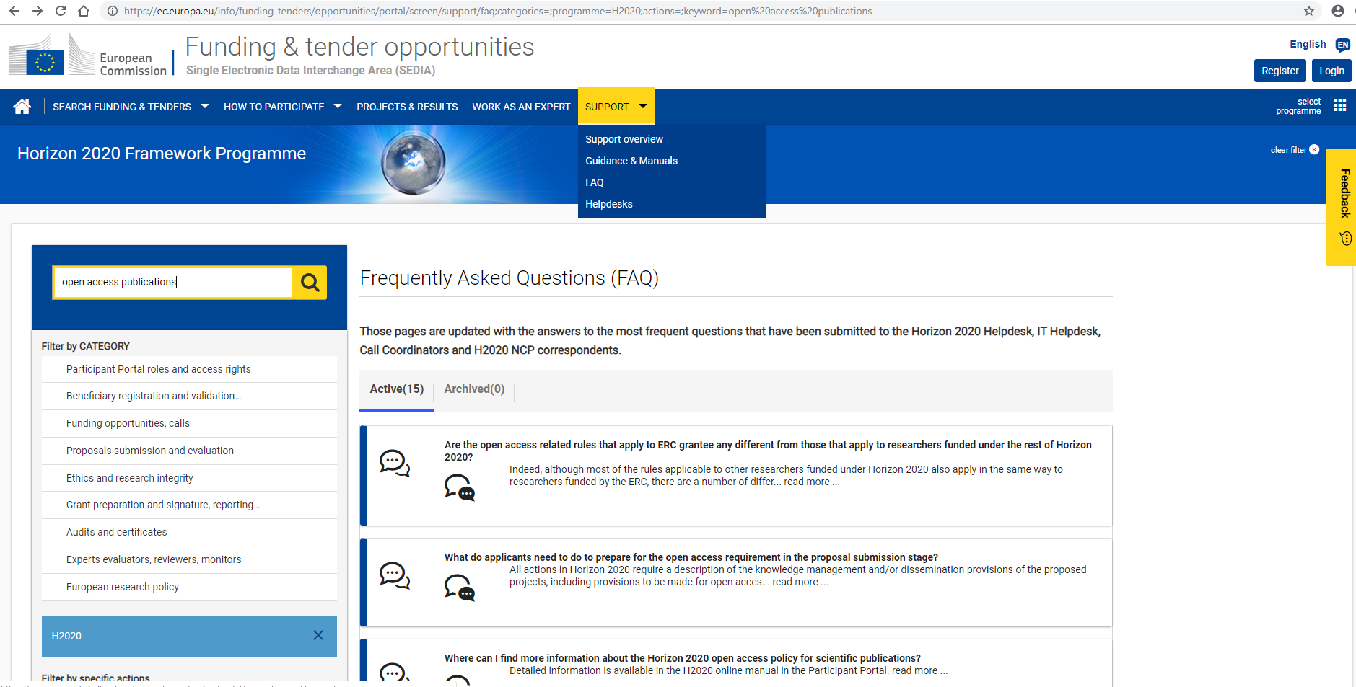
Resources
Participant Portal: FAQs on open access

Slide 38
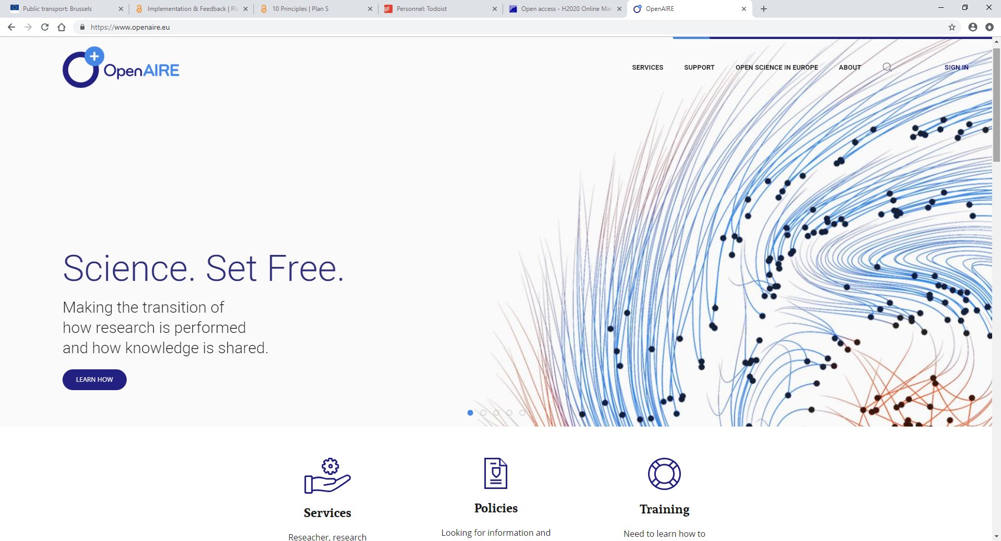
Resources
Openaire and helpdesk. Ask questions!!! Get resources!!!

Slide 39
Many challenges ahead
Open access to publications
  Increasing uptake to 100%
  Reinforcing monitoring and incentives/'sanctions'
  Hybrid journals and other financial issues (caps, post-grant etc.)
Open access and research data
  The DMPs!
  Mainstreaming FAIR data across the FPs
  Stimulating a change in scientific culture

Slide 40
What about FP9?

Slide 41
Our ambition for Open Science in FP9:
FP9 goes beyond OA (publications & data)
to embrace & incentivise Open Science as modus operandi for science

Slide 42
Horizon Europe as modus operandi for science
Open Science in
Horizon Europe
  FP9 clarifies and strengthens the OA obligations
  FP9 empowers authors of scientific publications to provide open access
  FP9 is home of FAIR and open data (‘as open as possible, as closed as necessary’)
  FP9 supports responsible research data management (DMPs required for projects producing data)
  FP9 promotes the European Open Science Cloud
  FP9 broadens OA (with opting out options) to other research output
  FP9 promotes compliance with 'Open Science principles' through a combination of obligations and incentives
  FP9 further implements sanctions for those beneficiaries significantly failing to provide open access, requiring institutions to assume responsibility for their intellectual output
  FP9 introduces the use of 'next generation' metrics for better assessing the systemic impact of research output and the engagement in Open Science by researchers and their institutions
  Status quo: trilogue negotiations

Slide 43
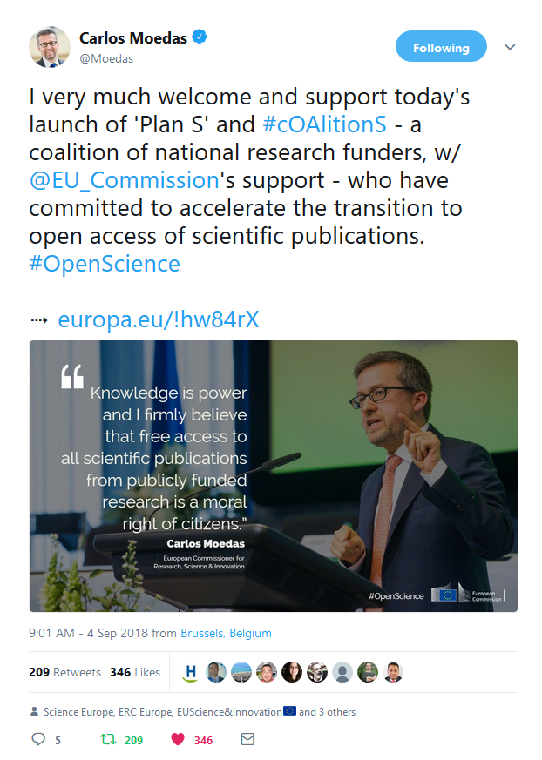
Plan S
Notes:
3) Open Science Policy Platform (OSPP)

Slide 44
We do more than funding research

Slide 45
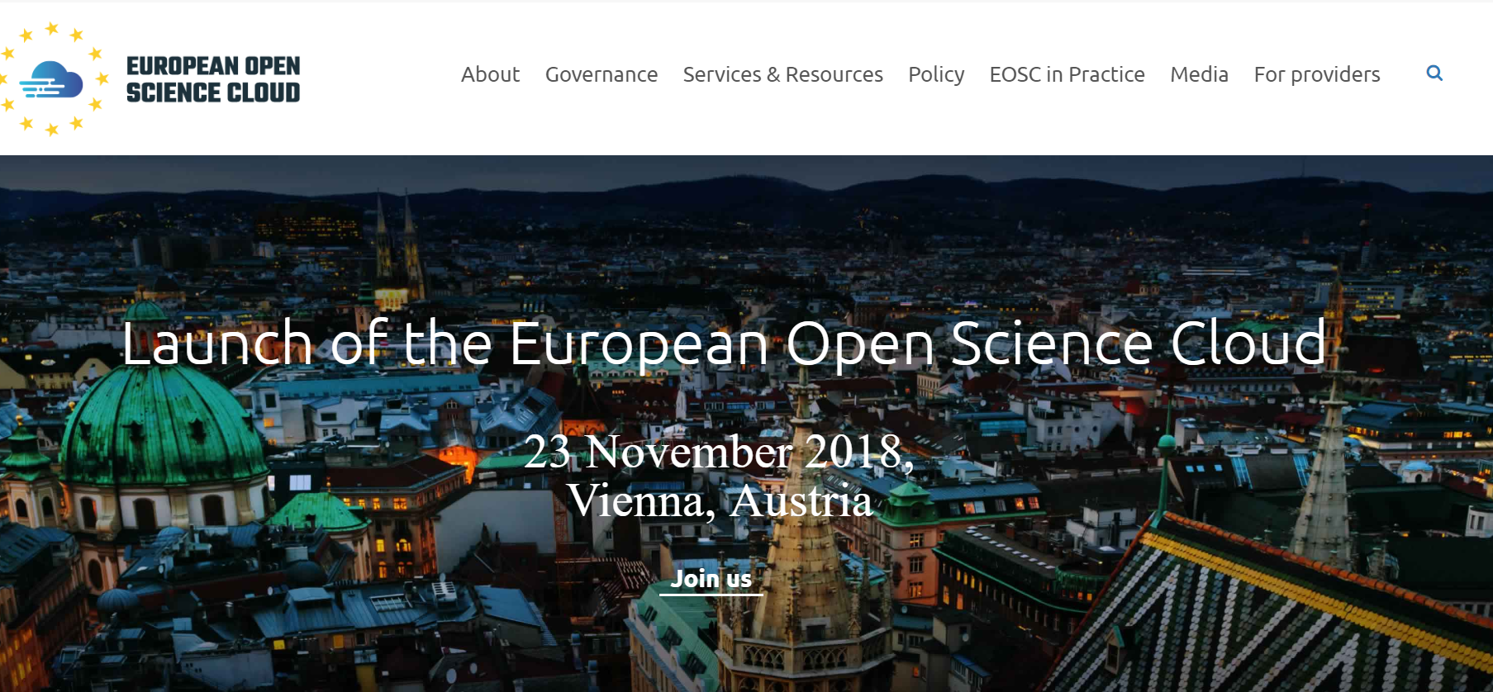

Slide 46
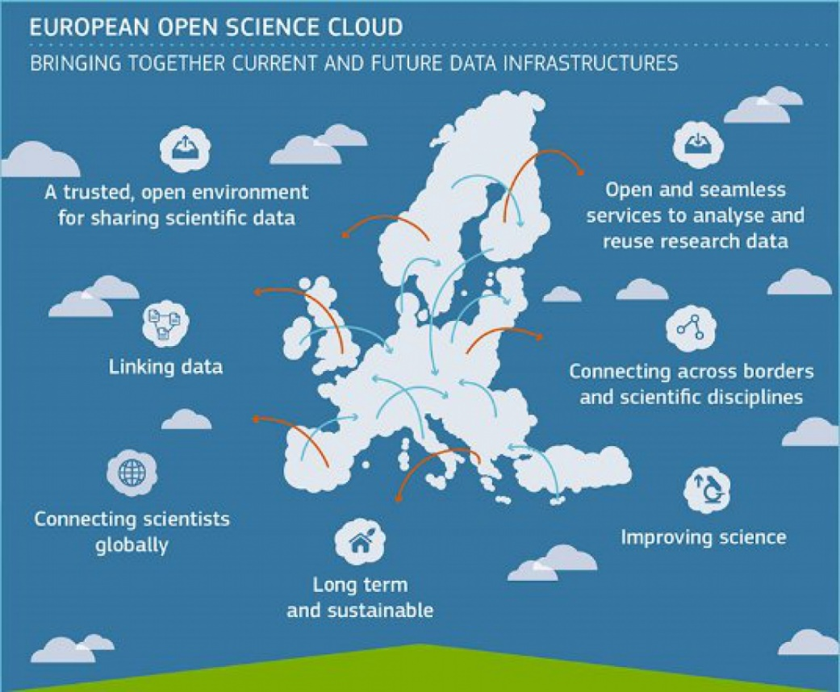
  The Vision for EOSC
EOSC will provide 1.7m EU researchers an environment with free, open services for data storage, management, analysis and re-use across disciplines
EOSC will join existing and emerging horizontal and thematic data infrastructures, bridging todays fragmentation and ad-hoc solutions
EOSC will add value (scale, data-driven science, inter-disciplinarity, faster innovation) and leverage past infrastructure investment (10b per year by MS, two decades EU investment)
Notes:
-The EOSC is:
An open and trusted environment for managing research data. It will be a facility at the service of European researchers that will allow them to make the most of open science.
The concept of EOSC originates in the 2016 Commission Communication “European Cloud Initiative - Building a competitive data and knowledge economy in Europe”.
The EOSC aims to federate existing and emerging data infrastructures and to provide European researchers with world-class data infrastructures and cloud-based services.
The EOSC portal is the universal access channel through which all European scientists will be able to access, use and reuse research outputs and data across disciplines.
The EOSC can be looked at as a ‘plug-and-play’ environment, where e-infrastructures will feed into the EOSC and where users can access federated resources through a single point of access.

Slide 47
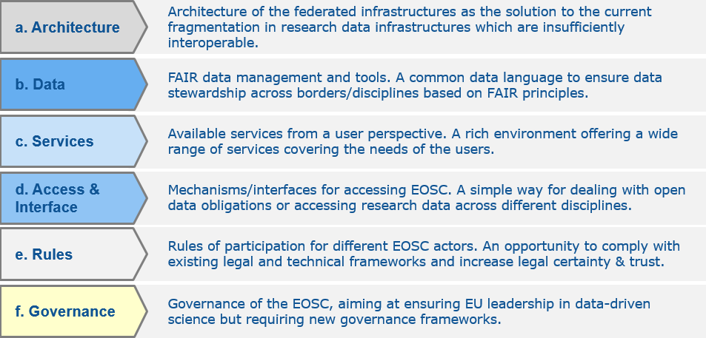
  History of the EOSC
  project
European
Cloud initiative
Implementation Roadmap
Council conclusions
H2020 – WP 2018-20
2016
Vision for European Open Science Cloud
INFRAEOSC-05-2018-2019 Call
2017
Federated model with 6 action lines
2018
Set up of EOSC governance framework by end 2018

Slide 48

  Not a cloud made in
  Brussels

Slide 49
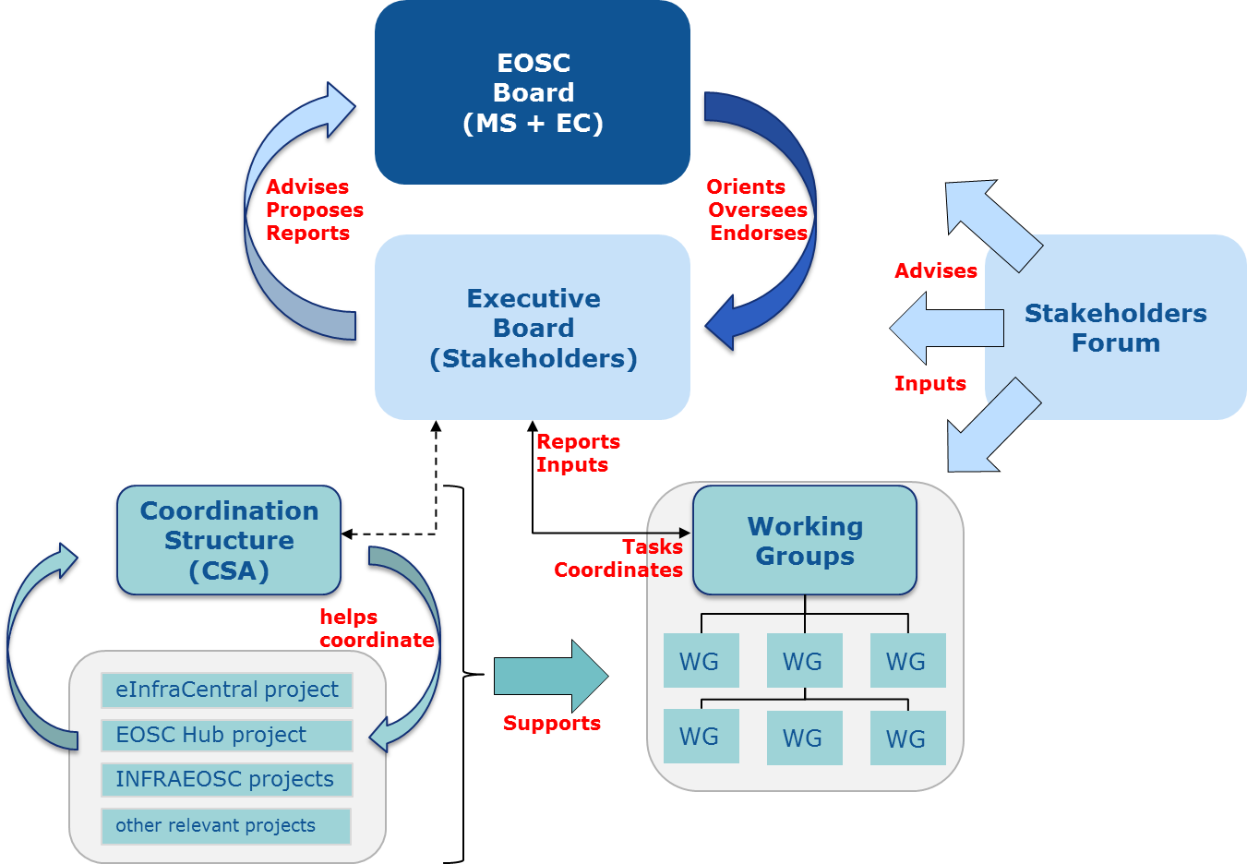
  Governance framework
Three layer structure
  EOSC Board of MS/AC and EC representatives to ensure effective supervision of EOSC implementation
    Working Group of the strategic configuration of the Programme Committee
  Executive Board of stakeholder representatives to help ensure proper EOSC implementation and accountability
    Commission expert group
  Stakeholder Forum to provide input from a wide range of actors
    Self-organised with EC support

Slide 50
  Formal vehicles
  EOSC governance
 | Membership | Formal vehicle
EOSC Board | Member States/Associated Countries and EC representatives | Working Group of the strategic configuration of the H2020 PC (EOSC PC-WG)
EOSC Executive Board | Stakeholder representatives and individual experts | Commission formal Expert Group
Stakeholders Forum | Stakeholders organisations; e.g. scientific/user community, universities, research institutions, research infrastructures, eInfras | Self-organised with EC support; notably by the Coordination and Support Action funded by the WP of H2020 - INFRAEOSC Call

Slide 51
  Calendar
  EOSC governance
 | Formal vehicle | Set-up calendar
EOSC Board | Working Group of the strategic configuration of the H2020 PC (EOSC WG) | Set-up: October 2018 1st report to H2020 PC: 22/11 End: December 2020
EOSC Executive Board | Commission formal Expert Group | EC Decision: 27/08 Call for EoI: 11/9-10/10 Set-up: November 2018 End: December 2020
Stakeholders Forum | Self-organised with EC support; notably by the Coordination and Support Action funded by the WP of H2020 - INFRAEOSC Call | Currently: EOSC pilot Re-launch: early 2019

Slide 52
https://eosc-portal.eu/

Slide 53
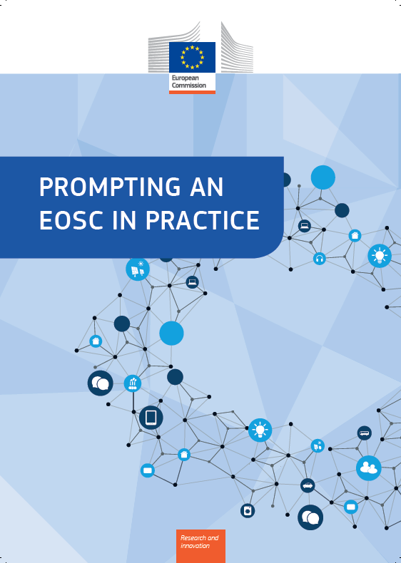
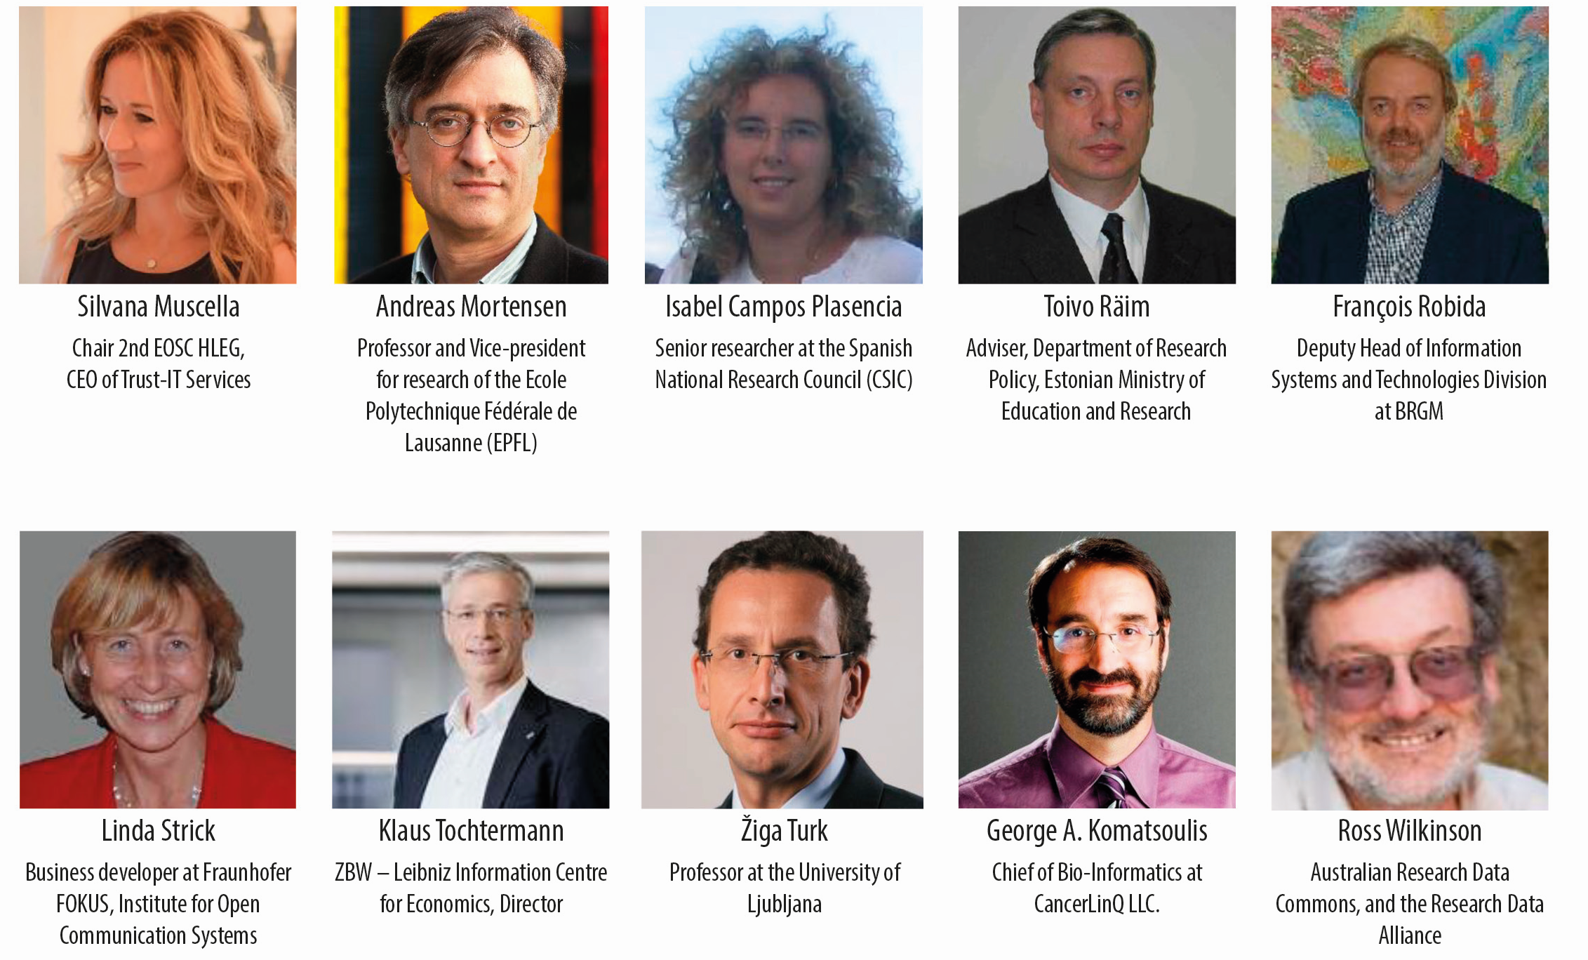
  Prompting an EOSC in practice
  EOSC 2nd High Level Expert Group
Aim: To mark a transition towards the practical implementation of the EOSC and to set the scene for the practical launch of the EOSC
Focus: Governance Structure, Rules of Participation and Business model options
32 recommendations are provided, clustered in Implementation, Engagement and Steering

Slide 54
  Prompting an EOSC in practice
  Key elements in the report
  Vision – The EOSC as interlinking people, data, services & trainings, publications, projects, and organisations across borders and scientific disciplines
  MVE – Discussion on how to make EOSC a Minimum Viable Ecosystem
  Business models – 3 valid alternatives for funding the EOSC have been outlined
  The stimulating set of practical recommendations – including on EOSC portal
  Preliminary list of possible WGs
VER
Notes:
Planning an MVE includes:
Identifying & understanding the Business needs
Finding the opportunities which includes
Identification of users
Their actions &
Desired results as well as
Identification of pains & gains of each action
Deciding what features to build
What pains to remove with products
Gives gains to the user
Different business models:
Direct Support Model
An institute receives a grant from a funding entity to build/operate the resource and make it available to other grantees of the funding entity
Ability of certain researchers to access these resources may be restricted (i.e. non-grantees of the funding entity cannot access to the resource)
Cloud Coin Model
Based on a certification programme for commercial & non-commercial provider of scientifically useful services
Accept specific EOSC-defined financial transactions in payments (“cloud-coins”)
Hybrid Model
Combination of Direct support Model & Cloud Coin Model

Slide 55
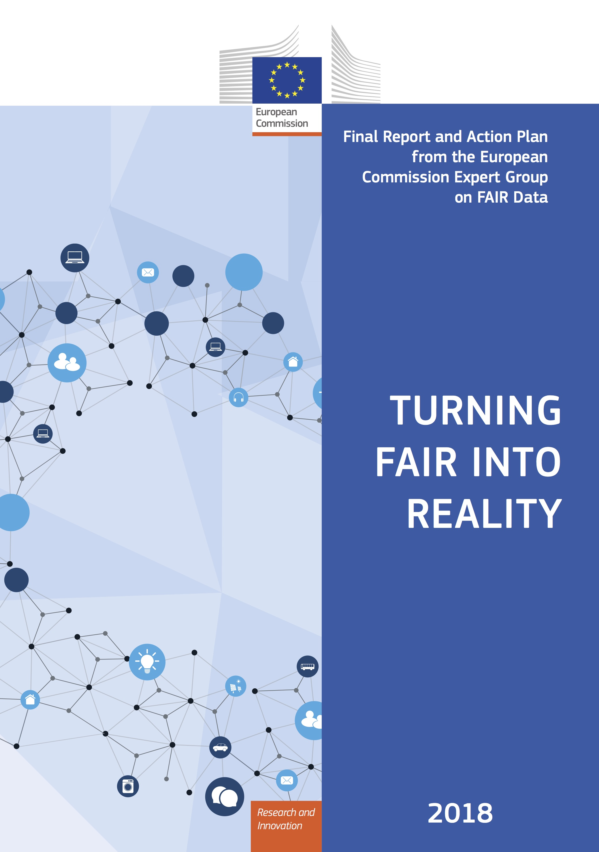
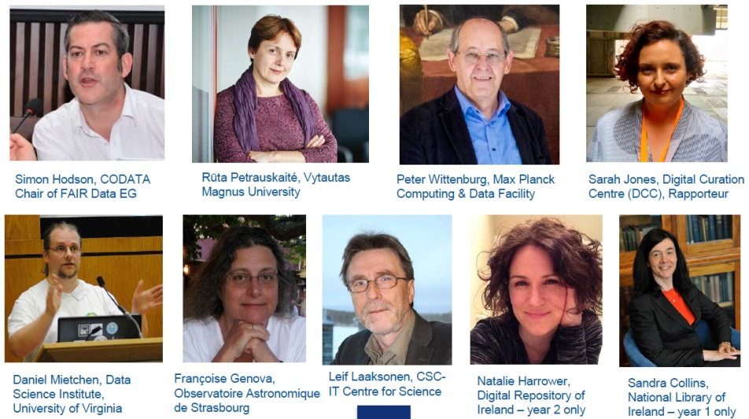
  Turning FAIR into Reality
  FAIR Data Expert Group
Report and Action Plan: Take a holistic approach to lay out what needs to be done to make FAIR a reality, in general and for EOSC
Addresses the following key areas: Concepts for FAIR, the FAIR data culture, the FAIR data ecosystem, skills, incentives and metrics, investment and sustainability.
Recommendations and Actions: 27 clear recommendations, structured by these topics, are supported by precise actions for stakeholders.
  European Commission Expert Group on FAIR Data, March 2017-Dec 2018

Slide 56
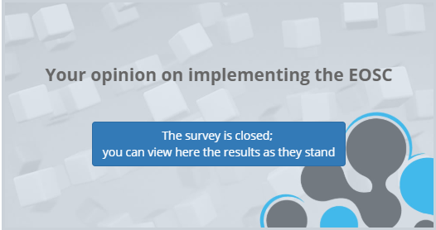
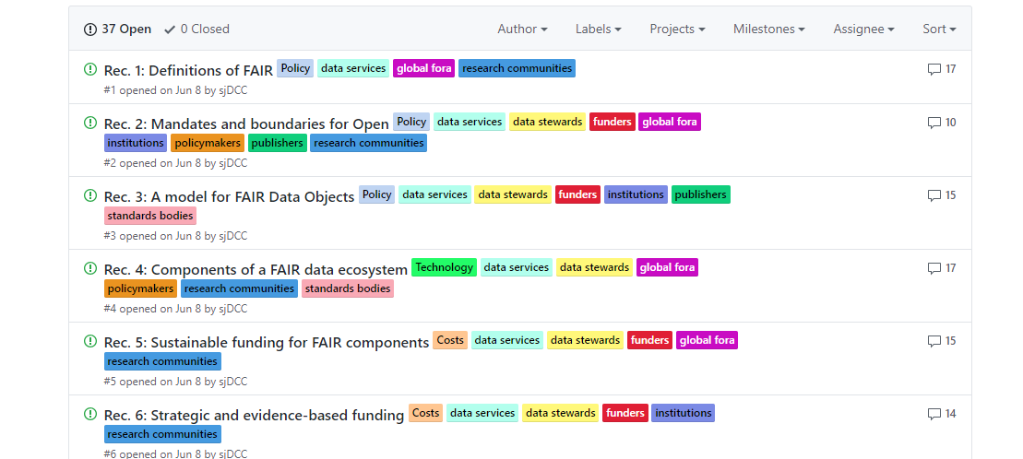
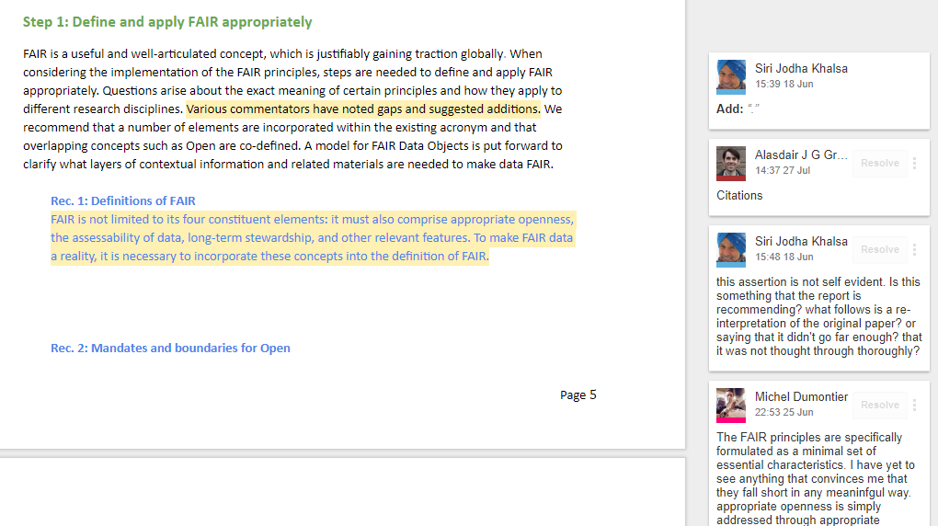
  Public consultations
  EOSC Rules of Participation
  Turning FAIR into reality
Input on the recommendations: https://eoscpilot.eu/open-consultation
Input on the report:
http://bit.ly/interim_FAIR_report
Input on the proposed "FAIR Data Action Plan": https://github.com/FAIR-Data-EG/Action-Plan

Slide 57
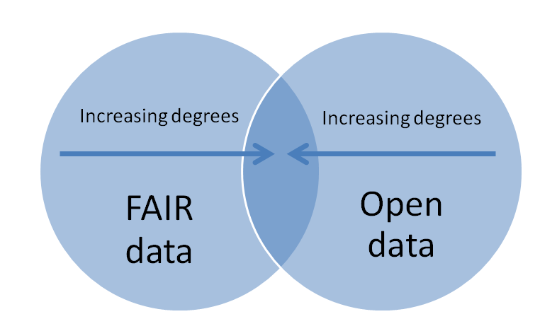
  Turning FAIR into Reality
  Key Elements of the Report
Extensive consultation: Over 500 comments and suggestions from c.50 stakeholder groups
To gain the greatest benefit and support EOSC, turning FAIR into reality must be supported by additional concepts and policies:
  as Open as possible
  prompt publication
  good practices for selection, stewardship and sustainability.
FAIR must apply to all digital outputs (including data, code, metadata etc)
Need to address enabling practices and technologies

Slide 58
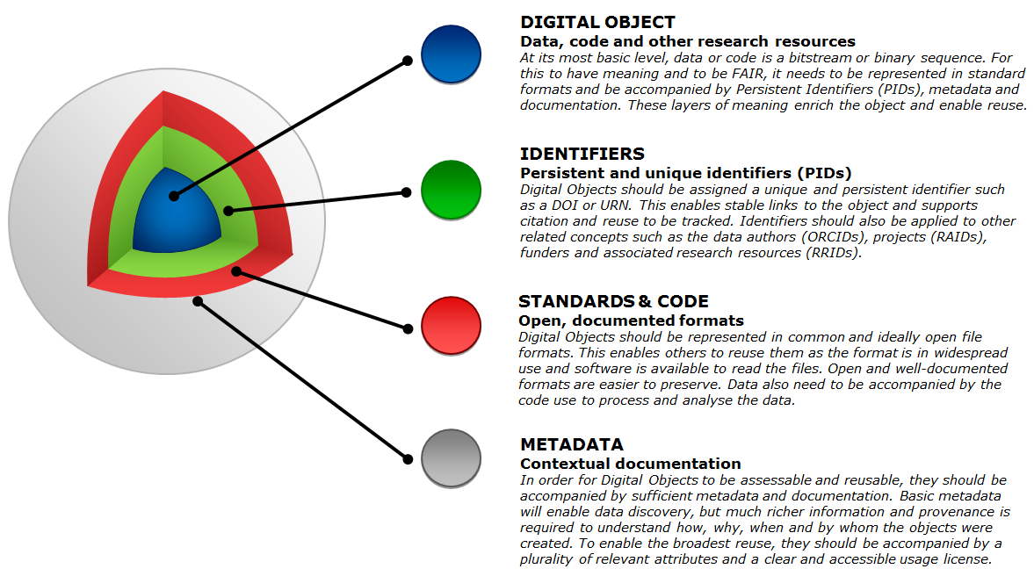
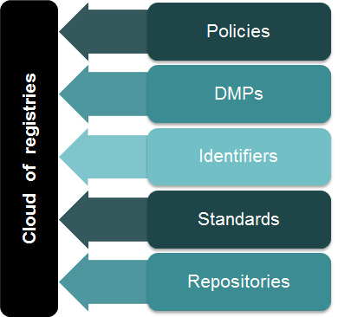
  Turning FAIR into Reality
  Key Concepts
FAIR Digital Objects: FAIR requires a model for FAIR digital objects: outputs (data, software and other research resources) have appropriate PIDs, use standard formats, rich metadata, licenses
FAIR ecosystem: FAIR requires an ecosystem of components, including policies, DMPs, PIDs, specifications and standards, repositories and registries of these components
Interoperability frameworks: Essential to support research communities to develop interoperability frameworks (for traditional disciplines and for new interdisciplinary research areas)

Slide 59
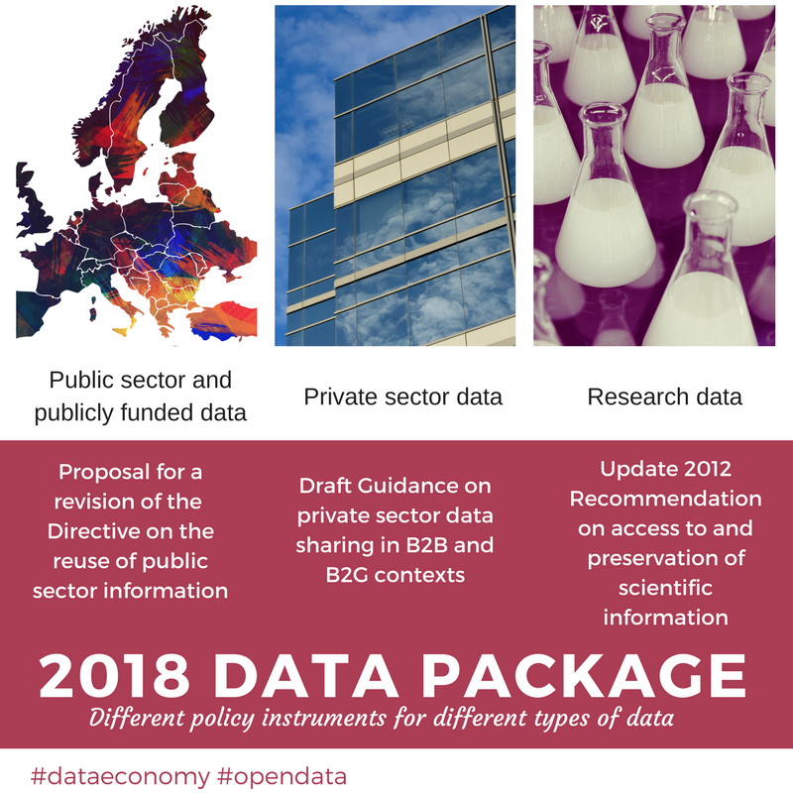
Data package
Adopted
25/4/2018

Slide 60
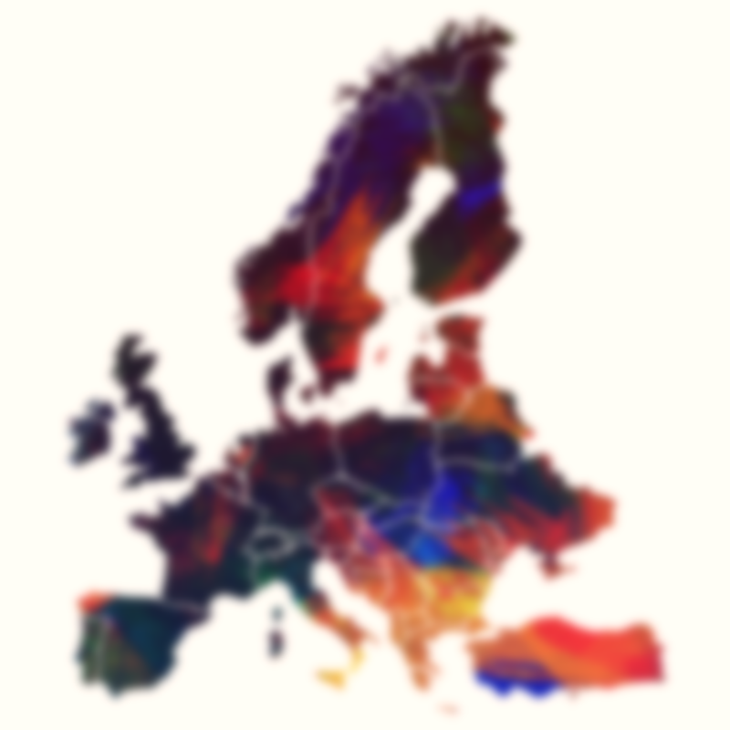
Proposal for a PSI Directive (recast) and research data
The proposal adopted on 25 April as part of the
'Data Package' extends the scope of the PSI Directive
to publicly-funded research data already accessible via repositories (art. 10).
In addition, it requires the Member States to adopt national Open Access policies to further encourage the availability and re-use of research data.
Re-use of research data will be free. The provisions of the PSI Directive will apply (e.g. licensing, formats, non-discrimination) with some exceptions (i.e. request procedure – Article 4).
Notes:
Publishing of dynamic data and the uptake of APIs
Limit the exceptions that allow public bodies to charge for the reuse of their data more than the marginal costs of dissemination.
Enlarge the scope of the Directive to:
Data held by public undertakings — charges for the reuse of such data can be above marginal costs for dissemination;
Research data resulting from public funding — Member States will be asked to develop policies for open access to publicly funded research data. The reusability of research data that are already contained in open repositories because of open access mandates will be facilitated.
Strengthen the transparency requirements for public–private agreements involving public sector information, avoiding exclusive arrangements.
Clarification of the interplay with INSPIRE/Database Directive
A next step will be a Delegated Act listing a set of high-value datasets which are to be provided in a timely manner and free of charge.

Slide 61
A stronger instrument
Commission Recommendation on access to and preservation of scientific information
The main changes
  Research data management (incl. FAIR data)
  Incentives schemes and reward systems for researchers to share data and commit to other Open Science practices
  Skills and competences regarding scientific information
  Text and Data Mining (TDM) and technical standards that enable re-use
  Infrastructures for OS (incl. European Open Science Cloud)
The expected impact
  An even more powerful policy instrument that is fit for purpose
  A new compass for Member States

Slide 62
Other initiatives

Slide 63
The Open Research Europe publishing platform
  Help H2020 beneficiaries and their researchers comply with the open access mandate without paying APCs during and after the grant
  Improve uptake of OA in H2020
  Promote OA as THE mode for publishing from now on
  Support open science and lead by example
    Early sharing of research (pre-prints + peer-reviewed articles)
    Open peer-review+ post publication commenting
    New generation metrics
  Explore business models in OA publishing and sustainability
  Non-award decision- New call to be published
Notes:
4) The Open Research Europe (ORE) Publishing Platform

Slide 64
Open Science Monitor
http://ec.europa.eu/research/openscience/monitor/

Slide 65
Thank you!
More information at
http://ec.europa.eu/research/openscience

