Slide 1
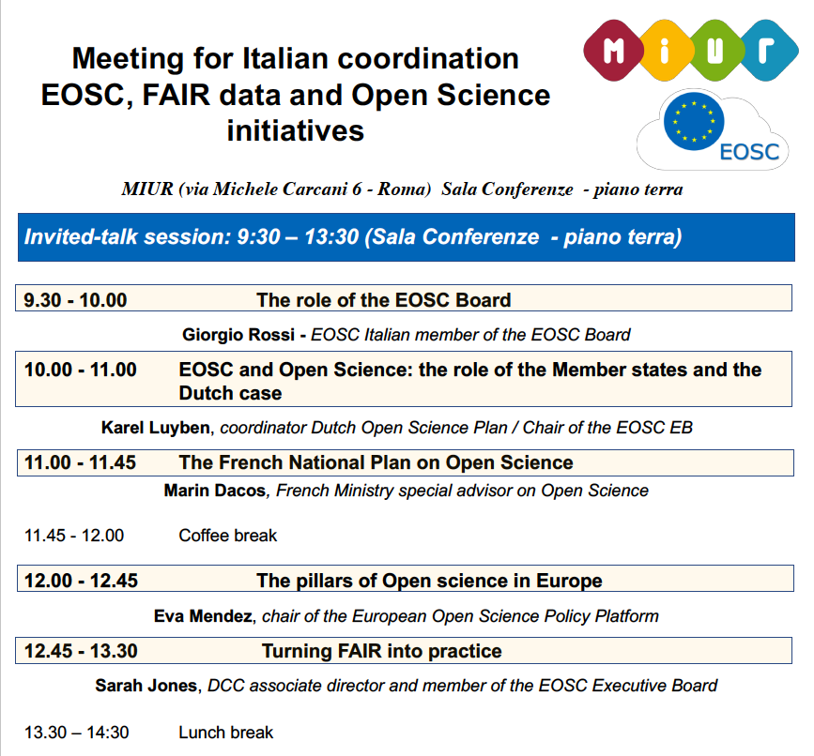


Slide 2

-
Two goals of the day:
Morning - Update on work for EOSC at European level, role of GB, Executive Board, other national activities, FAIR data and Open Science
Afternoon - Draft a reference Position Paper on the Italian contributions to the construction of the EOSC and coordinate the participation to the Working Groups

Slide 3
Mandate:
The European Open Science Cloud Governance Board (EOSC GB) will deliberate on the orientations of the actions funded across Horizon 2020 in support of the implementation of the EOSC and inform the Strategic Configuration's exchange of views, notably in the context of possible work programme updates to support the overall governance.
Beyond recommending to the Strategic Configuration choices on H2020 strategic priorities for EOSC, the EOSC GB can exchange views, form opinions and provide recommendations on:
the design of the post-2020 governance structure (recommendations on strategic and financing orientations and organisational settings for the future of the EOSC)
measures to fostering synergies between the EOSC activities funded at national, regional or transnational levels;
the mobilisation of national co-funding for EOSC and related activities;
orientations for the work of the EOSC Executive Board and its technical secretariat.

Slide 4
Mandate:
The EOSC GB will review the EOSC strategic implementation and annual work plans, and related documents (e.g. rules for participation to guide service provision and an action plan for scientific data interoperability to operationalise the FAIR principles), which the European Commission will submit to the EOSC GB building on the EOSC Executive Board's work.
The Governance Board where appropriate, may decide to set up working groups for the purpose of examining particular issues related to its mandate. The decision of the EOSC GB to set up working groups should clearly define the purpose and mandate of the working group, and guidelines for its membership. The working groups will be set up under the Executive Board responsibility and will be open to include Experts suggested by the GB.
The EOSC GB will function until the end of 2020.

Slide 5
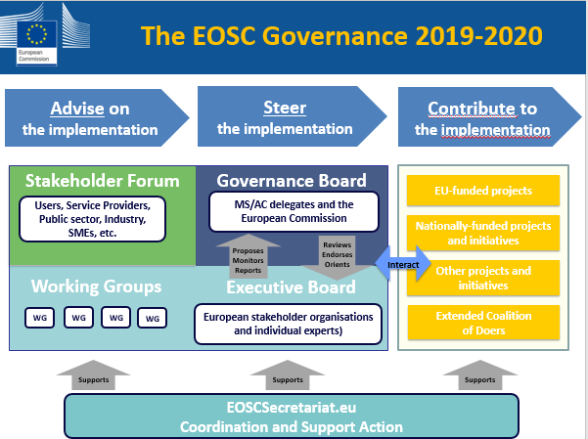

Slide 6
Working modalities:
The EOSC GB is created on the basis of Article 6 of the Rules of Procedure (RoP) of the Programme Committee for the specific programme implementing Horizon 2020 - the Framework Programme for Research and Innovation (2014-2020);
In adequacy with these RoP, the EOSC GB will be chaired by the Commission (co-chaired by DG RTD and DG Connect). ----- additional informal “third chair” -----
The EOSC GB will be reporting directly to the Strategic Configuration and its work and conclusions will be recorded in the minutes of the Strategic Configuration; The EOSC GB will agree by consensus on how to organise itself in an adequate manner in order to best prepare for its mandate.
The EOSC GB shall form its opinions, recommendations or reports by consensus.
The EOSC normally meets in Brussels … four to five times a year.

Slide 7
Interactions with the Executive Board and the Stakeholders Forum
:
The Executive Board is set up by the Commission as an expert group. It will do:
a draft strategic implementation plan and draft annual work plans, and draft mechanism for overseeing and steering the implementation of the strategic and annual work plans, and for monitoring and reporting on progress;
draft rules for participation to guide service provision and an action plan for scientific data interoperability to operationalise the FAIR principles;
recommendations on the appropriate mechanisms and possible forms for the EOSC governance after 2020 including business models and modes of financing, and on how the user base of the EOSC could be extended to the public sector and industry.

Slide 8
Interactions with the Executive Board and the Stakeholders Forum
:
The European Commission will submit to the EOSC GB all the documents produced by the Executive Board and its Working Groups including the synthesis of the Stakeholders Forum advice for discussion and review. For the transition period (i.e. until 2020), feedback will be channelled back to the Executive Board via the Commission and the Strategic Configuration.
The Stakeholders Forum will be invited to provide publicly available structured feedback to the Executive Board. To this view, the Stakeholders Forum will be supported by a Coordination and Support Action (CSA) project (to be selected from the Call H2020-INFRAEOSC-2018-4). This project will also work as technical secretariat of the Executive Board.

Slide 9
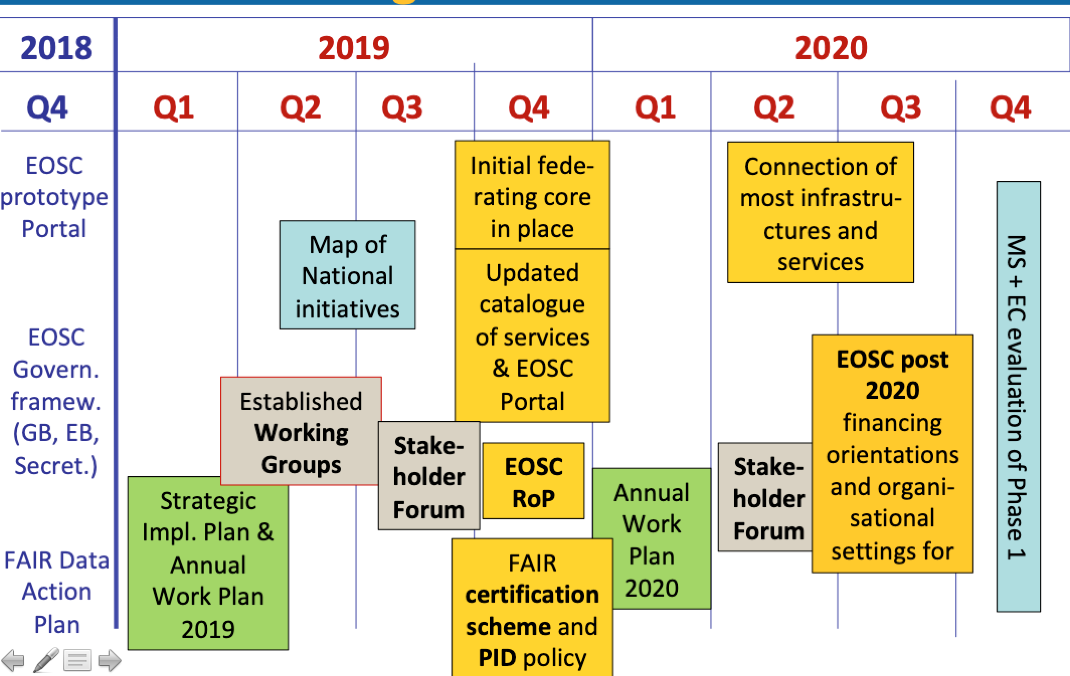

Slide 10
EOSC Governance Board (EOSC WG) First meeting 2019
28 January 2019 – Bucharest
DRAFT Minutes
Chairing: JD Malo (Director, RTD.B) and T Skordas (Director, CNECT.C)
The mandate was discussed. DE/NL/FR/IT presented the necessity for the GB to structure its own internal working modalities, and to include the possibility of activating variable-geometry sub-groups to prepare the GB discussion on the relevant agenda issues. At the demand of the several delegations, changes were made to include the possibility for the GB to request the EB to set up relevant working groups. After integrating those changes aimed at underlying the steering role of the GB, the mandate was adopted (final adopted version sent together with the minutes).
Several delegates pointed out the need for the GB to have a more important role in the elaboration of the content of the EOSC implementation and to benefit from a distinct level of strategic responsibility. The Commission welcomed the delegates’ suggestion of creating internal sub-groups to advance on relevant strategic issues. It was agreed that it would enable the GB to work more proactively and more efficiently with a view to provide more guidance to the EB. MS underlined the importance of fostering a close working relationship between GB sub-groups focussed on strategic topics and the corresponding EB working groups.
The DE delegation will propose a description of the internal modalities of sub-groups for feedback and approval of all delegates. IT proposed to consider the possibility of having short reports by the H2020 EOSC related projects in order to present their final results as these can be useful reference elements for elaborating the strategic view on the implementation of the EOSC.
The Commission suggested to the delegates to elect an ‘informal third chair’ among themselves to help amplifying the collegial views by the Member States and Associated Countries on the implementation of the EOSC.

Slide 11
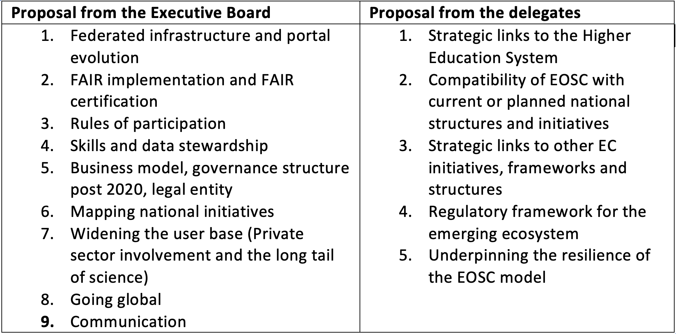
From DRAFT Minutes:

Slide 12
From DRAFT Minutes:
After a discussion on all the issues/working groups, the delegates took the decision to head start with the following five priority groups that shall be launched as soon as possible by the Executive Board (all equally important, not sorted by priority).
1) Future model of EOSC incl. the business model, governance structure and legal entity post 2020 Architecture WG – Abramatic
2) National and regional (if appropriate) initiatives – compatibility with national (regional) current & planned national (regional) structures and initiatives Landscape WG - Hrusak
3) FAIR implementation and FAIR certification FAIR WG - Sarah Jones
4) Federated infrastructure and the portal evolution Sustainability WG - Lueck, Kuster
5) Rules of participation Rules of Participation WG - Bicarregui
The five proposals will be elaborated in a form of half page descriptions by the Executive Board supported by the Secretariat and will be subject to review and endorsement by the GB.
EOSC GOVERNANCE BOARD (EOSC WG) SECOND MEETING
27 MARCH 2019
BRUSSELS

Slide 13
EOSC Governing Board sub-groups modus operandi & operating principles (proposal to the GB)
The EOSC Governance Board (GB) brings together representatives from the Member States (MS), Associated Countries (AC) and the European Commission (EC) to ensure strategic direction and supervision of the EOSC roadmap, and coordination with relevant national initiatives. The GB is chaired by the Commission. It was agreed with the EC that the GB will also have an (informal) co-chair who will be appointed by the MS at the GB meeting of 27 March 2019. The proceedings of the GB and its sub-groups will be based on four core operating principles: Openness, Inclusivity, Balance and Foresight.
Openness
The membership, findings and summary of proceedings of the GB and its sub-groups will be publically available on the EC Open Science website. The approach and working methods of sub-groups will be fully transparent. All finalised outputs of the GB and its sub-groups (position papers, reports, recommendations etc.) will be FAIR by default.
Inclusivity
Sub-group participation is open to any MS/AC delegate of the GB. Interim outputs and findings will be presented to the full GB for consideration.
Balance
The GB aims to take into account, reflect and balance the different perspectives and stakeholders in the EOSC ecosystem.
Foresight
The EOSC GB will provide strategic guidance and effective oversight for the EOSC through the proactive contribution of its members. To do this effectively, sub-groups focussed on specific topics will aim to provide contextual analysis, synthetic reports and recommendations. They will have a mandate to assess the current context and anticipate issues that may impact the development of the EOSC, with a forward-looking focus to consider issues relevant to the future of the EOSC.

Slide 14
The GB will form sub-groups on selected topics considered of general or specific strategic interest. The role of these sub-groups is to support the deliberations of the GB by providing analysis and recommendations on key issues relevant to the co-construction, development, and sustainability of the EOSC. GB sub-groups will function according to the following modus operandi:
Sub-groups are formed by the GB and can be proposed by any delegate of the GB, at any point in time. A short description of their scope of interest, respective tasks and expected outputs is required.
Sub-groups are during their constitution open to all GB Delegates. They will consist of at least five country representatives, with an appropriate representation of smaller and larger countries.
The work of sub-groups is fully transparent, and their proceedings, approaches, and interim results are openly communicated to all the delegates of the GB for discussion during GB meetings. Members of the sub-groups organise their own working methods (e.g. meetings, telephone conferences, circular resolutions, etc.) and can request support from the Secretariat.
Sub-groups may nominate a representative to participate in, or liaise with a working group.
Sub-groups will report on a regular basis to the GB and prepare the input to GB meetings on their topic.
In accordance with it’s mandate, the GB can decide that working groups should be established by the EB on topics considered of particular strategic importance. The mandates of working groups recommended by the GB will be jointly prepared by the GB and the EB. The EB will prepare the mandates for all other working groups to be endorsed by the GB. Working groups will be supervised by the EB and supported by the Secretariat. The GB can provide guidelines for membership of working groups and suggest the inclusion of specific Experts to any working group. The GB sub-groups will work closely with working groups related to their sphere of interest, may provide orientation to related working groups, participate in (selected) meetings of corresponding working groups, monitor the outputs, and report the findings as a basis for in-depth discussion and deliberations in the GB. Budget and planning of the Secretariat permitted, GB sub-groups can request support from the Secretariat to prepare reports, gather data, and other analytical inputs.

Slide 15
Action Points
:
The delegates will propose a ‘third chair’ from the MS/AC (before the next meeting)
The Executive Board with the Secretariat will provide a half a page description per working group and circulate to the GB for quick feedback.
In the absence of objection by the GB, the EB will be charged to launch asap the first wave of five Working Groups
The GB will discuss on the composition of the groups.
Discussion of the draft on internal modalities of sub-groups and its relations with the working groups.
Open agenda

Slide 16
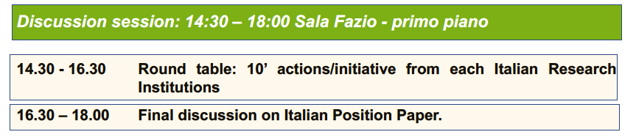

Slide 17
Italy’s Position Paper on EOSC
finalized on 12 Mar 2019
Italy expects the European Open Science Cloud (EOSC), as a part of Open Science, to strengthen European competitiveness in the global scene by making high quality scientific data and tools from all domains effectively and efficiently available to research and innovation activities.
Italy believes that a well-designed EOSC should:
optimize resources and data services making them broadly accessible;
reach relevant academic digital services as high-performance computing and data analytics, data management, networking, cloud computing;
build on existing and upcoming technical solutions oriented to specific scientific challenges;
enable interdisciplinary usage of scientific data;
promote training programmes aimed at capacity building in data science and broad data literacy;
accelerate the transition to Open Science and Open Innovation by removing the barriers to the re-use of research data and tools.

Slide 18
Italy recognizes that:
promoting the interoperability of data services and deploying strategic e-services, according to the users communities’ needs, requires a concerted European action;
the building blocks for the EOSC are the Research Infrastructures of pan-European interest (ESFRI, ERICs, EIROForum and national RIs operating international open access) along with the operational national and international e-infrastructures and resources for HPC, data services and high-bandwidth networks ;
federating these infrastructures and services will set the solid basis for the EOSC;
the EOSC should help, gradually, to align all scientific domains to the most advanced standards and practices and, subsequently, build on those for realizing effective and sustainable interoperability;

Slide 19
Italy recognizes that:
…
it is crucial to support training and hiring of experts/scientists/practitioners/managers for e-infrastructures: specific concerted actions at European level should involve the universities, RIs, all research performing organizations in the public and private sectors;
a broad plan for achieving data-literacy must involve the education system as a whole in order to prepare the next generation of users of the EOSC;
identifying concerted implementation rules for FAIR data services, transparent certification principles for EOSC compliance of data-centres, and agreed rules of participation to the EOSC, is relevant for optimizing both the European and national investments;
the main Italian organizations in research, computing and data management, are engaged in national, regional and European H2020-projects and in the construction and operation of the pan-European Research Infrastructures. They actively pursue a coherent vision of European e-infrastructure and e-services (EOSC, EuroHPC, EDI).
…

Slide 20
Italy wishes to:
contribute to realize leading-edge digital services for the exploitation of scientific data;
capitalize on existing national data and computing resources, operated by universities and by research institutions, concerted through the ICDI - Italian Computing and Data Infrastructure – consortium;
implement a convergent policy of funding for all the relevant aspects of e-infrastructure, addressing in a concerted manner all aspects of data infrastructure including FAIR-data and services, EOSC, high-level computing including EuroHPC and high-bandwidth data-networks.
Italy supports a strategic governance of EOSC and all efforts towards an overall coherent European e-infrastructure action, where the national resources and the European undertakings concur to its implementation.
…

Slide 21
After a discussion on all the issues/working groups, the delegates took the decision to head start with the following five priority groups that shall be launched as soon as possible by the Executive Board (all equally important, not sorted by priority).
Future model of EOSC incl. the business model, governance structure and legal entity post 2020
National initiatives – compatibility with national current & planned national structures and initiatives
FAIR implementation and FAIR certification
Federated infrastructure and the portal evolution
Rules of participation
The five proposals will be elaborated in a form of half page descriptions by the Executive Board supported by the Secretariat and will be subject to review and endorsement by the GB.

Slide 22
Working Group: Landscape Jan HRUSAK
Mission
The “Landscape Analysis” working group will be assigned with the task of providing options allowing a progressive EOSC convergence and alignment of structures and initiatives in Europe including national research infrastructures and e-infrastructures, national open science policies, ESFRI RIs and cluster projects, thematic initiatives and clouds, EOSC-relevant H2020 projects and international working groups (such as RDA, etc.).
Rationale
The EOSC-Landscape Analysis working group will build on the outcomes of the EOSC related projects provided by the EC and on the inputs provided by the Member states.
Deliverables
The EOSC-Landscape Analysis working group is expected to:
Deliver the mapping of EOSC-relevant national infrastructures and the current level of spending on research data infrastructures as follows:
an initial mapping by Q3 2019 , based on what’s existing in EOSC-HUB and other related projects , as well as any contributions by the GB members;
a revised and final mapping by Q4 2019 with the input by the new INFRAEOEC-5b cluster of projects (to build on top of the initial mapping when they kick-off their mapping activities in September 2019).
The mapping should take into consideration the Conclusion no 10 of the Draft Council conclusions on the European Open Science Cloud (EOSC).
Take stock of federation constraints and opportunities at the various architectural levels, arising from national and regional structures and initiatives
Propose mechanisms and best practices that will facilitate convergence and alignment between national and regional structures and initiatives
Conduct an analysis of the Member State’s level of preparedness to provide financial resources and support for political stability and infrastructural planning to EOSC
Dependencies
The EOSC-Landscape Analysis working group will provide input to the work of the EOSC-Sustainability working group, and collaborate with this group on the compatibility of proposed EOSC governance model(s).
The EOSC-Landscape Analysis working group will work in collaboration with EOSC-FAIR Practices working group to ensure that the compatibility of EOSC with the relevant structures and initiatives will happen in accordance with FΑΙR principles.
The EOSC-Landscape Analysis working group will work in collaboration with EOSC-Rules of Participation working group to ensure that EOSC convergence and alignment with relevant initiatives occurs inside the participatory rules framework.
“INVITES the Commission and the Member States therefore, to jointly explore the creation of a map of national research data infrastructures and initiatives in the Member States which could be federated, in order to ensure that current structures, competences, functions, and initiatives regarding research data management are duly taken into account;” Draft Council conclusions on the European Open Science Cloud (EOSC), 9029/18. https://data.consilium.europa.eu/doc/document/ST-9029-2018-INIT/en/pdf

Slide 23
EOSC Working Group: Architecture Coordinator: Jean-François Abramatic
Mission
The EOSC Architecture working group will be in charge of proposing the technical framework required to enable and sustain an evolving EOSC federation of systems. Such a technical framework may include standards, APIs and protocols that will facilitate interoperable digital services delivered by diverse providers.
Rationale
In order to fulfill the EOSC vision, an interoperability layer that allows to build the EOSC federation of systems
has to be defined
has to be agreed upon by all stakeholders
has to be developed through an open and transparent process.
It will be built on the results delivered by the EOSC-related Horizon 2020 projects.
Deliverables
The EOSC Architecture working group will provide an in-depth independent review of the current offering and the required evolution of the EOSC technical architecture, its standards and best practices. It will propose a way forward by describing and/or defining:
the EOSC core services and their interfaces
the EOSC open source APIs for reuse by thematic services
the EOSC portal components and federated catalogues of service offerings
the EOSC data description standards
any other standards and best practices necessary to ensure the evolution of EOSC and the widening of its user base to the industry and the public sectors.
Dependencies
The EOSC Architecture working group will work in collaboration with the EOSC FAIR working group in order for the technical architecture to support the requirements of Findability, Accessibility, Interoperability and Reusability.
The EOSC Architecture working group will work in collaboration with the EOSC Rules of Participation working group to ensure that the technical architecture facilitates the contributions of service providers and the uses of researchers.
The EOSC Architecture working group will work in collaboration with the EOSC Sustainability working group in order to define the process that will allow a managed evolution of the EOSC architecture.

Slide 24
EOSC Working Group: Sustainability Rupert LÜCK, Stephan KUSTER
Mission
The EOSC Sustainability working group will provide a set of recommendations concerning the implementation of an operational, scalable and sustainable EOSC federation after 2020, which will be gradually opening up its user base to the public sector and industry. The working group will examine core aspects related to the business model of EOSC, its governance structure and propose options for the best-fit legal entity to be put in place after 2020.
Rationale
The EOSC Sustainability WG working group will build on the legacy of the EOSC Roadmap, Council Conclusions 2018, Horizon 2020-funded projects, stakeholder reports and experience of similar initiatives. Taking on board input of ongoing initiatives will support analysing the gaps towards identifying a future model for EOSC and completing the EOSC vision.
Deliverables
The EOSC Sustainability working group will assist the Executive Board in taking stock, assessing and recommending strategic and financing orientations that EOSC could follow during its second phase of implementation (post 2020).
More specifically, the WG will aim to:
Prepare a business model detailing the financial ecosystem required to sustain, upgrade and scale the EOSC federation, as a whole and in its components. The model should propose mechanisms to ensure appropriate ongoing financial commitment by stakeholders and identify where funding responsibility lies for different components and services. It will identify income streams as well as opportunities for consolidation and economies of scale.
Propose an applicable governance framework to steer and oversee initial EOSC operations and further development beyond the initial phase. Balancing the requirements of stakeholders, Member States and European Commission will stimulate fast and broad uptake towards completing the operational EOSC vision.
Mapping the policy framework, considering regulations and legislation influencing the EOSC and defining potential legal entity options EOSC could adopt to support optimal service delivery and growth post 2020.
Dependencies
The EOSC Sustainability working group will work in collaboration with EOSC-Rules of Participation working group in order to ensure that the EOSC Governance and legal entity post 2020 will be compatible with the EOSC Rules of Participation.
The EOSC Sustainability working group will work in collaboration with EOSC-Landscape Analysis working group to ensure that the:
Member State’s level of preparedness analysis is taken into account for the formation of a sustainable business model post 2020; and
Governance framework post 2020 will consolidate the compatibility of national and regional Structures and Initiatives with EOSC.
.

Slide 25
EOSC Working Group: FAIR Coordinator: Sarah Jones
Mission
The EOSC FAIR working group will coordinate and steer activities that implement Open and FAIR practices within the EOSC. It will address cross-disciplinary interoperability, gather requirements to inform the development of EOSC services, and advise the EOSC governance on FAIR-related matters.
The FAIR & Architecture WGs will operate in close alignment. The former addresses cultural aspects such as semantic and legal interoperability, certification and community data standards, while the latter will focus on the related technical specifications that address FAIR requirements.
Rationale
The implementation of FAIR and Open Science policy requires a culture change supported by appropriate incentives and coherent, easy-to-use data services. This WG will build on existing FAIR practice to increase maturity in all disciplines, and address interoperability across them to ensure that data are managed and shared in ways that maximise reuse.
Deliverables
The EOSC-FAIR working group will define and implement annual FAIR work plans. These will be based on the Action Plan proposed by the EC Expert Group on “Turning FAIR into reality”, as well as ongoing community initiatives and outputs from key projects like FAIRsFAIR.
The WG will coordinate activities that:
Support the development and adoption of data standards and sharing agreements
Upscale best-practice solutions already applied in specific scientific domains or countries to the multi-disciplinary and European levels
Propose/validate an EOSC Interoperability Framework that overarches disciplinary approaches and encourages research infrastructures to be interoperable-by-design
Identify service requirements for FAIR implementation to inform the Architecture WG
Help steer international development to convergence on globally-accepted frameworks for the certification of FAIR data and services
Validate and implement FAIR assessment frameworks, including the collation of results e.g. catalogues of FAIR repositories
Dependencies
The FAIR working group will work in close collaboration with the Architecture WG to ensure that the FAIR principles of findability, accessibility, reusability and interoperability are supported by the technical arrangements under development.
The FAIR working group will also collaborate with Landscape WG to ensure that the federation of relevant structures and initiatives is conducted under the scope of the FAIR principles.
The FAIR working group will coordinate with the Rules of Participation WG to ensure that EOSC services support FAIR and are FAIR.

Slide 26
Working Group: Rules of Participation Juan BICARREGUI
Mission
The “Rules of Participation” working group will focus on recommending a minimal set of clear Rules of Participation that shall define the rights, obligations and accountability governing all EOSC transactions by the various EOSC users, providers and operators. Emphasis will be put on finding the common requirements across the very heterogeneous European landscape of Research Infrastructures and service providers.
Rationale
EOSC-RoP working group recommended Rules of Participation shall embrace the principles of openness, transparency and inclusiveness. They shall guarantee an open, secure and cost-effective federated Pan-European EOSC with services of documented quality.
There will be room and need for differentiating the rules applicable to different EOSC users taking into account:
The different roles and different services available in EOSC (eg data producers, service providers, data/service users);
The specificities of different scientific disciplines;
The diversity and level of readiness of infrastructures and services at disciplines, Member States and Associated Countries, and EU level and the differences in their established rules and processes;
The variety of service providers and users that will be involved in the EOSC (e.g. public versus private, horizontal versus specialized);
Changing needs and practices regarding the implementation of the rules, in particular concerning compliance with existing legal frameworks in Europe (GDPR, etc.) and emerging ones (e.g. free flow of data)
The widening of EOSC user base to the industry and the public sector.
Deliverables
The WG will build on work undertaken in EOSCpilot WP2 and reported in D2.5 (https://eoscpilot.eu/content/d25-recommendations-minimal-set-rules-participation)
The EOSC-Rules of Participation working group outputs will include:
the proposal of an initial set of RoP by the end of 2019 for implementation from 2020 onwards;
the collection in 2020 of user feedback on the initial set of RoP, followed by a revised proposal of the RoP for application after 2020.
Dependencies
Due to the nature of the research that EOSC-Rules of Participation working group will conduct, it is advised that all other working groups should also contribute to the progress by providing to EOSC-Rules of Participation working group findings that directly contribute towards the completion of the tasks planned.

Slide 27
Proposals to populate the WGs
Duration – end 2020
Meetings – several trips to be planned + remote work
ICDI should propose experts

Slide 28
Elements for an Italian Position on EOSC
Italy wishes to contribute to constructing an effective and efficient e-infrastructure and data service-infrastructure for European science to foster the competitiveness on the global scene.
Italy wishes to implement a convergent policy of funding for all the relevant aspects of e-infrastructure, addressing in a concerted manner the ensemble of the issues of data-infrastructure including FAIR-data and services, EOSC, high-level computing including Euro-HPC and high-bandwidth data-networks, all making the European Digital Infrastructure (EDI).

Slide 29
Italy recognize that the EOSC should first help aligning all scientific domains to the most advanced standards already operational and then building on these for pursuing effective interoperability as a long-term goal that will fully enable interdisciplinary research.
Italy recognizes that effective building blocks for the EOSC and for HPC policy are the Research Infrastructures of pan-European interest (ESFRI, ERICs and national RIs operating international open access) as well as the national coordinated resources for HPC, data repositories and high-bandwidth networks. Federating the good practices of the RIs must set the reference starting level for the EOSC and EDI initiatives. Deploying strategic e-services requires a concerted European action.

Slide 30
[Federating the currently operational data services (repositories, HPC/HTC resources, analysis software, high bandwidth networking) of Research Infrastructures, e-Infrastructures and large national projects, in a cross linked environment that captures the whole landscape and allows to identify the aligning criteria for optimal efficiency in operation and in investment strategy. This should produce a comprehensive recognition of the current assets that perform open data science services and that must be the Italian building block for the EOSC, with an investment analysis (e.g. quota -15% ?- of FOE for Research Infrastructures plus quota -?- of running budget of EPR, perhaps Universities –difficult- …). Good practices and some degree of integration in the Federation (ICDI-inspired?) should be proposed as key elements of the EOSC at all levels, and perhaps address also the Mediterranean area The model could be the outcome of the einfracentral.eu, and influence should be done on CatRIs. Build the Italian element of the “minimum viable ecosystem” as defined by the HLEG “EOSC in practice” paper involving RIs participating to ESFRI Clusters, other RIs providing Open Access to Research Facilities and Data (LNGS, Elettra, SRT, EPOS, …) and participants to EOSC H2020-projects testing the EOSC and FAIR-data definitions and temporary guidelines available. Use this experience as building block for the full EOSC.]

Slide 31
Italy recognizes that it is urgent to set a plan for training and hiring of e-infrastructure experts/scientists/practitioners with specific actions involving the universities, RIs, national research institutes and all research performing actors in the pubic and private sectors. A broader plan for data-literacy must involve the education system as a whole in order to prepare the next generation of beneficiaries of the EDI. European coordination of action (international credits, equivalences) is needed.
The main Italian actors in research, computing and data management are contributing to the ICDI and BIG DATA initiatives, as well as in all the ESFRI and ERIC Research Infrastructures, to implement a coordinated vision of e-infrastructure therefore optimizing the effective contribution of Italy to the EOSC, EURO-HPC, EDI initiatives.

Slide 32
Italy recognizes that identifying concerted implementation rules for FAIR data services and the certification principles for EOSC-readiness of data-centres/repositories, and overall rules of participation to the EOSC will greatly help in optimizing both the European and national investments.
Italy supports a strategic governance of all EDI related actions, where the national resources and the European undertakings concur to the implementation.

Slide 33
[Provide capacity to the Open Data system and EOSC by identifying the existing capacity, the current saturation levels, the perspective saturation levels and investment needs of novel infrastructure for “certified” FAIR and EOSC services. This should produce a comprehensive analysis of the current capacity to support the data traffic (access, on-site or remote data analysis, on-site or remote data storage –short term and long term-) and of the investment to be made order to support the perspective volume of EOSC-originated data traffic in 5 years and in 10 years. Simple symbolic questions like “when exascale will be needed ALSO for EOSC?”, when “la terza corsia” of the network will be needed? Estimating the current value invested (absorbed) and the new investment for continuous upgrade that is required by EOSC (on top of the non-EOSC needs). This is ALSO the connection with EDI and EuroHPC that should not be lost (as the inter DG conflict of EC tends to produce)]

Slide 34



9. ESFRI WORKSHOP ON EOSC
PARTICIPANTS
ESFRI WORKSHOP ON RIs AND EOSC
Royal Geographical Society, London
30 January 2018, 10:00 – 18:00
ESFRI Forum delegates – Around 50
ESFRI RI Projects (including the 6 new ESFRI 2018 Roadmap ones who are not part of the Cluster projects), ESFRI Landmarks and ESFRI Cluster projects – At least 1 per project
EC representatives
Targeted EOSC-related project representatives
StR-ESFRI logistical representatives
Expected participation: 120-150 persons
67th ESFRI MEETING - 11 December 2018, Brussels

Slide 35
9. ESFRI WORKSHOP ON EOSC
AGENDA SKELETON – PART 1
09:15 – 10:00
Session 1 – Scope, EOSC status update and ESFRI Position Statement
Moderator – ESFRI Chair
Introduction – ESFRI Chair (10’) Jan Hrusak
Update on EOSC status – EC (10’) Jean David Malo (tbc)
Next steps for EOSC – EOSC Executive Board Chair (15’) (Karel Luyben)
10:00 – 12:45
Session 2 – EOSC and ESFRI RIs services: how do they tango?
Moderator – Ana Proykova
EOSC Services for RIs (40’)
  Short presentations of EOSC-Hub, eInfraCentral, FREYA, OpenAIRE-Advance with emphasis on relevant current and future services for RIs
Coffee break – 10:40 – 11:10

Slide 36
9. ESFRI WORKSHOP ON EOSC
AGENDA SKELETON – PART 2
[…continued] Session 2 – EOSC and ESFRI RIs services: how do they tango?
Moderator – Ana Proykova
RI Cluster projects for EOSC (50’)
  ENVRI-FAIR - Andreas Petzold, FZJ
  EOSC-LIFE - Niklas Blomberg, ELIXIR
  ESCAPE - Giovanni Lamanna, CNRS
  PANOSC - Andy Götz, ESRF
  SSHOC – Ron Dekker, CESSDA
Panel discussion (40’)
  Prospective EOSC services for ESFRI RIs
  Connections of current and forthcoming EOSC and ESFRI RIs services
  The role of Cluster projects
Lunch break – 12:45 – 13:45
67th ESFRI MEETING - 11 December 2018, Brussels

Slide 37
9. ESFRI WORKSHOP ON EOSC
AGENDA SKELETON – PART 3
13:45 – 16:00
Session 3 – Break-out sessions (2 rounds, 1 hour each ) - How ESFRI RIs can contribute to and steer the various dimensions of EOSC; Short introduction by moderators, followed up by interactive discussions; Possible use of questionnaires and slido.com on-line polling tool
Services: Good practices and Business Models
Experience of RIs and e-Infrastructure services
Classification of services
Sustainability
KPIs
Policies: Open Science, FAIR data, Reproducibility (Reliability)
EC Expert Group on “Turning FAIR data into Reality” results, FAIR principles for RIs; FAIR ecosystem and digital objects (data, services, tools, software- PIDs, metadata, policies, Data Management Plans); linking people, data, services and trainings, publications, projects and organisations; FAIR metrics for RIs
67th ESFRI MEETING - 11 December 2018, Brussels

Slide 38
9. ESFRI WORKSHOP ON EOSC
AGENDA SKELETON – PART 4
Architecture: technologies, platforms and interfaces
Moderators/Rapporteurs: Leonardo Candela, CNR, Raphael Jimenez, ELIXIR, Christos Kanellopoulos, GEANT
  Access Pathways; Universal Authentication/Authorisation framework: eduGAIN and eduTEAMS; Interoperability frameworks for data sharing across domains and reuse of domain solutions;
Skills and training
Moderators/Rapporteurs: Roberto Barbera, INFN, Markus Pasterk, BBMRI-ERIC and RITrain, Francoise Genova, CNRS
  Demand vs. supply in HRs: Data Science/Stewardship skill set, Promoting change of culture to share data – good practices, incentives and reward frameworks; The role of the clusters; Next actions
Coffee break – 16:00 – 16:30
There will be two rounds of four sessions, 1 hour each, so that everyone can participate in 2 discussions. A 15‘ break in between to move between the rooms.
67th ESFRI MEETING - 11 December 2018, Brussels

