Slide 1
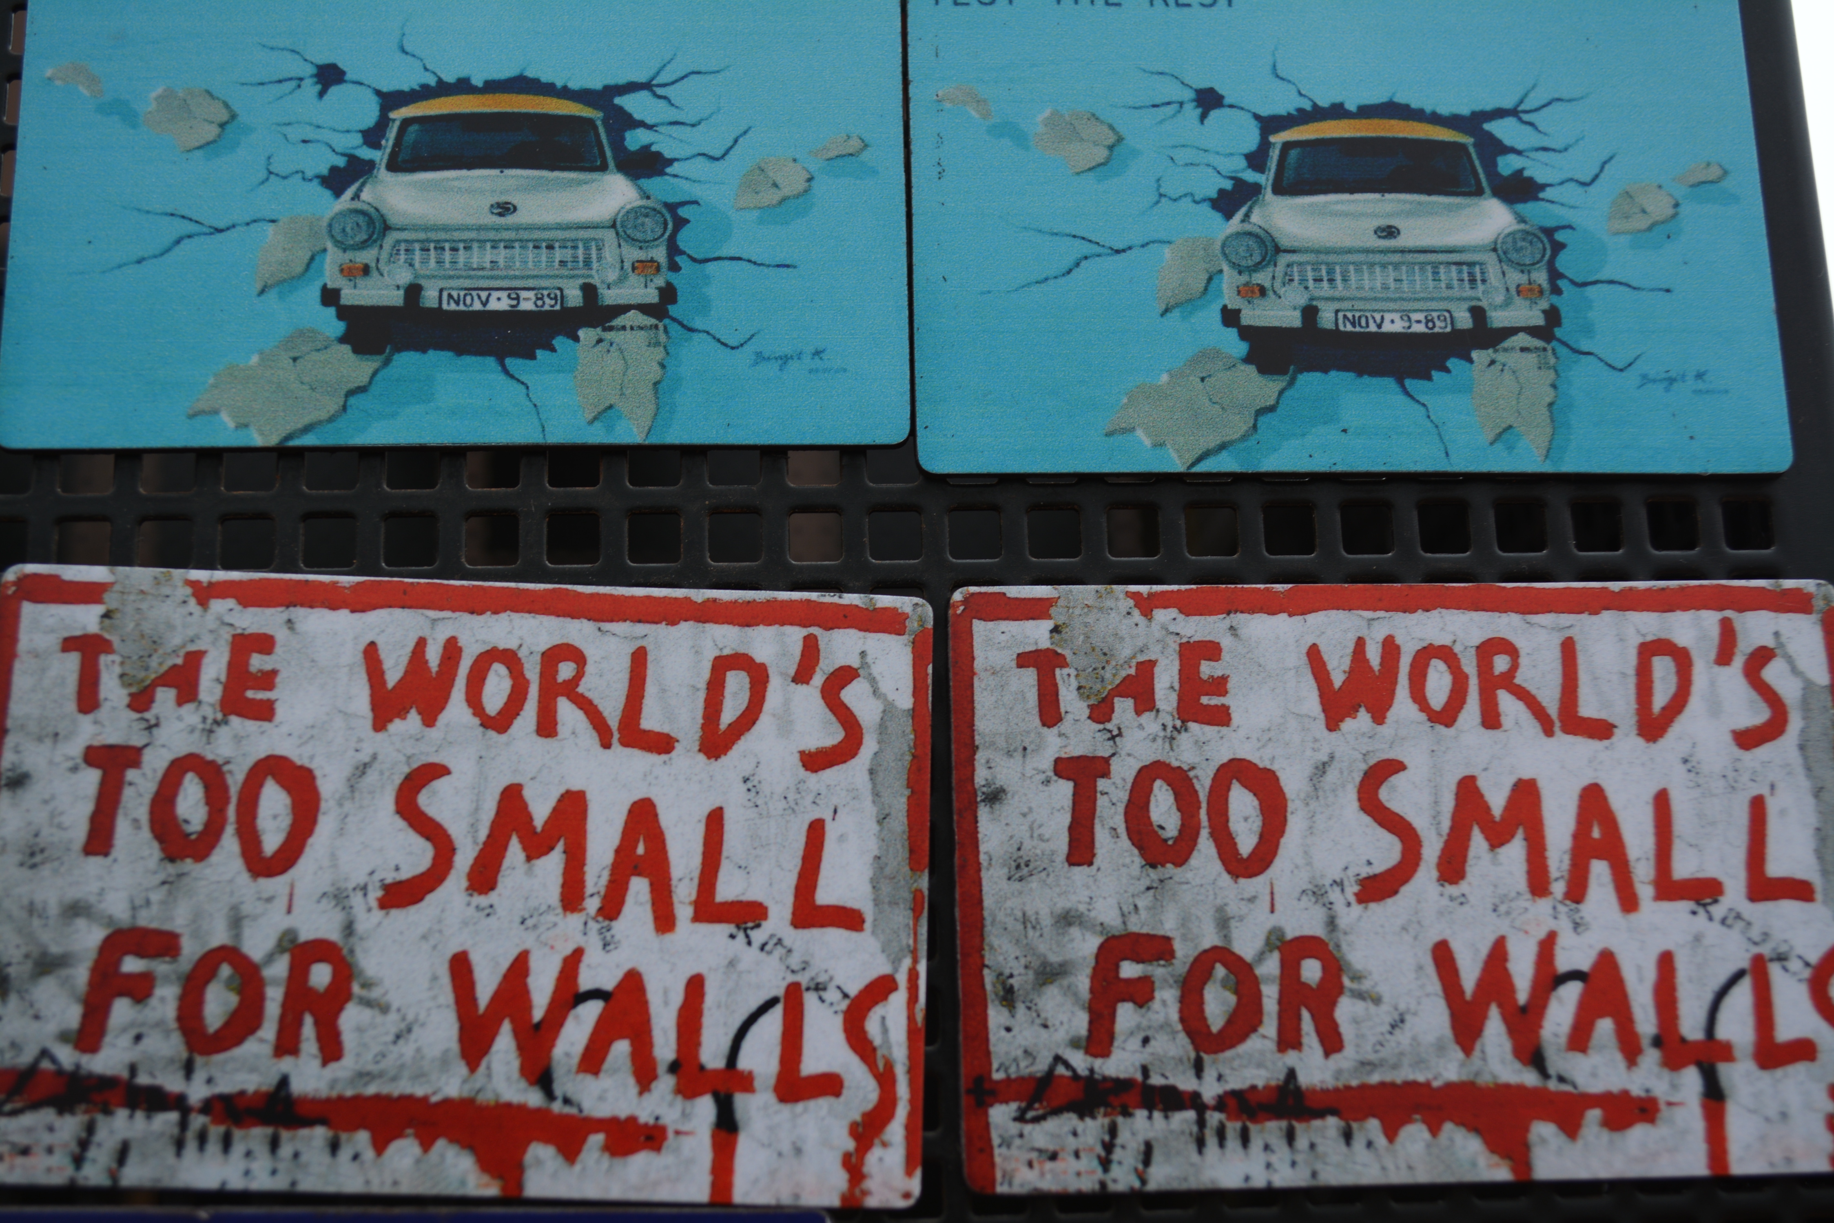
OPEN SCIENCE:
GOOD FOR SCIENCE,
GOOD FOR SOCIETY
Elena Giglia
Roma, APRE, 23 maggio 2018
elena.giglia@unito.it
This work is licensed under a Creative Commons Attribution-ShareAlike 4.0 International License.

Slide 2
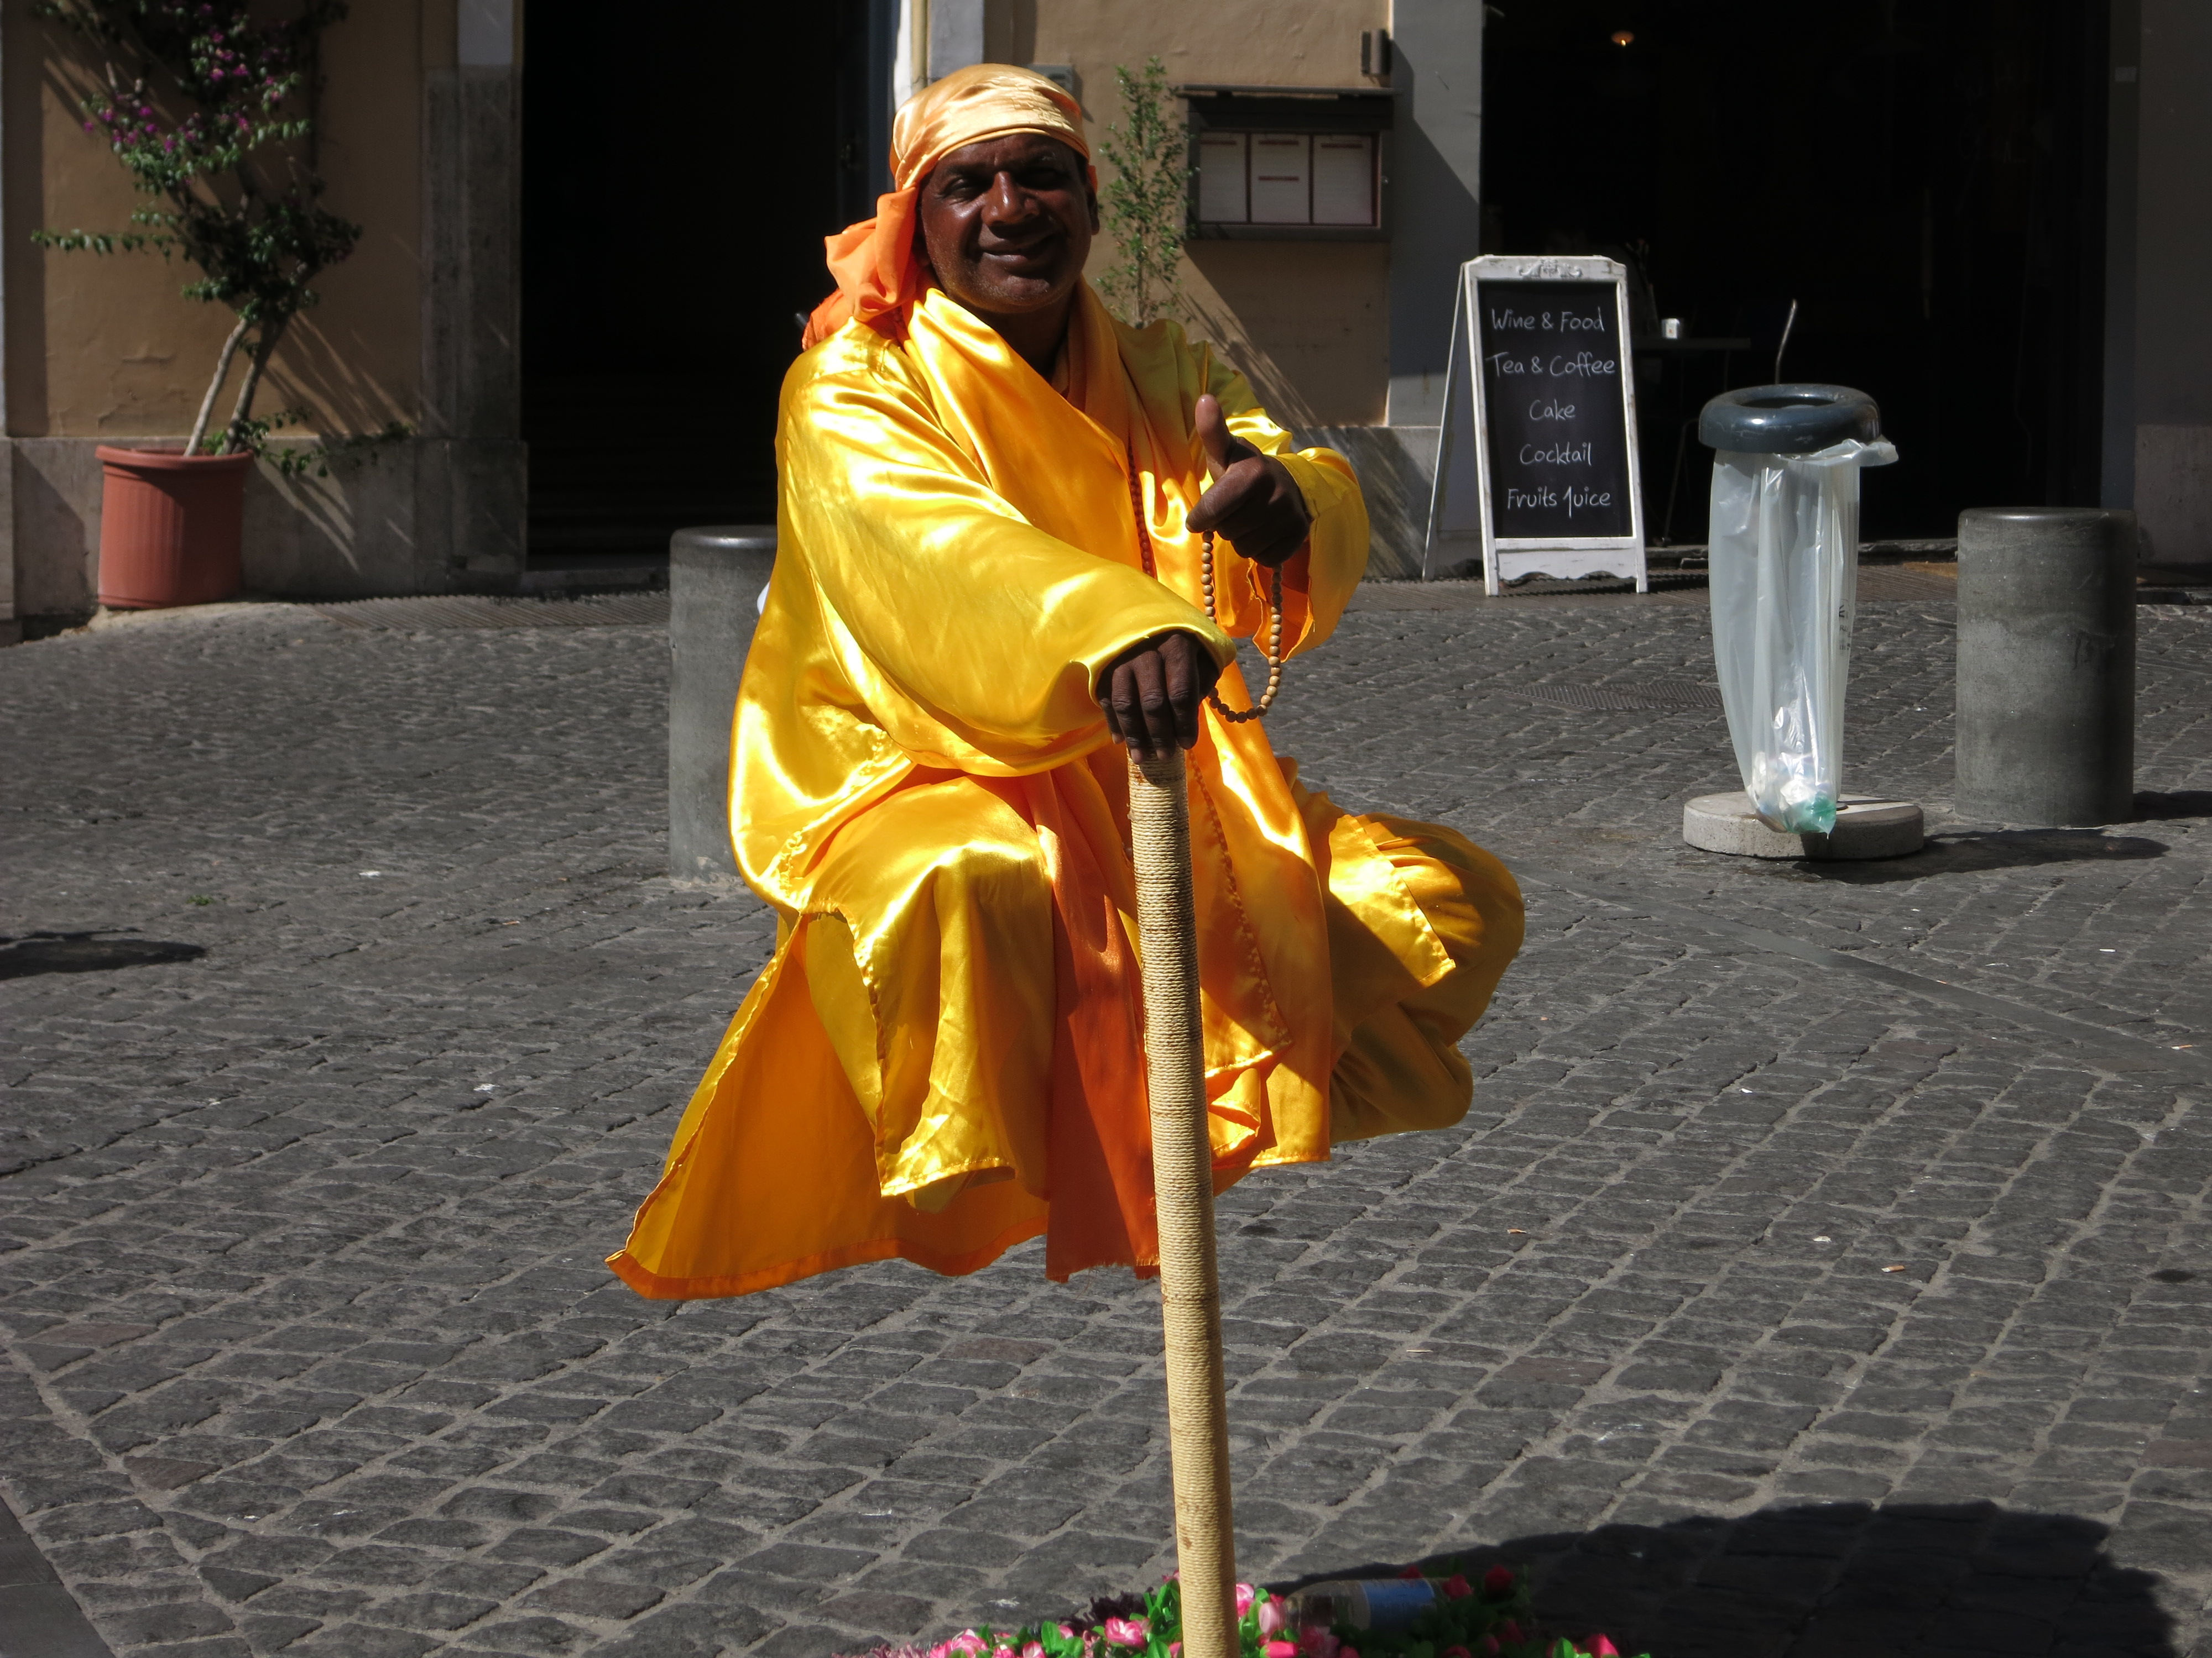
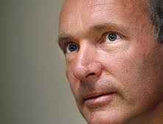
…il migliore esempio di Open Science?

Slide 3
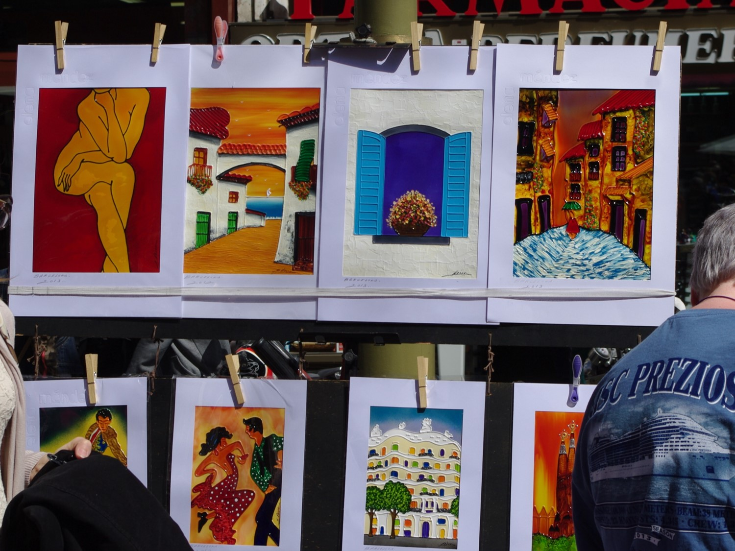
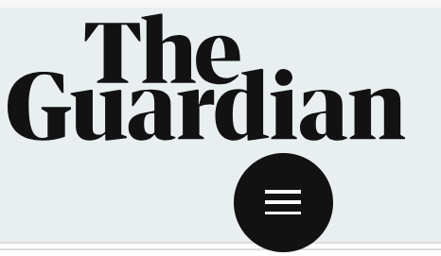
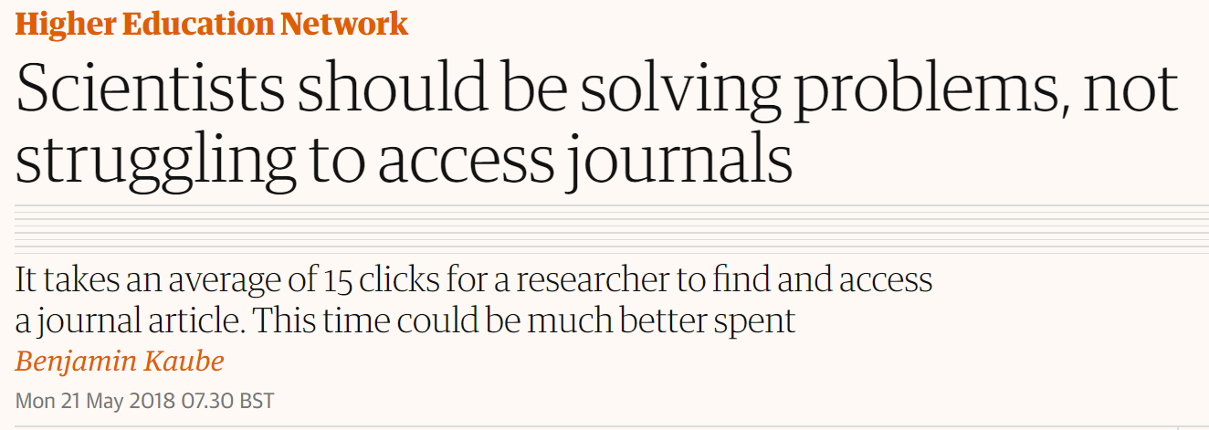
May 21, 2018

Slide 4
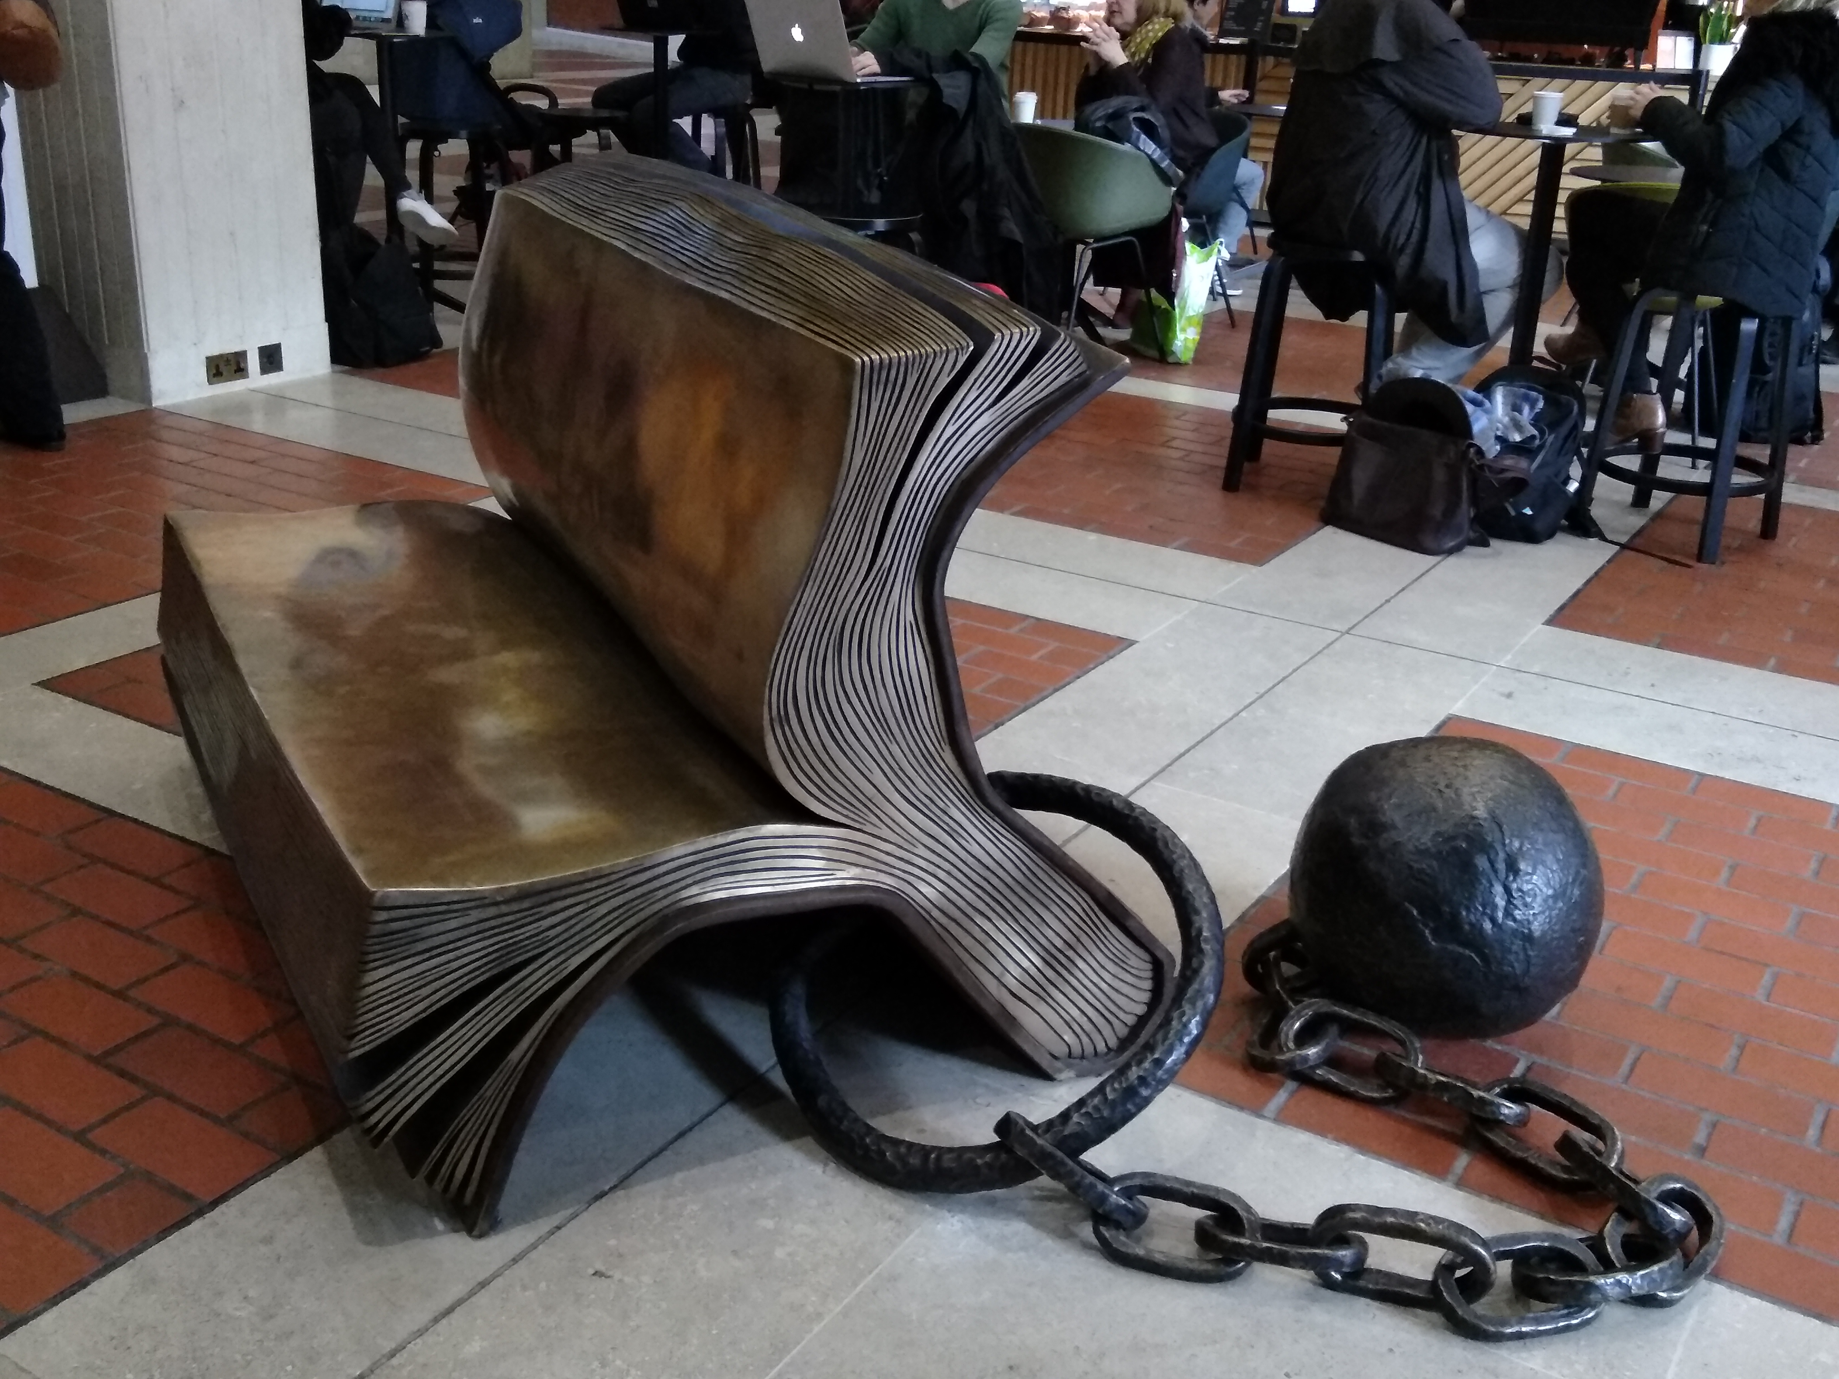
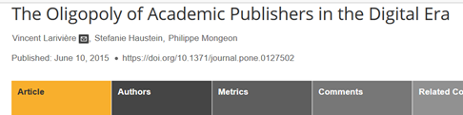
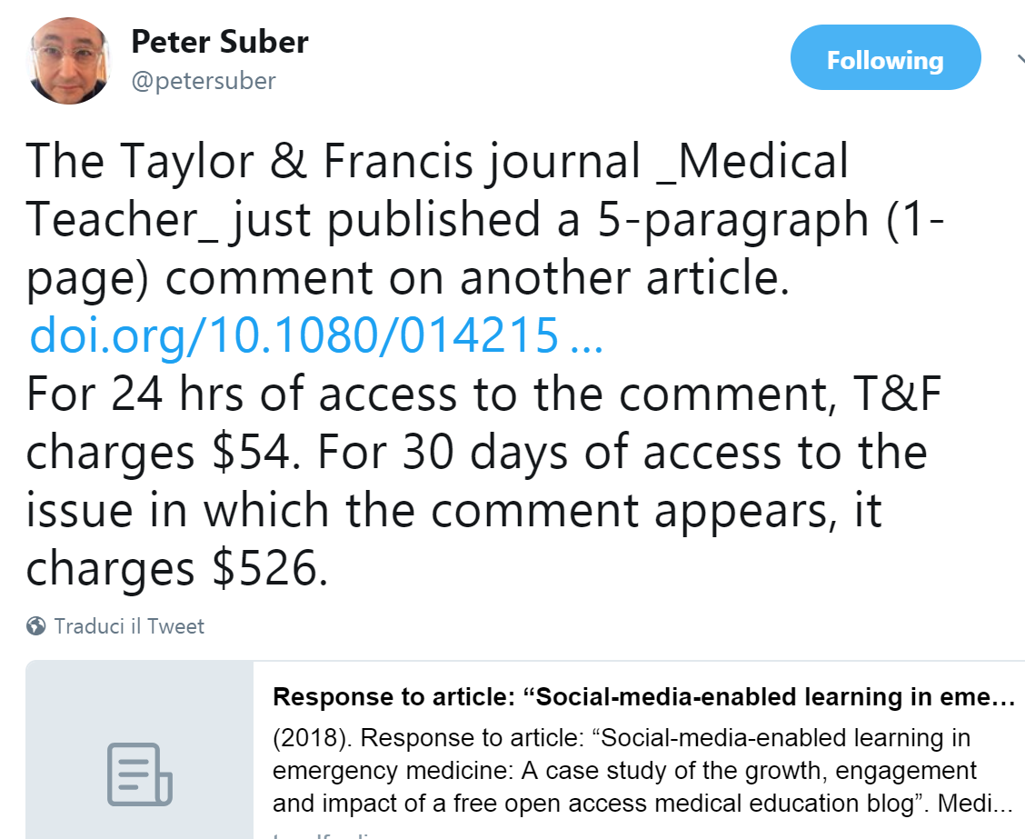
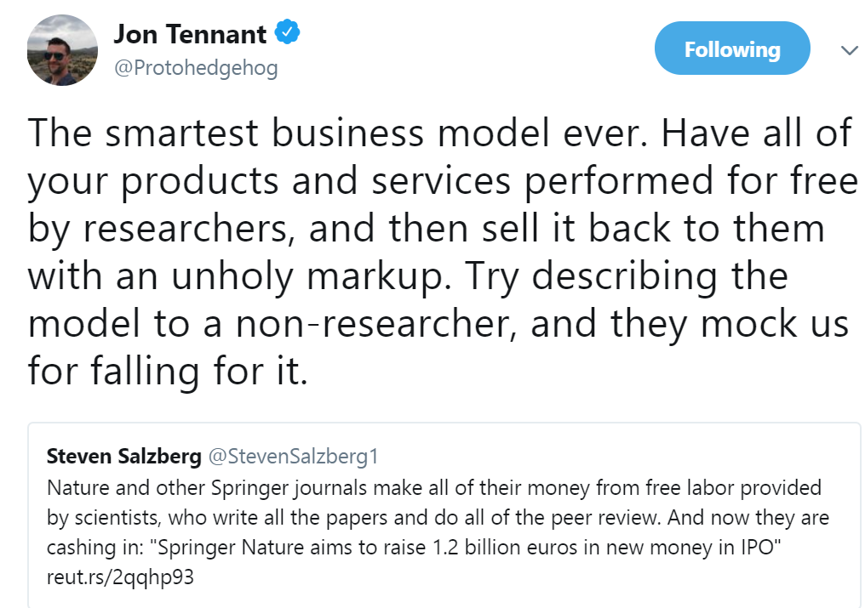
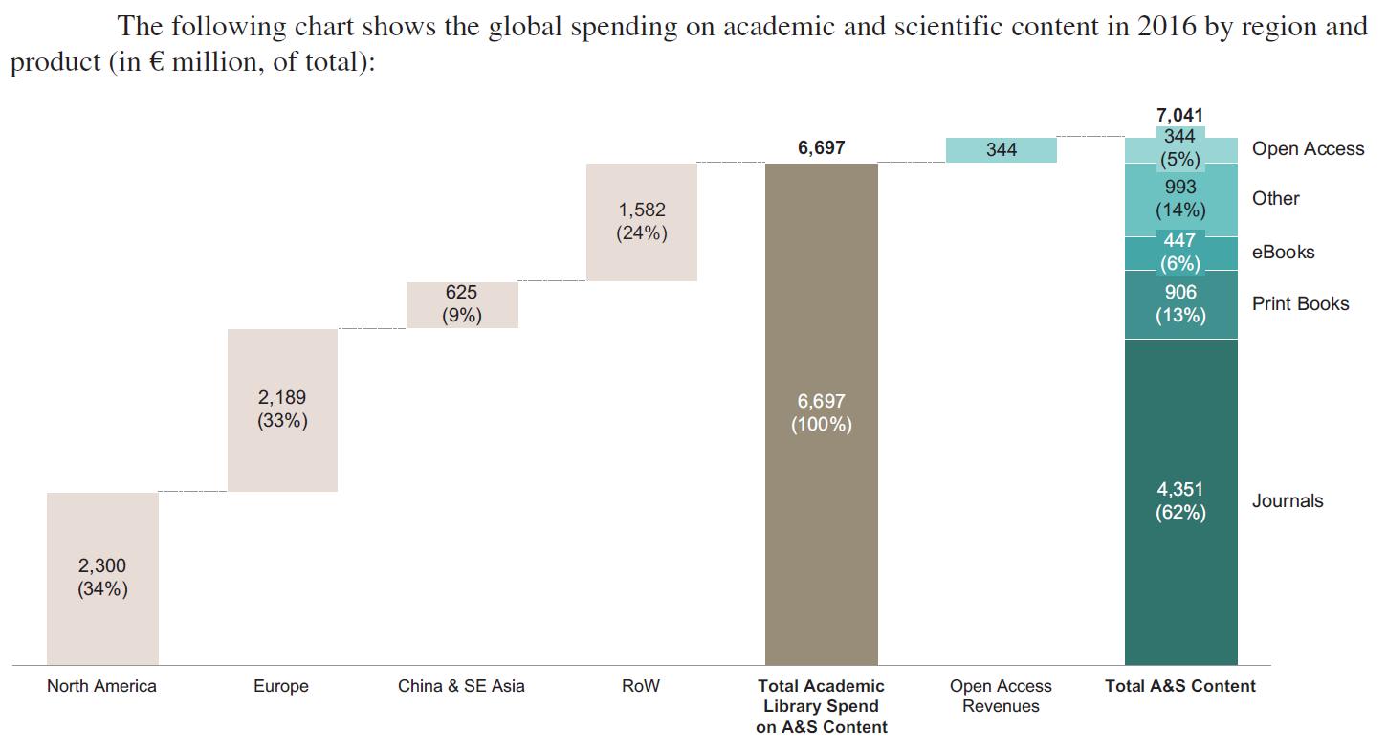
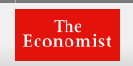
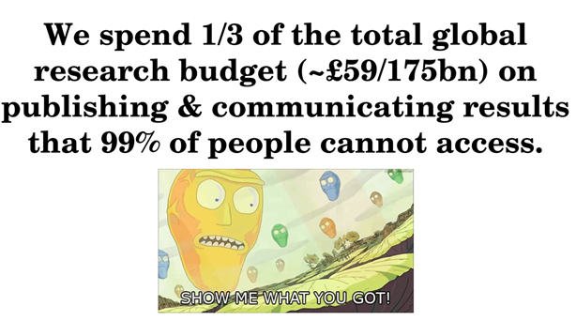
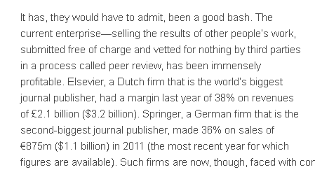
… comunicazione scientifica, oggi…
May 13, 2018
http://journals.plos.org/plosone/article?id=10.1371/journal.pone.0127502
https://twitter.com/Protohedgehog/status/985439318897410048
Elsevier: +38%
Free for all, 4 may 2013
Jon Tennant, Barriers for young researchers, 7 Sept 2017
… paghiamo gli editori commerciali perché mettano sotto chiave il nostro contenuto…
Springer Prospectus Apr. 25 p. 88, citing OC&C Market Report

Slide 5
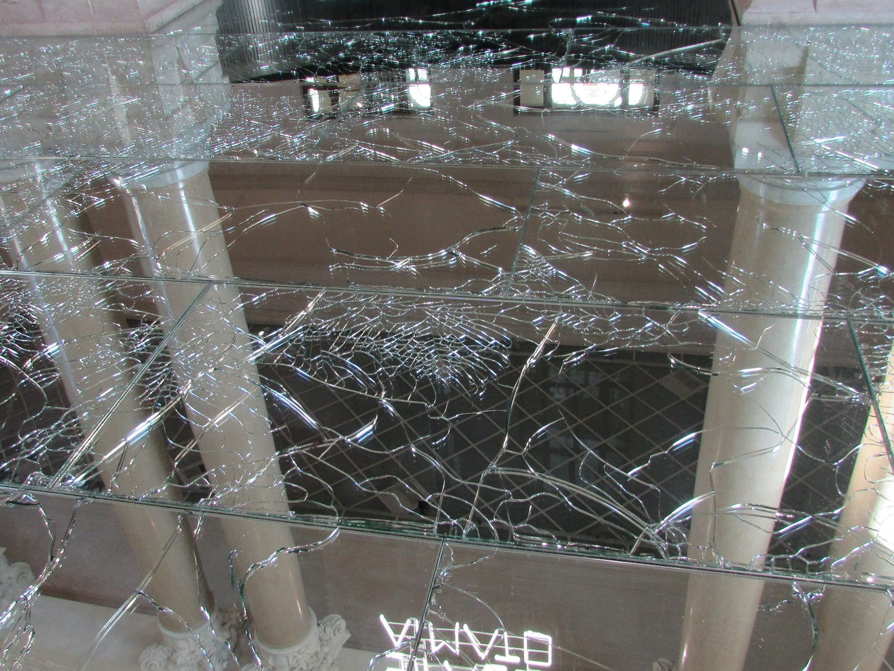
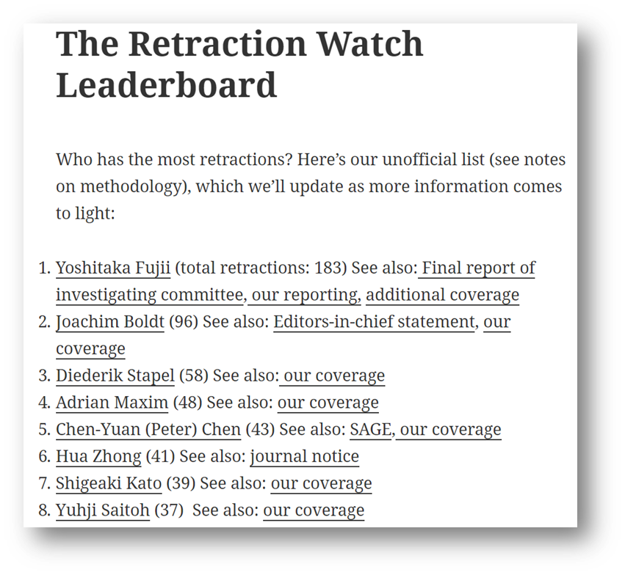
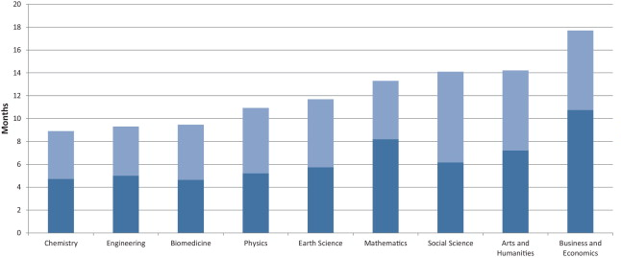
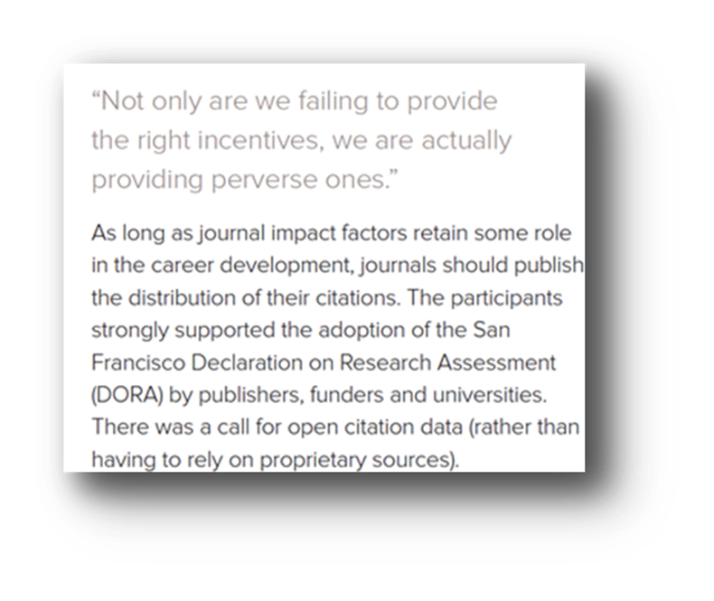
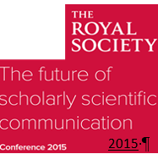
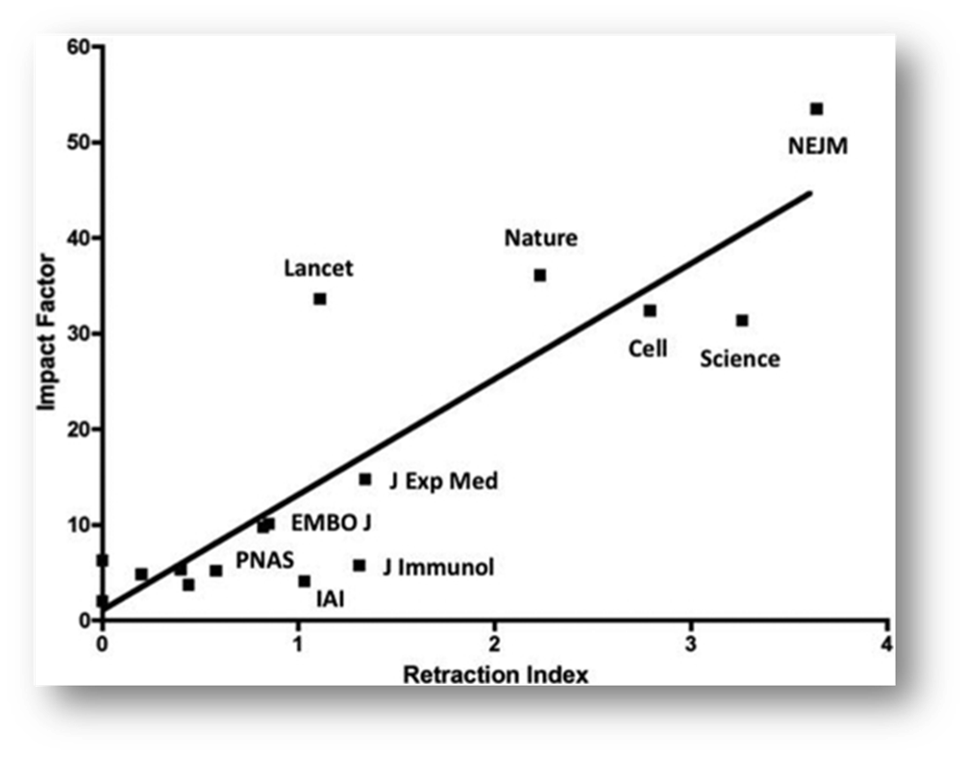
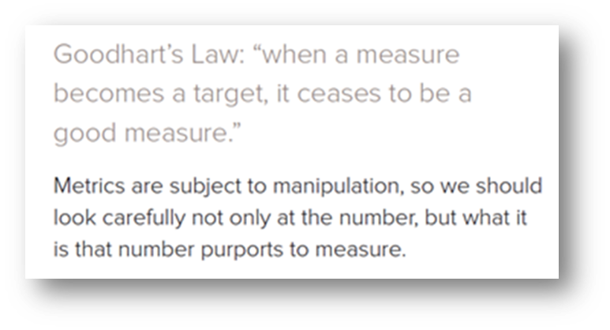
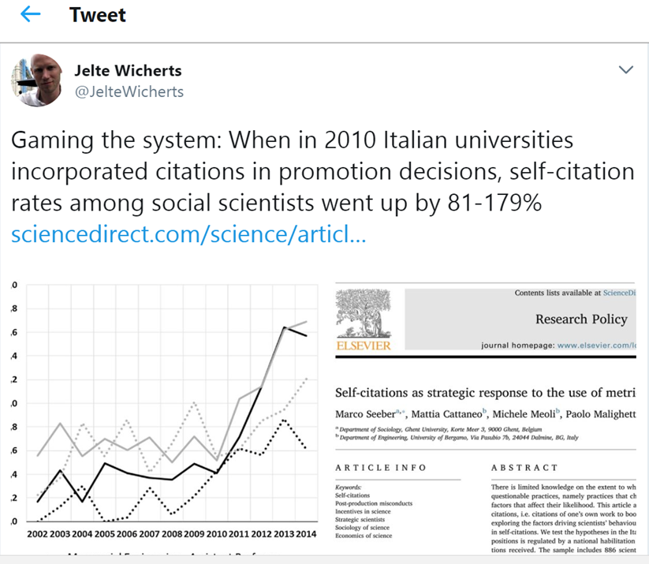
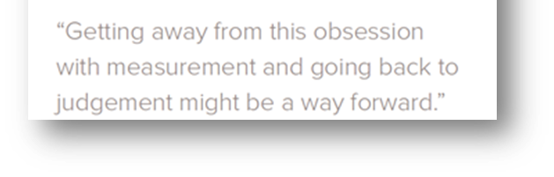
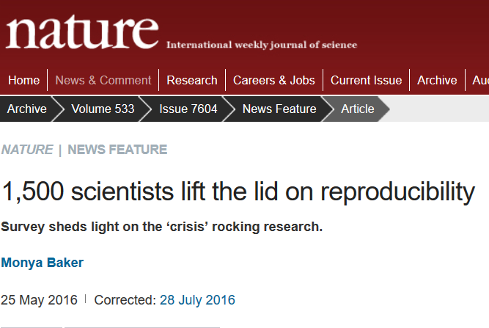
…funziona?
…crescente numero di ritrattazioni per dati falsificati o fabbricati
…tempi di pubblicazione? 9-18 mesi
…nelle riviste più «prestigiose»
Bjork 2013
…ossessione per la valutazione; ipercompetizione (doping)
March 2018
Fang, Casadevall 2011
…autocitazioni +179%
…crisi della riproducibilità

Slide 6
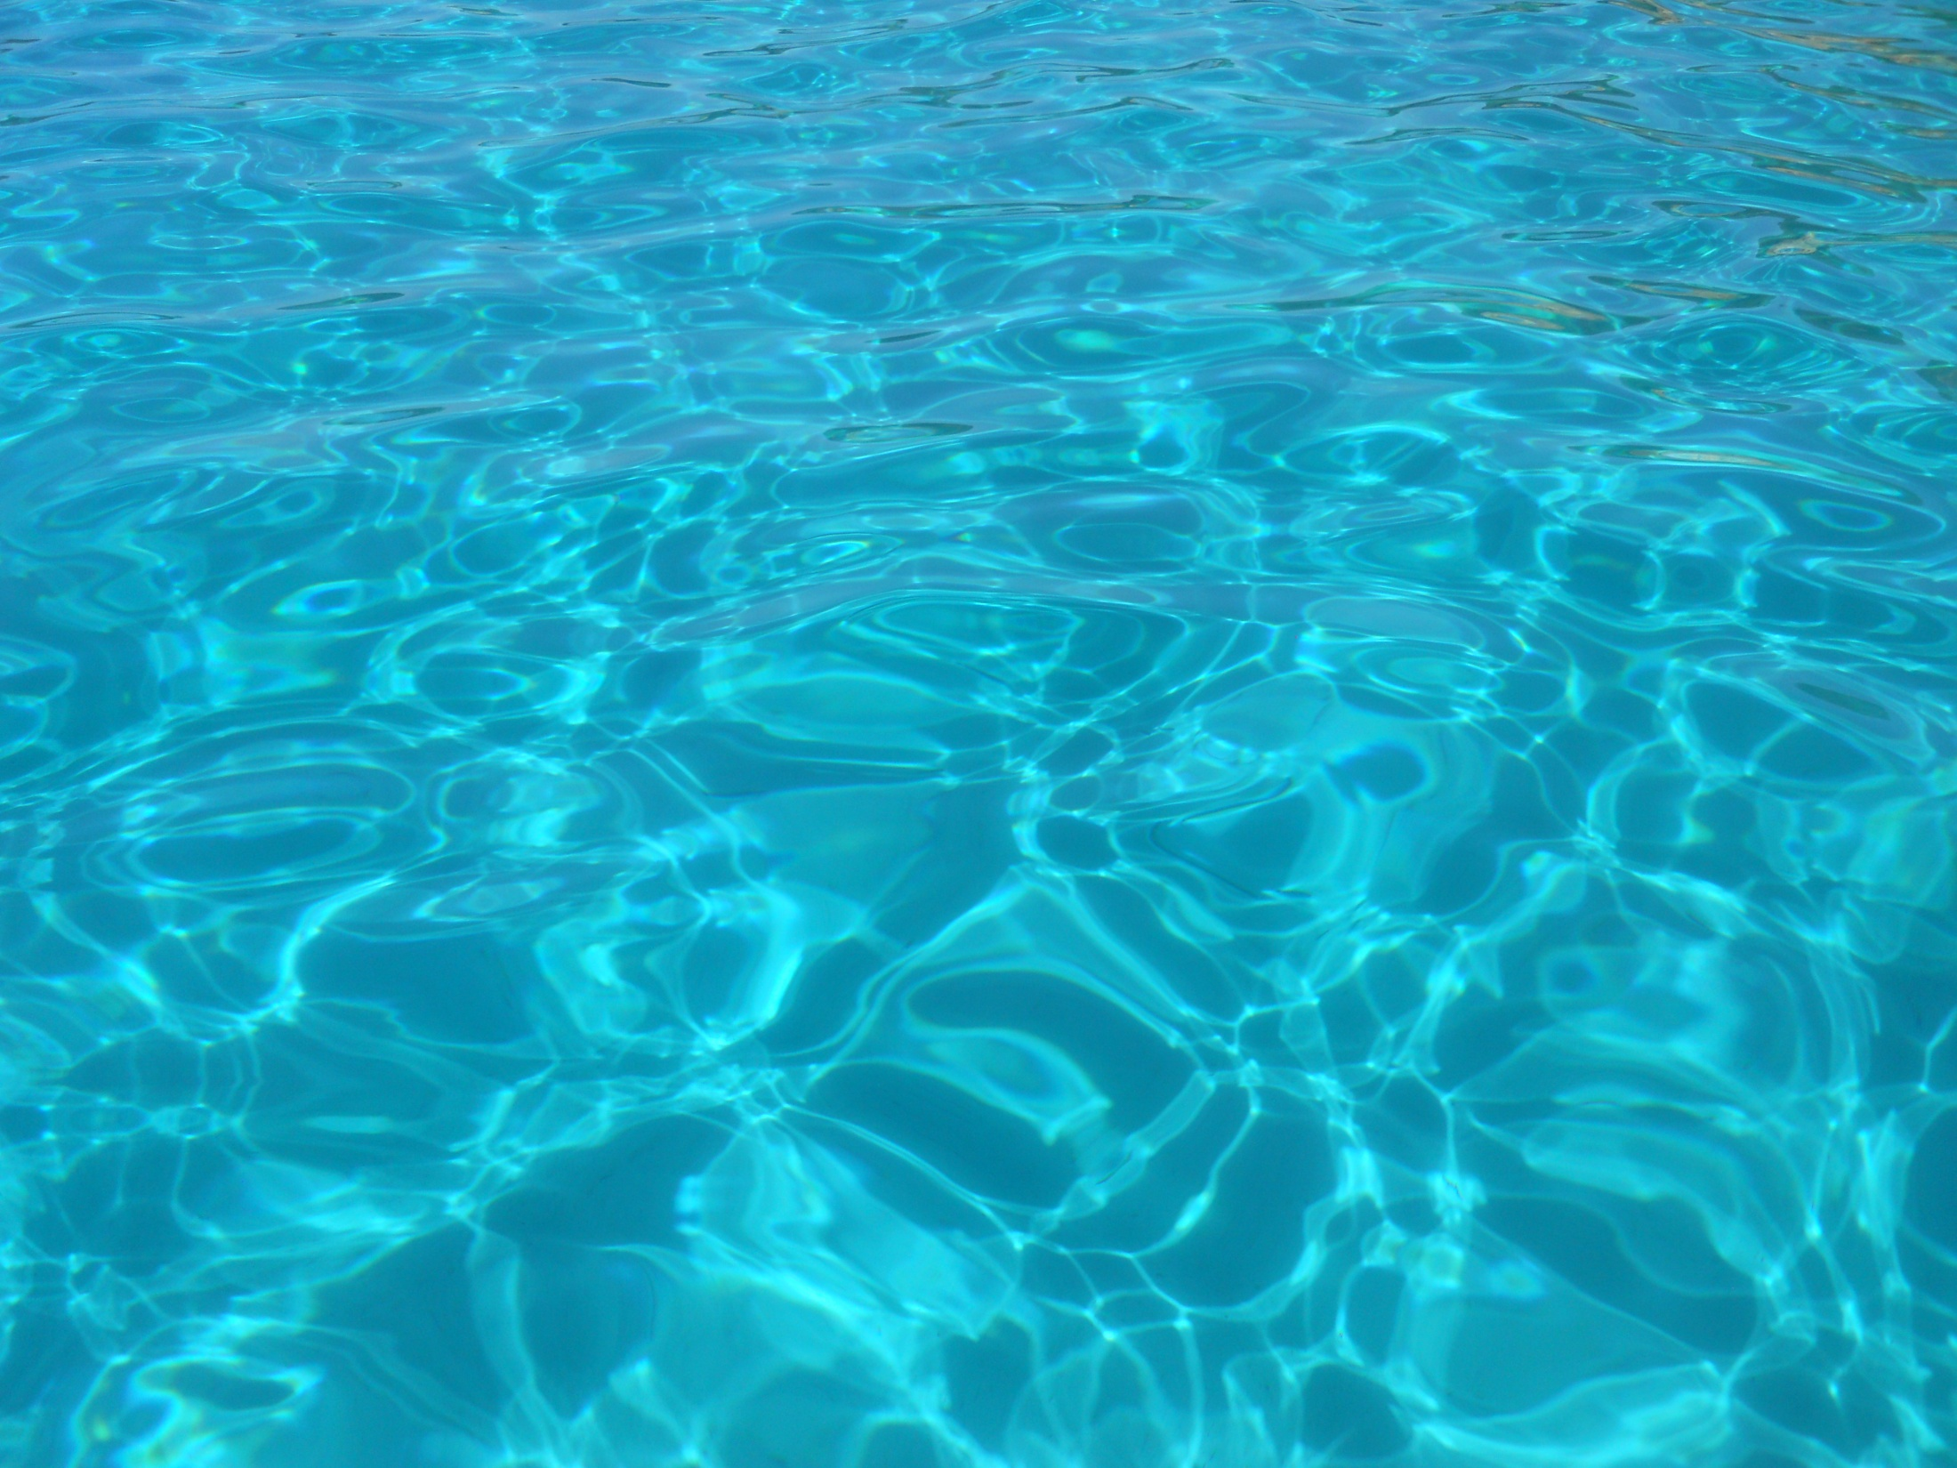
… cambiare panorama?

Slide 7
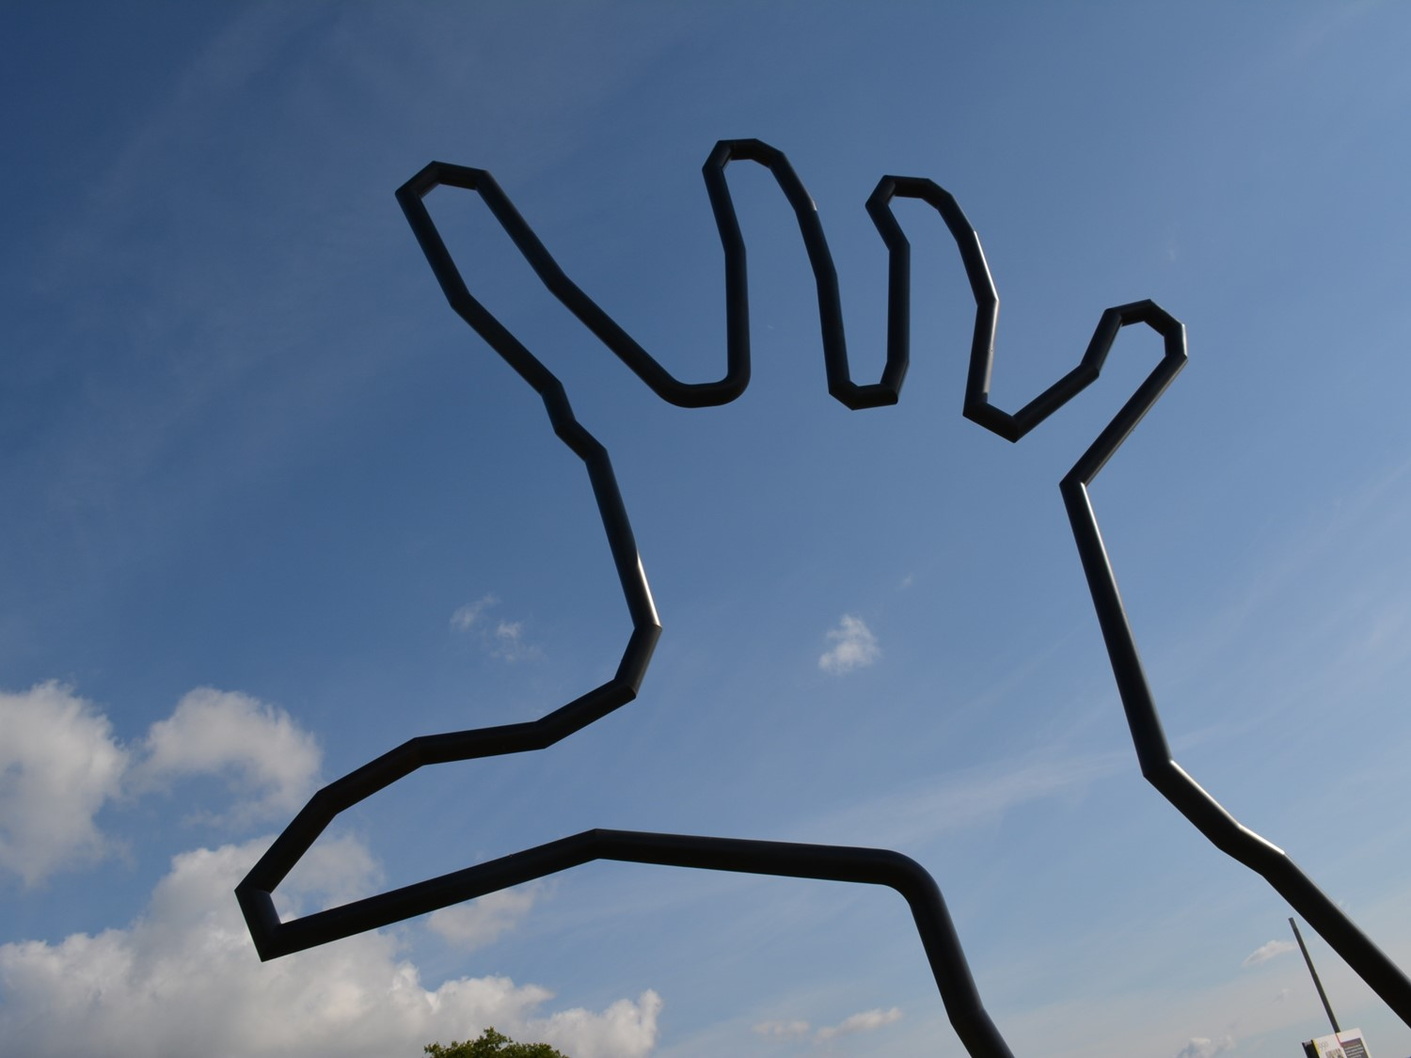
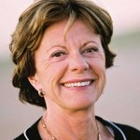
…un po’ di ispirazione…
The best thing about Internet is that it’s open. In every field it let us share and innovate.
In science, OPENNESS IS ESSENTIAL.
Open science doesn’t mean ignoring economic reality.
Of course we need business models to be sustainable. But that doesn’t mean we have to carry on doing things the way they have always been done.
So, wherever you sit in the value chain, whether you’re a researcher or an investor or a policy maker, my message is clear:
let’s invest in collaborative tools that let us progress…
Let’s tear down the walls that keep learning sealed off.
And let’s make science open.
N. Kroes, Let’s make science open, giugno 2012

Slide 8
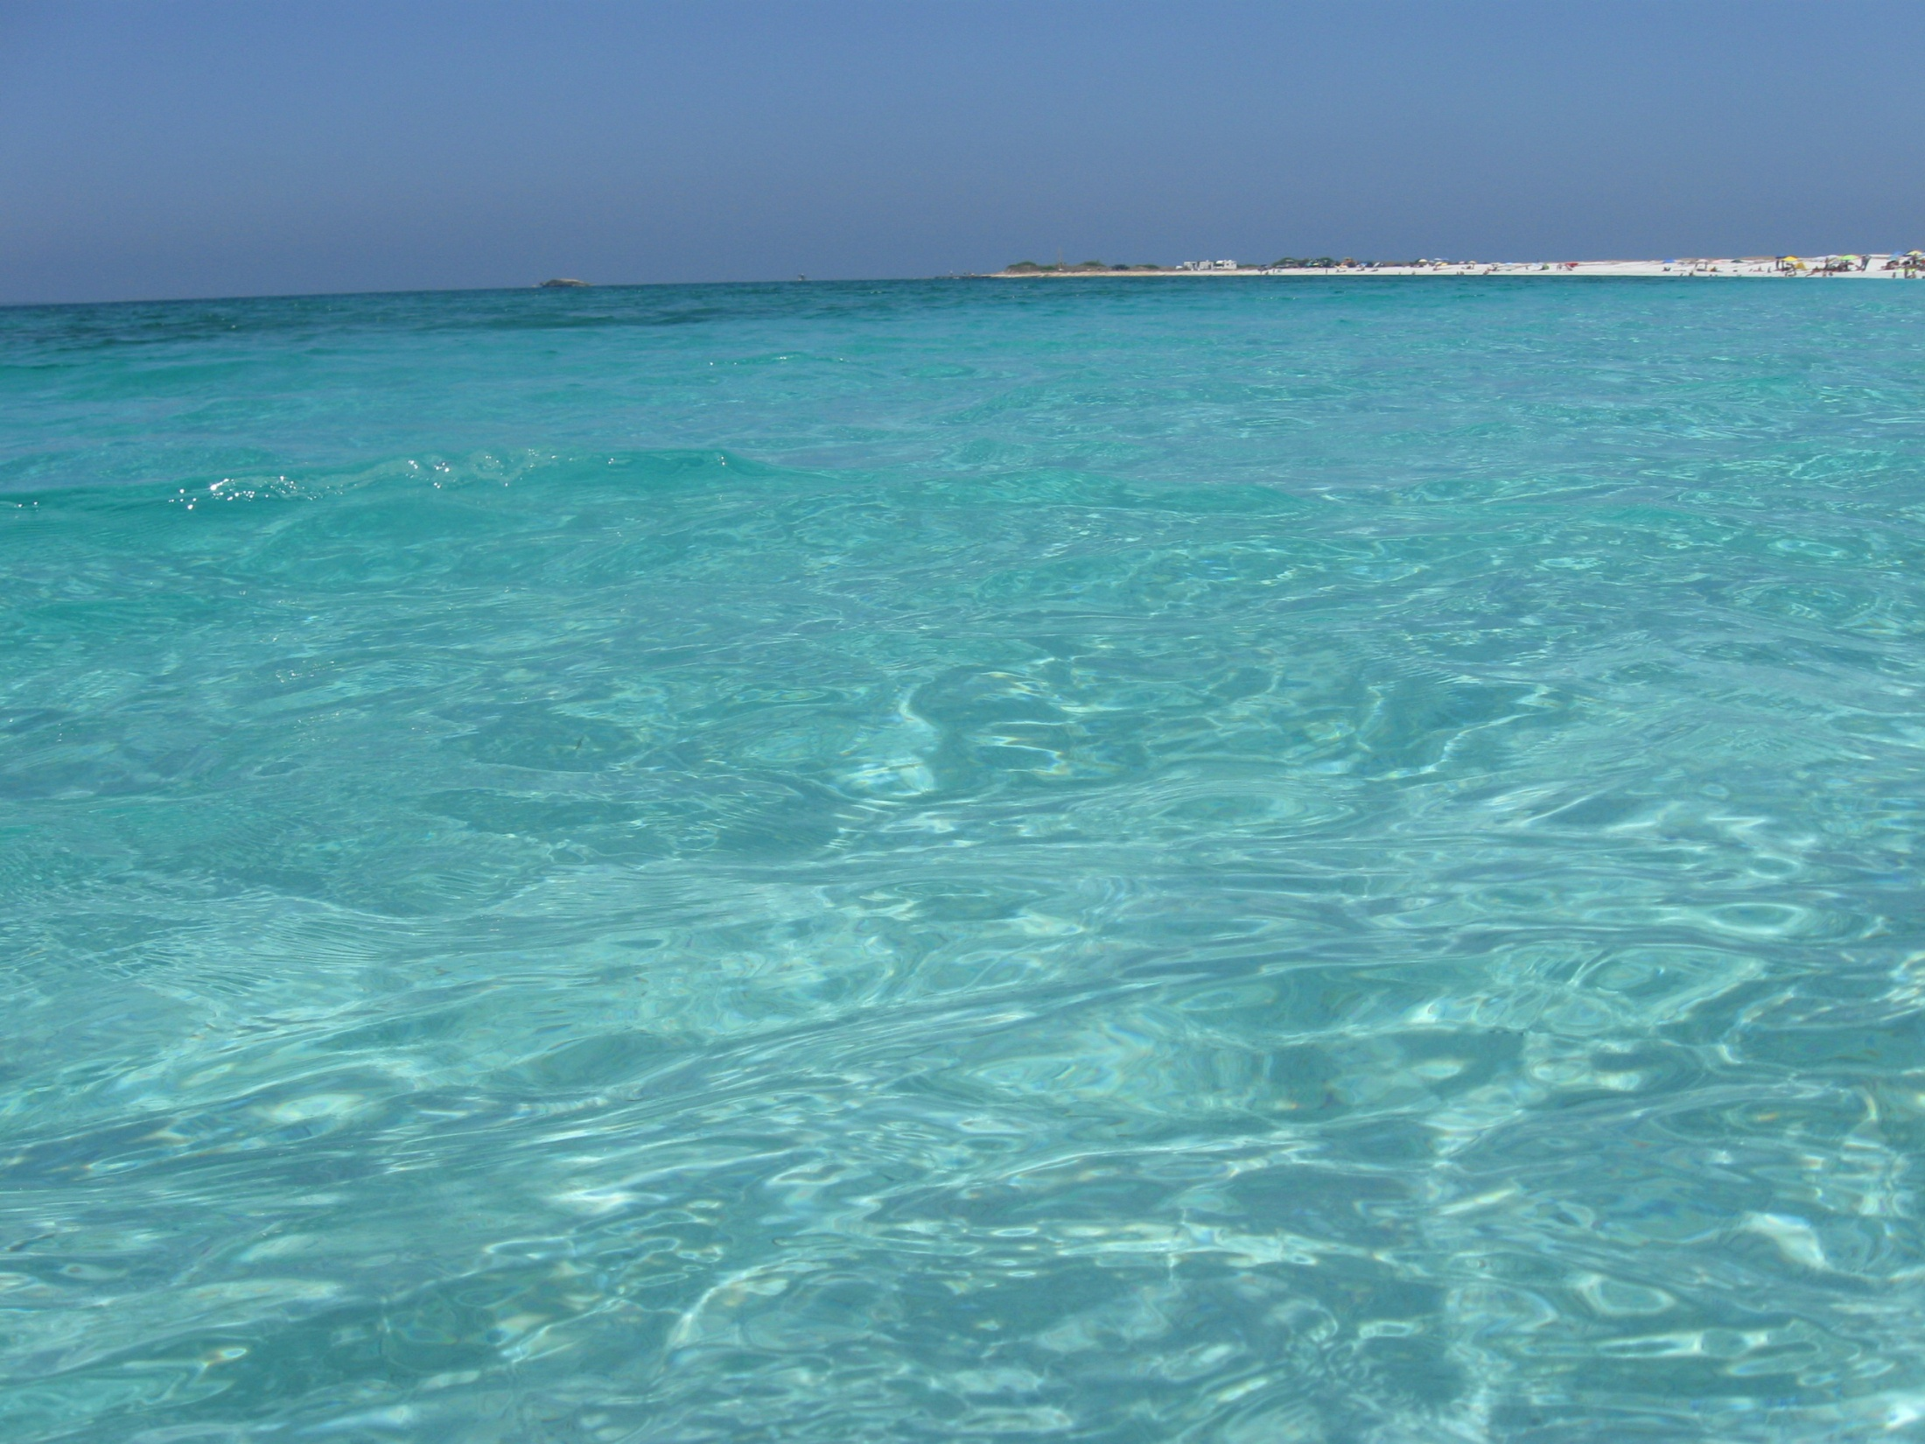


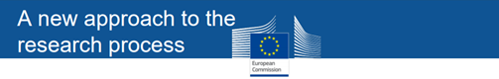
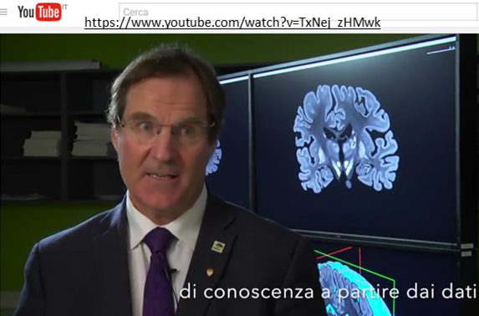
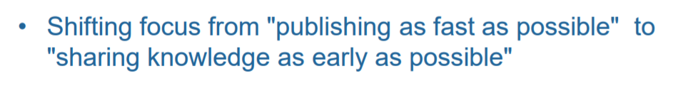
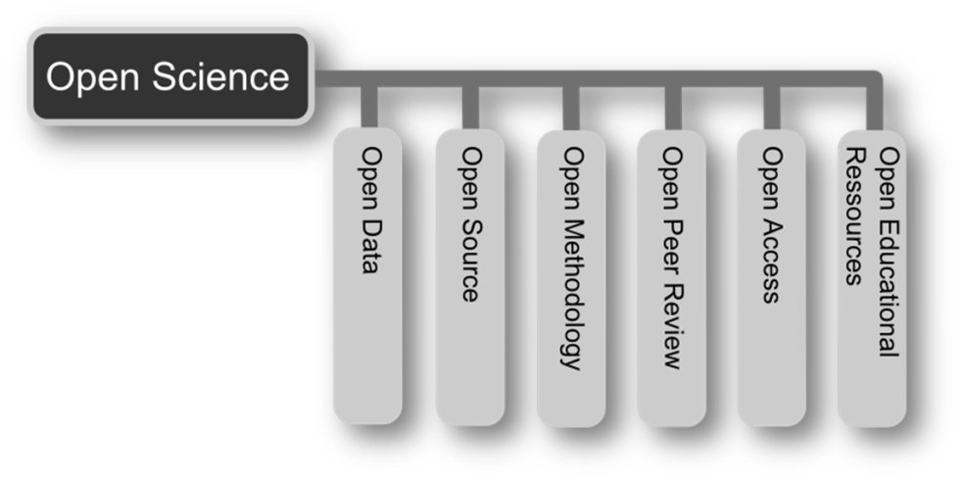
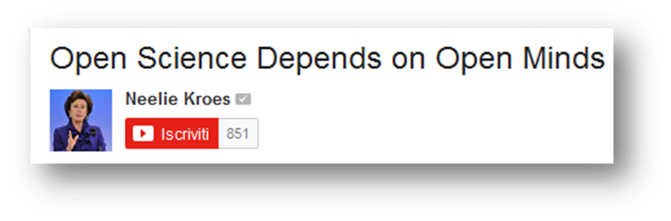
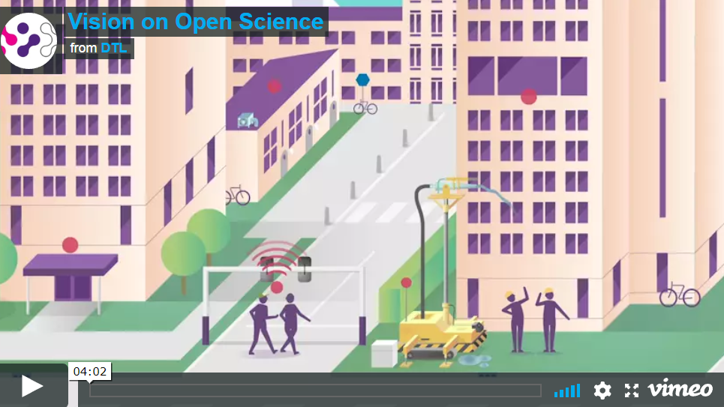
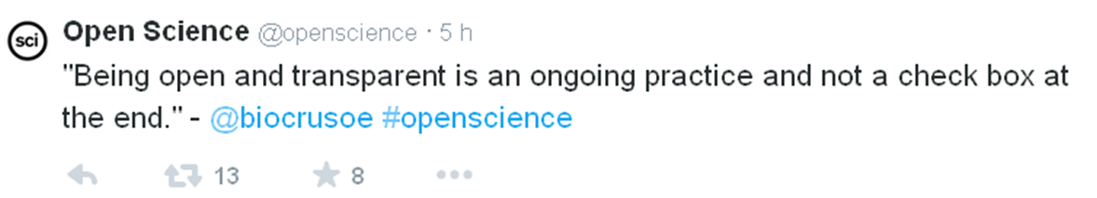
Open Science
http://opendefinition.org/
Burgelman, Venice Nov 2016
https://player.vimeo.com/video/162062013

Slide 9
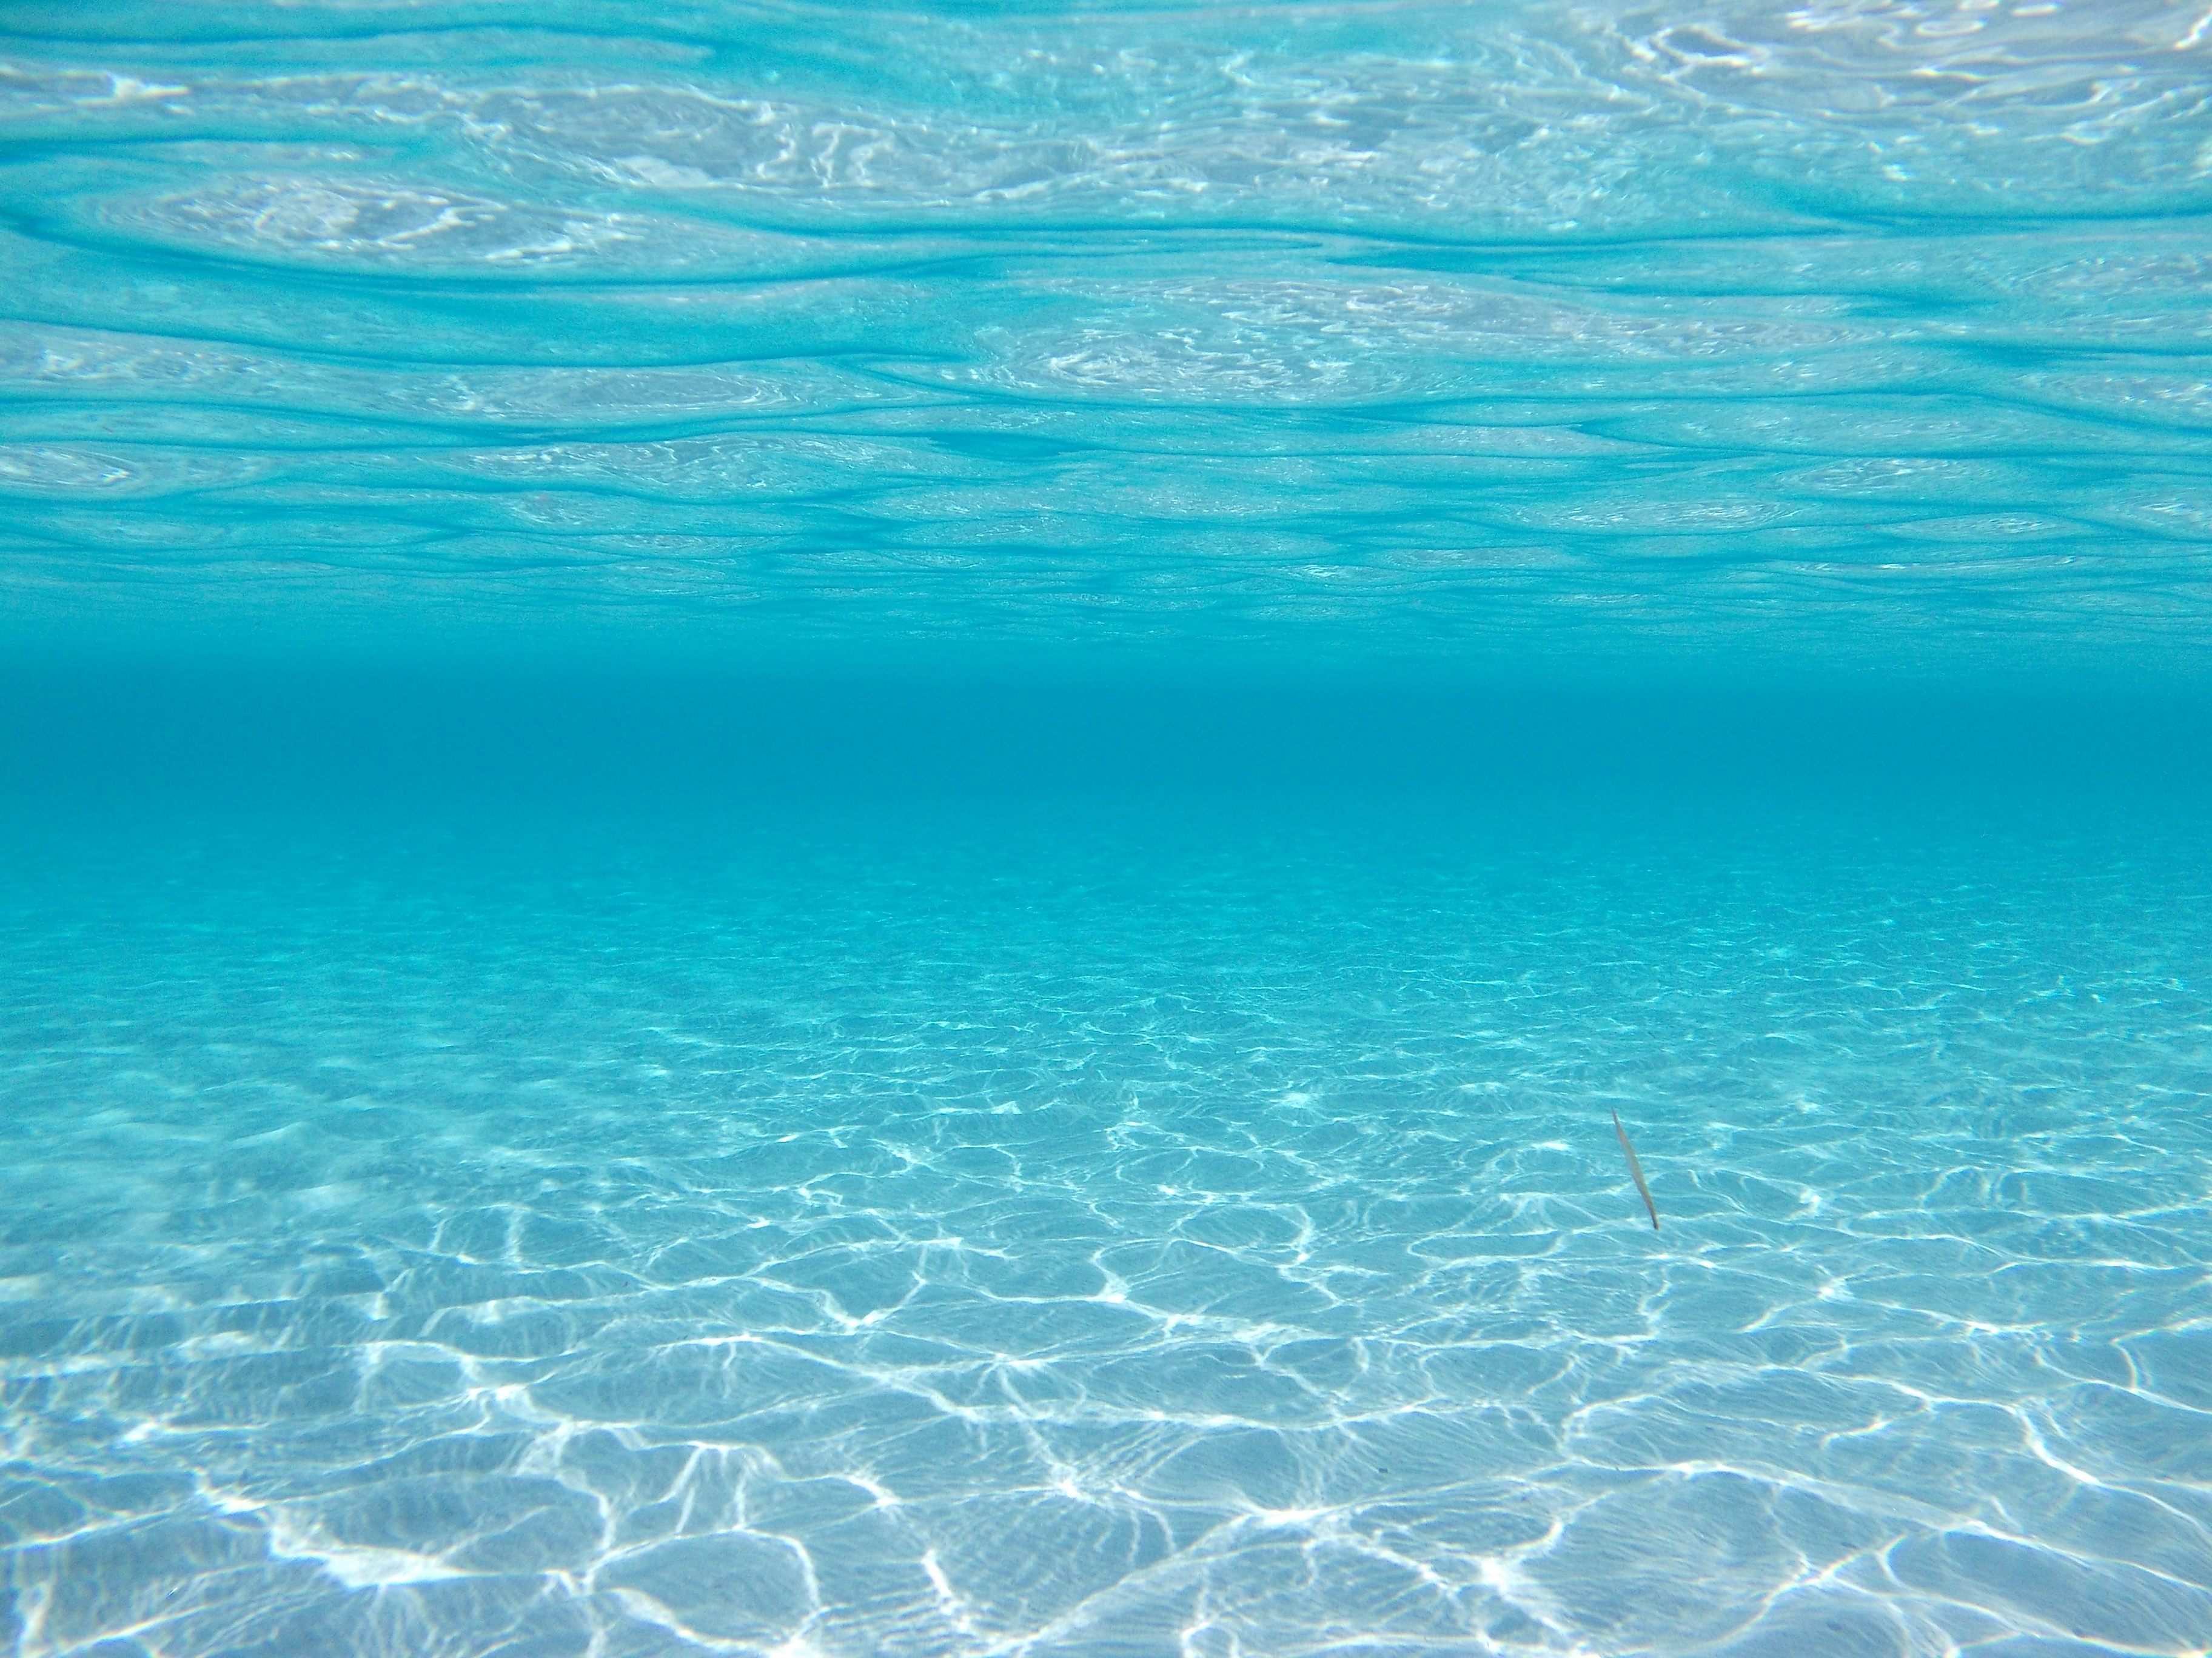
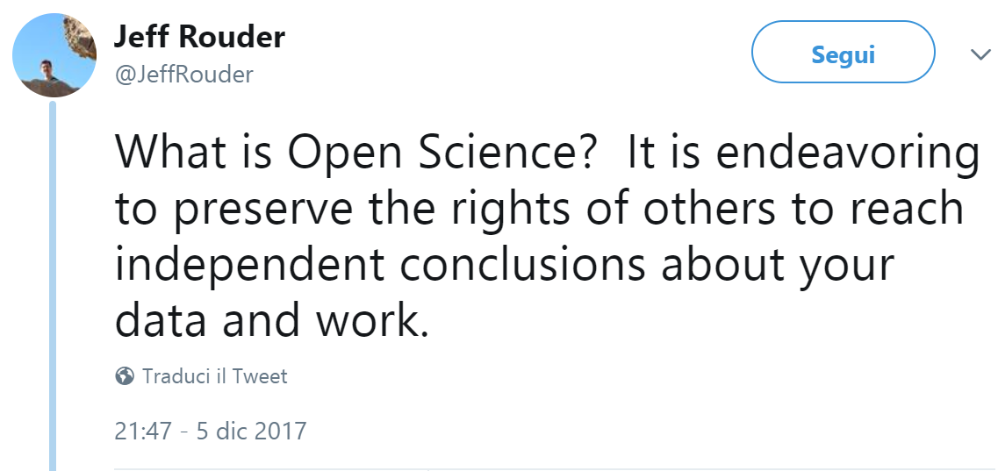
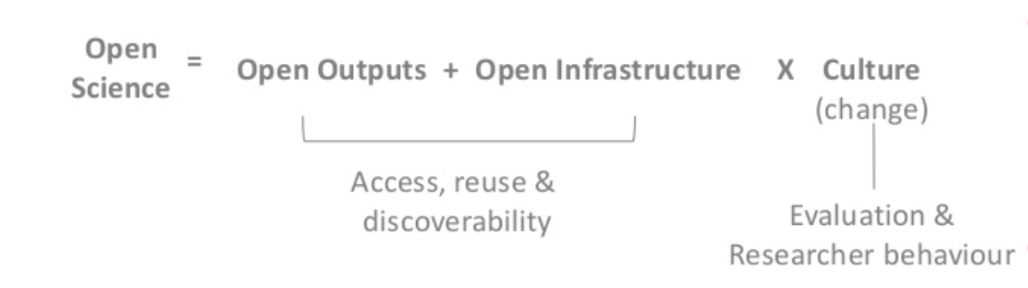
Open Science
C. Mac Callum, UKSG, April 2018
Open Science: risultati aperti + infrastruttura aperta x cambiamento culturale

Slide 10
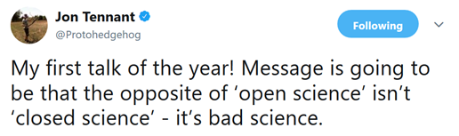
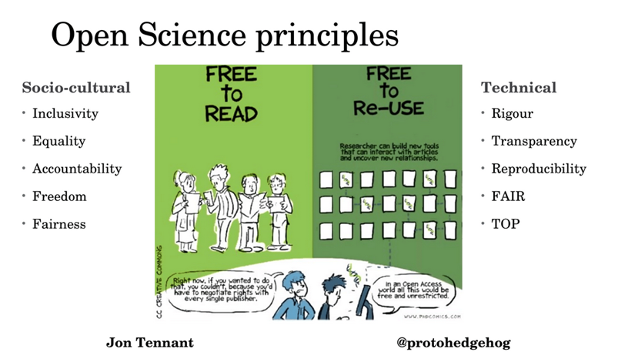
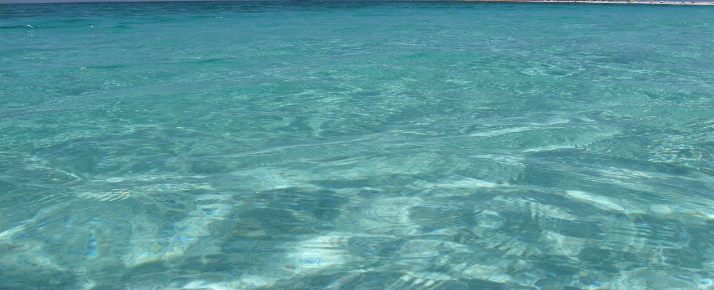
Open Science
Open Science is just good science!
[J.Tennant]

Slide 11
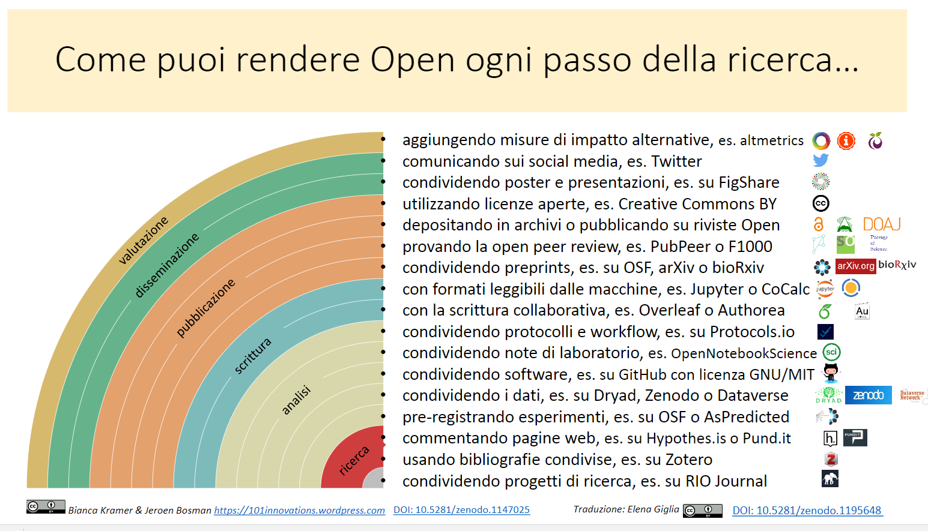
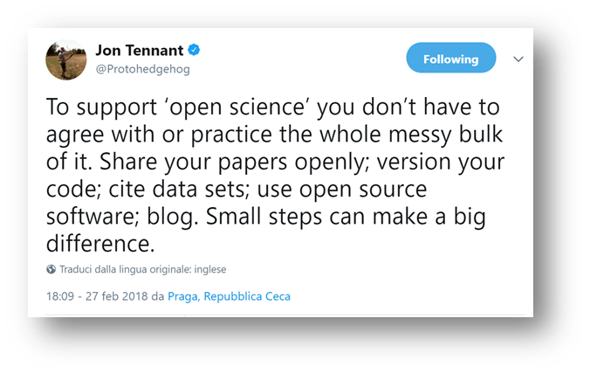
Open per…

Slide 12
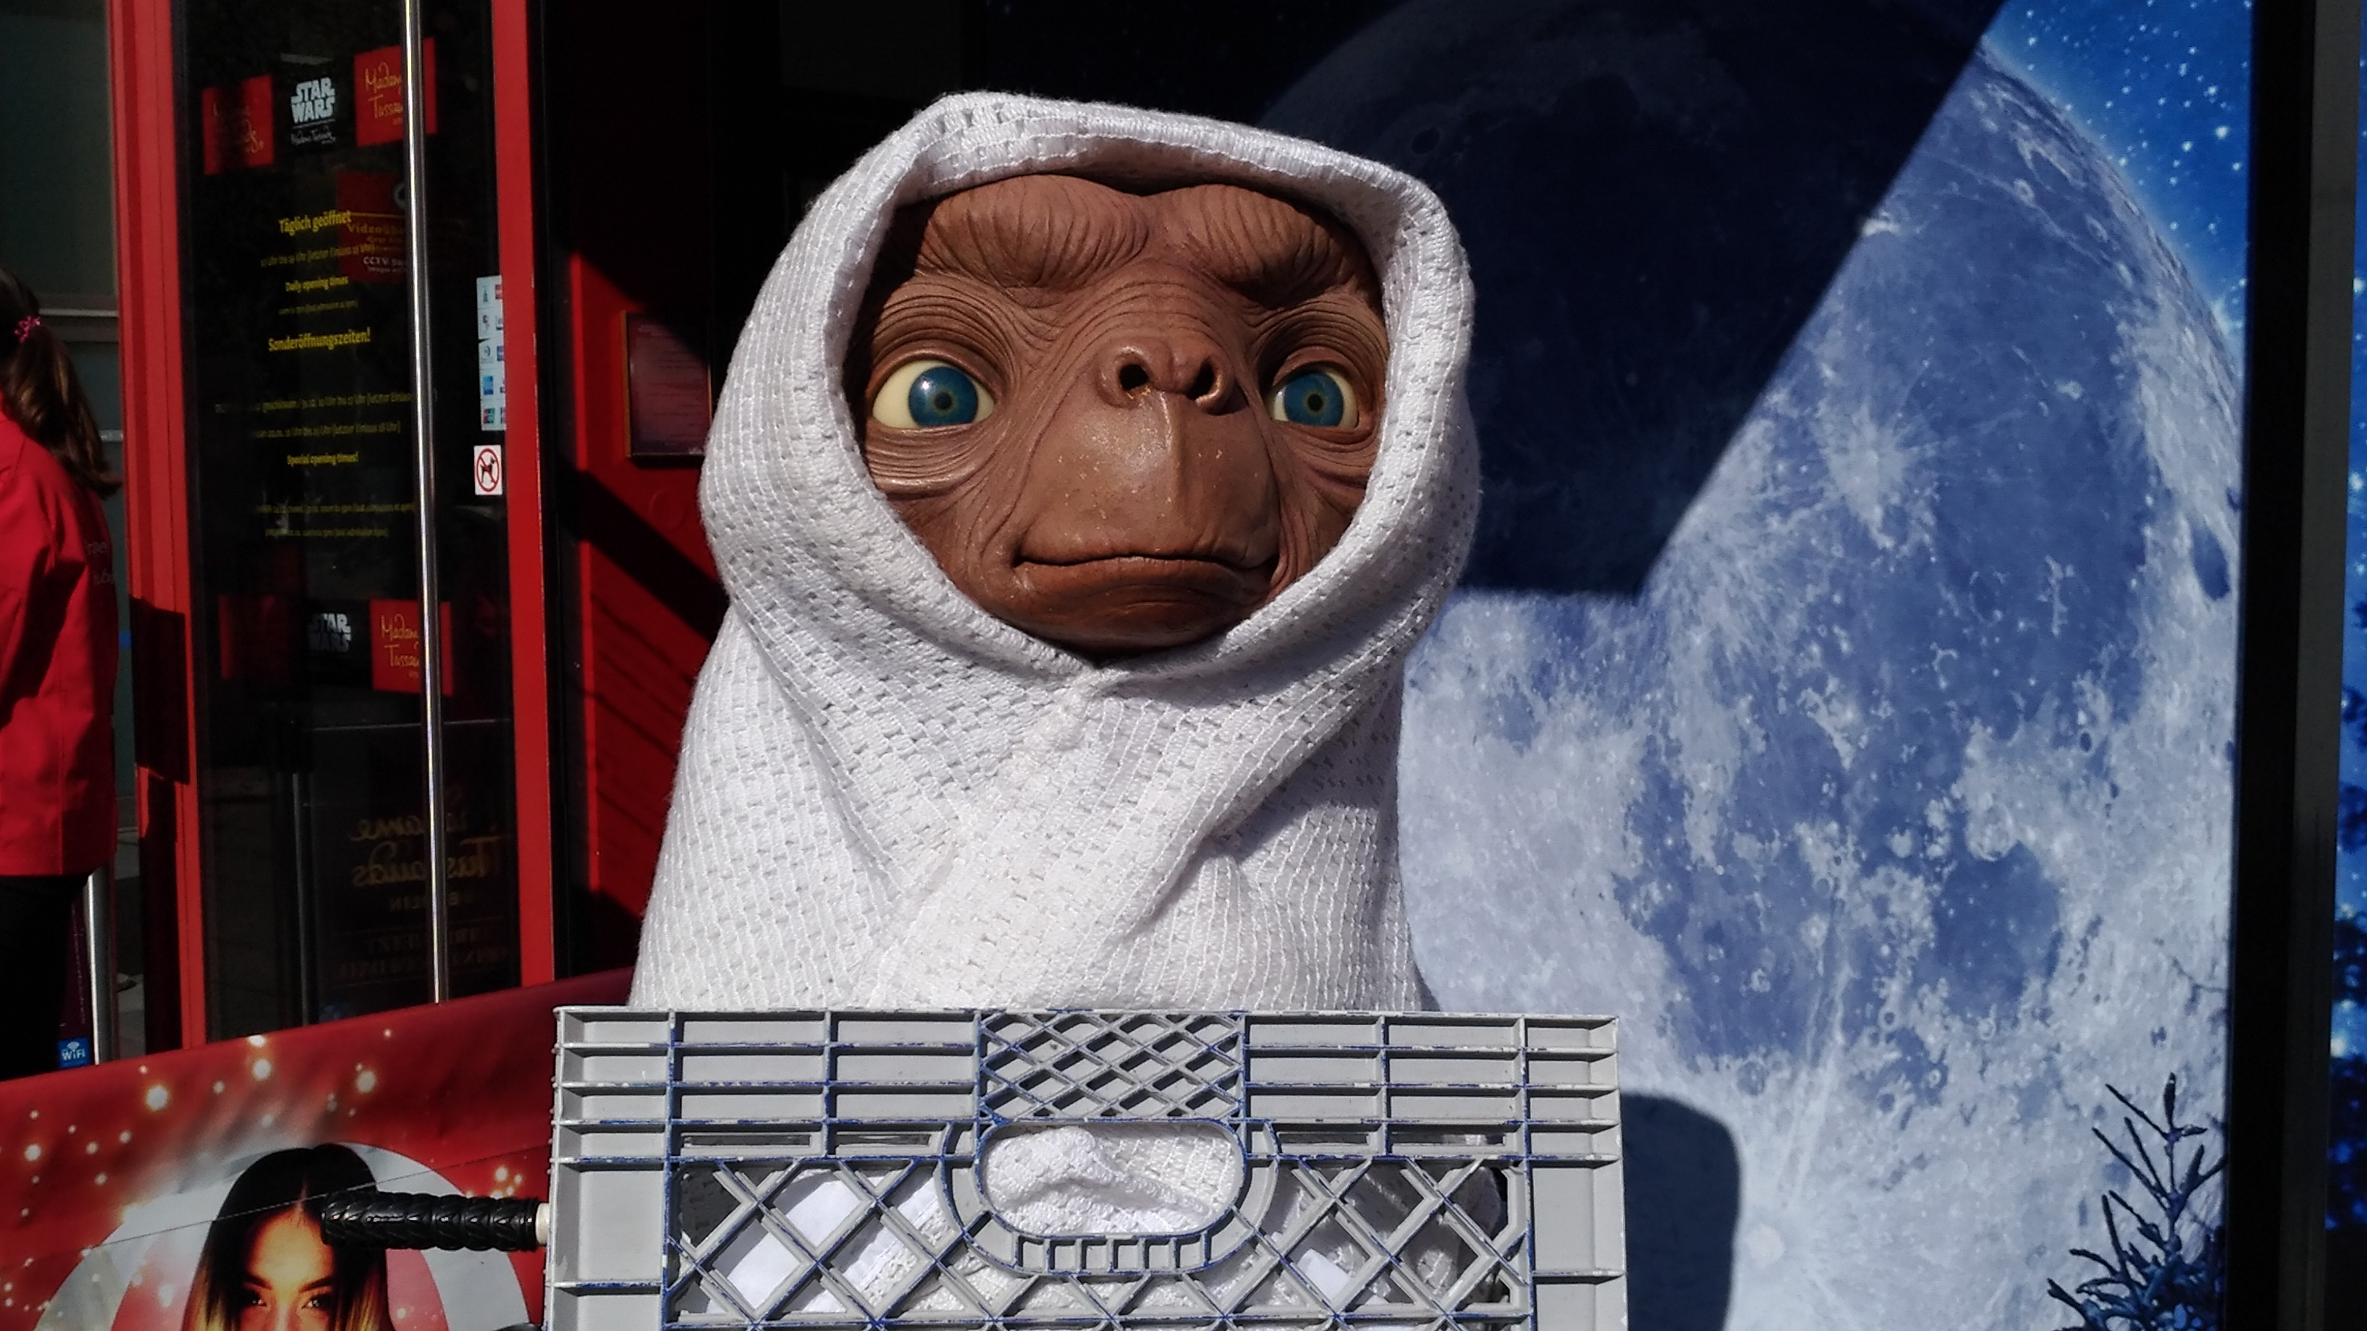
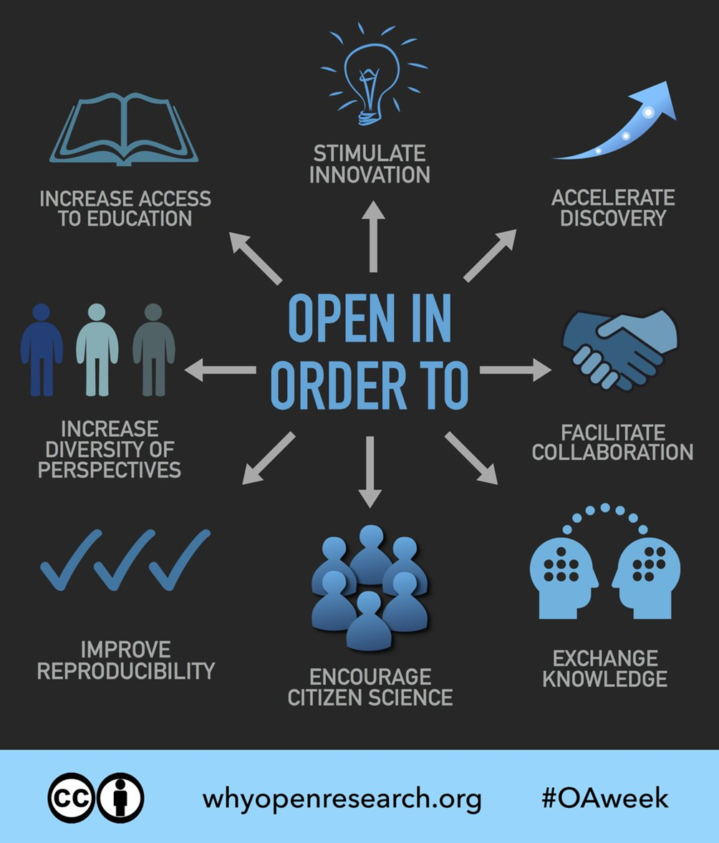
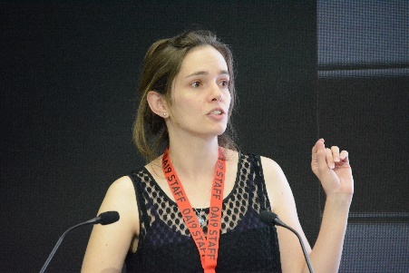
[una chiamata]

Slide 13
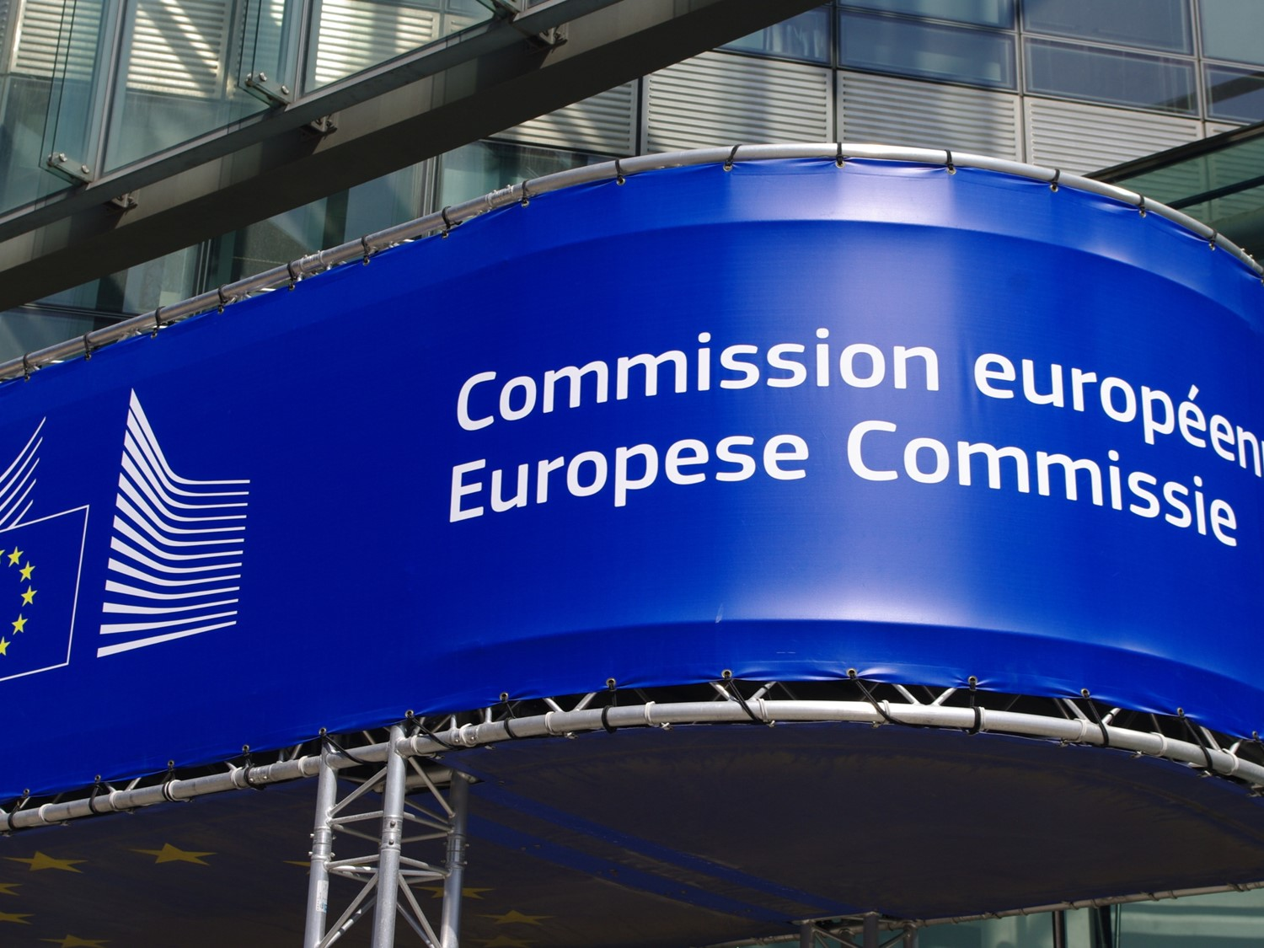

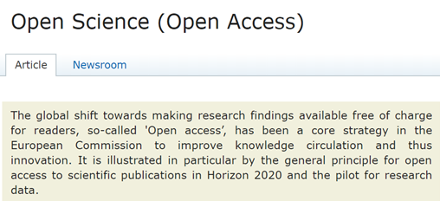
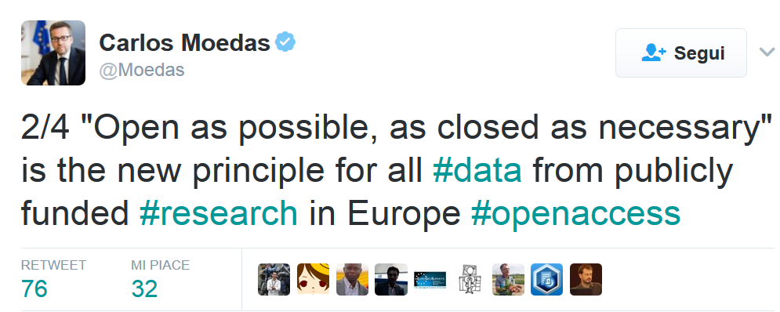
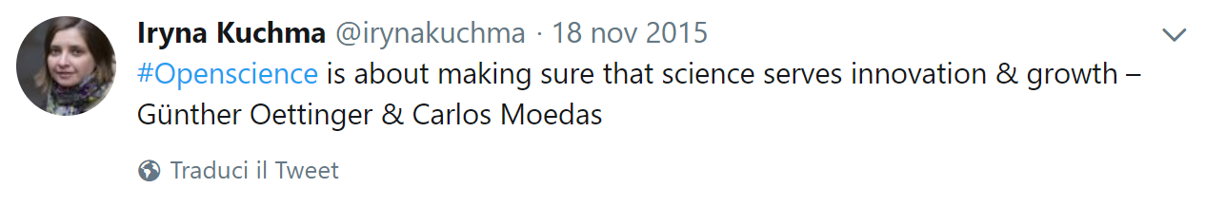





… «core strategy»…
https://twitter.com/wvanwezenbeek/status/973491971288391680
March 23, 2018

Slide 14



Ragioni per NON fare open science?
https://twitter.com/CaAl/status/966279936028958720

Slide 15


Whose side are you on?
… e voi?
…grazie!

