Slide 1
From Open Access to Open Science? [Torino, Italia, 2018] Elena Giglia
Roma, 17 maggio 2018 elena.giglia@unito.it
This work is licensed under a Creative Commons Attribution-ShareAlike 4.0 International License.

Slide 2
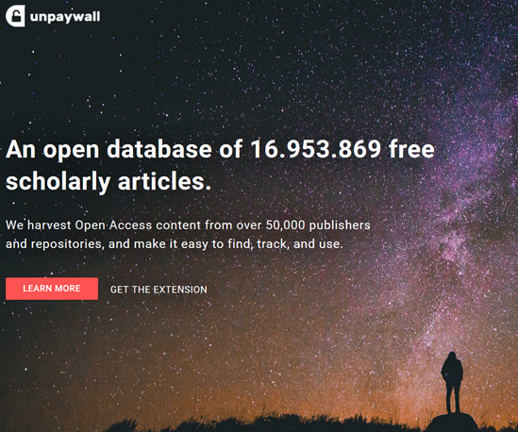
University of Turin Open Access policy
2° booster: advertise unpaywall [works only IF they deposit]
enacted June 2013
Liège model
[green+link to internal evaluation]
compliance 2016: 87%
06/17 07/17 08/17 09/17 10/17 11/17 12/12 01/18 02/18 03/18 04/18
a booster: PubMed LinkOut
Open Access files | Items | + %
Nov. 8, 2008 - Nov. 1, 2013 (before the Policy) | 3.430
Nov. 2013 – May11, 2018 (after the Policy) | 26.363 | 668%

Slide 3
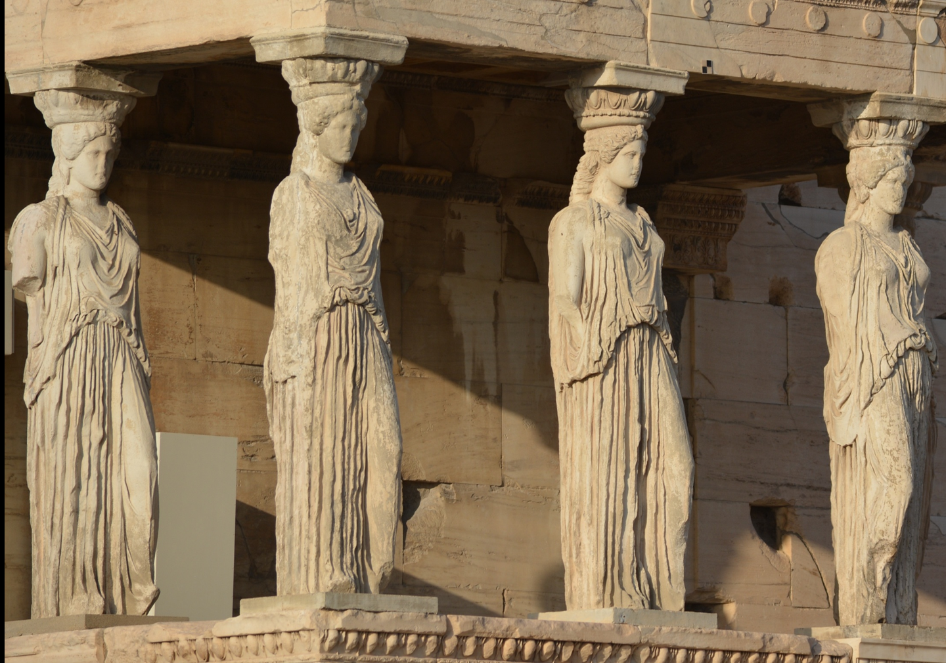
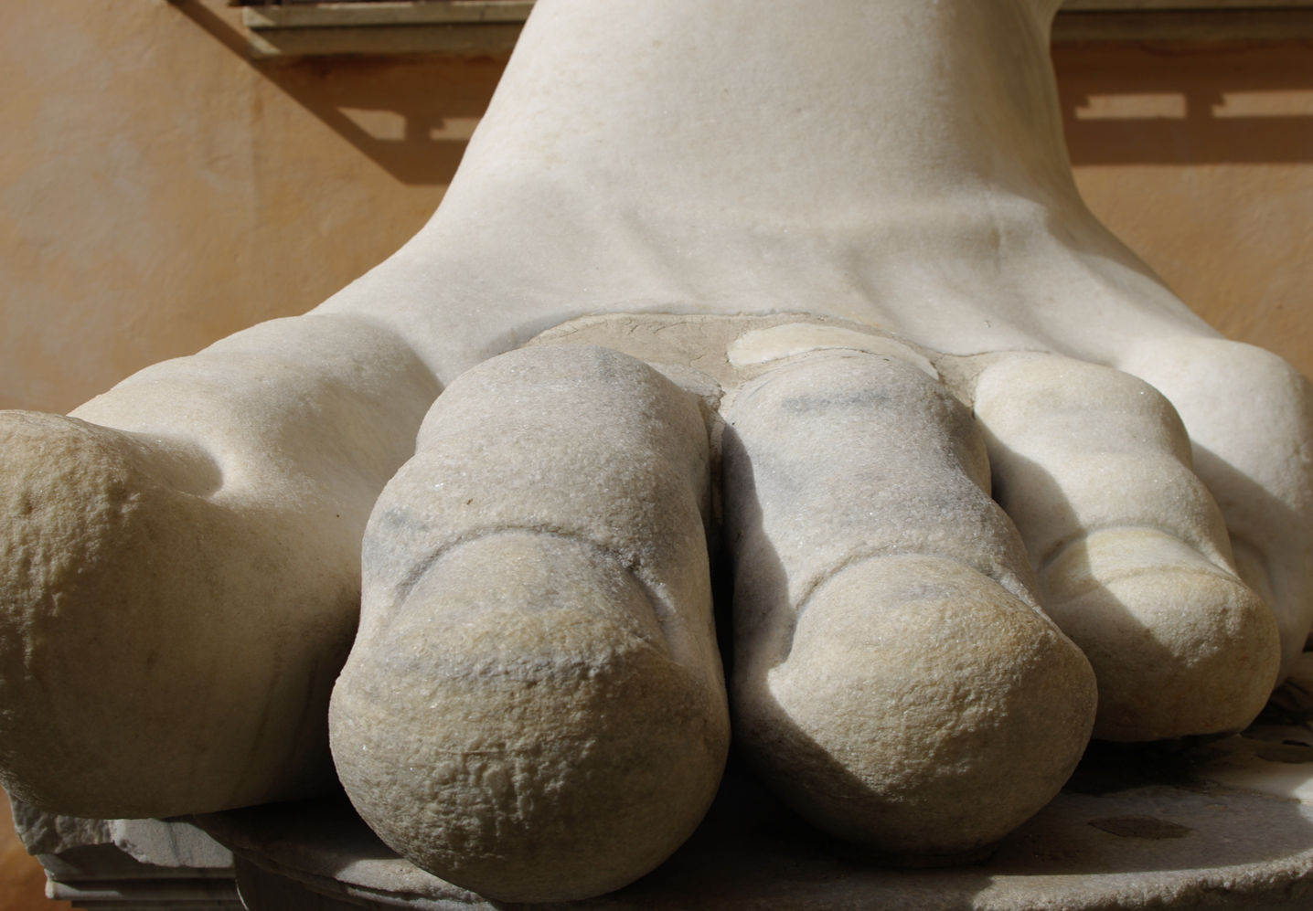
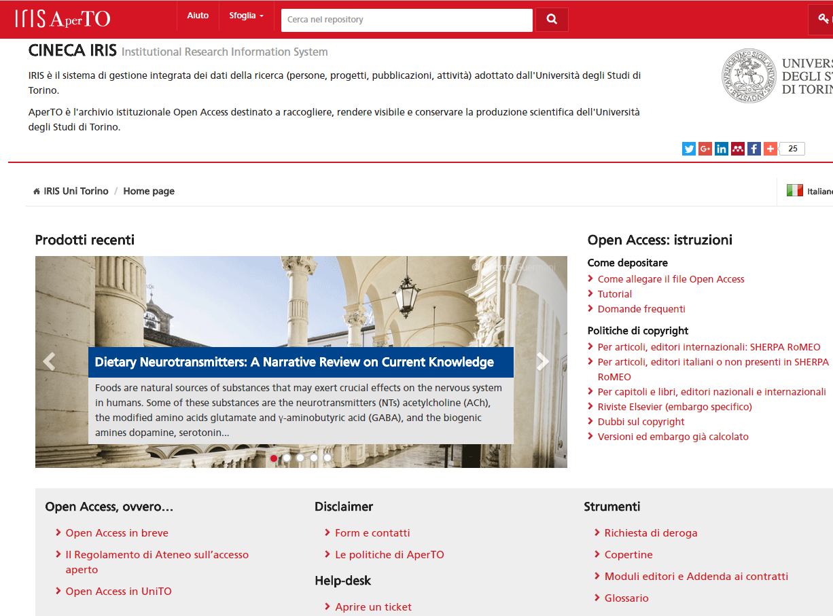
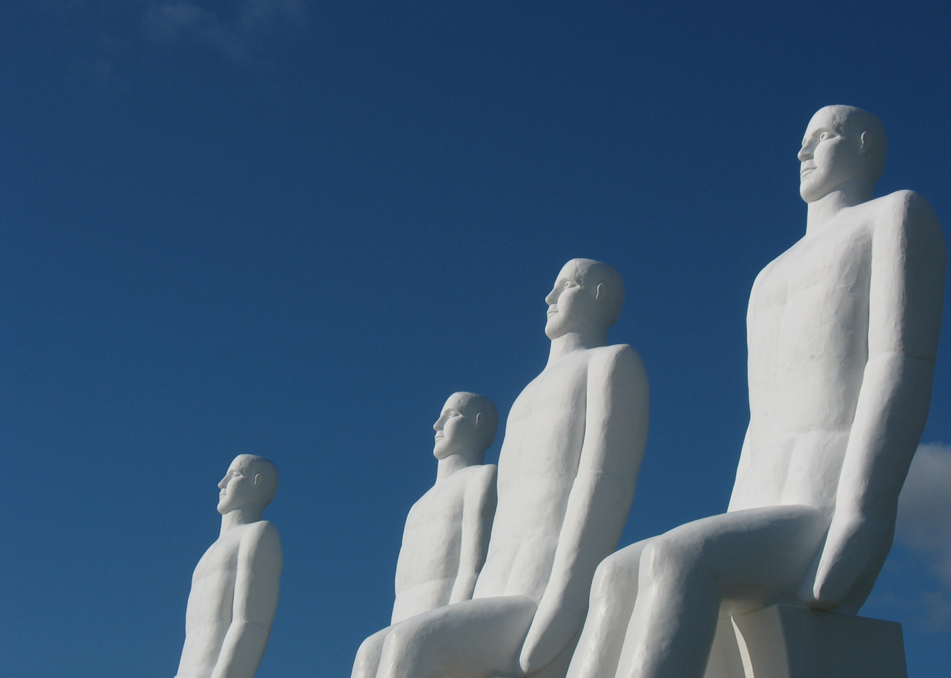
What worked (and what not)
Providing all the operational support authors needed
First steps:
working group on OA
raise awarenes: seminars in each Dept.
connecting: points of reference network in Dept.
lack of a global vision
lack of synergies
lack of human resources
bibliometric tide
Institutional involvement/ commitment

Slide 4
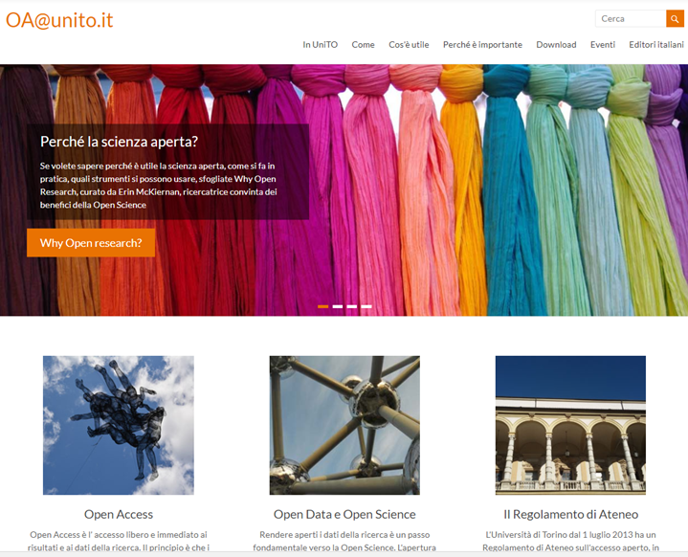
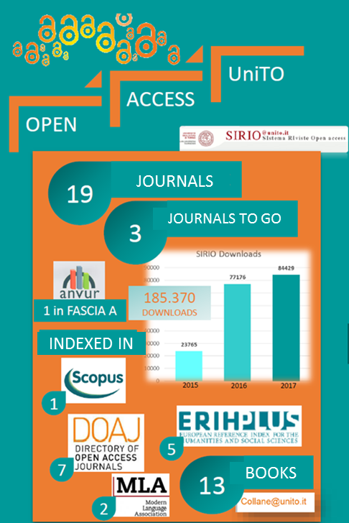
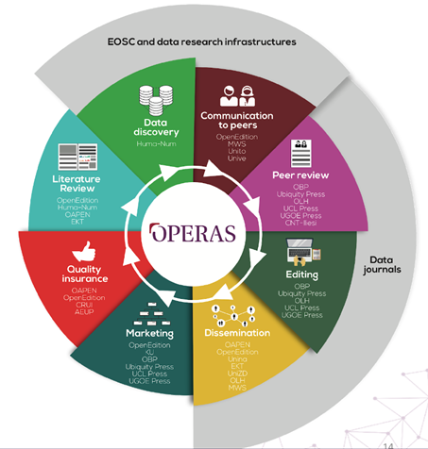
UniTO on the move

Slide 5
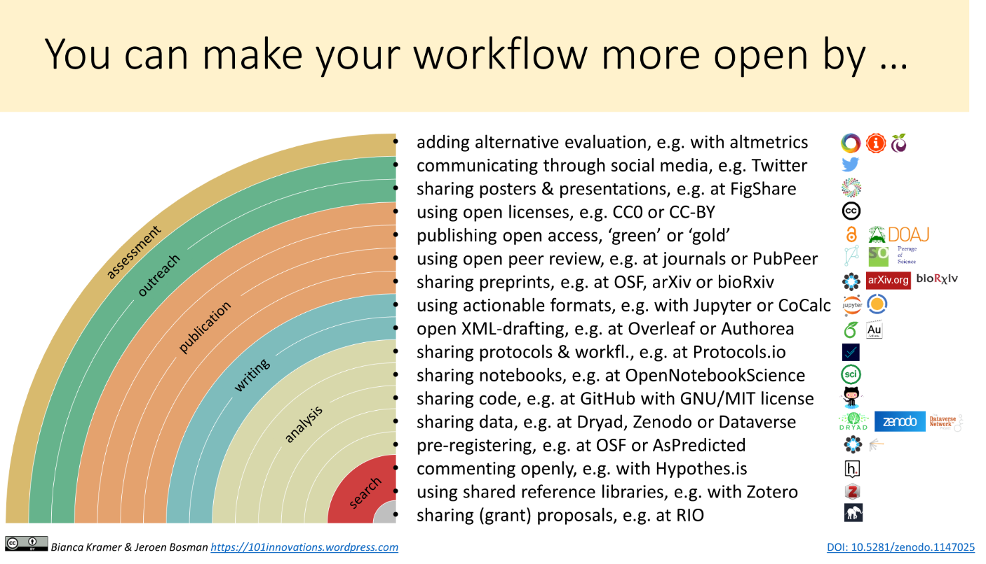
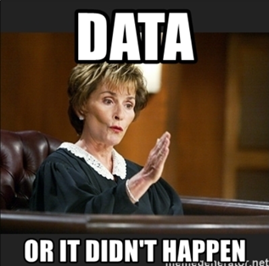
… Data policy?
…so, LET’S CREATE AWARENESS [again]
courses for PhD and researchers (June)
training for librarians (May)
Bianca&Jeroen (March)
«just an administrative burden»
«I have no time to add documentation to my data»
«nobody cares about my data»

Slide 6
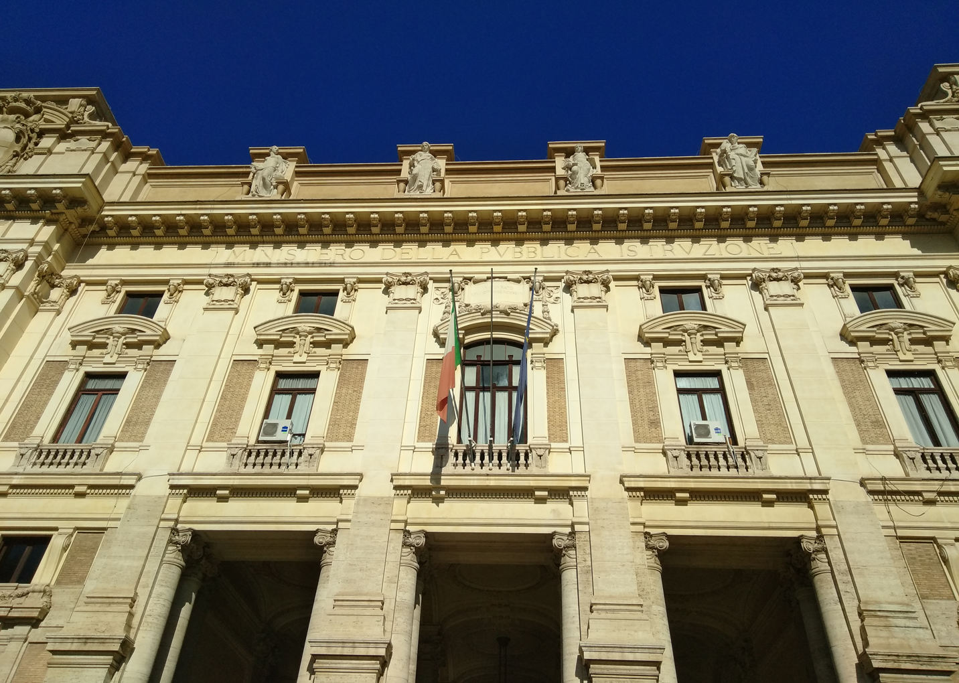
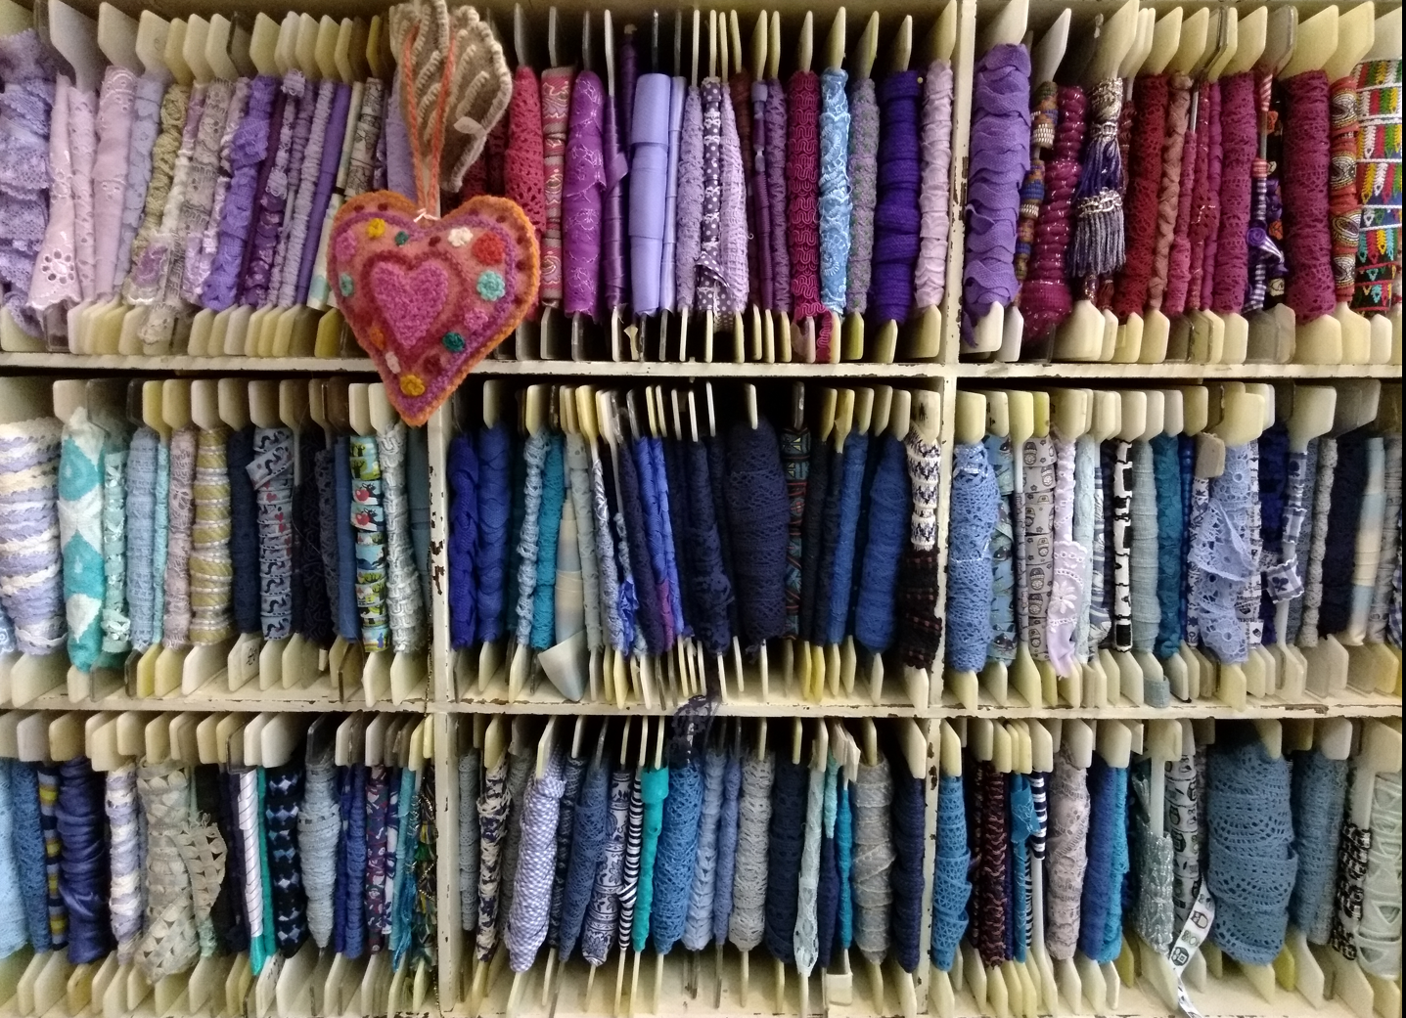
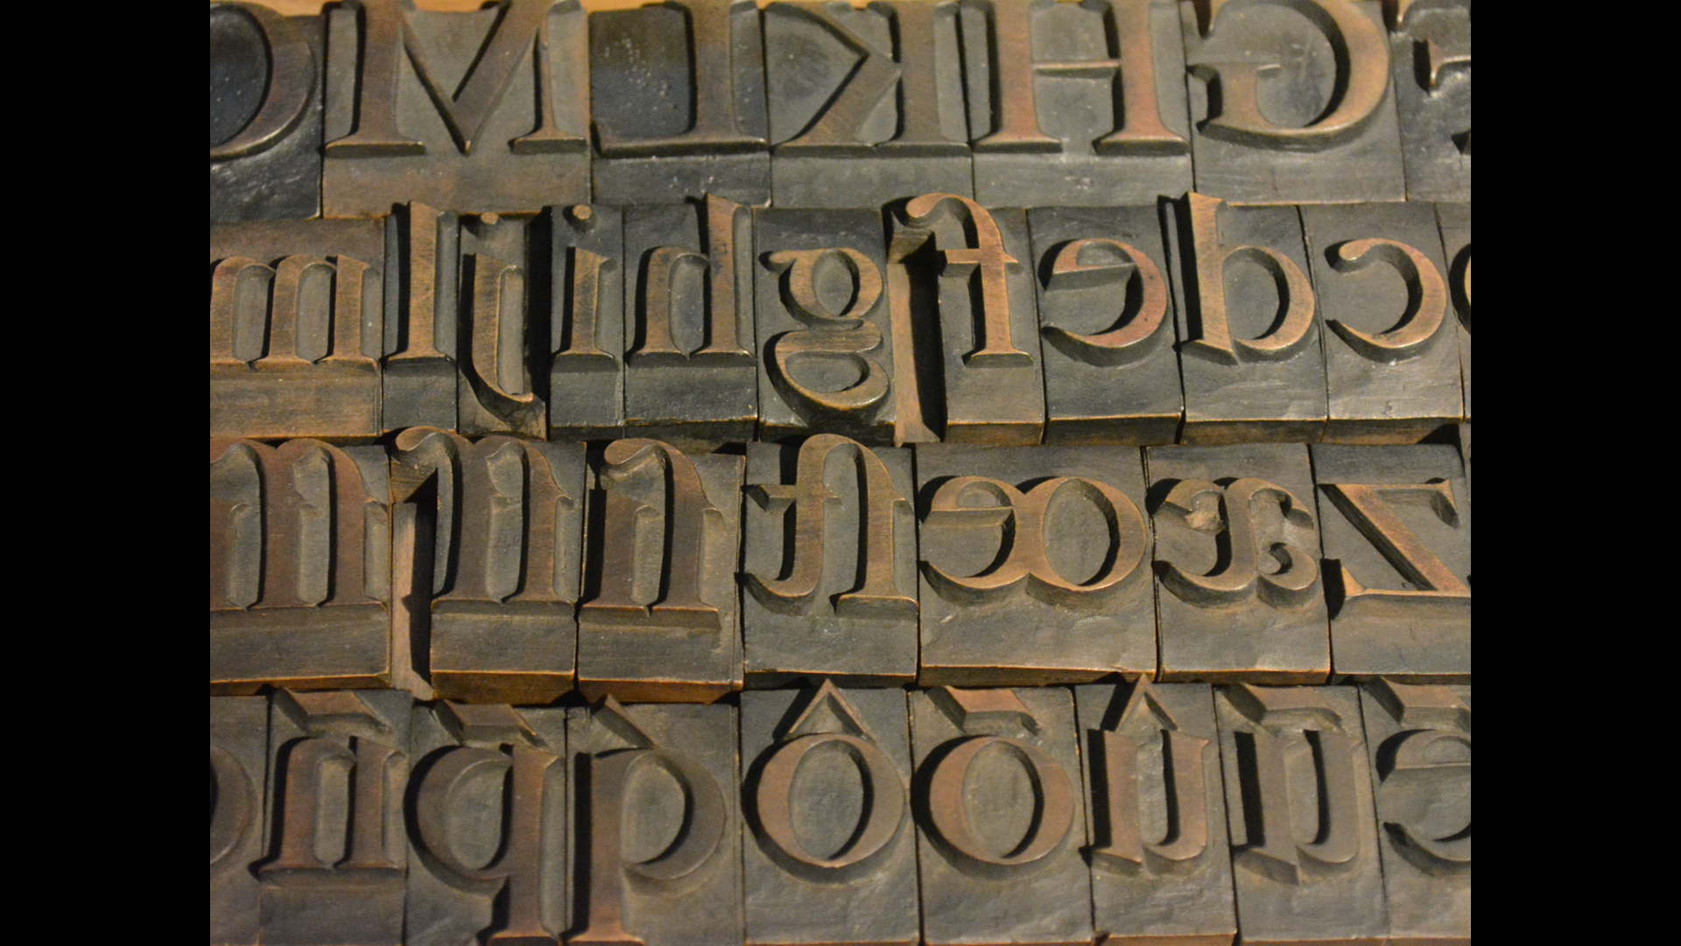
Coming to Italy…
Hello?
obsessed by research evaluation (ANVUR)
… a lot of initiatives / lack of coordination / lack of central input
Prehistoric publishers afraid of OA – no policy
A call: let’s join Europe. Don’t miss the EOSC!
There is life (and Open Science) outside ANVUR
Lack of training and awareness on benefits
IRIS: a lost opportunity. Just a CRIS as OA not explained/understood
In EU: missing in action

Slide 7
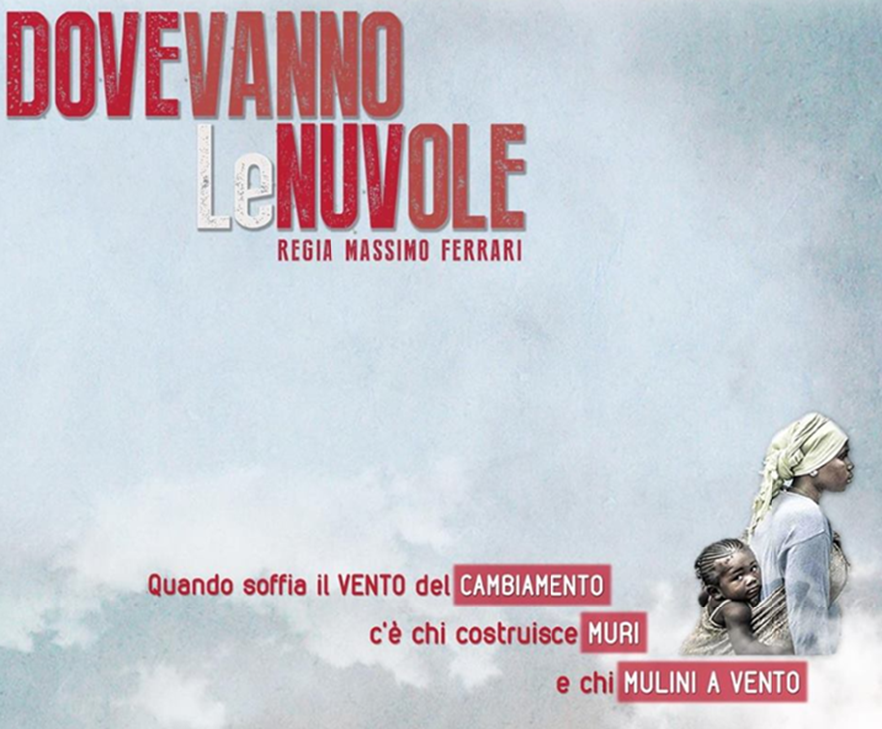
…whose side are you on?
[when the wind of changes blows, some people build walls, some people build windmills]
…thank you

